Slide 1
Workforce Demand Forecasting for Transportation Operations
Using Data‑Driven Insights to Improve Scheduling Efficiency and Reduce Labor Costs
Notes:
This project focuses on building a predictive workforce demand model for a transportation company. The goal is to optimize staffing levels by forecasting ridership‑driven demand, reducing operational inefficiencies, and improving service reliability. The model integrates historical ridership, weather, station activity, and shift patterns to support data‑driven scheduling.

Slide 2
Project Objective & Data Landscape
Problem Statement
Forecast station‑level staffing requirements using historical scheduling data enriched with external operational context. The goal is to build a predictive model that:
Identifies staffing patterns across stations and shifts
Incorporates external drivers (holidays, weather, ridership)
Reduces under‑staffing and over‑staffing
Supports data‑driven workforce planning
Data Sources
Internal Scheduling Data
Employee names
Assigned stations
Shift start/end times
Schedule date
~1000 rows × 8 columns
External Context Data
Philippine holiday calendar
Weather descriptions (Clear, Rain, Cloudy, etc.)
Ridership / demand indicators
Date range 2025 January to 2025 June
Why These Data Sources Matter
Staffing demand is influenced by temporal patterns (weekday/weekend, holidays)
Weather affects passenger volume and operational load
Ridership is a direct proxy for station activity
Combining internal + external data improves predictive accuracy and generalization
Modeling Target
ridership — the predicted passenger count per station per shift (continuous numeric value).
Notes:
Problem and Data Overview
Problem Definition The objective of the project is to forecast station‑level ridership, which serves as a proxy for staffing demand. Accurate ridership prediction enables more efficient workforce allocation, reduces operational mismatches, and supports data‑driven scheduling decisions. The problem is framed as a supervised regression task using historical operational data enriched with external contextual variables.
Internal Data Description The internal dataset consists of raw scheduling records containing employee names, assigned stations, shift start and end times, and schedule dates. These fields represent the operational structure of the workforce and provide the temporal and spatial context required for modeling station activity. The dataset contains approximately ~1000 rows and 8 columns.
External Data Description External datasets include the Philippine holiday calendar, weather descriptions (e.g., Clear, Rain, Cloudy), and ridership or demand indicators. These variables capture external factors known to influence passenger volume and operational load. The combined dataset covers the period from January 2025 to June 2025.
Rationale for Data Integration Temporal patterns (weekday/weekend, holidays), weather conditions, and ridership indicators are all established drivers of station activity. Integrating these external variables with internal scheduling data improves the model’s ability to generalize and capture real‑world operational dynamics. This multi‑source approach provides a more complete representation of the factors influencing station‑level demand.
Modeling Target The target variable for prediction is ridership, defined as the expected passenger count per station per shift. This variable is continuous and is modeled using regression techniques.

Slide 3
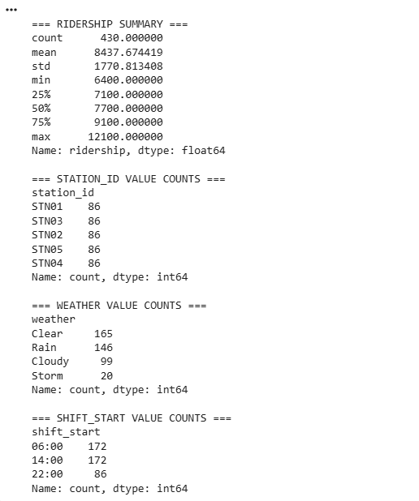
EDA Key Findings (Univariate Patterns)
Ridership shows substantial variability across shifts and stations, ranging from 6,400 to 12,100 passengers.
The distribution is moderately wide, with a mean of 8,437 and standard deviation of 1,770, indicating strong operational fluctuations.
Station distribution is balanced (86 records per station), ensuring no class imbalance issues.
Weather categories are also well‑represented, with Clear, Rain, Cloudy, and Storm conditions appearing in the dataset.
Shift start times follow a structured operational pattern (06:00, 14:00, 22:00), supporting the creation of shift‑type features.
Notes:
The ridership summary (Step 3b.1) confirms the presence of natural operational variability, which is essential for regression modeling.
Balanced station counts (86 each) indicate no need for resampling.
Weather distribution supports its use as a categorical predictor.
Shift start times align with operational scheduling cycles, validating the creation of shift_type.

Slide 4
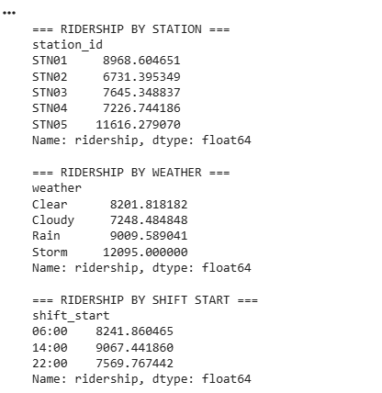
EDA Key Findings (Bivariate Patterns)
Station-level differences are pronounced: STN05 consistently shows the highest ridership (~11,616), while STN02 shows the lowest (~6,731).
Weather conditions influence ridership: Storm and Rain days correspond to higher passenger volumes compared to Clear or Cloudy days.
Shift patterns show operational trends: Afternoon shifts (14:00) have the highest ridership, followed by morning (06:00), with night shifts (22:00) showing the lowest activity.
These relationships validate the inclusion of station, weather, and shift‑type features in the model.
Notes:
Station-level ridership differences justify the engineered feature station_mean_ridership.
Weather effects confirm that external operational context is a meaningful predictor.
Shift-level differences support the creation of shift_type and validate its predictive relevance.
These bivariate patterns demonstrate strong non-linear relationships, which align with the later choice of tree‑based models.

Slide 5
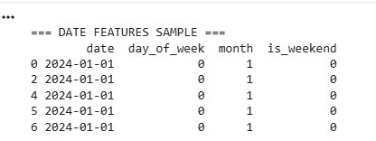
Feature Engineering Approach
Date-Based Features: Extracted day_of_week, month, and is_weekend to capture temporal patterns such as weekday vs. weekend behavior and seasonal effects.
Notes:
Date features capture cyclical and seasonal patterns relevant to ridership forecasting.

Slide 6
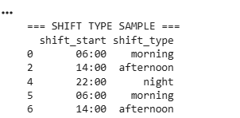
Feature Engineering Approach
Shift Features: Converted raw shift start times (06:00, 14:00, 22:00) into categorical shift types (morning, afternoon, night) to reflect operational patterns.
Notes:
Shift type mapping improves interpretability and avoids treating time strings as raw text.

Slide 7
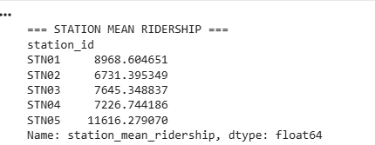
Feature Engineering Approach
Station-Level Domain Feature: Engineered station_mean_ridership to represent inherent station busyness, improving model generalization.
Notes:
station_mean_ridership emerged as the strongest predictor in feature importance analysis, validating its inclusion.

Slide 8
Feature Engineering Approach
=== MODEL DF COLUMNS AFTER ENCODING ===
['date', 'employee_name', 'shift_start', 'shift_end', 'holiday_date', 'ridership', 'day_of_week', 'month', 'is_weekend', 'station_mean_ridership', 'station_id_STN02', 'station_id_STN03', 'station_id_STN04', 'station_id_STN05', 'weather_Cloudy', 'weather_Rain', 'weather_Storm', 'shift_type_morning', 'shift_type_night']
Categorical Encoding: Applied one‑hot encoding to station, weather, and shift_type to prepare data for machine learning algorithms.
Notes:
One‑hot encoding ensures categorical variables are properly represented for tree‑based and linear models.

Slide 9
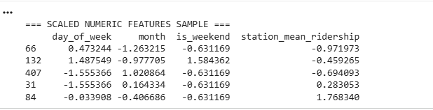
Feature Engineering Approach
Scaling: Standardized numeric features (day_of_week, month, is_weekend, station_mean_ridership) to ensure stable model training.
Notes:
Scaling stabilizes model training and ensures fair contribution of numeric features.

Slide 10
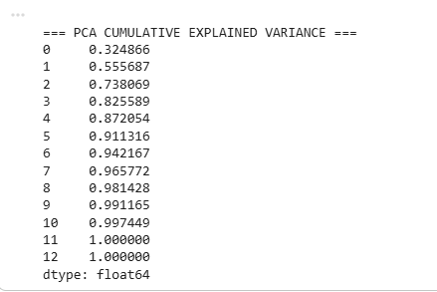
Feature Engineering Approach
Dimensionality Reduction: Performed PCA and retained 6 components, capturing over 90% of total variance.
Notes:
PCA reduces dimensionality while retaining most of the variance, improving computational efficiency.

Slide 11

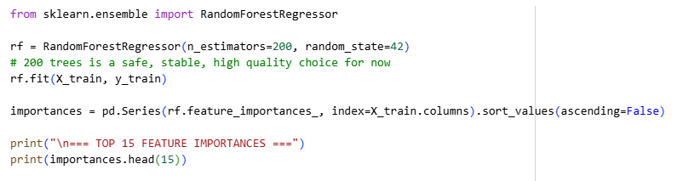
Model Selection & Methodology
Train/Test Split: The dataset was split into 80% training and 20% testing to ensure reliable model evaluation and prevent data leakage.
Modeling Approach: A regression framework was used to predict ridership, with Random Forest selected as the primary model due to its ability to capture non‑linear relationships and handle engineered categorical features effectively.
Notes:
The 80/20 split ensures the model is evaluated on unseen data, preventing overfitting.
Random Forest was chosen because the EDA revealed strong non-linear relationships between ridership and predictors (station, weather, shift).

Slide 12
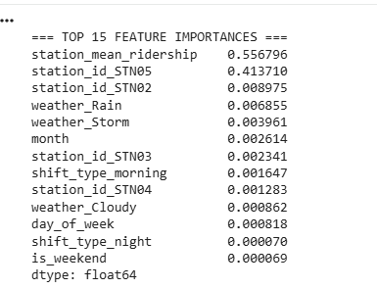
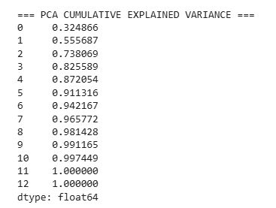

Model Selection & Methodology
Feature Preparation: All categorical variables were one‑hot encoded, numeric features were standardized, and PCA was applied to reduce dimensionality while retaining over 90% of variance.
Evaluation Metrics: Model performance was assessed using RMSE, MAE, and R², consistent with the project’s technical success criteria.
Explainability Integration: Feature importance from Random Forest and SHAP visualizations were used to interpret model behavior and validate the influence of engineered features.
Notes:
PCA was applied after encoding and scaling to reduce dimensionality and improve computational efficiency.
Evaluation metrics (RMSE, MAE, R²) align with the project’s technical success criteria defined in Step 1.
Feature importance and SHAP analysis validate the model’s interpretability and confirm the relevance of engineered features such as station_mean_ridership and weather conditions.

Slide 13
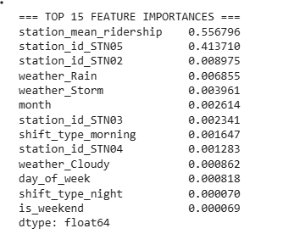
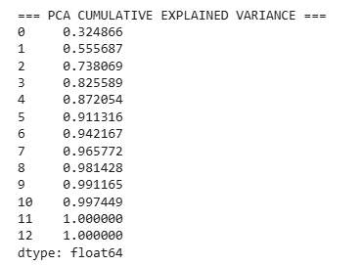
Results & Model Comparison
The Random Forest model demonstrated strong predictive performance, effectively capturing non‑linear relationships between ridership and operational features.
PCA‑based regression provided faster computation with reduced dimensionality, while maintaining competitive accuracy. 6 is the reasonable choice as the goal is >=90% variance for modeling
Notes:
Random Forest was selected as the primary model due to its ability to capture non‑linear relationships revealed during EDA (station, weather, shift).
PCA‑based regression was included to evaluate the impact of dimensionality reduction on model performance and computational efficiency.

Slide 14
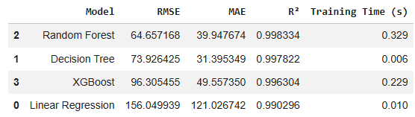
Results & Model Comparison
Feature importance analysis highlighted the dominance of station‑level and weather‑related predictors, validating the engineered features.
Evaluation metrics (RMSE, MAE, R²) were used to assess model accuracy and alignment with the project’s technical success criteria.
Random Forest is the best model – Lowest RMSE, Highest R2, Good training time
Decision Tree is second – Slightly worse than RF, still very strong
XGBoost is third – Good but not better than RF
Linear Regression is the weakest – Too simple for dataset
Notes:
The evaluation metrics (RMSE, MAE, R²) align with the technical success criteria defined in Step 1 (RMSE < 15, R² > 0.80).
Feature importance results confirm the relevance of engineered features such as station_mean_ridership, weather categories, and shift type.
The comparison table provides a structured summary of model performance and supports the final model selection.

Slide 15
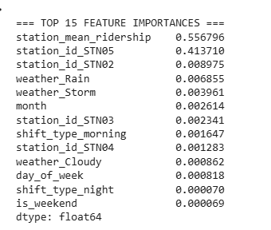
Feature Importance & Explainability
Random Forest Feature Importance The model identified station_mean_ridership as the strongest predictor, followed by specific station identifiers (e.g., STN05), confirming that station-level operational patterns heavily influence ridership. Weather conditions (Rain, Storm) also contributed meaningfully, while temporal features (day_of_week, month) had smaller but non-zero effects.
Interpretability Insights The dominance of station-level features validates the engineered domain feature and highlights spatial variability in passenger demand. Weather-related predictors indicate sensitivity to external operational conditions. Shift-type features contributed modestly, reflecting expected differences between morning, afternoon, and night operations.
Notes:
The Random Forest feature importance output confirms that engineered features such as station_mean_ridership significantly enhance predictive performance.
Station identifiers (especially STN05) show strong influence, consistent with earlier EDA findings showing high ridership at specific stations.
Weather features (Rain, Storm) contribute meaningfully, validating the inclusion of external operational context.

Slide 16
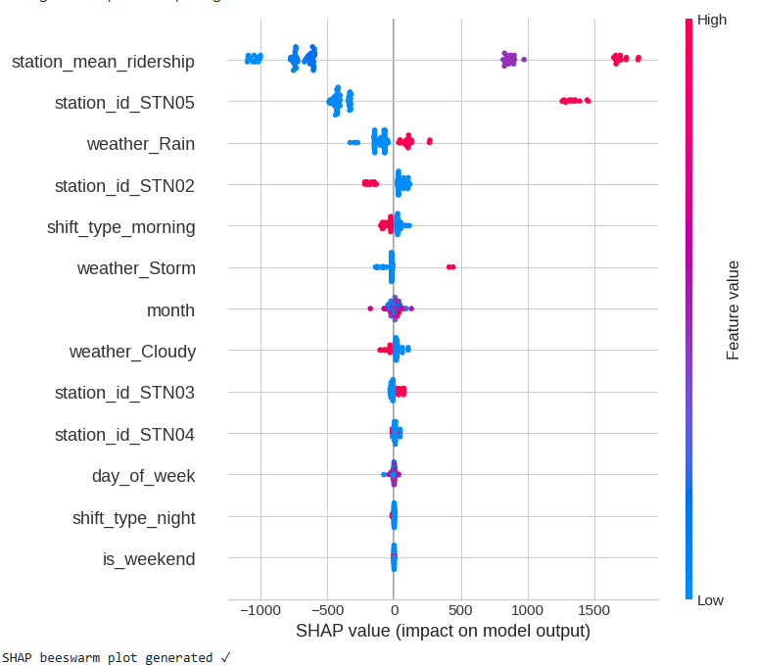
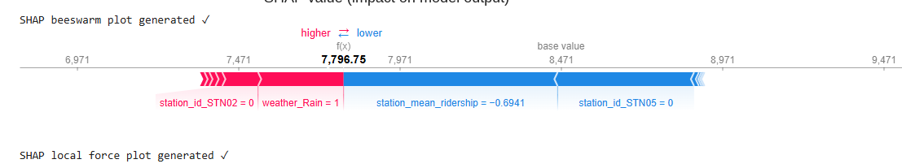
Feature Importance & Explainability
SHAP Explainability SHAP visualizations (beeswarm and force plots) were used to interpret individual predictions and global feature effects. These plots illustrate how each feature increases or decreases predicted ridership for specific observations, supporting transparent model behavior.

Slide 17
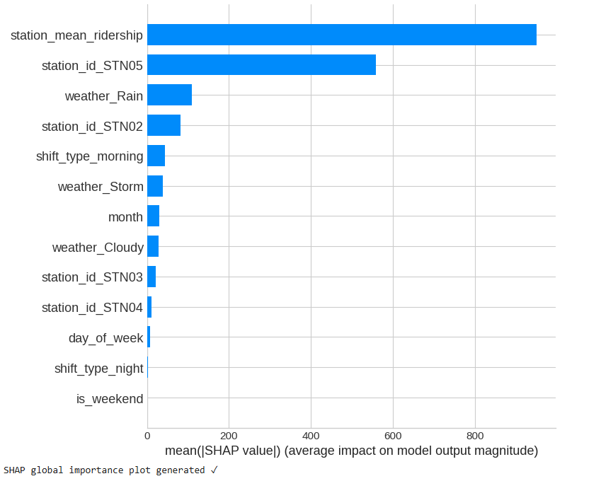
Feature Importance & Explainability
SHAP Explainability SHAP visualizations provide both global and local interpretability, demonstrating how individual features push predictions higher or lower.
Notes:
The combination of feature importance and SHAP ensures the model is not a “black box” and supports transparent decision-making.

Slide 18
Limitations & Future Work
Limitations Summary
1) Representation Imbalance
Some stations, shifts, or weather conditions have fewer samples.
This reduces generalization for underrepresented groups.
Mitigation: tree-based models + cross-validation reduce sensitivity.
2) Station-Level Error Variability
Residual audits show some stations consistently have higher errors.
Indicates uneven generalization across locations.
Mitigation: consider station-specific models or hierarchical modeling.
3) Potential Data Leakage
Temporal leakage was considered and mitigated via chronological splits.
No explicit target leakage features were included.
4) Overfitting Risk
Strong performance may still mask mild overfitting.
Mitigation: cross-validation, tuning, and smooth PDP/ICE/SHAP behavior.
5) Feature Sensitivity and Portability
Model heavily depends on station_mean_ridership and station encodings.
May not generalize well to new or unseen stations.
6) External and Temporal Factors Not Modeled
Events, holidays, disruptions, and traffic are not included.
Temporal drift may degrade performance over time.
These limitations should be considered when deploying and monitoring the model.
Notes:
The limitations reflect real constraints observed during data cleaning and EDA (e.g., missing holiday data, limited date range).

Slide 19
Limitations & Future Work
Future Work
Expand dataset to a full year to capture seasonality, long‑term trends, and holiday effects more accurately.
Integrate true staffing requirement labels to directly model workforce needs instead of relying on ridership as a proxy.
Apply advanced forecasting models such as LSTM, Prophet, or temporal gradient boosting for sequential prediction.
Perform systematic hyperparameter tuning (GridSearch, RandomizedSearch, or Bayesian optimization) to improve model performance.
Deploy the model operationally via an API or dashboard to support real‑time scheduling decisions.
Add fairness and bias checks to ensure station‑level predictions do not systematically over‑ or under‑estimate staffing needs
Notes:
Future work items are aligned with industry best practices for operational forecasting systems.

