Slide 1

Property Based Testing
Hint: It’s not unit-testing

Slide 2
What is this about?
Property-based testing allows you to write properties that describe your code’s behaviour, and leave the task of test case generation and property evaluation to the testing tool

Slide 3
Key insights ?
Specifications
Tests
Notes:
=> Specification is a definition of a program’s behaviour in the general case
=> Test are concrete examples of how a program should behave in specific scenarios

Slide 4
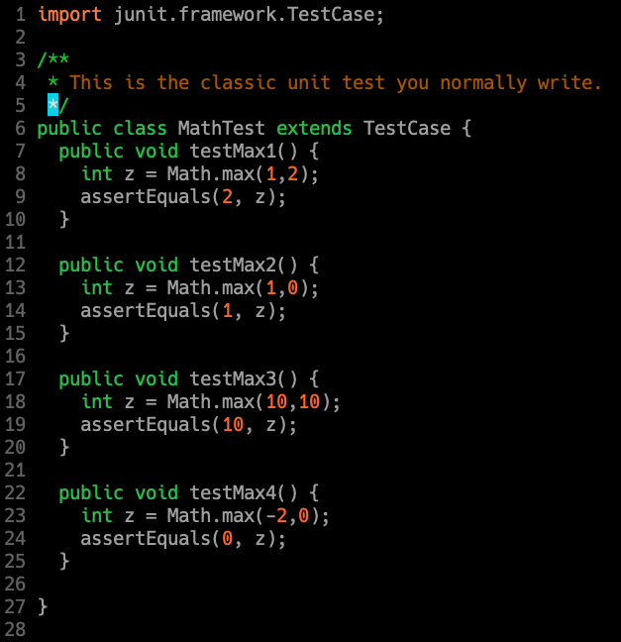
Test
Link: [1]

Slide 5
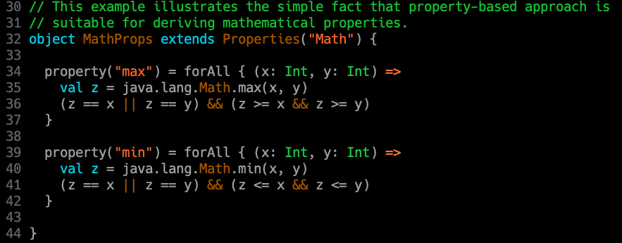
Specification
Link: [1]

Slide 6
Demo

Slide 7
With s
Several libraries inspired by Haskell QuickCheck
fast-check (compatible with jest, mocha, jasmine…)
JSVerify (mocha, jasmine)
testcheck

Slide 8
References
[1] Property Based Testing @ TDF Gitlab
[2] Introduction to Property-based Testing (fast-check)
[3] jqwik
[4] scalacheck
[5] junit-quickcheck
[6] jest
[7] fast-check

