Slide 1
Memory and evidence management
Candidate evidence
Bounded memory for the Planner
Run and query identity
Chemical system and candidate composition
Energy and observed stability
A separate record for every structure attempt
Recent observations with contrasting outcomes
Up to 8 records and 4,000 JSON characters
Episode isolation and checkpoint recovery
Complete evidence in both ON and OFF runs
Export the official trajectory, including the final evaluation.
Online logs support diagnostics and do not replace the complete trajectory.
M4 interface is available. Planner consumption remains pending.
Notes:
Approximately 45 seconds. M4 separates complete experiment evidence from the bounded records returned to planning. Stability labels refer to the observed phase diagram at evaluation time. The standalone core additionally supports target-composition retrieval, but M1 get_memory() supplies no target, so that mode is not active through the adapter. Current main does not enable M4. Sources: M4/EVIDENCE_SCHEMA.md; M4/src/m4_memory/m1_adapter.py; M1/PLUGIN_INTERFACE.md; course brief, section 2.

Slide 2
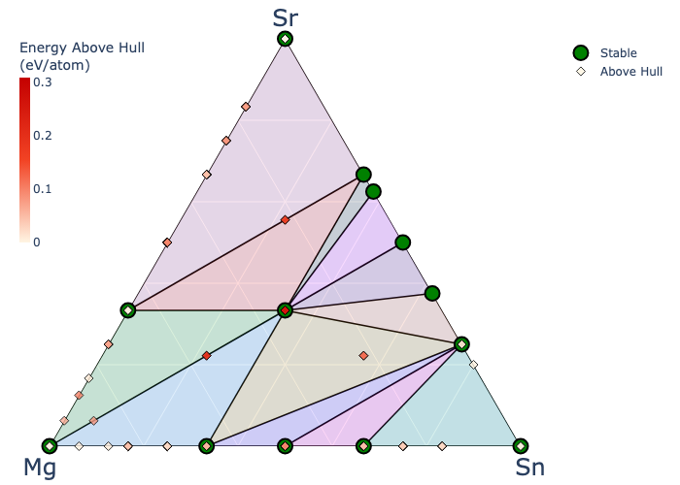
Workflow validation and planned ablation
Completed
All 20 evaluations exported
Final observation retained
20 campaign queries exclude
additional initialization evaluations
Planned Memory ablation
Matched systems, oracle, budget and seeds
Official mSUN@B, AUDC, AF/EF and cost
Two or three traceable discovery cases
Mg-Sn-Sr workflow validation
CPU ORB, seed 17, 20 campaign queries
157.193 seconds, including first-run setup
Memory effect has not yet been measured.
Notes:
Approximately 45 seconds. This figure is the official observed phase diagram from the saved real-material workflow, not evidence of a memory benefit. Original run: M1 protocol v1, m1_baseline, dev Mg-Sn-Sr, seed 17, attempt_02. Runtime 157.193 seconds includes initialization and the first model download. 203 MP entries loaded, 194 retained, and 112 known stable/near-stable structures re-evaluated during initialization. Campaign count is 20, not total oracle workload. Source: preserved official trajectory and run_metadata.json; M4/REAL_TEST_STATUS.md. After M1/M3 activate actual memory consumption, compare against the frozen full-agent reference using M6 settings. Add official results and cases only after controlled runs.

