Slide 1
Intro. to Audio Signals
Jyh-Shing Roger Jang (張智星)
http://mirlab.org/jang
MIR Lab, CSIE Dept
National Taiwan Univ., Taiwan

Slide 2
What Are Audio Signals?
Audio signals are…
  Signals that are audible to human, such as speech and music
  The range of fundamental frequencies of audible signals is about 20 ~ 20000 Hz.
    The range is wider for the young people, narrower for the elderly.
Quiz!
Quiz!
Ultrasound
狗隻、海豚、蝙蝠
犬笛

Slide 3
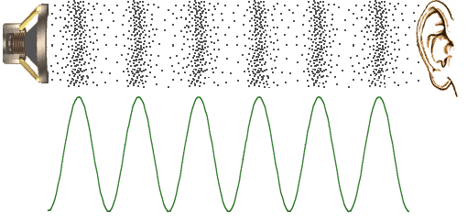
Voice Generation & Reception
Steps in voice generation & reception
  Vibration of voice source
  Resonance by surrounding objects
  Traveling through air (or other media)
  Reception of membranes and neurons at inner ears
  Recognition by brains
Examples
  Singing
  Whistling
  Guitar
  Flute
Pressure wave
Sound waveform

Slide 4
Categorization of Audio Signals
Number of sources
  Monophonic: example
  Polyphonic: example
Waveform
  Quasi-periodic sound
    voiced sound of speech
  Aperiodic sound
    Unvoiced sound of speech
Source types
  Sounds from animals (bioacoustics)
    Dog barking, cat meowing, frog croaking, duck quacking, cow mooing…
  Sounds from non-animals
    Car engines, thunders, music instruments

Slide 5
Parameters for Recording
Quiz!
Three major parameters for recording audio files
  Sample rate: no. of samples per second
    8 kHz (phone quality)
    16 KHz (for common speech recognition)
    44.1 KHz (CD quality)
  Bit resolution: no. of bits for representing a sample
    8-bit (uint8 with range: 0~255)
    16-bit (int16 with range: -32768~32767)
  No of channels
    Mono: 1 channel
    Stereo: 2 channels
Quiz!
Hz = Hertz = samples/sec
(Also used for fundamental frequency…)

Slide 6
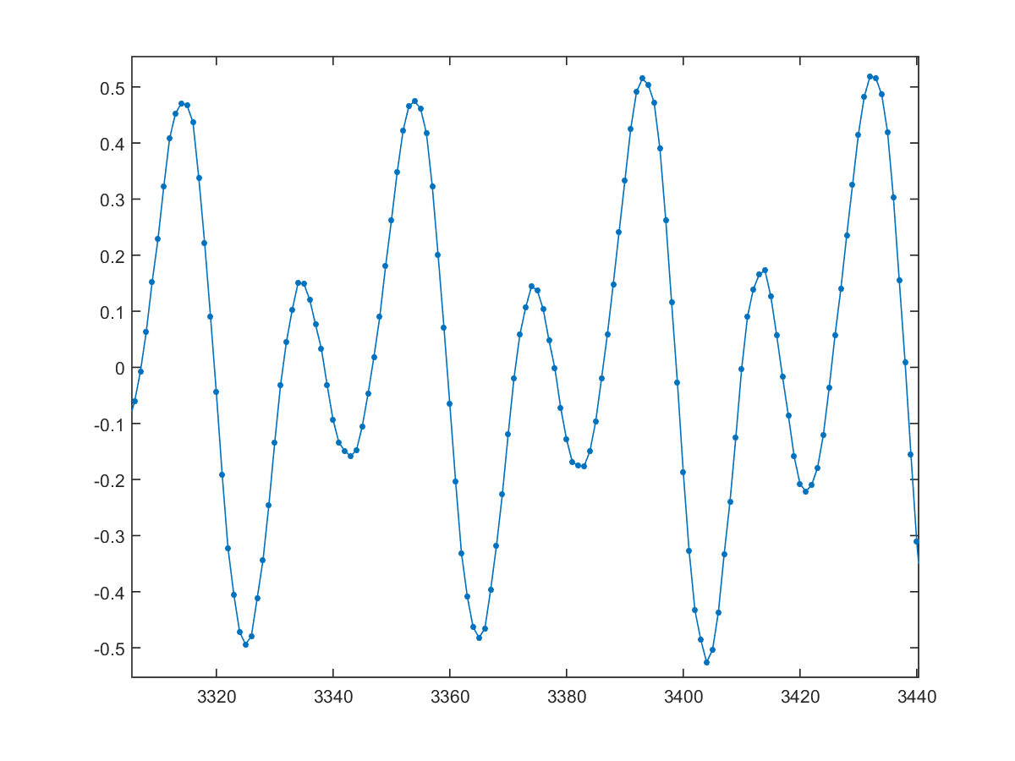
Live Recording
Three major parameters for recording audio files
  Sample rate, bit resolution, and no. of channels
  Demo of recording via Cooledit
    Compare of the waveforms of a tuning fork and human speech of vowels. What is the major difference? Why?
Quiz!

Slide 7
Tools for General Audio Processing
Tools for real-time recording and waveform display
  Audacity
  CoolEdit
  GoldWave
  MATLAB

Slide 8
S/U/V in Speech
Speech signals can be divided into S, U, V
  S (silence): no speech activity
  U (unvoiced): speech activity without vibration from vocal chords
  V (voiced): speech activity with vibration
How to detect S, U, V?
  Put your hand on your throat to feel the vibration
  Observe the waveform directly
Quiz!

Slide 9
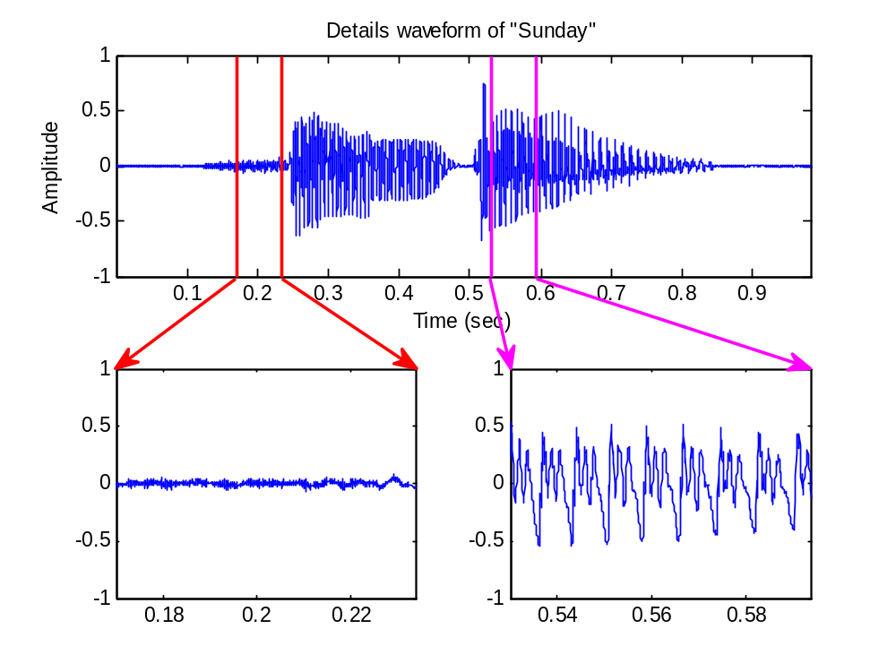

Speech Signal of “Sunday”
Unvoiced vs. voiced frames
Notes:
Books/audioSignalProcessing/example/displaySunday.m

Slide 10

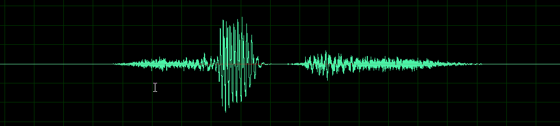
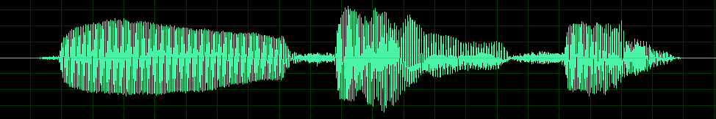
Silence, Unvoiced and Voiced Sounds
Examples of S, U, V
  “Six”
  “資訊系”
Quiz!
s
u
v
s
u
s
s
u
v
u
v
u
v
s

Slide 11
Storage for Audio Files
Examples of storage requirement
  1 min. of recording with fs=16000, nbits=16, #channel=1➔ 60 (sec)*16 (KHz)*2 (bytes)*1 (channel) = 1920 KB = 1.92 MB
  3-mins of CD music with fs=44.1KHz, nbits=16, #channel=2 ➔ 180 (sec)*44.1 (KHz)*2 (bytes)*2 (channels) = 31752 KB = 32 MB
Quiz!
MP3 compression ratio is about 10!

Slide 12
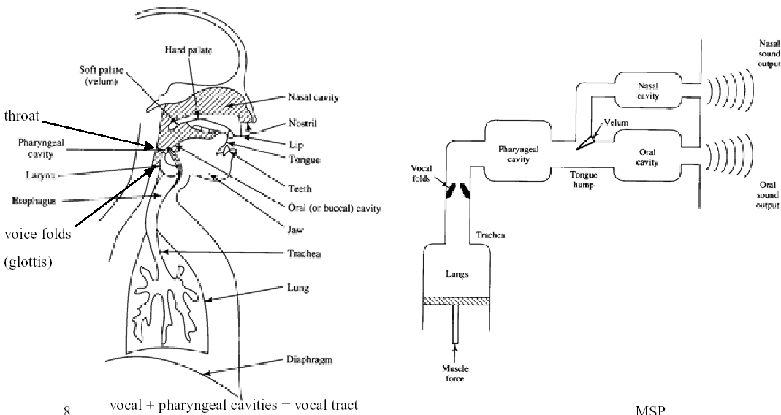
Human Speech Production

Slide 13
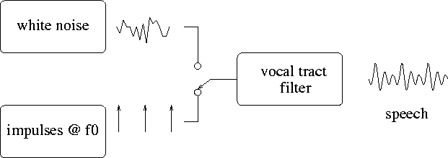
Source-filter Model for
Human Speech Production
Speech is split into a rapidly varying excitation signal and a slowly varying filter. The envelope of the power spectra contains the vocal tract info.
Two important characteristics of the model are fundamental frequency (f0) and formants (F1, F2, F3, …)
Pharyngeal cavity
Nasal cavity
Oral cavity
unvoiced
voiced

Slide 14
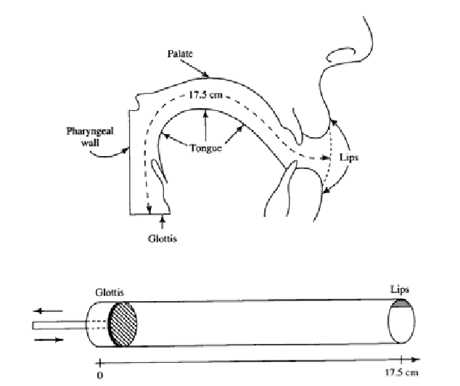
The Vocal Tract

Slide 15
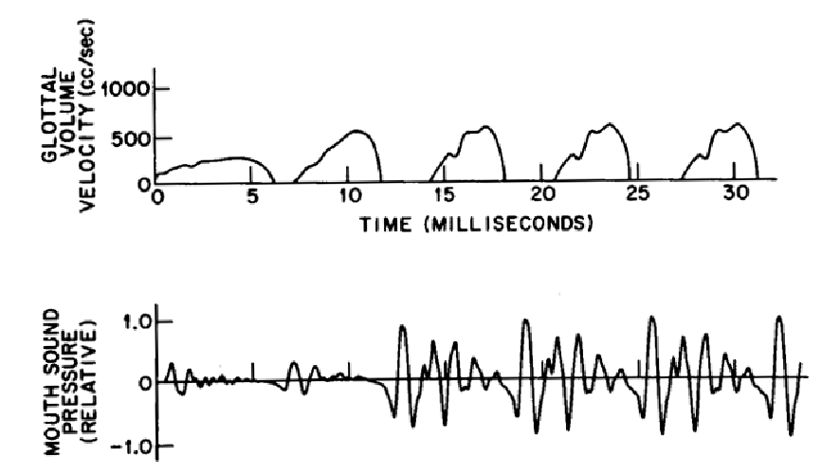
Glottal Volume Velocity &
Resulting Sound Pressure (Voiced)

Slide 16
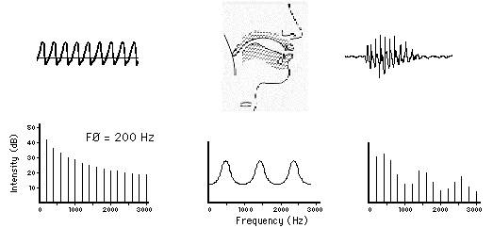
Speech Production
Glottal Pulses Vocal Tract Speech Signal
+
=
+
=
(a) Source Spectrum
(b) Filter
Function
(c) Output Energy Spectrum

Slide 17
Videos for Vocal Cords Movement
Movement of vocal cords
  http://www.youtube.com/watch?v=mJedwz_r2Pc
  http://www.youtube.com/watch?v=v9Wdf-RwLcs

Slide 18
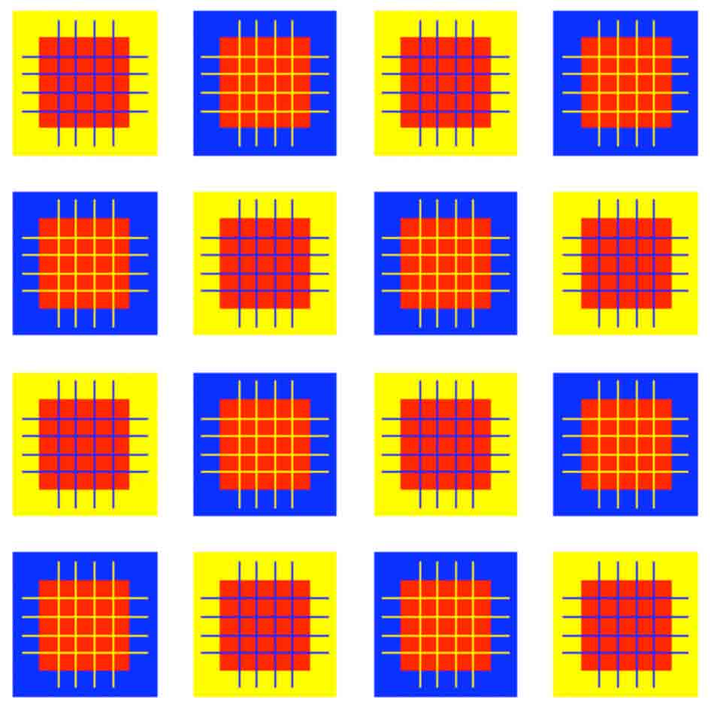

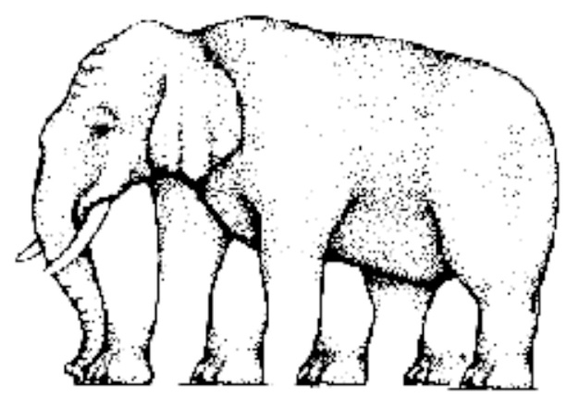
Other Interesting Phenomena
Interesting phenomena about audio signals
  Don’t trust what you have heard! (Vision rules)
  Perceived speech is highly context dependent:

Slide 19

Hints for Exercises
How to generate a sine wave signal:
  Math formula:
  MATLAB code:
    duration=3;
    f=440;
    fs=16000;
    time=(0:duration*fs-1)/fs;
    y=sin(2*pi*f*time);
    plot(time, y);
    sound(y, fs);

Slide 20
Voice Generation & Reception
空氣的壓力波
音訊的波形

