Slide 1
Basic Features of Audio Signals
(音訊的基本特徵)
Jyh-Shing Roger Jang (張智星)
http://mirlab.org/jang
MIR Lab, CSIE Dept
National Taiwan Univ., Taiwan

Slide 2
Audio Features
Commonly used audio features include volume, pitch, zero crossing rate, spectrum, etc.
  These features can be perceived subjectively.
Our goals
  To define formulas for computing these features
  To compute these features for further analysis and recognition of audio signals.

Slide 3
General Steps for Audio Analysis
Frame blocking
  Frame duration of 20~40 ms or so
Frame-based feature extraction
  Volume, zero-crossing rate, pitch, MFCC, etc.
Frame-based Analysis
  Pitch vector for QBSH comparison
  MFCC for speech recognition via HMM training & evaluation
  …
Query by singing/humming
Mel-frequency
cepstral coefficients
Hidden Markov models

Slide 4
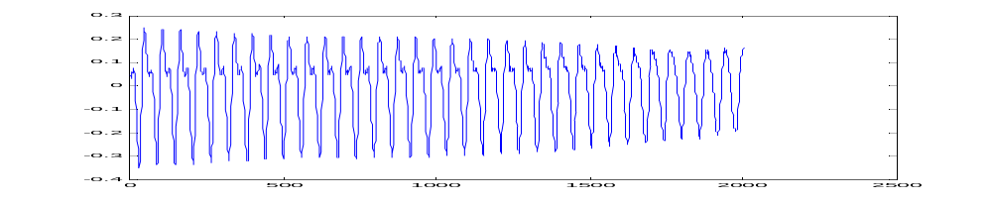
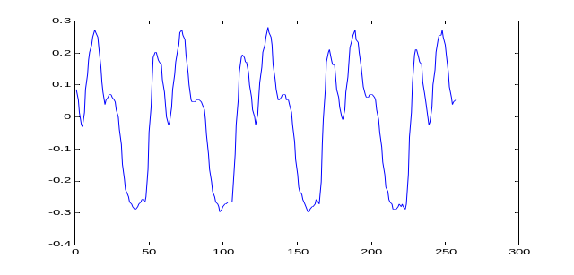
Frame Blocking
Quiz!
Overlap
Frame
Sample rate = 16 kHz
Frame size = 512 samples
Frame duration = 512/16000 = 0.032 s = 32 ms
Overlap = 192 samples
Hop size = frame size – overlap = 512-192 = 320 samples
Frame rate = 16000/320 = 50 frames/sec
frame size
= hop size + overlap
hop size
overlap

Slide 5
Basic Features of Audio Signals
Quiz!
Volume (音量): the amplitude of audio signals
  Also known as intensity, or energy.
Pitch (音高): Fundamental frequency (the number of fundamental periods in a second)
  Usually males have a lower pitch while females have a higher one
Timbre (音色): Waveform inside a fundamental period.
  Different vowels have different timbres
  Different singers also have different timbres.
Check out waveform
Of your recording!

Slide 6
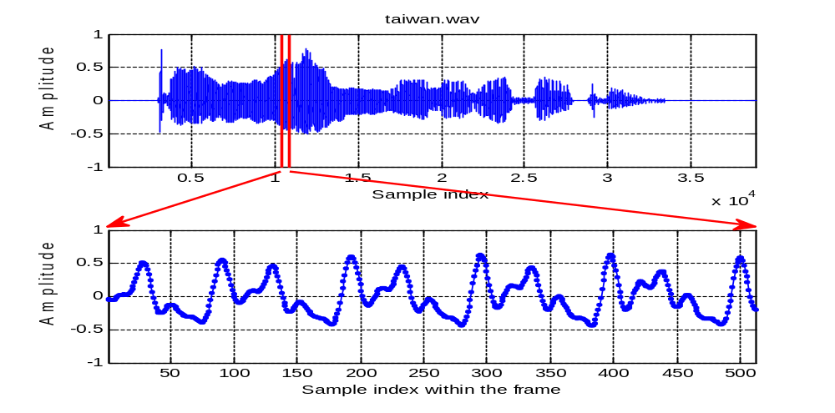
Audio Features in Time Domain
Three of the most prominent audio features in a frame (aka analysis window)
Quiz:
How to control these features
during your pronunciation?
Fundamental period
Volume:
Waveform
amplitude
Timbre: Waveform within an FP

Slide 7
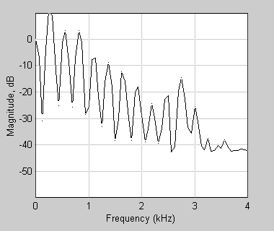
Audio Features in Frequency Domain
Frequency-domain audio features in a frame
  Energy: Sum of power spectrum
  Pitch: Distance between harmonics
  Timbre: Smoothed spectrum
F1:
First formant
F2:
Second formant
Pitch
Volume:
Waveform
height

Slide 8
Frame-based Manipulation
How to pack frames into a matrix for easy manipulation in MATLAB:
  [y, fs] = audioread(‘file.wav’);
  frameMat = enframe(y, frameSize, overlap);
frameMat =
Frame 1
…
Frame 2
Frame n

Slide 10
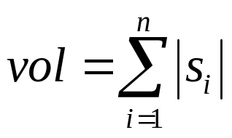
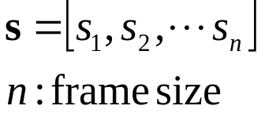
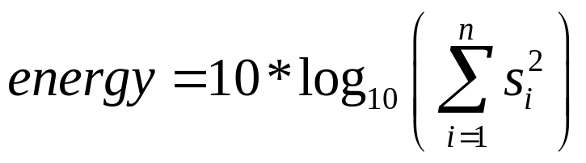
Introduction to Volume
Loudness of audio signals
  Visual cue: Amplitude of vibration
  AKA energy or intensity
Two major ways to compute volume in a frame:
  Volume:
    Easy computation
  Energy (in decibel):
    Better correlation with our perception
Quiz!

Slide 11
Volume: Perceived and Computed
Perceived volume is influenced by
  Frequency
  Timbre
Computed volume is influenced by
  Microphone types
  Microphone setups

Slide 12
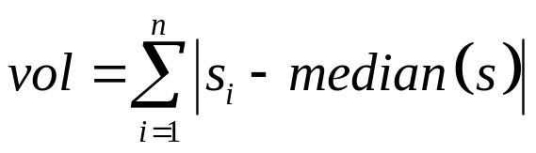
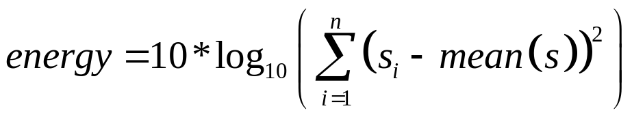
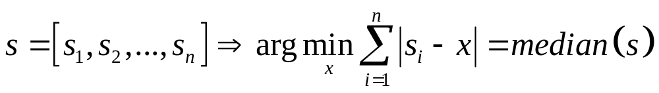
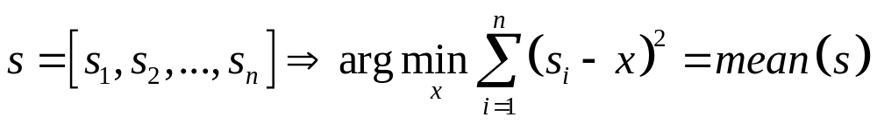
Volume Computation
To avoid DC bias (or DC drifting)
  DC bias: The vibration is not around zero
  Computation (assuming constant DC bias):
    Volume:
    Energy (in decibel):
How to prove these identities?
Quiz!

Slide 13
Examples of Volume
Functions for computing volume
  Example: volume01
  Example: volume02
  Example: volume03
Volume depends on…
  Frequency
    Equal loudness test
  Timbre
    Example: volume04

Slide 15
Zero Crossing Rate
Zero crossing rate (ZCR)
  Number of zero crossings in a frame.
Characteristics：
  Higher for noise and unvoiced sounds, lower for voiced sounds.
  Zero-justification is required before computing ZCR.
Usage
  For endpoint detection, especially for detecting unvoiced sounds.
  To distinguish unvoiced sound from noise, usually we add a shift before computing ZCR.
Quiz!

Slide 16
ZCR Computations
Two types of ZCR definitions
  If a zero-value sample is considered a case of ZCR, then the value of ZCR is higher. Otherwise its lower.
  The above distinction diminishes when using a higher bit resolution.
Other consideration
  ZCR with shift can be used to distinguish between unvoiced sounds and silence.
  But it is hard to set up the right shift amount.

Slide 17

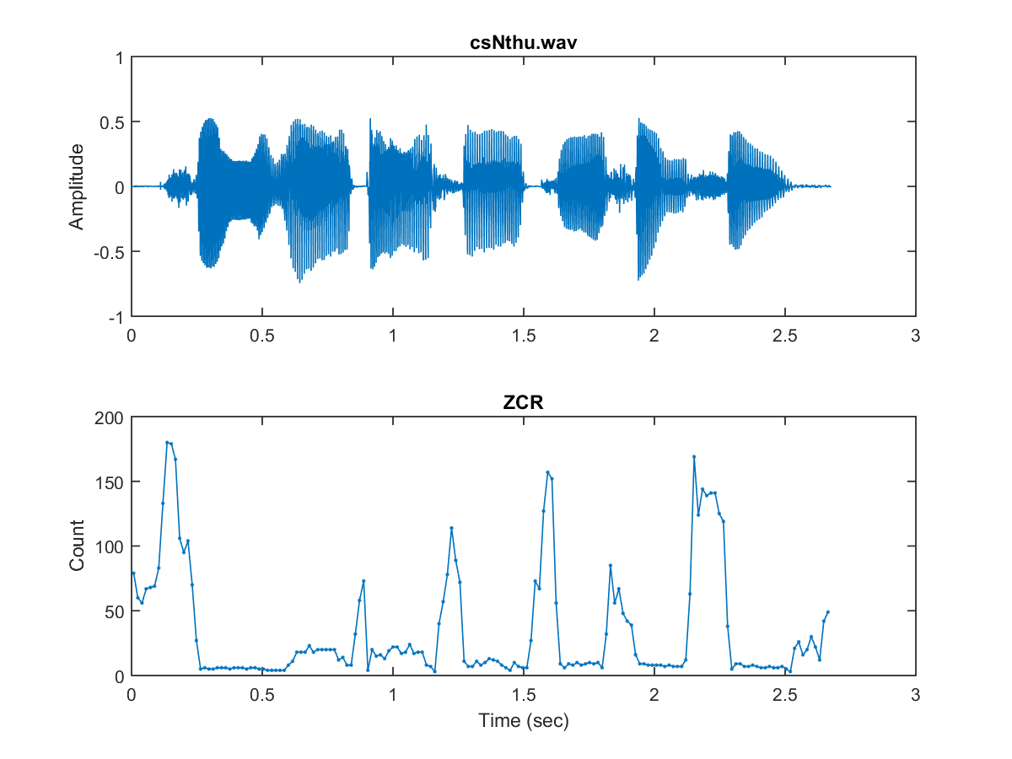
Examples of ZCR (1/2)
ZCR computing
  Example: zcr01
  Example: zcr02

Slide 18
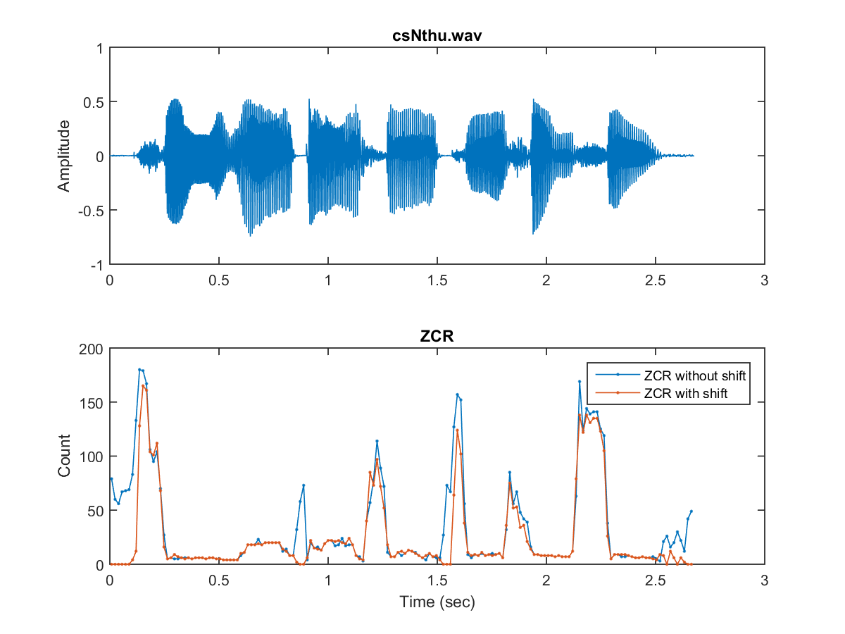
Examples of ZCR (2/2)
Use ZCR to distinguish between unvoiced sounds and environmental noise
  Example: zcrWithShift

Slide 20
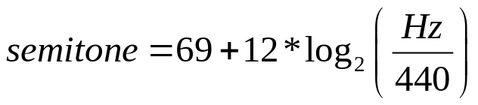

Fundamental Frequency & Pitch
Fundamental frequency (FF)
  The no. of fundamental period in a second.
  Unit: Hertz (Hz).
  Pitch
    Can be converted from FF in Hertz:
    Unit: semitone or MIDI number
Quiz!
Not related to sample rate!
Piano roll via HTML5

Slide 21
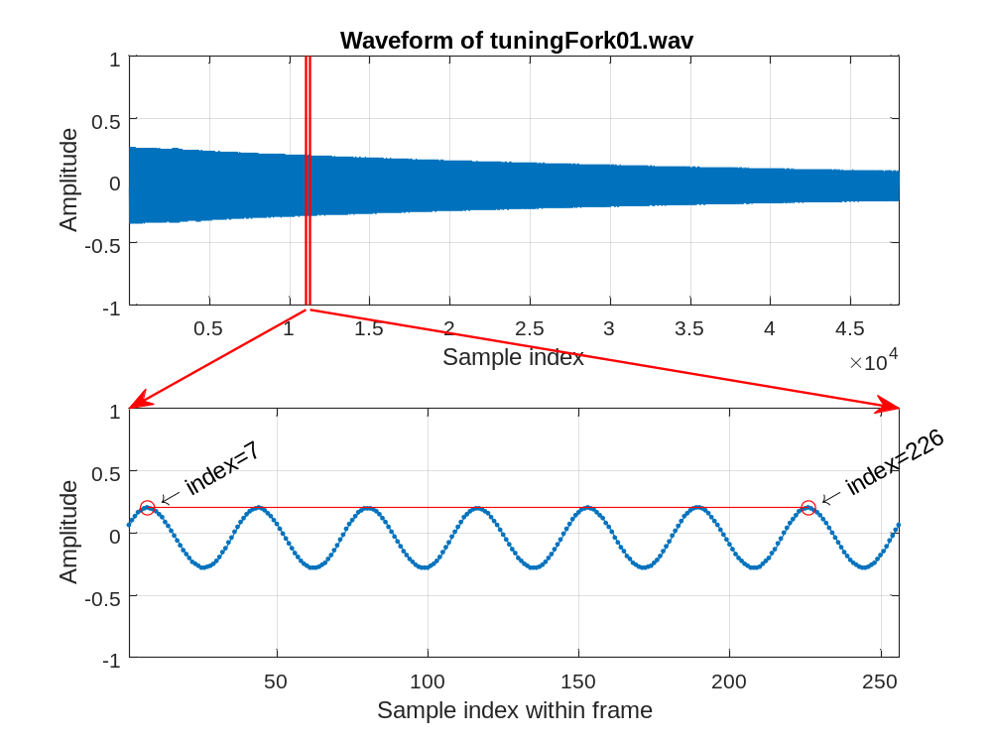
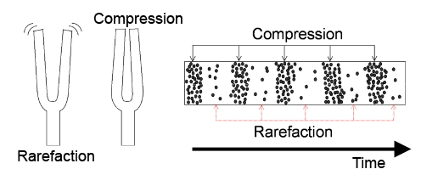

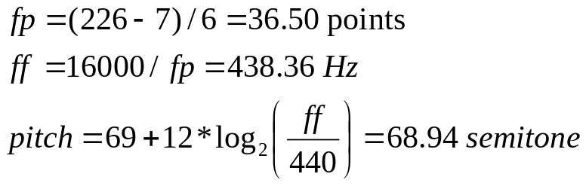
Pitch Computation for Tuning Forks
Pitch of tuning forks (code)

Slide 22
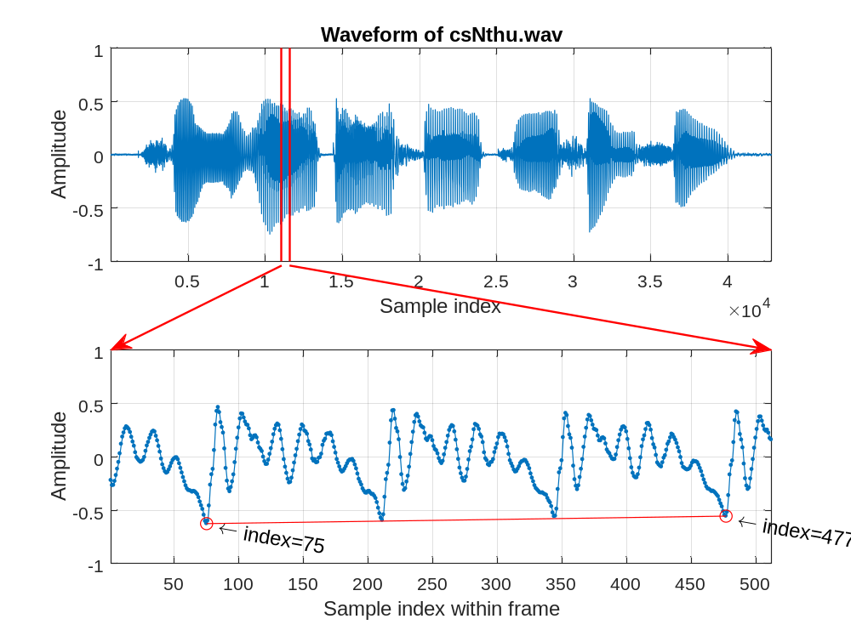
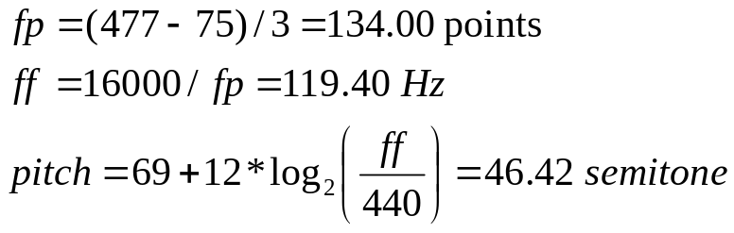
Pitch Computation for Speech
Pitch of speech (code)

Slide 23
Pitch Change due to Fast Forward
If audio is played at a higher sample rate…
  Pitch is higher
  Duration is shorter
Pitch change due to sample rate change at playback
  Sample rate: fs ➔ k*fs (at playback)
  Duration: d ➔ d/k
  Fundamental frequency: ff ➔ k*ff
  Pitch: pitch ➔ pitch+12*log₂(k)
Quiz!

Slide 24
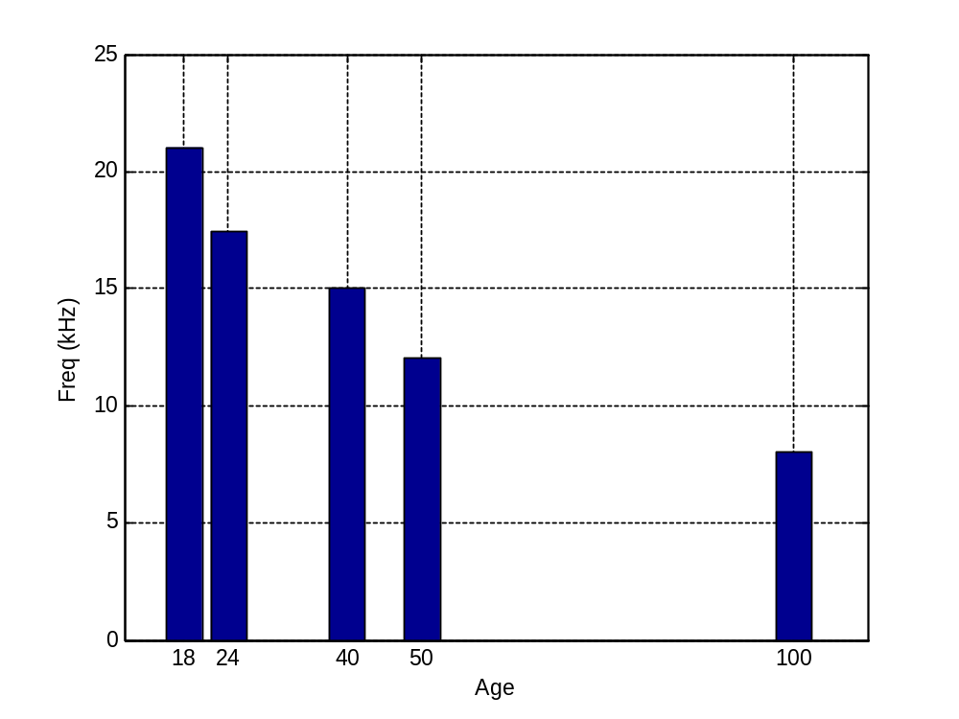
Pitch Perception
Age-related hearing loss
  As one grows old, the audible frequency bandwidth is getting narrower
  Mosquito ringtone
    Low to high, high to low
    Applications
Frequencies vs. ages
21k
17.4k
15k
12k
8k

Slide 26
Tones in Mandarin Chinese
Some statistics about Mandarin Chinese
  5401 characters, each character is at least associated with a base syllable and a tone
  411 base syllables, and most syllables have 4 tones, so we have 1501 tonal syllables
Syllables with 3 or less tones
  趴爬怕、當檔蕩、嗲
More examples
  1234：三民主義、三國演義、優柔寡斷、花明柳暗、科學理論
  ?????：美麗大教堂、滷蛋有夠鹹（Taiwanese）
  Tone sandhi：勇猛果敢
Notes:
三民主義
三國演義
三皇五帝
中流砥柱
中華史地
光明永繼
詩人李杜
聰明穎悟
低吟緩步
遵從禮義

Slide 27

Features Related to Tones
Tone is characterized by the pitch curves:
  Tone 1: high-high
  Tone 2: low-high
  Tone 3: high-low-high
  Tone 4: high-low
  (Put you hand on your throat and you can feel it…)
Tone recognition is mostly based on features obtained from pitch and volume
Quiz!

Slide 28
Tones in Mandarin TTS
TTS: Text to speech （demo）
Tone Sandhi: phonological change occurring in tonal language
  3+3 ➔ 2+3, such as 總統
    總統府、李總統、母老虎、膽小鬼、水彩筆、老古董
  不：
    不好、不難 vs. 不對、不妙
  一
    一個、一次、一半 vs. 一般、一毛、一會兒

Slide 29
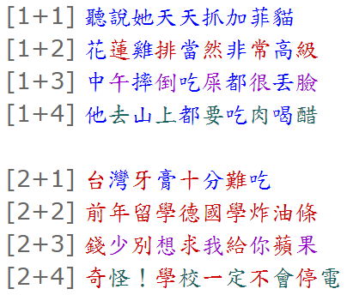
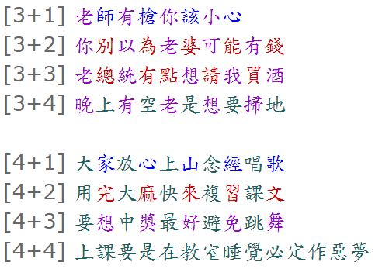
Mandarin Tone Practice
雙音節詞連音組合

Slide 30
Sentences of All Tone 3
Tone Sandhi of 3+3
  請老李給我買五把好雨傘
  老李買好酒請馬小姐買幾百把小雨傘
  總統府裏的李總統有點想請我買酒
  北海只有兩里遠，水也很淺
  展覽館北館有好幾百種展覽品
  你早晚打掃，我啃水果咬水餃
  我很了解你，我倆永遠友好
  水管可以點火，趕緊買保險
Quiz!

Slide 31
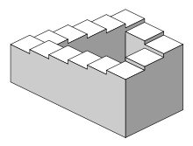
Other Things about Pitch
Some interesting phenomena about pitch
  Beat
    Music by beats
  Doppler effect
  Shepard tone
    Auditory illusion of a tone that ascends or descends in pitch continuously
  Overtone singing
Have you tried these?
  Inhale helium to produce high (squeaky) pitch
  Resonance: break a glass with the right pitch (just like a swing)
How to create these effects
in MATLAB?

Slide 32
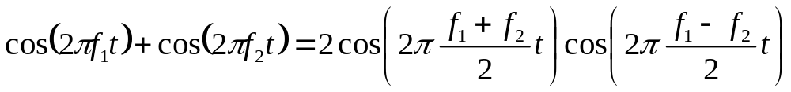

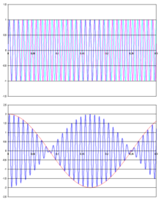
Beat
Beat: An interference between two sounds of slightly different frequencies…
  Audible beat frequency =
Quiz!
Not | f₁ – f₂ |/2!
signal 1 & signal 2
signal 1 plus signal 2

Slide 33

Experiments of Beats
Beats in MATLAB
  y1+y2:
Beats in the air
  yLeft:
  yRight:
  yBoth:
fs=8000;
duration=5;
t=(1:duration*fs)/fs;
y1=0.8*cos(2*pi*440*t)';
y2=0.8*cos(2*pi*444*t)';
sound(y1+y2, fs);
fs=8000;
duration=5;
t=(1:duration*fs)/fs;
y1=0.8*cos(2*pi*440*t)';
y2=0.8*cos(2*pi*444*t)';
sound([y1, y2], fs);
Beat frequency
= 4 Hz
Beat frequency
= 4 Hz

Slide 35
Timbre
Timbre is represented by
  Waveform within a fundamental period
  Frame-based energy distribution over frequencies
    Power spectrum (over a single frame)
    Spectrogram (over many frames)
  Frame-based MFCC (mel-frequency cepstral coefficients)

Slide 36
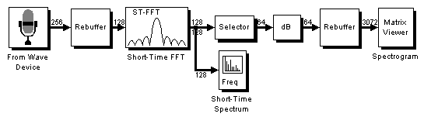
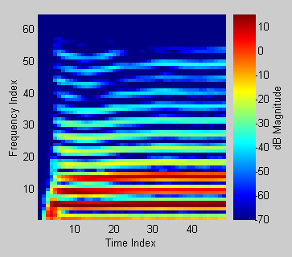
Timbre Demo:
Real-time Spectrogram
Simulink model for real-time display of spectrogram
  dspstfft_audio (Before MATLAB R2011a)
  dspstfft_audioInput (R2012a or later)
Spectrum:
Spectrogram:

Slide 38
基本週期
音量：
波形震幅
音色：基本週期內的波形

Slide 39
第一共振峰
音高
第二共振峰
音量：
波形高度
音色：平滑後的幅度頻譜

