Slide 1
Pitch Tracking in Time Domain
Jyh-Shing Roger Jang (張智星)
MIR Lab, Dept of CSIE
National Taiwan University
jang@mirlab.org
http://mirlab.org/jang

Slide 2
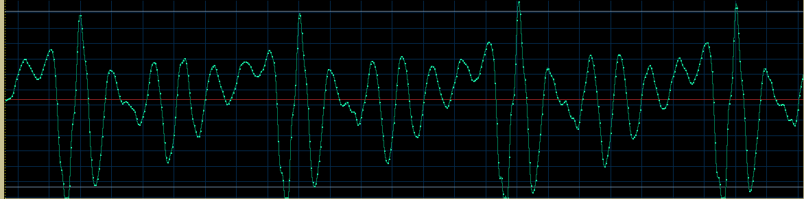
Audio Features in Time Domain
Audio features presented in the time domain
Fundamental period
Intensity
Timbre: Waveform within an FP

Slide 3
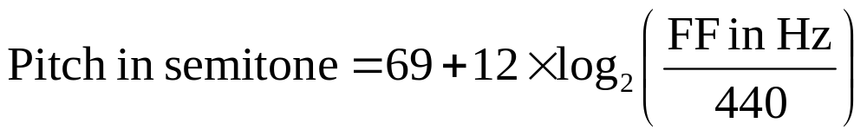
Fundamental Frequency and Pitch
Fundamental frequency (FF, in Hz)
  No. of fundamental periods in a second
Pitch (in semitone or MIDI number)
  Computed from the fundamental frequency through a log-based transformation
Hertz

Slide 4
Pitch Tracking (音高追蹤)
Pitch tracking (PT): The process of computing the pitch vector of a given audio segment (對整段音訊求取音高)
Applications
  Query by singing/humming (哼唱選歌)
  Tone recognition for Mandarin (華語的音調辨識)
  Intonation scoring for English (英語的音調評分)
  Stress detection in English word (英語單字的重音偵測)
  Text-to-speech synthesis (語音合成)
  Pitch scaling and duration modification (音高調節與音長改變)
  …
Quiz!

Slide 5
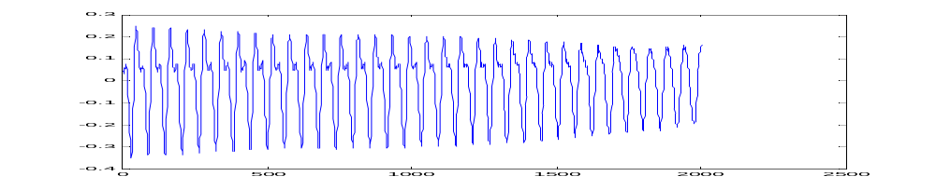
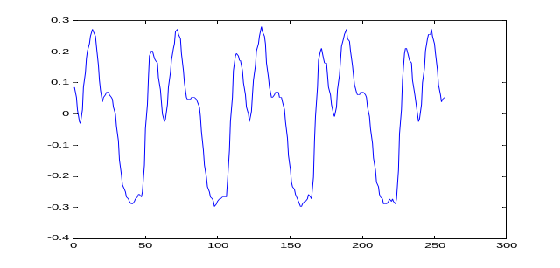
Frame Blocking
Quiz!
Overlap
Frame
Zoom in
Sample rate = 16 kHz
Frame size = 512 samples
Frame duration = 512/16000 = 0.032 s = 32 ms
Overlap = 192 samples
Hop size = frame size – overlap = 512-192 = 320 samples
Frame rate = 16000/320 = 50 frames/sec = 50 pitch/sec
= pitch rate
frame size
= hop size + overlap
hop size
overlap

Slide 6
Typical Steps for Pitch Tracking
Main processing for each frame
  Frame blocking
  PDF (periodicity detection function) computation
  Pitch candidates via max picking over PDF
  Pitch refinement via parabolic interpolation (optional)
Pre-processing
  Filtering
  Excitation extraction
Post-processing
  Unreliable pitch removal via volume/clarity thresholding
  Pitch smoothing via median filters, etc.
Segment based
Frame based
Segment based

Slide 7
Periodicity Detection Functions (PDF)
Use PDF to detect the period of a waveform
Two types of PDF
  Time domain (時域)
    ACF (Autocorrelation function)
    AMDF (Average magnitude difference function)
    …
  Frequency domain (頻域)
    Harmonic product spectrum
    Cepstrum
    …

Slide 8


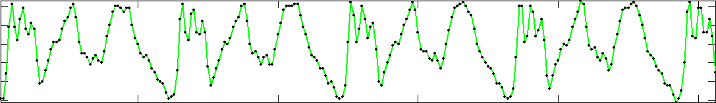


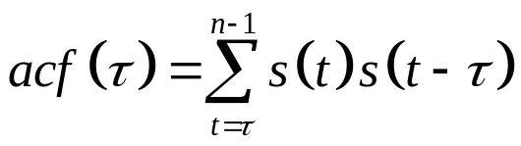
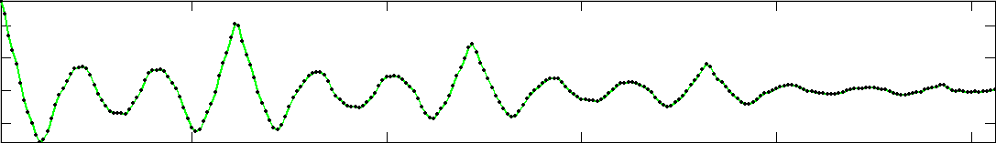

ACF: Auto-correlation Function
0-index based,
s =[s(0), s(1), …, s(n-1)]
1
128
Original frame s(t):
Shifted frame s(t-τ):
τ=30
acf(30) = inner product of the overlap part
Quiz!
Period
Quiz!
To play safe, the frame size needs to cover at least two fundamental periods!

Slide 9
Facts about ACF
Some facts about ACF
  It is a function of τ, or the time delay.
  Its value is getting smaller due to smaller overlap for inner product.
  We need to have a better criterion (to be detailed) for picking the right maximum.

Slide 10
ACF: Formula 1
Assume a frame is represented by s(t), t=0~n-1
ACF formula
s(t)
s(t):
Shift to right
t
s(t-τ):
τ
s(t-τ)
Quiz!

Slide 11
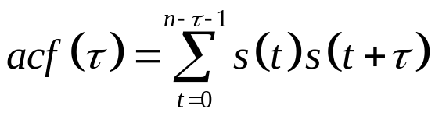
ACF: Formula 2
Assume a frame is represented by s(t), t=0~n-1
ACF formula
s(t)
s(t):
t
s(t+τ):
Shift to left
s(t+τ)
τ
This formula is the same as the previous one!
Quiz!

Slide 12
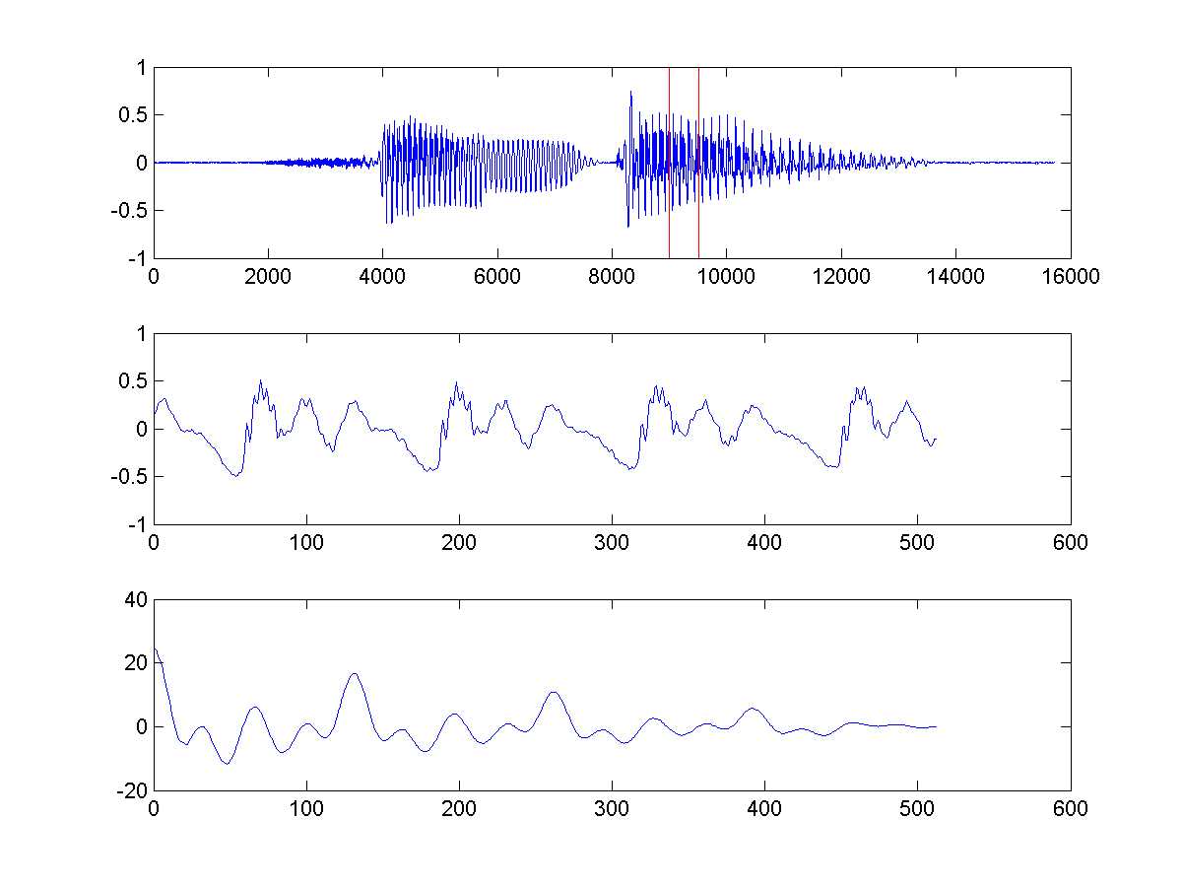
Example of ACF
sunday.wav
  Sample rate = 16kHz
  Frame size = 512 (starting from point 9000)
Fundamental frequency
  Max of ACF occurs at index 130
  FF = 16000/(130-0) = 123.077 Hz
frame2acf01.m
Index 0
Index 130
We suppose it is 0-based indexing.

Slide 13
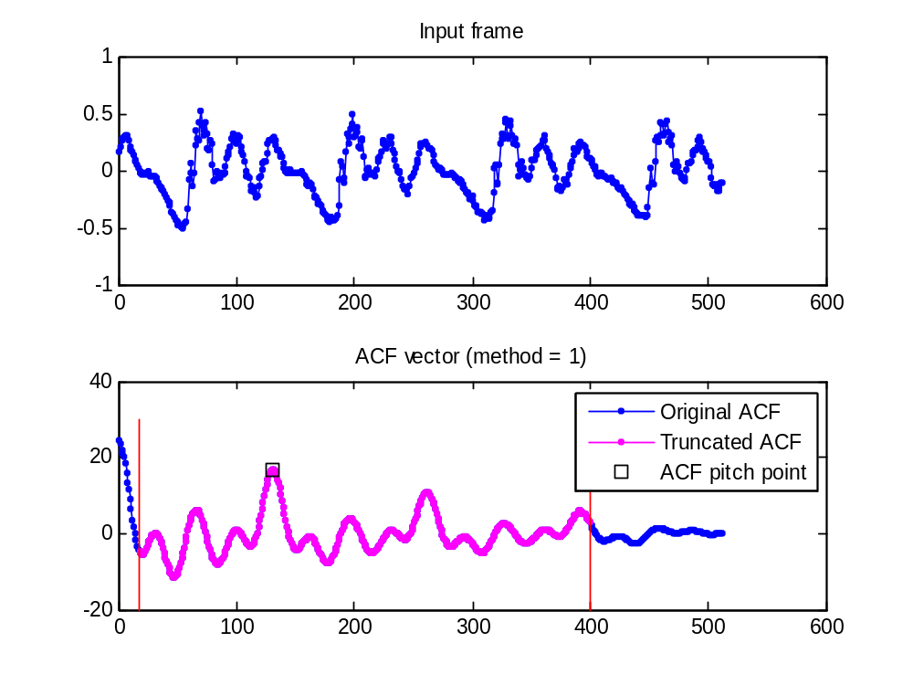
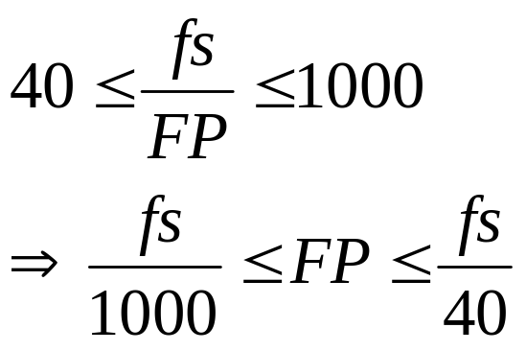
Locating the Pitch Point
If human’s FF range is [40, 1000], then the interval for locating fundamental period (FP) is:
frame2acfPitchPoint01.m
Sample rate
Index: 0
Index: FP
Quiz!

Slide 14
What Could Go Wrong?
The human pitch range could go wrong
  Pitch too high
    Vitas (local short clip)
    Whistling
  Low-pitch singing/humming ➔ requires a big frame size to cover at least two fundamental periods
Quiz!

Slide 15
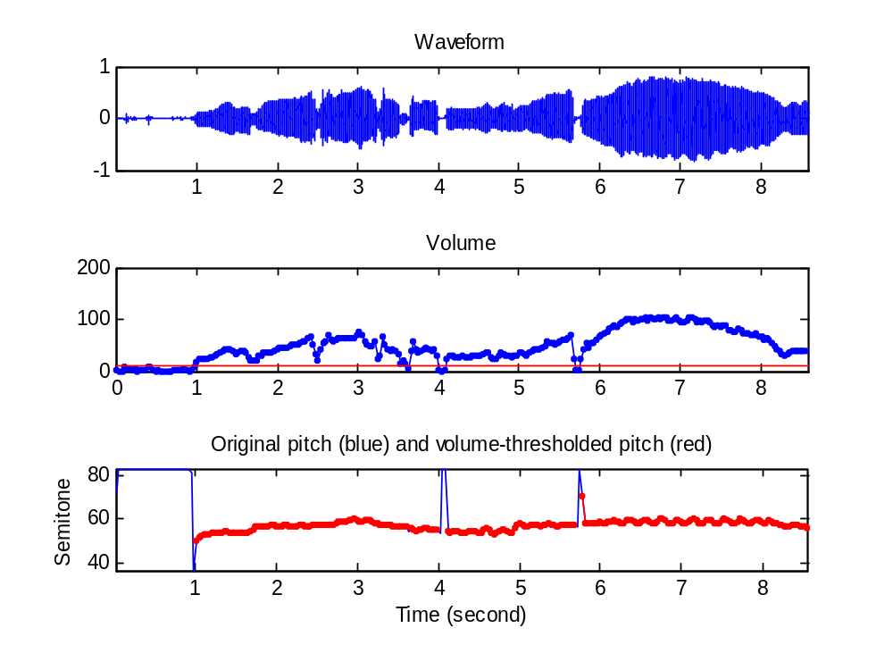
Example of ACF-based PT (1/2)
Specs
  Sample rate = 11025 Hz
  Frame size = 353 points = 32 ms
  Overlap = 0
  Frame rate = 31.25 f/s
Playback
  Original singing
  Pitch by ACF
wave2pitchByAcf01.m

Slide 16
Example of ACF-based PT (2/2)
Try the program and
play wave and pitch
at the same time!
Note
  The previous script is simplified by calling pitchTrackBasic.m in SAP toolbox.
ptByAcf01.m

Slide 17
Demo of ACF-based PT
Real-time display of ACF for pitch tracking
  goPtByAcf.mdl under SAP toolbox
Real-time pitch tracking for mic input
  goPtByAcf2.mdl under SAP toolbox

Slide 18
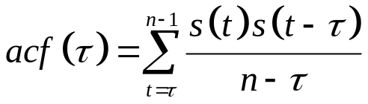
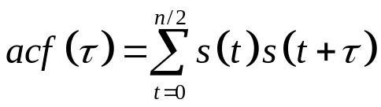
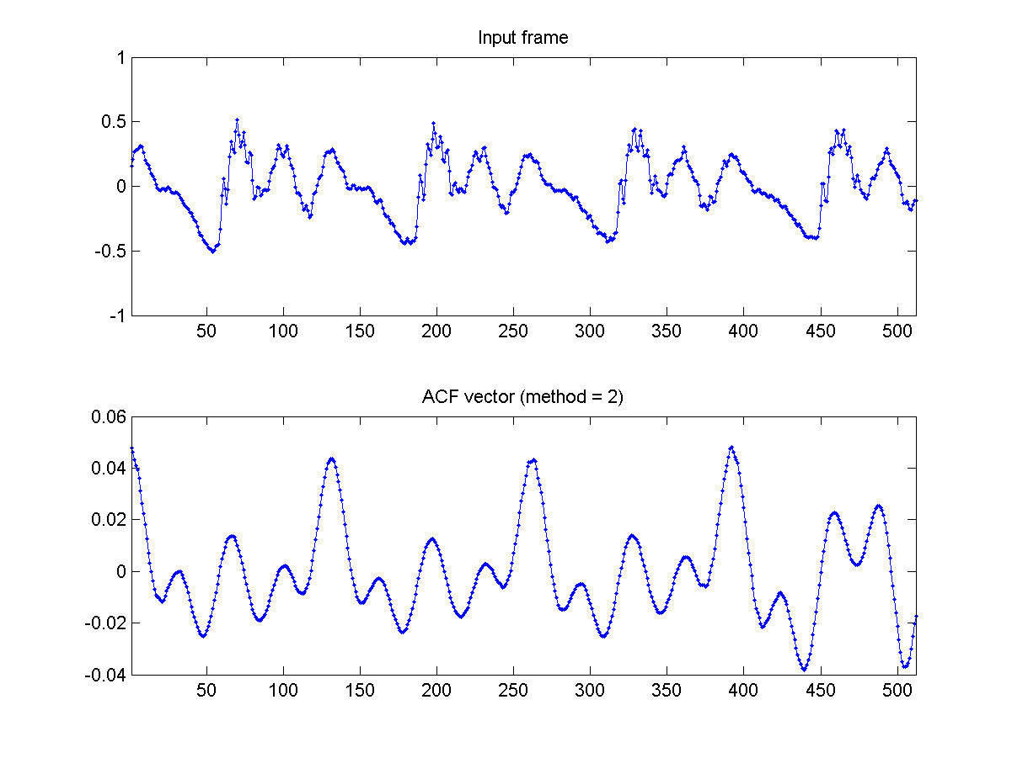
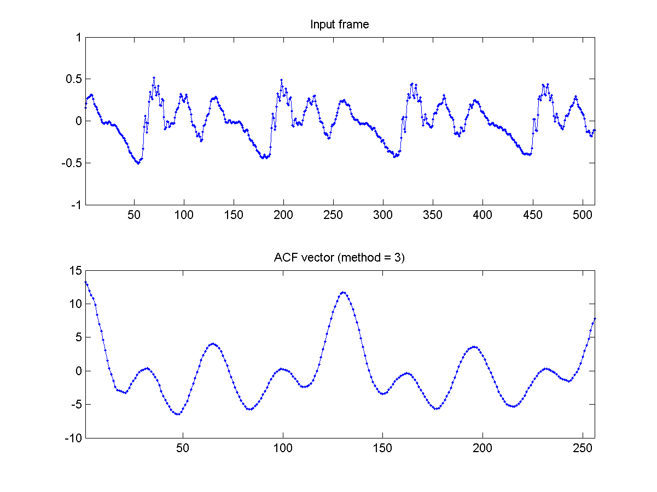
ACF Variants to Avoid Tapering
Normalized version
frame2acf02.m
Half-frame shifting
frame2acf03.m
method=2
method=3

Slide 19
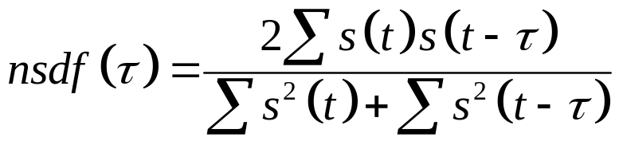
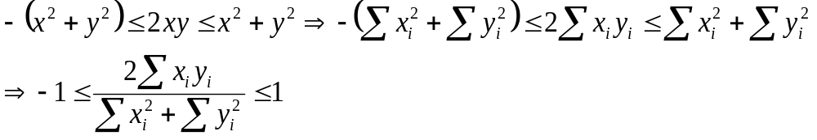
NSDF: ACF Variant with Normalize Range
NSDF: normalized squared difference function
  Formula:
  A variant of ACF within the range [-1 1], based on the inequality:

Slide 20
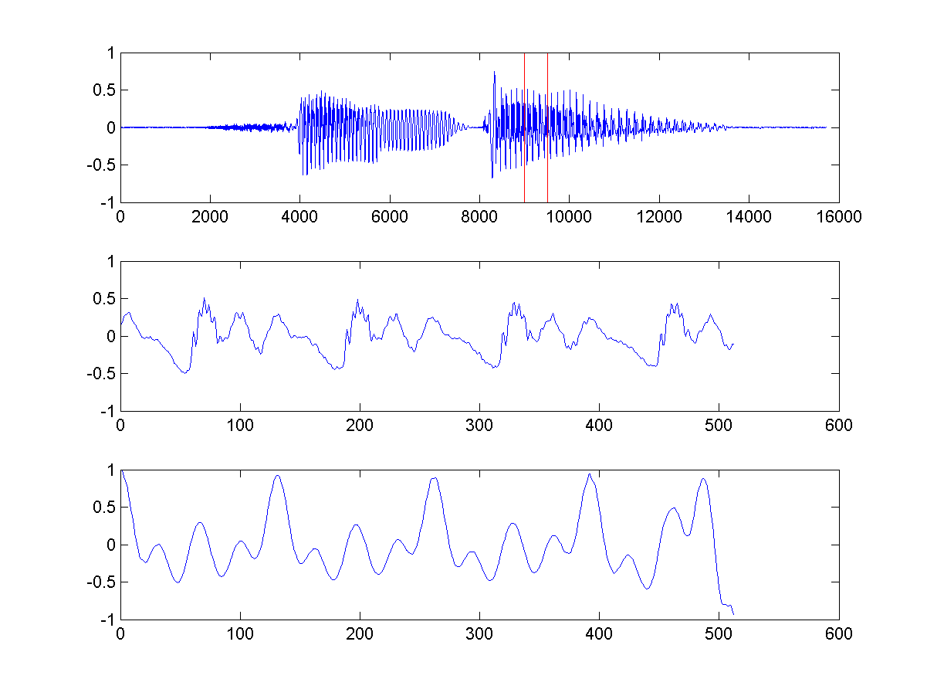
NSDF Example
frame2nsdf01.m
Clarity: height of the pitch point

Slide 21
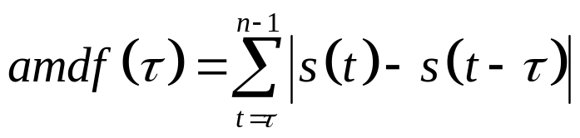
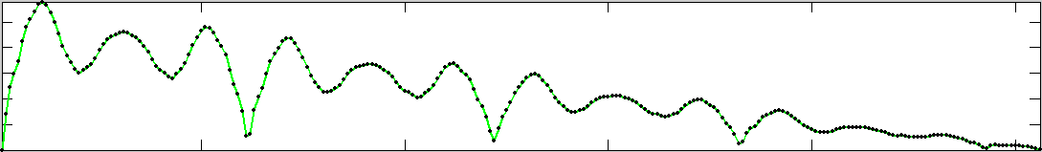
AMDF: Average Magnitude Difference Function
1
128
Original frame s(i):
Shifted frame s(i-τ):
τ=30
amdf(30) = sum of abs. difference
of the overlap part
Quiz!
Period
30

Slide 22
Comparison between ACF & AMDF
Formulas
  ACF:
  AMDF:
Two major advantages of AMDF over ACF
  AMDF requires less computing power
  AMDF is less likely to run into the risk of overflow
Quiz!

Slide 23
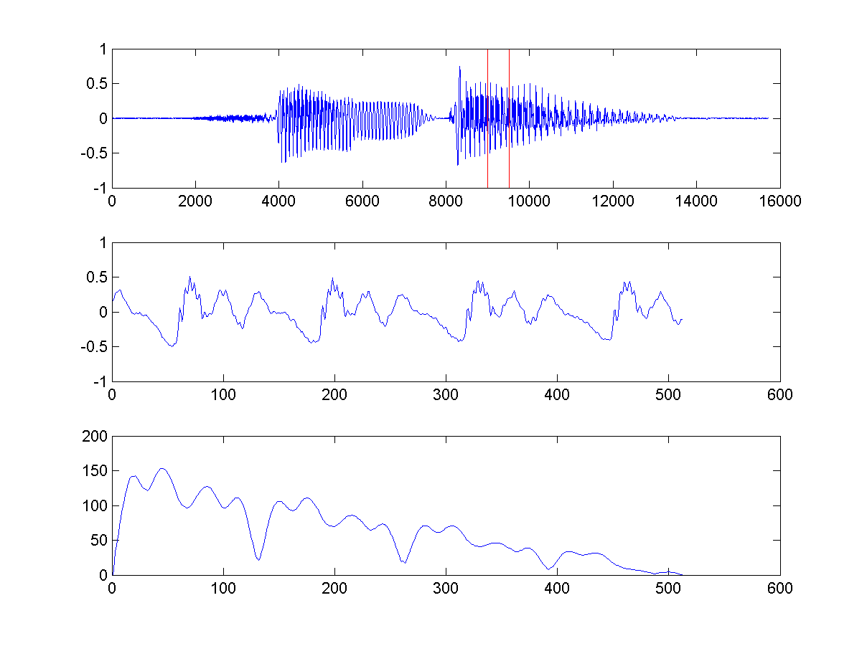
Example of AMDF
sunday.wav
  Sample rate = 16kHz
  Frame size = 512 (starting from point 9000)
Fundamental frequency
  Pitch point occurs at index 130, which is harder to determine
frame2amdf01.m
Index 0
Index 130

Slide 24
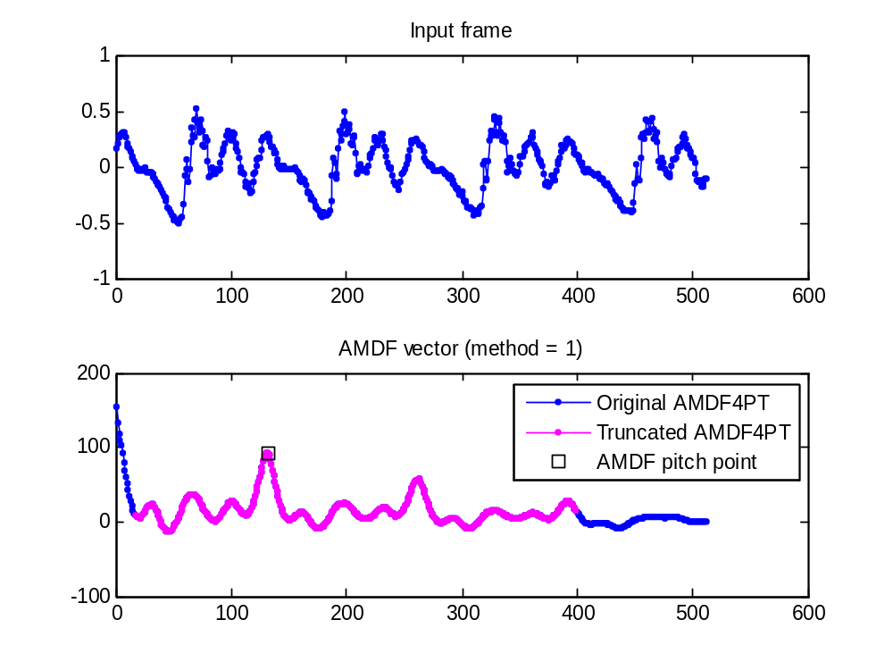
Example of AMDF to Pitch
sunday.wav
  Sample rate = 16kHz
  Frame size = 512 (starting from point 9000)
Fundamental frequency
  Pitch point occurs at index 130, which is determined correctly
  FF = 16000/(130-0) = 123.077 Hz
frame2amdf4pt01.m
Index 0
Index 130

Slide 25

Example of AMDF Based PT
Specs
  Sample rate = 11025 Hz
  Frame size = 353 points = 32 ms
  Overlap = 0
  Frame rate = 31.25 f/s
Playback
  Original singing
  Pitch by AMDF
ptByAmdf01.m

Slide 26
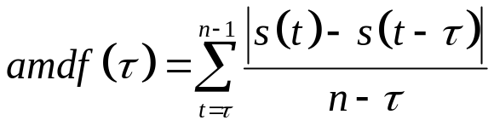
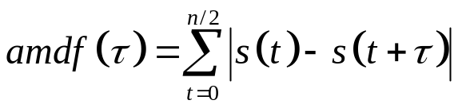
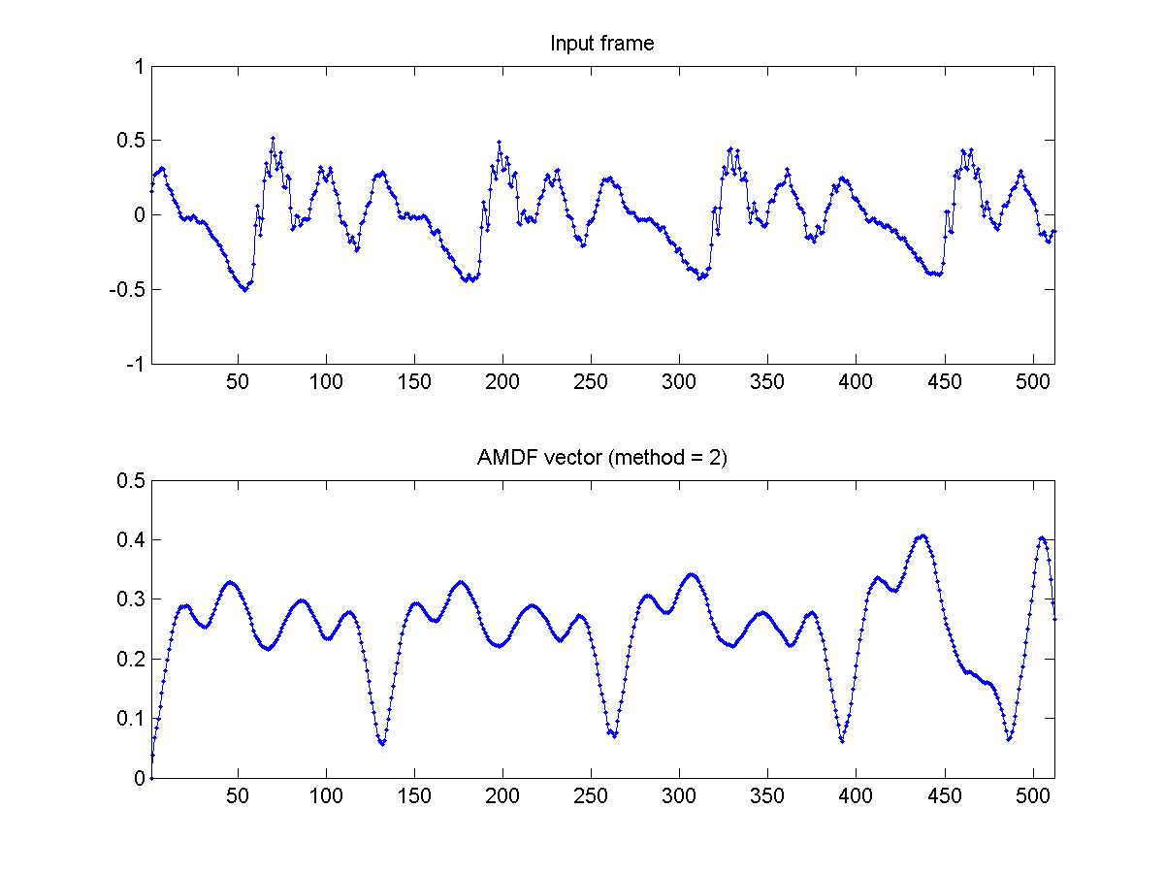
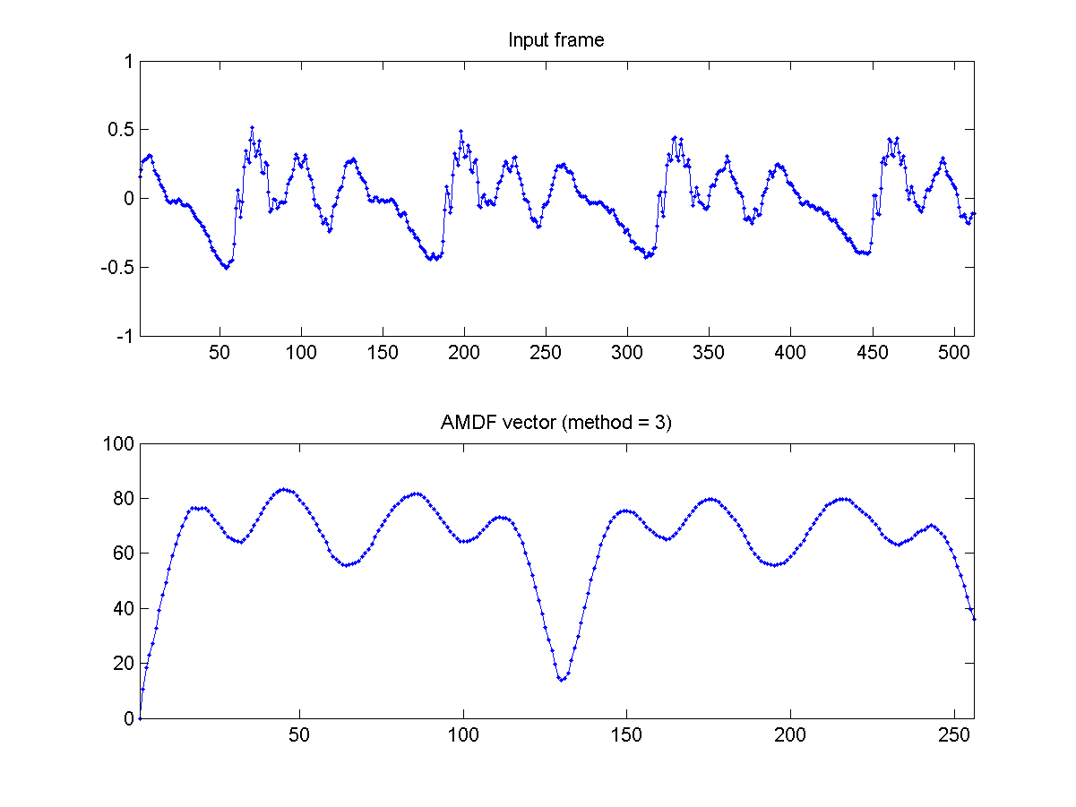
AMDF: Variations to Avoid Tapering
Normalized version
frame2amdf02.m
Half-frame shifting
frame2amdf03.m
method=2
method=3

Slide 27
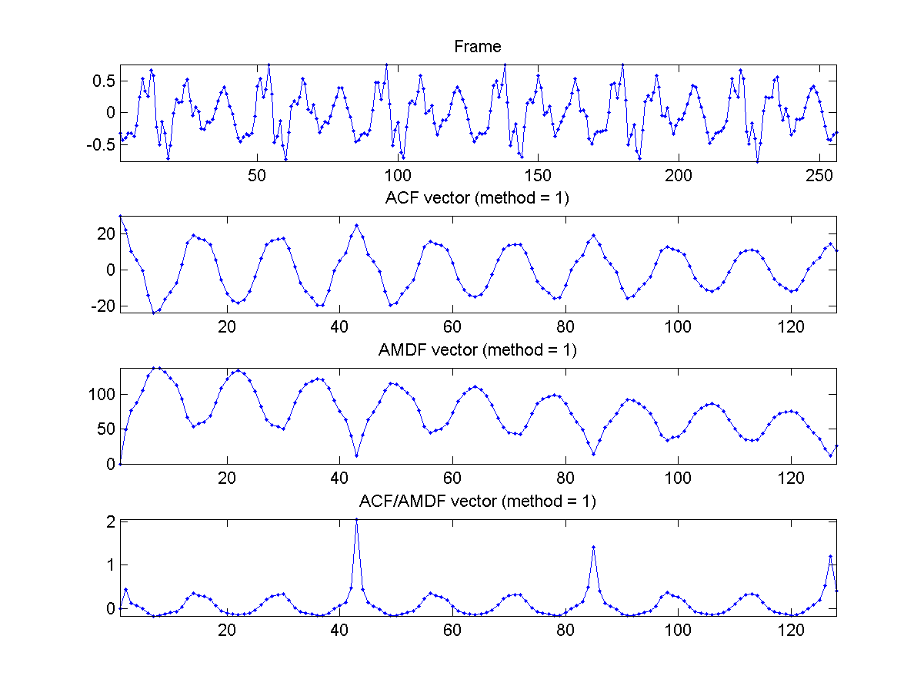
Combining ACF and AMDF
Frame
ACF
AMDF
ACF/AMDF

Slide 28
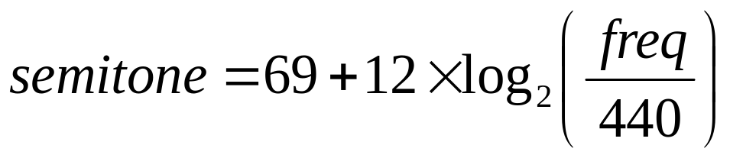


Frequency to Semitone Conversion
Semitone : A music scale based on A440
Reasonable pitch range:
  E2 (82Hz) - C6 (1047Hz)
  -
Quiz!

