Slide 1
AI-Driven KYC Onboarding
& Compliance Engine
Intelligent compliance-based onboarding with AI-powered fraud verification and background screening
HCLTech x UBC AI/ML Hackathon -- Use Case #06 -- Banking / FinTech

Slide 2
The problem -- and the three-stage answer
Every country demands different documents, fields, and verification flows -- but most onboarding pipelines don't adapt.
40-60%
$25-50
< 60s
$3.1B
average KYC onboarding drop-off
cost of one manual KYC review
target automated onboarding time
global KYC market size
Source: HCLTech x UBC Hackathon use-case brief, Use Case #06
A three-stage pipeline, cheapest check first
1
2
3
Behavioral fraud gate
Jurisdiction-aware verification
OSINT compliance agent
Flags pasted fields or scripted uniform-fast typing -- before any document or OSINT work runs.
Country A: full Video KYC (OCR + face-match + liveness). Country B: ID-only eKYC.
Real OFAC SDN list, adverse media, court records -> LLM risk summary (LOW/MED/HIGH).

Slide 3
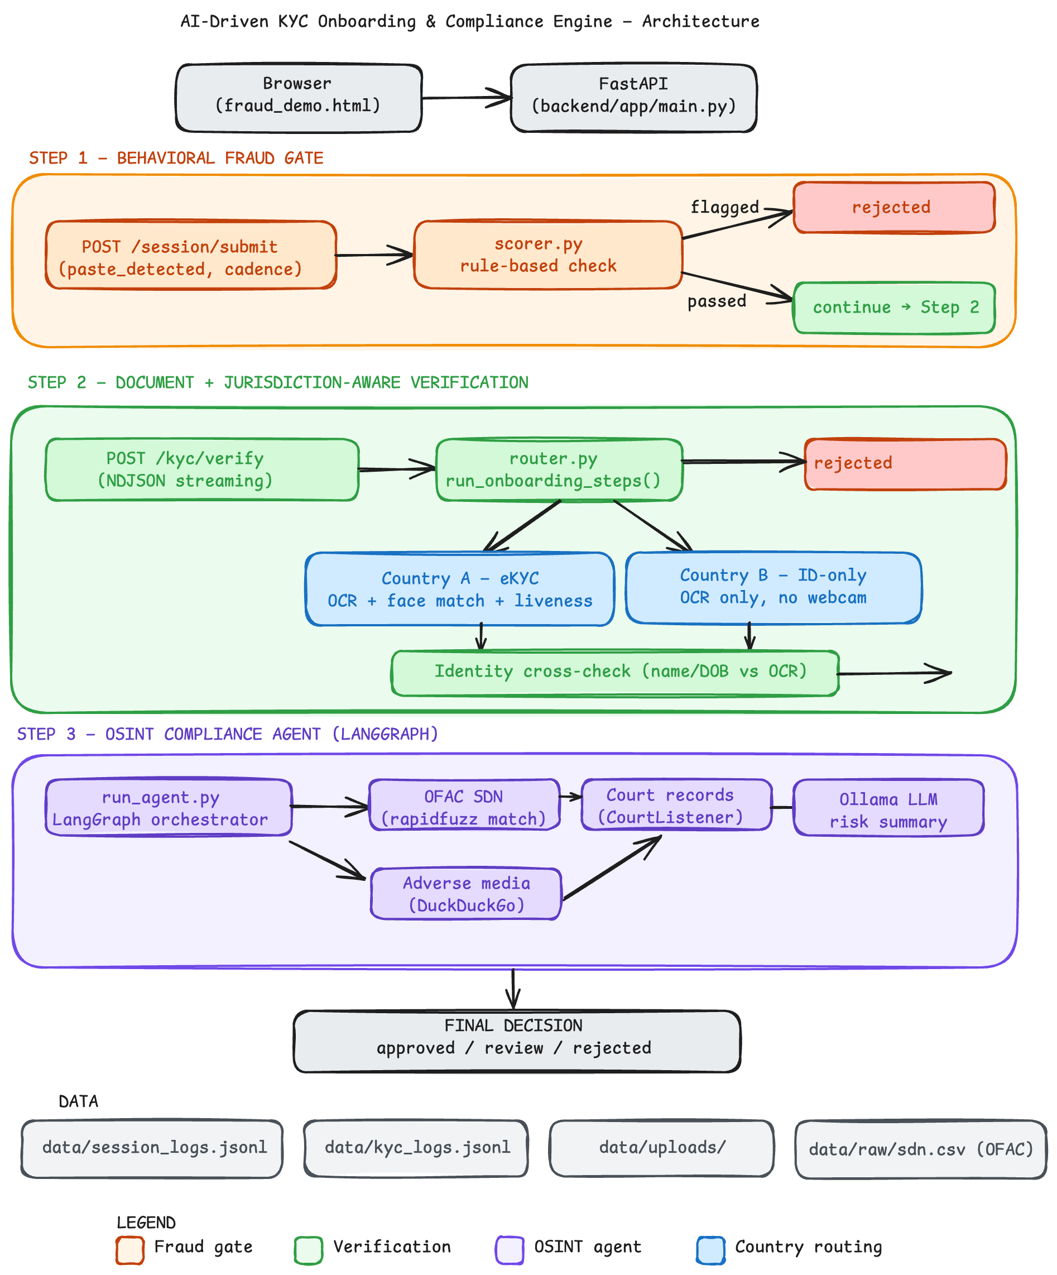




System architecture & real integrations
Requests flow through the fraud gate, jurisdiction-aware document check, then the OSINT agent -- which calls four real external services, in this order.
OFAC SDN List
Sanctions screening -- 7,495 entries, fuzzy name + DOB match
Static CSV, no per-request limit
DuckDuckGo (ddgs)
Adverse media search
Unofficial -- ~30 req/min community-observed
CourtListener API
Court records lookup
Free tier: 5 req/min, 50/hr, 125/day
Ollama (local LLM)
Risk summary generation (LOW/MED/HIGH)
Local hardware -- no external limit

Slide 4
AI risk & hallucination strategy
The OSINT agent's risk read is LLM-generated -- here's what can go wrong, and how a bad summary is kept from silently becoming a wrong decision.
Known risk: inconsistent search input
Mitigation: the LLM never decides alone
Adverse-media search runs live against DuckDuckGo -- the same query does not always return the same results between runs.
A domain filter map removes low-signal sources (e.g. Wikipedia) before anything reaches the LLM, but result quality still varies run to run.
That inconsistency feeds directly into what the LLM sees -- and therefore into how it summarizes and scores risk.
* OFAC sanctions match is deterministic (rapidfuzz name + DOB), computed independently of the LLM -- a real SDN hit still surfaces even if the LLM's summary undersells it.
* The LLM only emits a constrained LOW/MEDIUM/HIGH flag from a fixed prompt + evidence -- not an unconstrained free-text verdict driving the decision directly.
* Every risk summary is logged verbatim with its source evidence (data/kyc_logs.jsonl) -- a hallucinated claim is auditable, not hidden.
* MEDIUM risk routes to human review, not auto-approve -- borderline LLM calls never resolve themselves.
* Open item: no automated consistency check (e.g. cross-run majority vote) on the LLM output yet -- flagged as next-step hardening.

Slide 5
Business value & compliance case
Developed at no cost using freely available tools and resources.
Business value
Compliance case
* Reaches the brief's <60s performance target.
* Cheapest check (behavioral gate) runs first, so bot traffic never reaches OCR, face-match, or LLM calls.
* One JSON config change adds a country -- no per-country code branch, no re-architecture to scale.
* Real OFAC SDN list -- 7,495 entries, fuzzy name + DOB matching, not a hand-picked sample.
* Full audit trail: every fraud verdict, OCR field, face-match score, and OSINT summary is logged server-side.
* No black-box scores -- every rejection ships with a stated, human-readable reason.

Slide 6
Live demo -- three scenarios
Two minutes, three applicants -- each one exercises a different stage of the pipeline from slide 2.
1
2
3
Clean pass
Identity fraud caught
Sanctions hit caught
Myself, Country A -- full Video KYC with live webcam capture, then a clean OSINT check. Approved end-to-end.
Myself, Country A, with a mismatched ID photo. The identity cross-check catches it -- rejected before OSINT even runs.
A high-profile applicant, Country B -- ID-only routing, then the OSINT agent flags a real OFAC match. Rejected.
Real OSINT output -- scenario 3 (excerpt from data/kyc_logs.jsonl)
“Repeatedly identified across multiple sources (OFAC, Iran Watch) as subject to severe international sanctions and listed on the SDN list -- counter-terrorism concerns, secondary sanctions risk, involvement in illicit trade with sanctioned regions.”

Slide 7
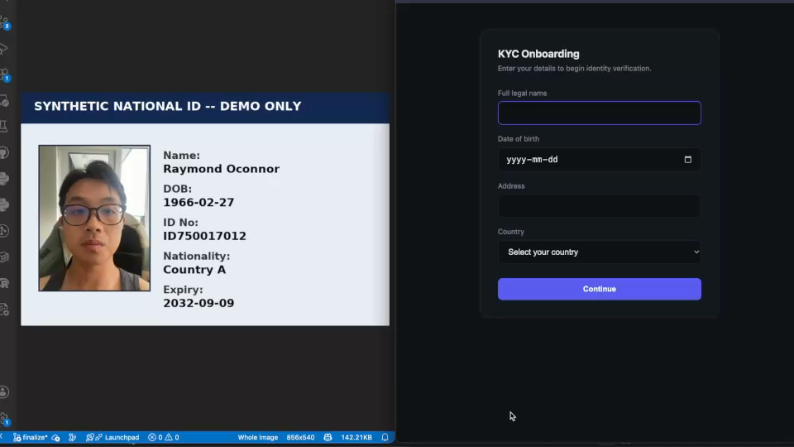

Slide 8
What's next -- thank you
A working prototype across two jurisdictions, both verification paths, fraud detection at both the behavioral and OSINT
What we'd build next
* Smarter gatekeeping -- ML-based behavioral fraud model
* Real liveness / anti-spoofing detection
* UN/EU sanctions blocklists + a distinct PEP flag
* Docker Compose (backend + Ollama + a real DB) for one-command setup
* Swap JSONL backlog for Postgres

Slide 9
Appendix -- sample logs
Two real captured entries from data/kyc_logs.jsonl
Applicant: raymond oconnor | Country A | STATUS: REJECTED (document_check)
Reasons:
* Face match failed (similarity = 0.034)
* Form name != ID name (similarity = 36/100 -- ID reads “KHOT, Arif Ibrahim”)
* Form DOB != ID DOB (1966-02-27 vs 1970-08-21)
Applicant: khot arif ibrahim | Country B | STATUS: REJECTED (OSINT) -- OSINT risk flag: HIGH
Risk summary (excerpt): “Repeatedly identified across multiple sources (OFAC, Iran Watch) as subject to severe international sanctions and listed on the SDN list -- counter-terrorism concerns, secondary sanctions risk, involvement in illicit trade with sanctioned regions.”

