Slide 1
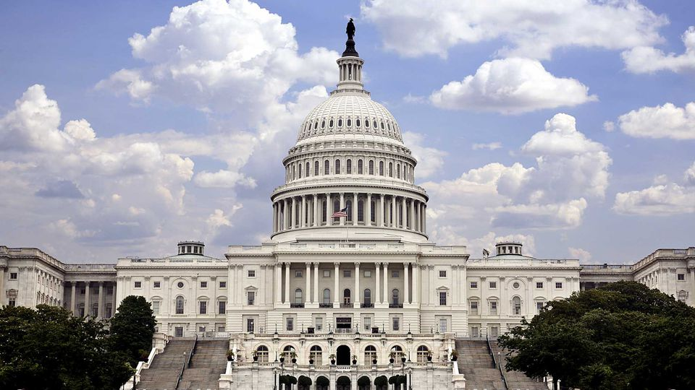

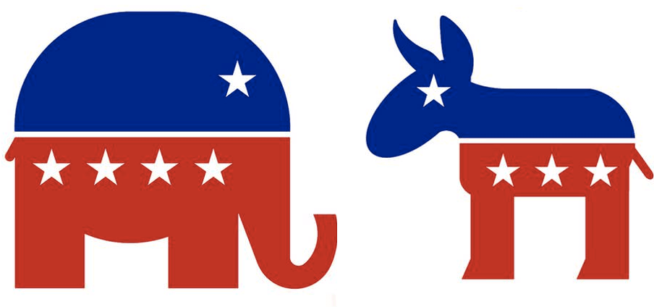

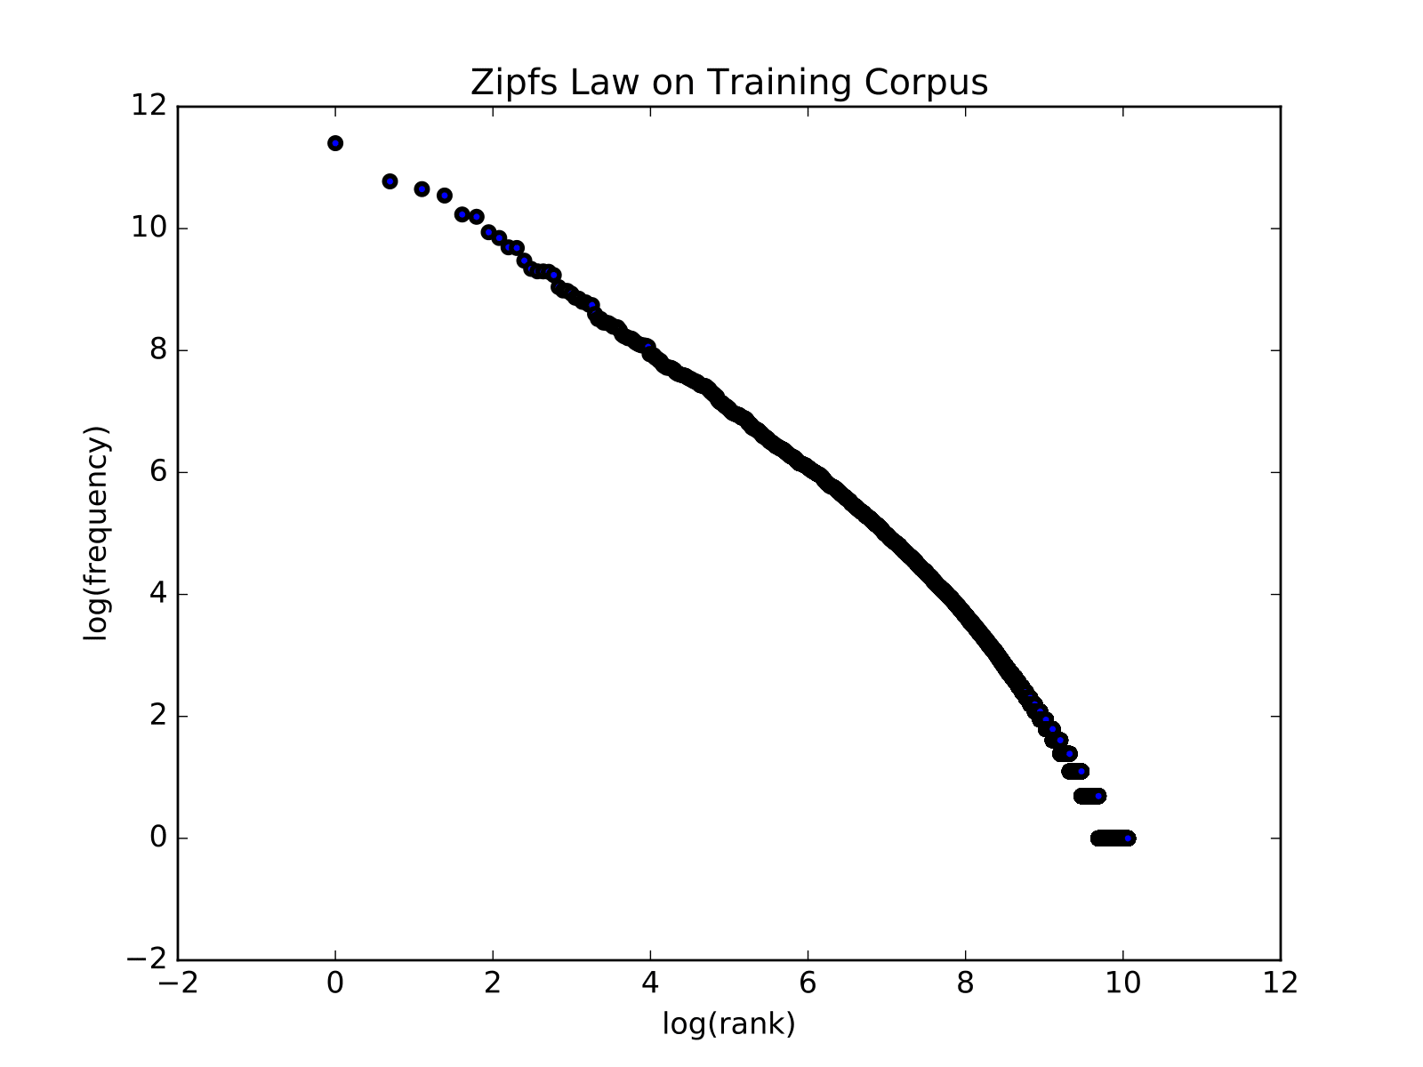
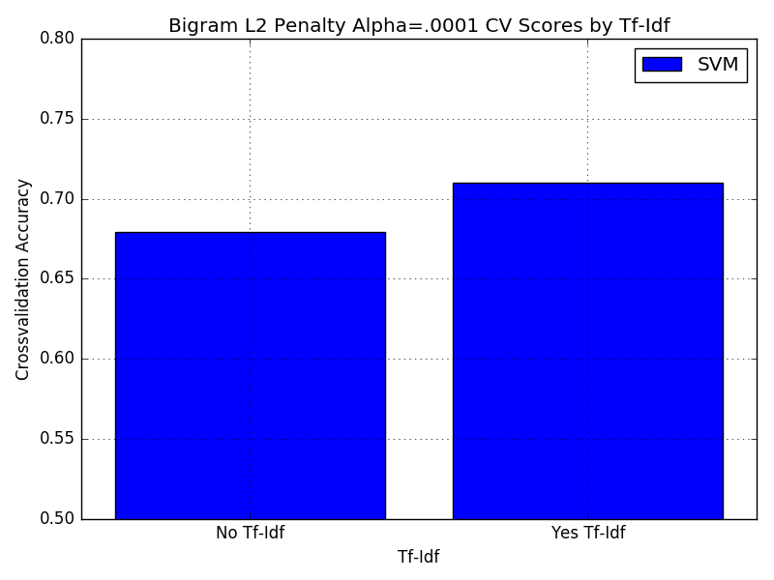
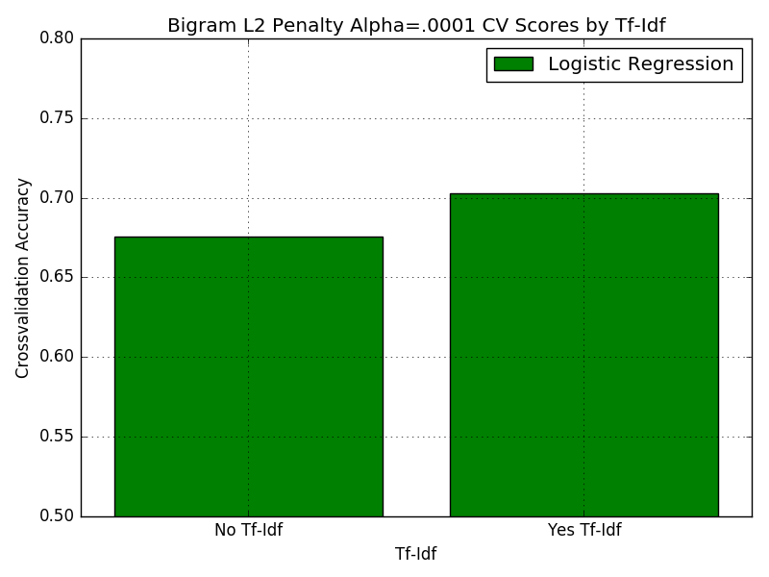
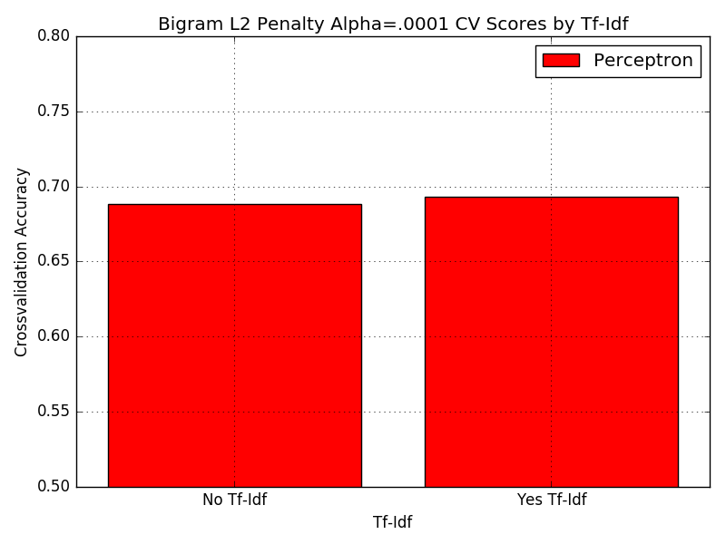
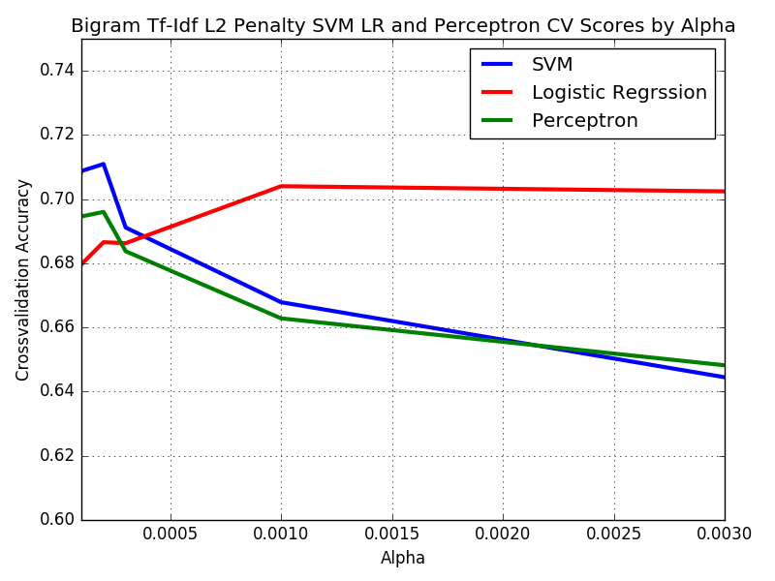
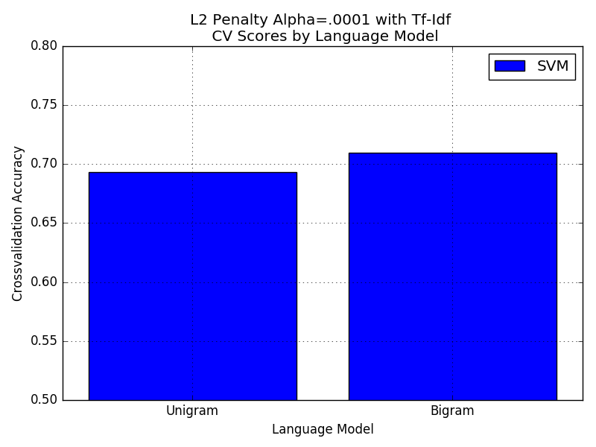
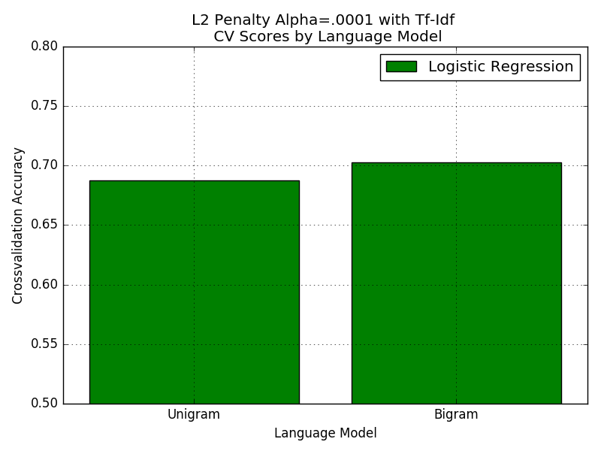
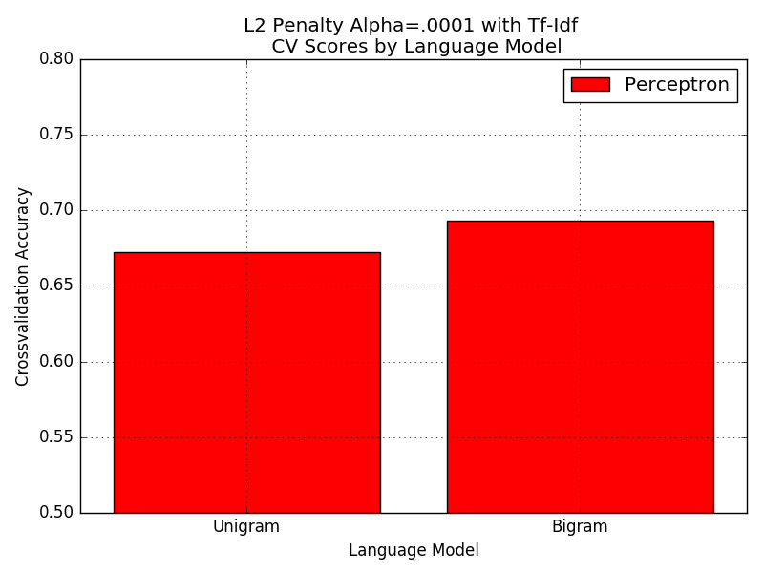
Predicting Party Affiliation from Political Speech
Raymond Zhu Patrick Carron
Goals
Data
Determine party affiliation based off Congressional speeches based on unique terms used by each group or differences in frequency of term use.
Find a way to parse the filename and create a sparse vector representation.
Compare classification algorithm and find optimal hyper-parameters.
Congressional Speech data set by Lillian Lee from Cornell.
Training set is 5660 documents, with 1.3 million tokens.
Single terms found:
herzog
surfrider
hamburglar
blazed
Death Tax!
Estate Tax!
Models
We used Multinomial NB and Stochastic Gradient
Descent.
We looked at the smoothing parameters for Multinomial
NB. We picked Multinomial NB because there was a
chance the features were independent.
Stochastic Gradient Descent:
Loss Functions Considered:
Hinge,Logistic, Perceptron
Regularization Penalties Considered:
L1, L2, None.
Range of Alphas Searched.
Used 3-fold cross validation In order to find optimal hyper-parameters.
Results
Highest test accuracy was 74.9% using Stochastic Gradient Descent with Hinge loss with a L2 penalty, Bigram LM, Tf-Idf, and Alpha=.0002.
Highest NB accuracy was 70.6% accuracy. Alpha of 0.05.
Our accuracy of predicting party affiliation beat their accuracy by 3% of trying to predict voting outcomes for speakers.
Tf-Idf Increased accuracy for all classifiers.
Cross Validation accuracy for Hinge loss with Bigram LM and Tf-Idf at Alpha=.0002
Bigram LM improved accuracy for all classifiers compared to Unigram LM

