Slide 1
The
Gilbert-Johnson-Keerthi (GJK)
Algorithm
Christer Ericson
Sony Computer Entertainment America
christer_ericson@playstation.sony.com

Slide 2
Talk outline
What is the GJK algorithm
Terminology
“Simplified” version of the algorithm
  One object is a point at the origin
  Example illustrating algorithm
The distance subalgorithm
GJK for two objects
  One no longer necessarily a point at the origin
GJK for moving objects

Slide 3



GJK solves proximity queries
Given two convex polyhedra
  Computes distance d
  Can also return closest pair of points P_{A}, P_{B}

Slide 4
GJK solves proximity queries
Generalized for arbitrary convex objects
  As long as they can be described in terms of a support mapping function

Slide 5
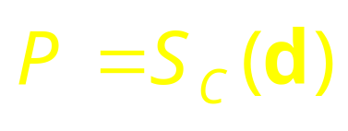


Terminology 1(3)
Supporting (or extreme) point
for direction
returned by support mapping function
Notes:
Supporting points are not necessarily unique. That is, there may be infinitely many supporting points for a given direction. The support mapping function for a convex polyhedron simply returns the vertex most distant in direction d (any one if several equally distant). The support mapping for a sphere C of radius r and center O is given by S_{C}(d) = O + r * ||d||.

Slide 6
Terminology 2(3)
0-simplex
1-simplex
2-simplex
3-simplex
simplex
Notes:
A d-simplex is the convex hull of d+1 affinely independent points in d-dimensional space. A simplex (plural simplices) is a d-simplex, for some given d.

Slide 7
Terminology 3(3)
Point set C
Convex hull, CH(C)
Notes:
The convex hull of a set C of points is here denoted by CH(C).

Slide 8
The GJK algorithm
Initialize the simplex set Q with up to d+1 points from C (in d dimensions)
Compute point P of minimum norm in CH(Q)
If P is the origin, exit; return 0
Reduce Q to the smallest subset Q’ of Q, such that P in CH(Q’)
Let V=S_{C}(–P) be a supporting point in direction –P
If V no more extreme in direction –P than P itself, exit; return ||P||
Add V to Q. Go to step 2
Notes:
“Point of minimum norm” is a snooty way of saying “point closest to the origin”.

Slide 9

GJK example 1(10)
INPUT: Convex polyhedron C given as the convex hull of a set of points
Notes:
The example here uses a convex polyhedron, but the same principle applies to any convex object.

Slide 10




GJK example 2(10)
Initialize the simplex set Q with up to d+1 points from C (in d dimensions)
Notes:
Here we initialize Q with three points simply to reduce the number of steps required for the algorithm to terminate (to keep the example short).

Slide 11

GJK example 3(10)
Compute point P of minimum norm in CH(Q)
Notes:
Exactly how the point of minimum norm in CH(Q) is found is described further ahead.

Slide 12

GJK example 4(10)
If P is the origin, exit; return 0
Reduce Q to the smallest subset Q’ of Q, such that P in CH(Q’)
Notes:
Only Q₁ and Q₂ are needed to express P as a convex combination of points in Q. Q₀ is therefore deleted from Q. A convex combination is a weighted linear combination of the points, all weights being non-negative. (Compare barycentric coordinates.)

Slide 13
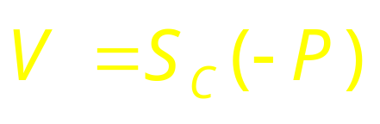
GJK example 5(10)
Let V=S_{C}(–P) be a supporting point in direction –P
Notes:
The indicated yellow point V is the supporting point in direction –P.

Slide 14

GJK example 6(10)
If V no more extreme in direction –P than P itself, exit; return ||P||
Add V to Q. Go to step 2

Slide 15
GJK example 7(10)
Compute point P of minimum norm in CH(Q)

Slide 16

GJK example 8(10)
If P is the origin, exit; return 0
Reduce Q to the smallest subset Q’ of Q, such that P in CH(Q’)

Slide 17

GJK example 9(10)
Let V=S_{C}(–P) be a supporting point in direction –P
Notes:
Here there are infinitely many supporting points in direction –P. We arbitrarily picked Q₂.

Slide 18

GJK example 10(10)
If V no more extreme in direction –P than P itself, exit; return ||P||
DONE!
Notes:
Q₂ is no more extreme than P in direction –P, so the algorithm terminates. P is the point on C closest to the origin.

Slide 19
Distance subalgorithm 1(2)
Approach #1: Solve algebraically
  Used in original GJK paper
  Johnson’s distance subalgorithm
    Searches all simplex subsets
    Solves system of linear equations for each subset
    Recursive formulation
    From era when math operations were expensive
    Robustness problems
  See e.g. Gino van den Bergen’s book

Slide 20
Distance subalgorithm 2(2)
Approach #2: Solve geometrically
  Mathematically equivalent
    But more intuitive
    Therefore easier to make robust
  Use straightforward primitives:
    ClosestPointOnEdgeToPoint()
    ClosestPointOnTriangleToPoint()
    ClosestPointOnTetrahedronToPoint()
  Second function outlined here
    The approach generalizes

Slide 21




Closest point on triangle
ClosestPointOnTriangleToPoint()
  Finds point on triangle closest to a given point

Slide 22

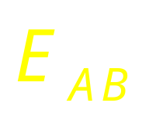
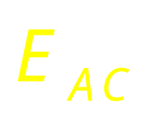

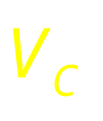

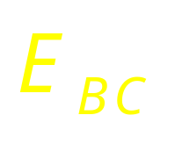
Closest point on triangle
Separate cases based on which feature Voronoi region point lies in
Notes:
A triangle has 7 feature Vornoi regions: 3 vertex regions, 3 edge regions, and 1 face region.

Slide 23
Closest point on triangle
Notes:
If the point lies in a vertex region, the closest point on the triangle is that vertex. The vertex regions are all tested in a similar manner.

Slide 24
Closest point on triangle
Notes:
If the point lies in an edge region, the closest point on the triangle is the orthogonal projection of the point onto the edge. If neither vertex nor edge regions contain the point, the closest point must lie inside the triangle (in the face region).

Slide 25
GJK for two objects
What about two polyhedra, A and B?
Reduce problem into the one solved
  No change to the algorithm!
  Relies on the properties of the Minkowski difference of A and B
Not enough time to go into full detail
  Just a brief description

Slide 26
Minkowski sum & difference
Minkowski sum
  The sweeping of one convex object with another
Defined as:

Slide 27
Minkowski sum & difference
Minkowski difference, defined as:
Can write distance between two objects as:
A and B intersecting iff A–B contains the origin!
  Distance between A and B given by point of minimum norm in A–B!

Slide 28
The generalization
A and B intersecting iff A–B contains the origin!
  Distance between A and B given by point of minimum norm in A–B!
So use previous procedure on A–B!
Only change needed: computing
Support mapping separable, so can form it by computing support mapping for A and B separately!

Slide 29

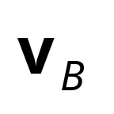
GJK for moving objects
Notes:
With minimal changes GJK can be applied to detect collisions between objects undergoing uniform linear (translational) motion.

Slide 30
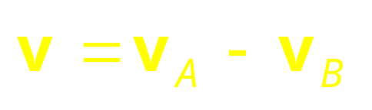
Transform the problem…
Notes:
The first step is to transform the problem from two moving objects into a problem of one moving and one stationary object.This transformation is done by subtracting V_{B} off the movement of both objects, rendering object B stationary.

Slide 31

…into moving vs stationary

Slide 32

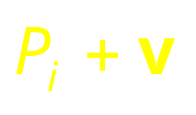
Alt #1: Point duplication
Let object A additionally include the points
…effectively forming the convex hull of the swept volume of A
Notes:
To see if A during its motion intersects with B we form the swept volume of A and intersect it against B. One approach to forming the swept volume is to include the points P_{i}+v in A (in addition to its original points P_{i}). A drawback with this approach is that doubling the points of A creates more work in finding supporting points.

Slide 33
Alt #2: Support mapping
Modify support mapping to consider only points
when
Notes:
A better approach is to modify the support mapping function to search for a supporting point amongst either P_{i} or P_{i}+v depending on the sign of Dot(d, v).

Slide 34
Alt #2: Support mapping
…and to consider only points
when

Slide 35
GJK for moving objects
Presented solution
  Gives only Boolean interference detection result
Interval halving over v gives time of collision
  Using simplices from previous iteration to start next iteration speeds up processing drastically
Overall, always starting with the simplices from the previous iteration makes GJK…
  Incremental
  Very fast
Notes:
The described solution only gives a Boolean interference detection result. That is, it only specifies if the objects intersect during motion, not where. Determining the time of collision can be done by applying an interval halving approach to the motion vector v. This is fast, since the simplices from the previous iteration are an excellent starting point for the next iteration.

Slide 36
References
Ericson, Christer. Real-time collision detection. Morgan Kaufmann, 2005. http://www.realtimecollisiondetection.net/
van den Bergen, Gino. Collision detection in interactive 3D environments. Morgan Kaufmann, 2003.
Gilbert, Elmer. Daniel Johnson, S. Sathiya Keerthi. “A fast procedure for computing the distance between complex objects in three dimensional space.” IEEE Journal of Robotics and Automation, vol.4, no. 2, pp. 193-203, 1988.
Gilbert, Elmer. Chek-Peng Foo. “Computing the Distance Between General Convex Objects in Three-Dimensional Space.” Proceedings IEEE International Conference on Robotics and Automation, pp. 53-61, 1990.
Xavier Patrick. “Fast swept-volume distance for robust collision detection.” Proc of the 1997 IEEE International Conference on Robotics and Automation, April 1997, Albuquerque, New Mexico, USA.
Ruspini, Diego. gilbert.c, a C version of the original Fortran implementation of the GJK algorithm. ftp://labrea.stanford.edu/cs/robotics/sean/distance/gilbert.c

