Slide 1
NASTE CALCIFICATION
2023

Slide 2
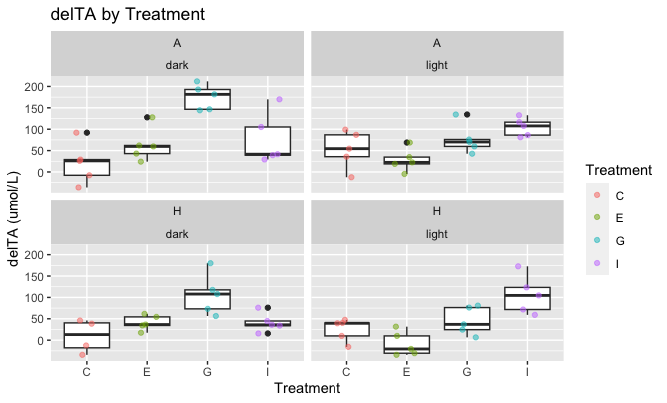
All Data

Slide 3
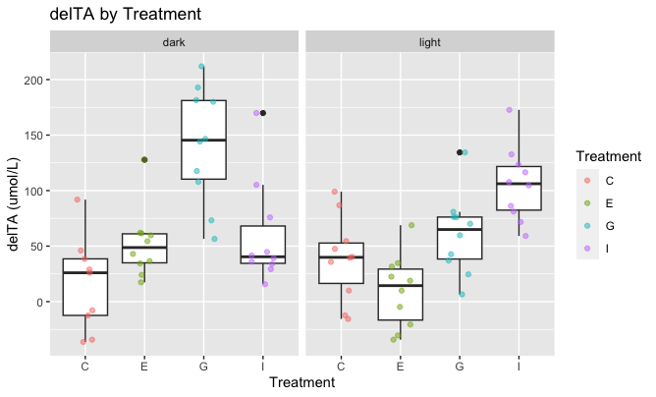
All Data combining A&H

Slide 4
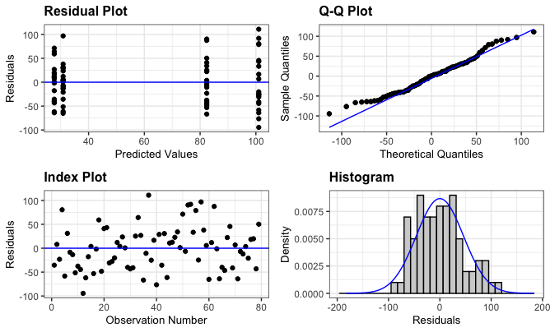
ANOVA Just Treatment
Anova Table (Type II tests)
Response: delTA
Sum Sq Df F value Pr(>F)
Treatment 80402 3 12.199 1.382e-06 ***
Residuals 164768 75
---

Slide 5
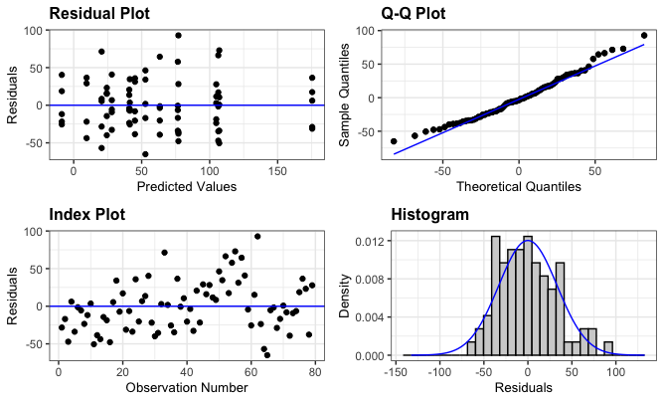
ANOVA – Including temp and light
Anova Table (Type II tests)
Response: delTA
Sum Sq Df F value Pr(>F)
Treatment 81047 3 19.8254 3.651e-09 ***
Temp 17004 1 12.4780 0.0007768 ***
light.dark 3657 1 2.6838 0.1063576
Treatment:Temp 3235 3 0.7913 0.5032721
Treatment:light.dark 51307 3 12.5504 1.565e-06 ***
Temp:light.dark 599 1 0.4394 0.5098331
Treatment:Temp:light.dark 3441 3 0.8418 0.4760915
Residuals 85849 63
---

Slide 6
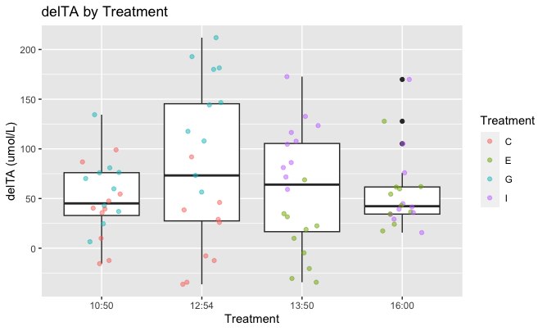
Slightly higher calcification rates in the middle of the day

Slide 7
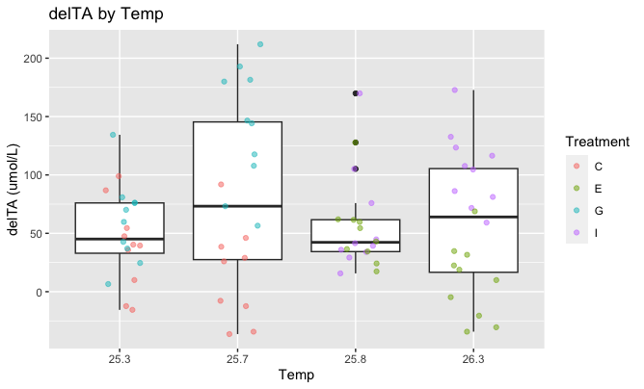
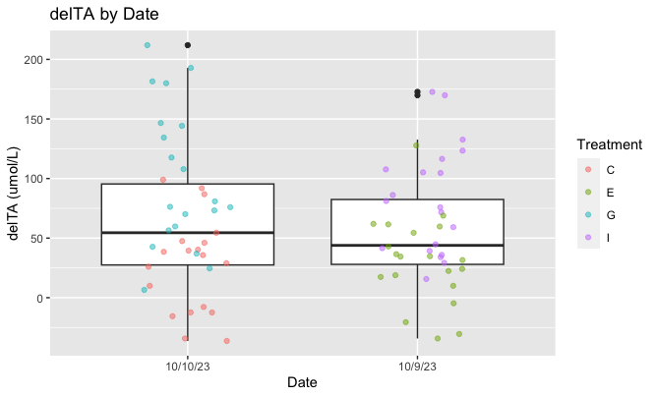
Also no effect of these

Slide 8
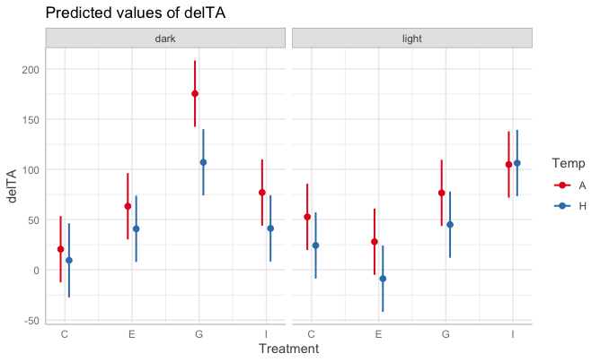
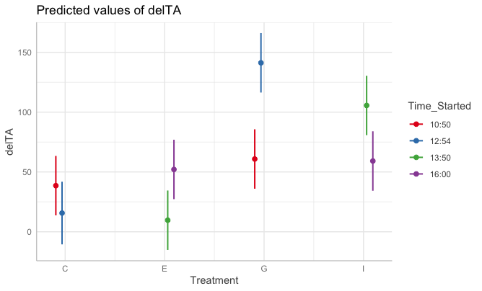
Effects

