Slide 1
NGS pipline

Slide 2
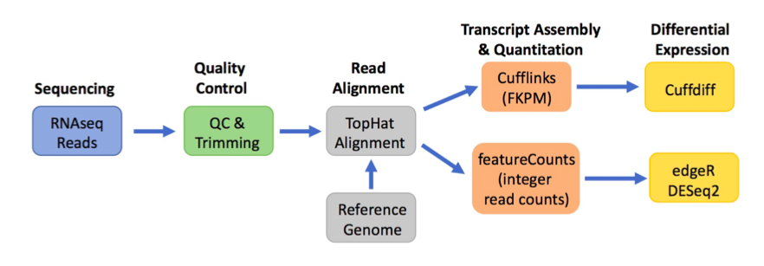
Overview

Slide 3
Sequencing: generation of the files with the short sequence reads
Quality control: assessment of read quality and removal of poor quality and adaptor sequences at ends of reads
Read alignment: Mapping of reads to a reference genome
Transcript assembly & quantitation: assignment of reads to transcripts and/or genes; quantitation of reads for each transcript/gene
Differential expression: comparison of transcript/gene quantities in two different conditions

Slide 4
The so-called “Tuxedo Package”

Slide 5
Getting started
adrenal2.fastq(RNAseq/DNAseq reads) +adrenal_assembled_transcripts.gtf (refrence genome)
adrenal_alignment.sam (or BAM alignment file)
adrenal_alignment.bai (index file)
adrenal_splice_junctions.bed (describing splice junction)
adrenal_gene_expression.tabular
adrenal_featureCounts.txt

Slide 6
FastQ
human readable text-based files that contain the short reads output by the sequencer

Slide 7
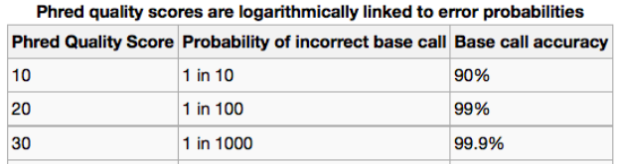

FastQ
Phred quality scores: Pr(base call error)
Q+33=ASCII base

Slide 8
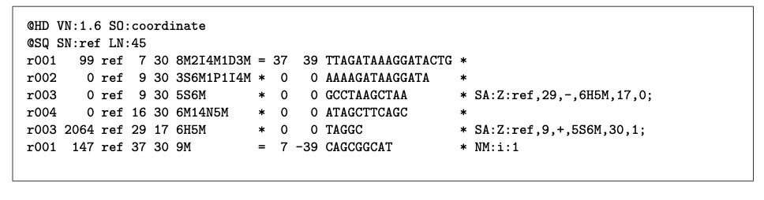
SAM/BAM
Standard format for compactly representing alignment data
Some of the key information in the alignment portion of a SAM file: Column 1: Name of read Column 3: Name of reference sequence where the read aligned Column 4: Leftmost position in the reference sequence that aligns to the read Column 7: Name of reference sequence where the mate (if paired end) or next read aligns

Slide 9
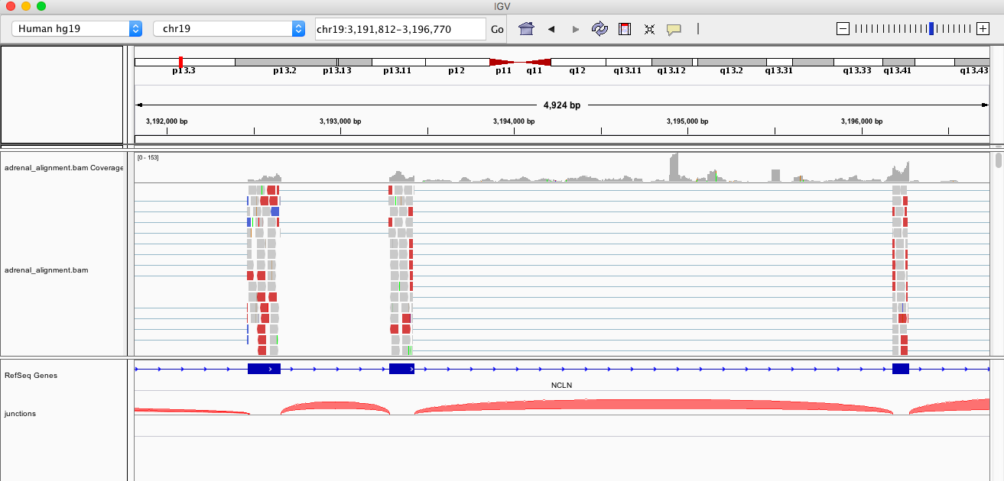
View in IGV

Slide 10
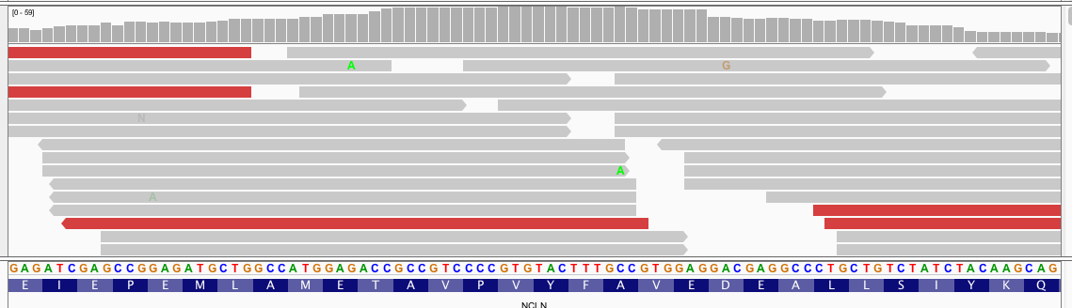
View in IGV

Slide 11
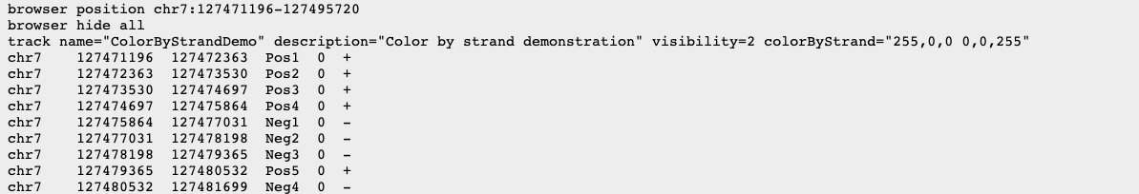
BED
Track annotation (Genome Browser )

Slide 12
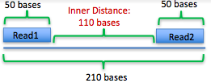
Read Alignment
Tophat: splice aware mapper
Need to specify inner distance b/w paired end reads
SAM file: alignment/human readable
BAM file: alignment/machine only
Index file:
To view BAM in IGV
BED file: splice junction & insertion and deletion

Slide 13
Transcript Assembly & Quantitation
Cufflink
assemble the aligned reads into transcripts and quantitate transcript levels
output files including
assembled transcripts file (gtf format) →lists the coordinates of each transcript and its component exons
transcript expression file → gives the normalized expression level of each transcript in FPKM
gene expression file that gives → normalized expression level of each gene (sum of all transcripts for that gene) in FPKM

Slide 14
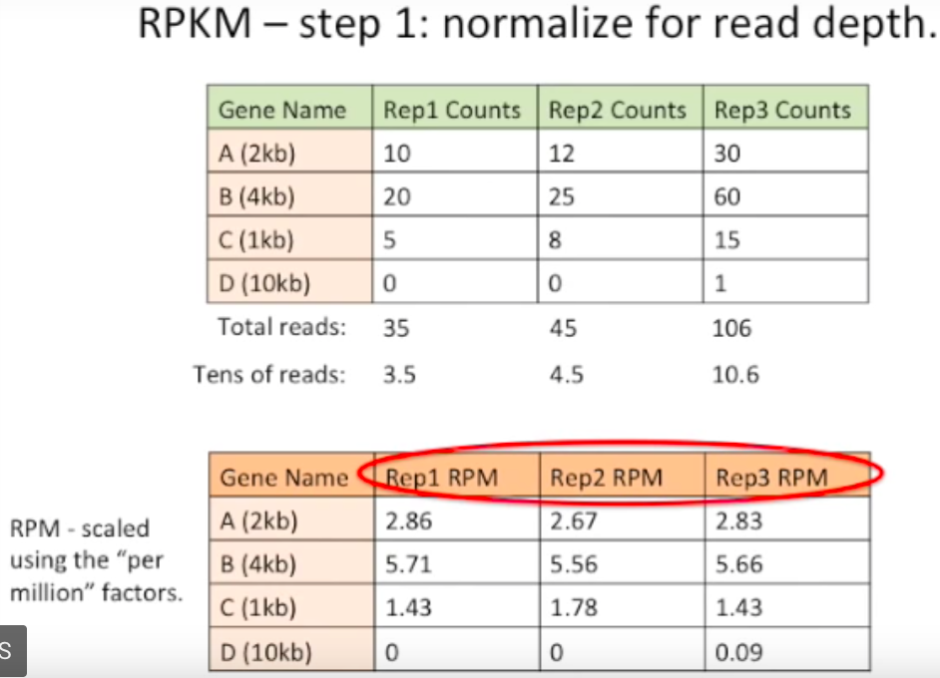
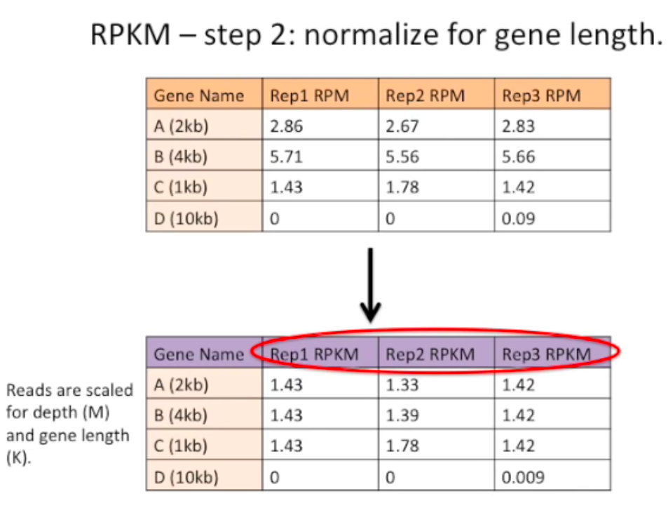
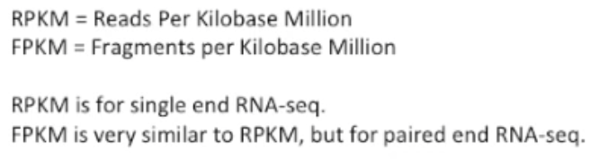
FPKM: fragments per kilobase of exon per million reads mapped
https://www.rna-seqblog.com/rpkm-fpkm-and-tpm-clearly-explained/

Slide 15
Transcript Assembly & Quantitation
FeatureCount: raw integer read counts
assemble the aligned reads into transcripts and quantitate transcript levels
output files including
3-column file → gene name, number of reads mapped to that gene, length of the gene.

Slide 16
Differential Expression

