Slide 1
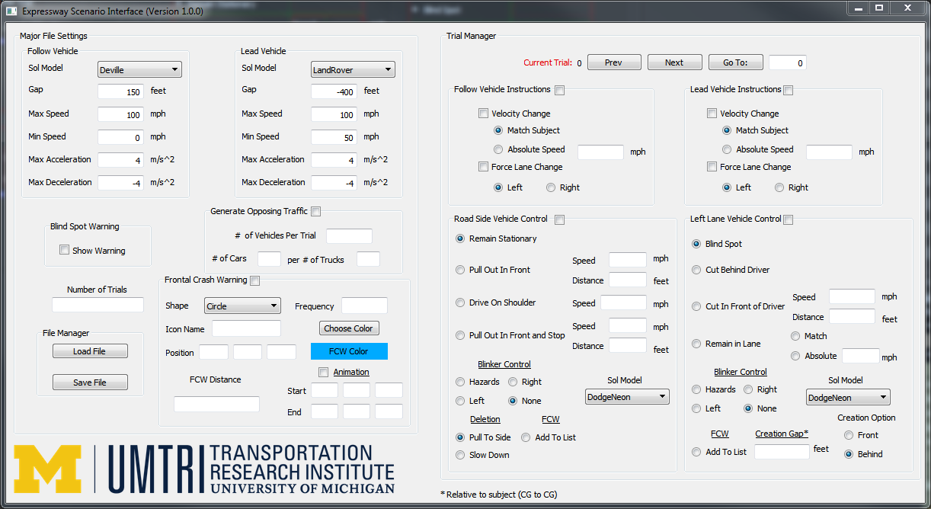


Slide 2
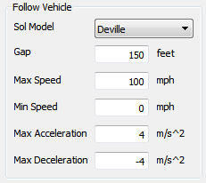
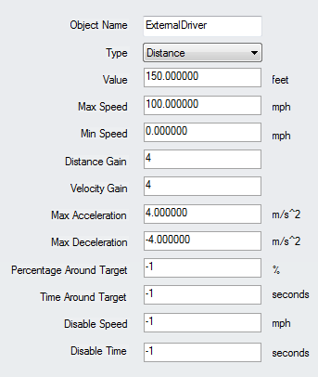

Slide 3
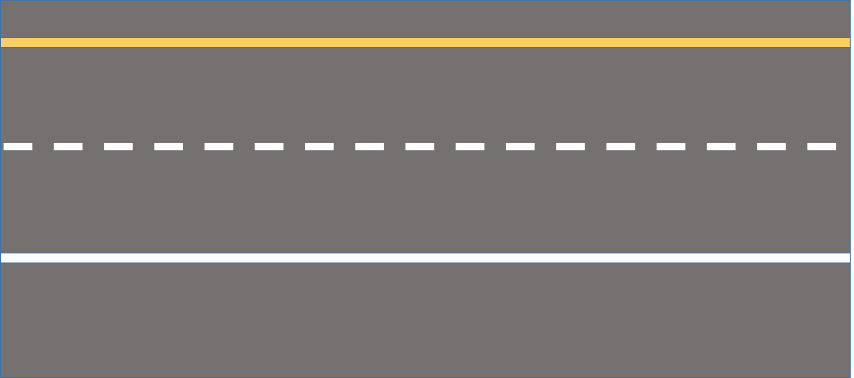
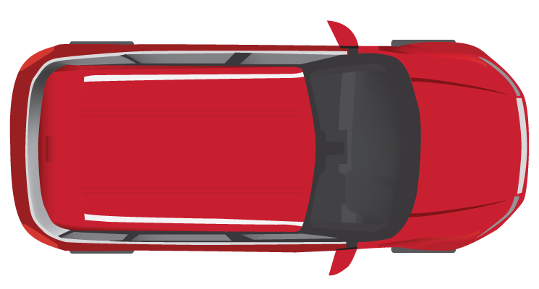

Slide 4
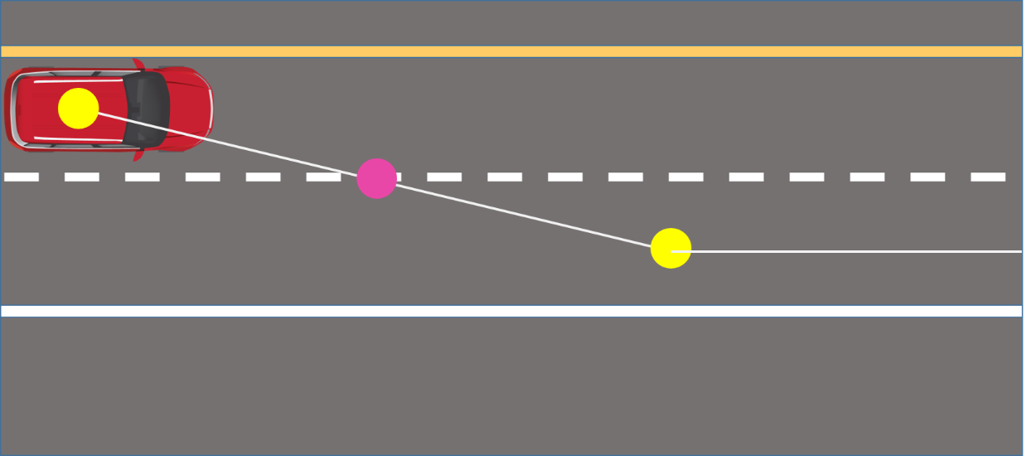
Half a Trial
FCWInRange Set to “1”
FCWInRange Set to “0”

Slide 5
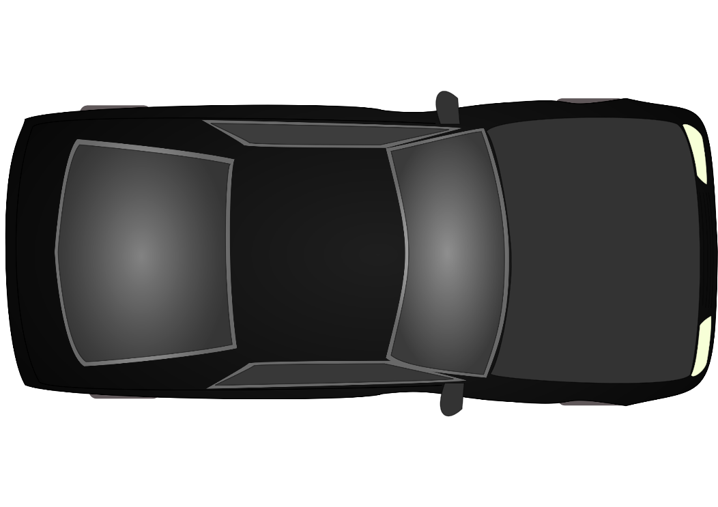
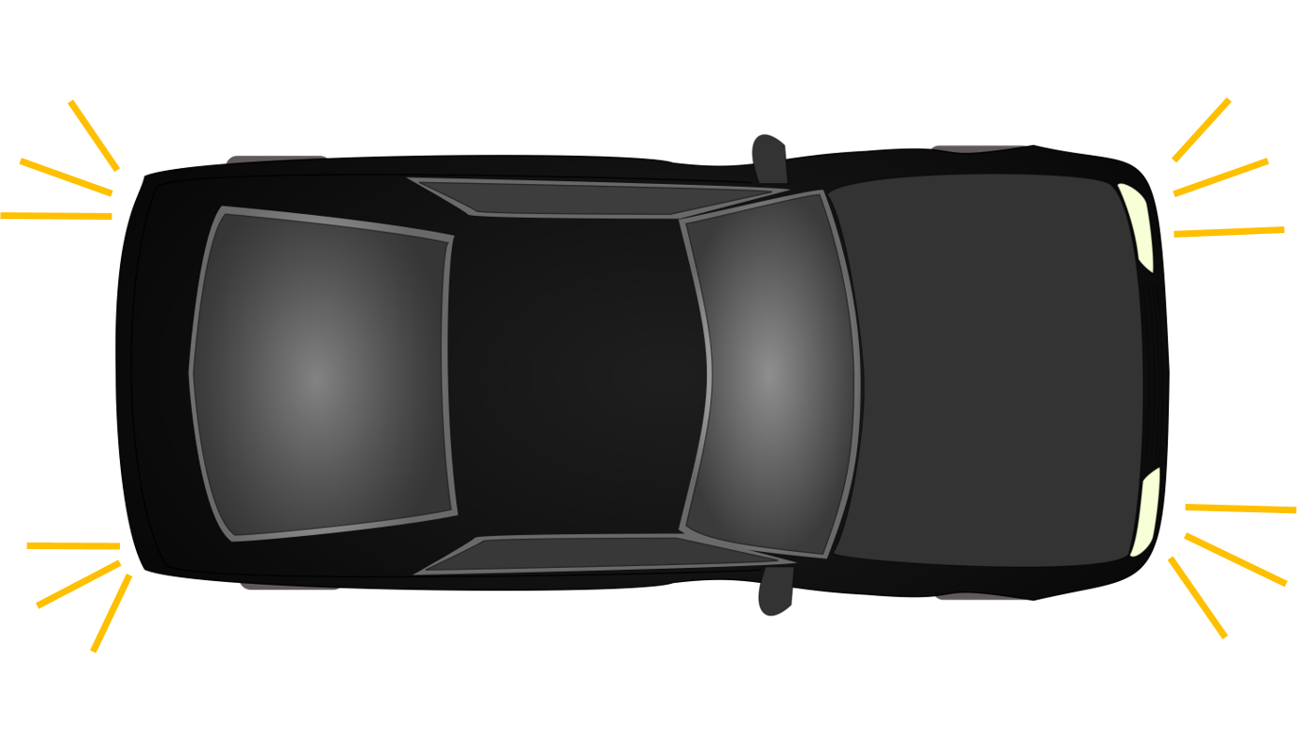
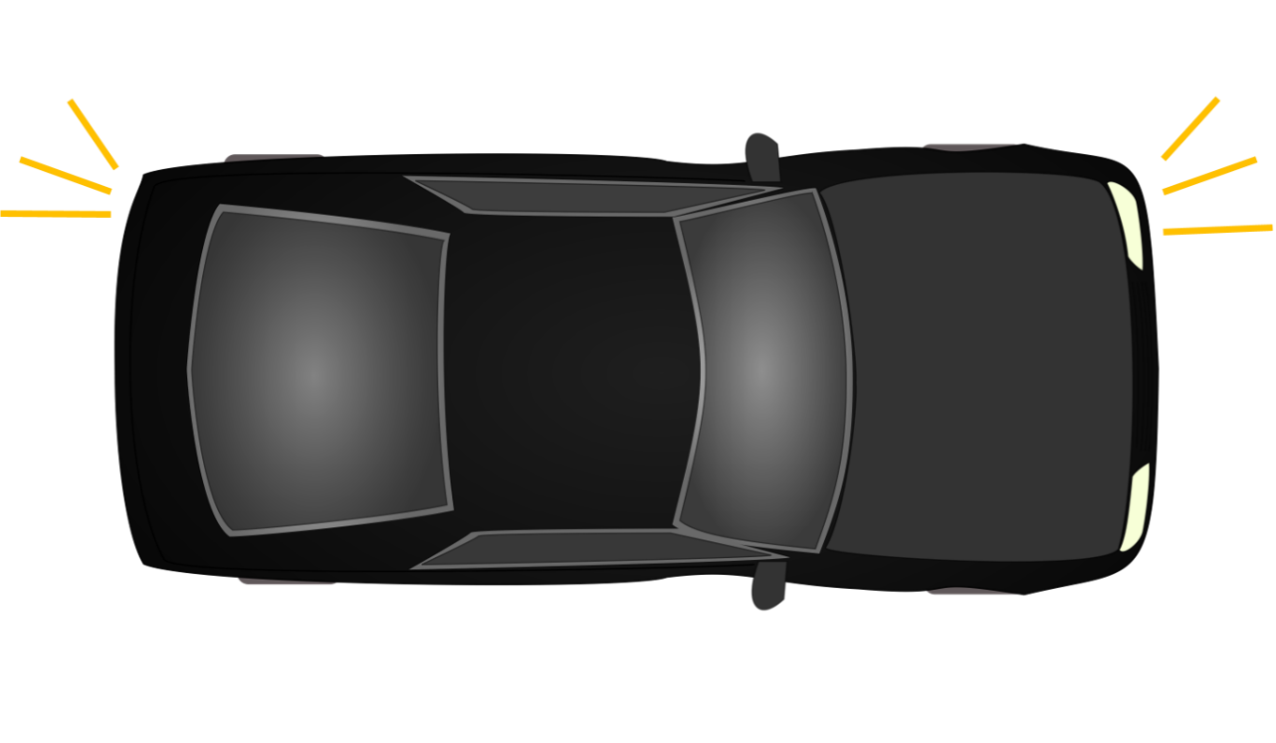
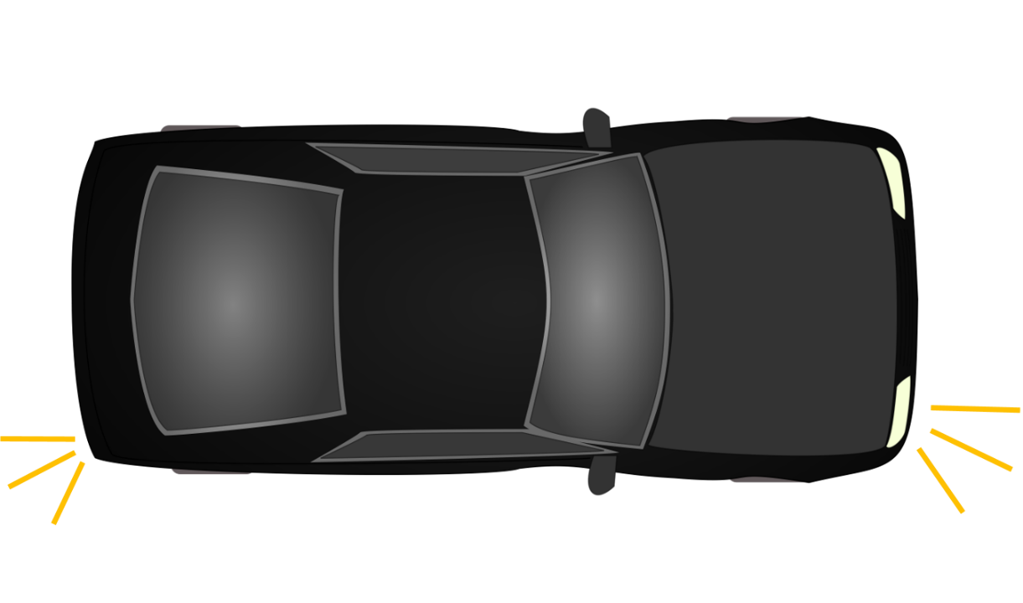
None
Hazards
Left
Right

Slide 6
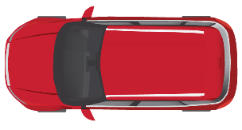
Legend
Target Location
Target Location point
given speed * 0.75
given speed * 0.85
given speed
remaining trial / 10
remaining trial / 10
given distance

Slide 7
Legend
Target Location
Target Location point
stop here
given distance

