Slide 1
Visualizations of the NBA
Ray Ogunjimi and Claude Baluh

Slide 2
NBA Data
Looking at the original data visualizations
There was a total of 10 plots, but we chose 3 to recreate and 1 to discuss further for potential fixes
Looking at Vishnu Bharadwaj’s original work we can see 10 plots comprised of different info
Original Data Visualizations

Slide 3
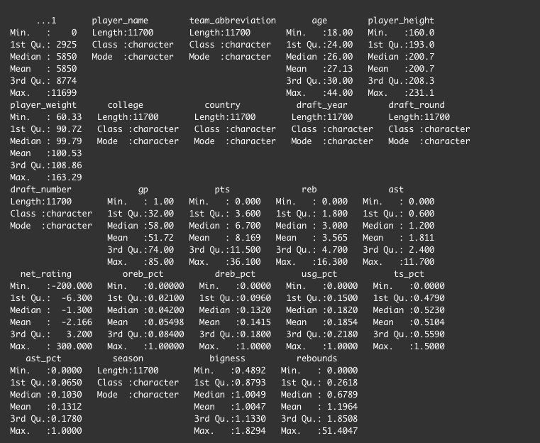
NBA Data
Finding the data was easy since it was provided through the article
Importing the data showed us the hefty amount we were working with
Knew that for each visualization it would only require parts of the data
The data spans from the 1996-97 season all the way to 2019-20 season

Slide 4
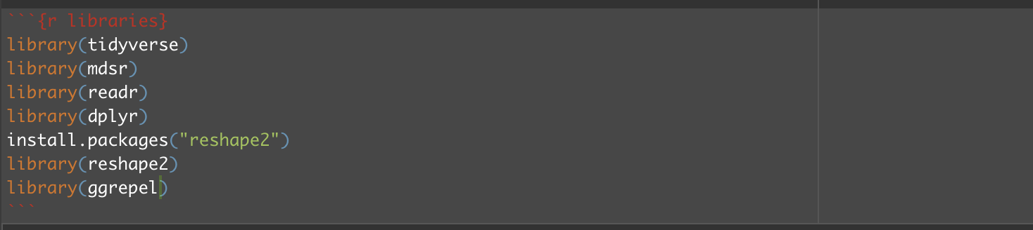
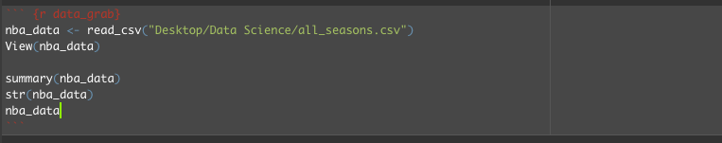
Reading in Our Data and Taking First Look

Slide 5
Looking at the 3 plots we wanted to recreate
Starting with…

Slide 6
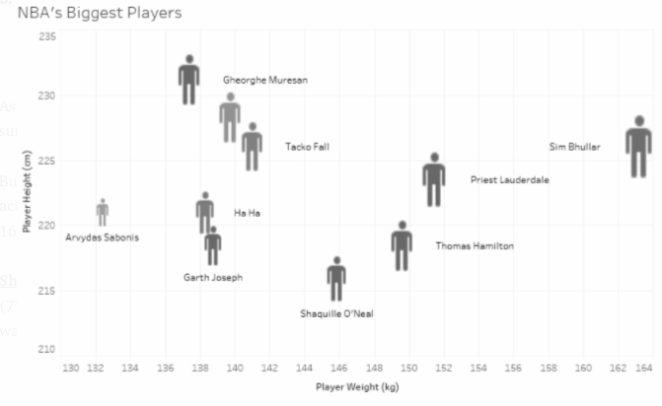
NBA’s Biggest Players

Slide 7
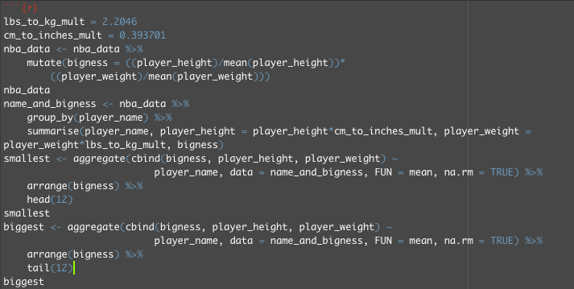
How to get there

Slide 8
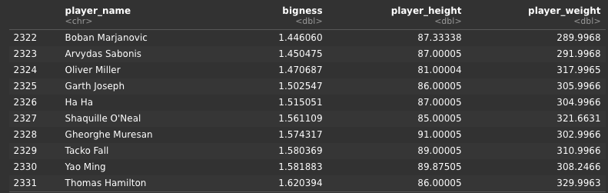
How to get there

Slide 9
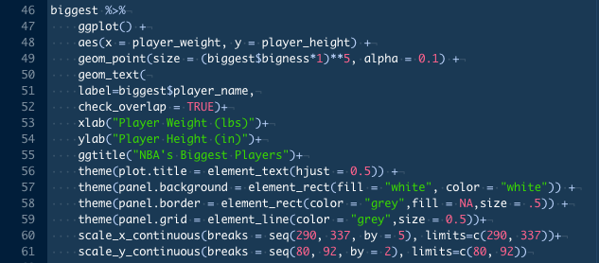
Putting it into a ggplot

Slide 10
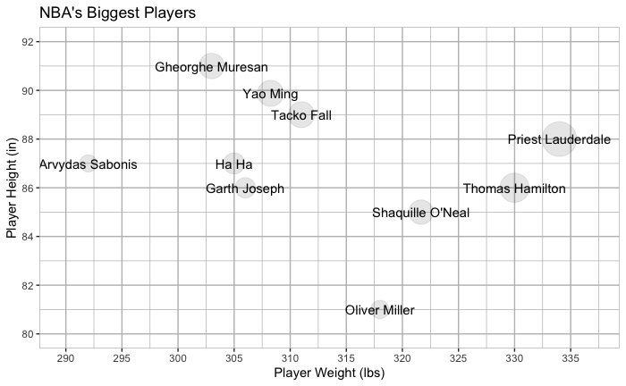
What We Created
01
Biggest Players in the NBA

Slide 11
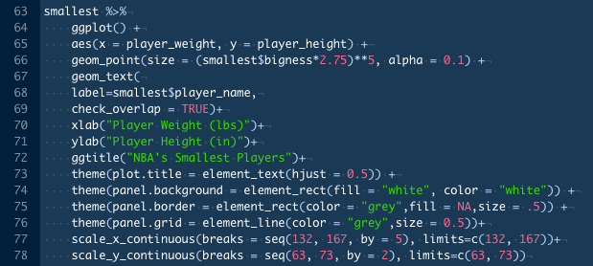
…Extra
01
Biggest Players in the NBA to Now the Smallest

Slide 12
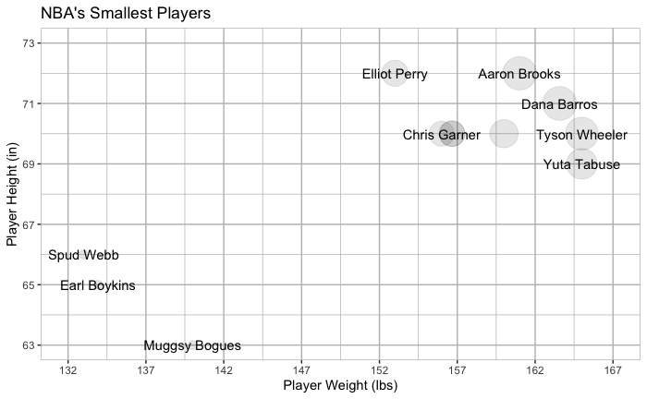
Smallest Plot

Slide 13
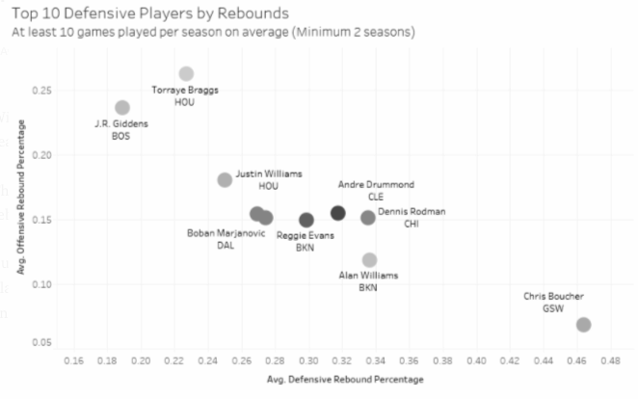
Next, Top 10 Defensive Players

Slide 14
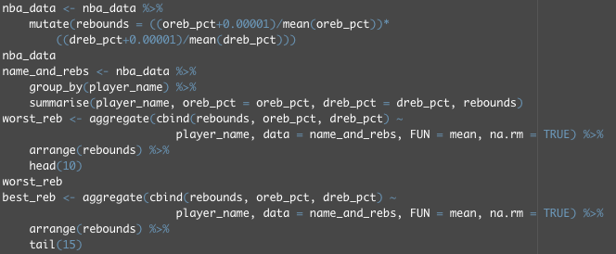
How to get there

Slide 15
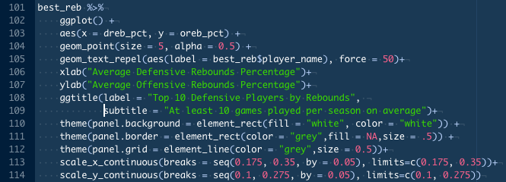
How to get there

Slide 16
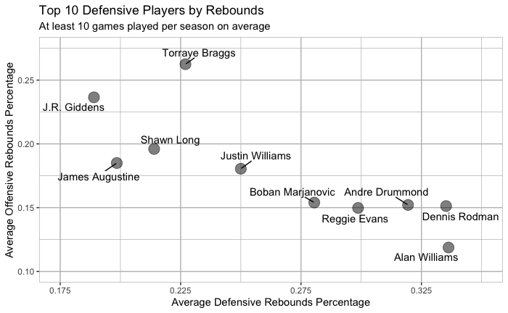
02
Best Rebounders in the NBA

Slide 17
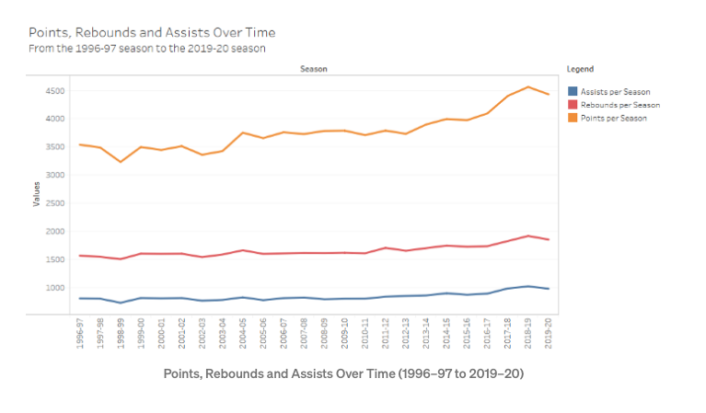
03
Finally, Points, Assists and Rebounds over Time in the NBA

Slide 18

How to get there
03
Points, Assists and Rebounds over Time in the NBA
We only needed the rebounds, points, assists, and the season data

Slide 19
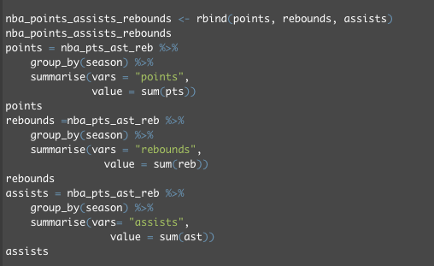
How to get there
03
Points, Assists and Rebounds over Time in the NBA
However, we needed it to be group by season and not have just individual points, but a sum of them over the season
We needed them bound together as well for the graph in the future
But kept separate for the individual lines on the graph

Slide 20
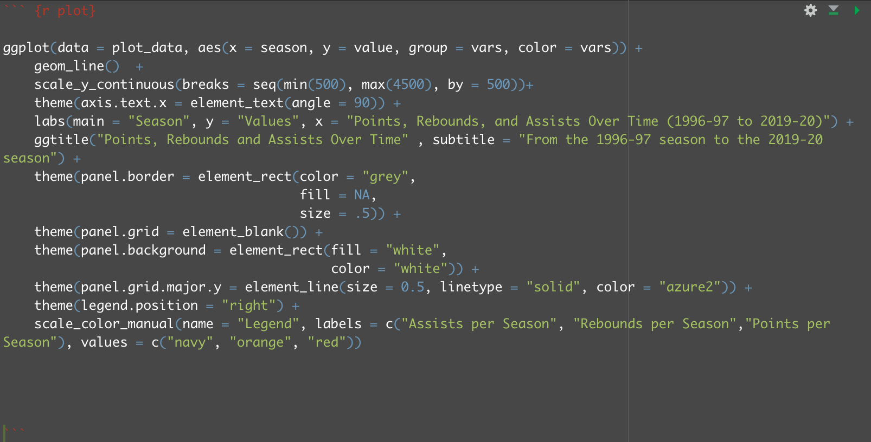
GGplot

Slide 21
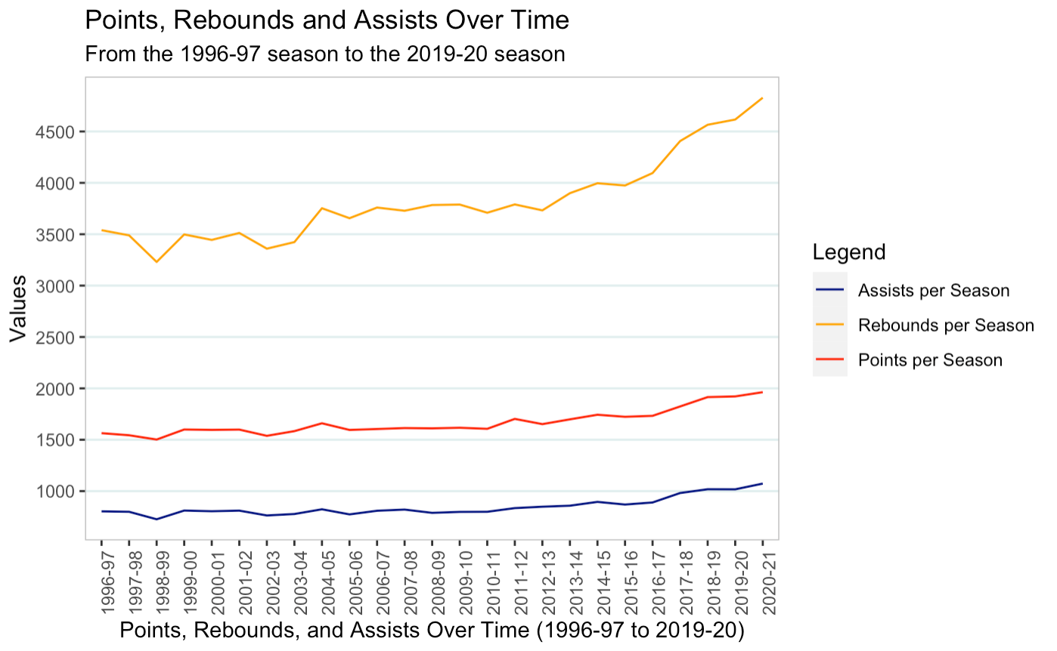
Points, Rebounds, and Assists over Time
03

Slide 22
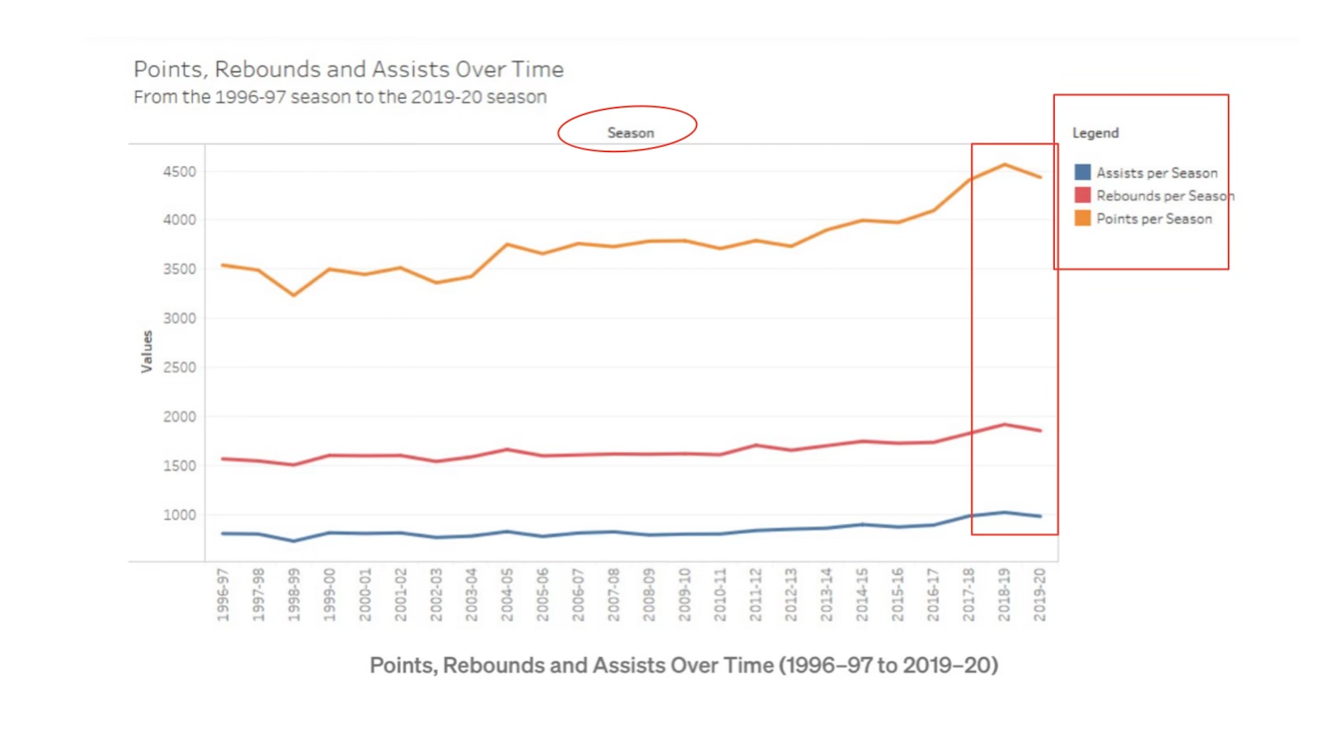
What could be improved

Slide 23
Conclusion
Overall, the created data visualizations may not replicate exactly published images, but the information they convey is very similar
Some of the steps taken to create the visualizations (such as ranking the players’ sizes) is hidden and had to be reproduced
Some information (such as units) needed to be changed in order to better represent the important aspects of the chart
The data required narrowing to focus on what we actually needed for each plot so that it was manageable
We also manipulated some data so that it was in more relatable terms (kg to lbs, cm to inches)

Slide 24
Conclusion
Overall, 1 showed us the distribution of the heights and weights of the biggest (and smallest) players
2 showed us the distribution of the best rebounders with respect to average offensive and average defensive rebounds
Finally, 3 showed us the sum of the points, rebounds, and assists for each season across the 25 seasons. It showed a slight increase in assists, and points and a larger increase in rebounds over all seasons.

