Slide 1
Saga Pattern Choreography Orchestration
UNIQUE
SOWJANYA MORISETTY
YASHWANTH RAVULA
RAYONA MATHEW

Slide 2
Saga Pattern
CONTENTS:
Introduction
Why We Need Saga Pattern
What is Saga Execution Controller
Pros and Cons of Saga Pattern
Choreography
Orchestration

Slide 3
Introduction to Saga Pattern
The Saga architecture pattern provides transaction management using a sequence of local transactions.
A local transaction is the unit of work performed by a Saga participant. Every operation that is part of the Saga can be rolled back by a compensating transaction. Further, the Saga pattern guarantees that either all operations complete successfully or the corresponding compensation transactions are run to undo the work previously completed.
In the Saga pattern, a compensating transaction must be idempotent and retry able. These two principles ensure that we can manage transactions without any manual intervention.
The Saga Execution Coordinator (SEC) guarantees these principles:

Slide 4
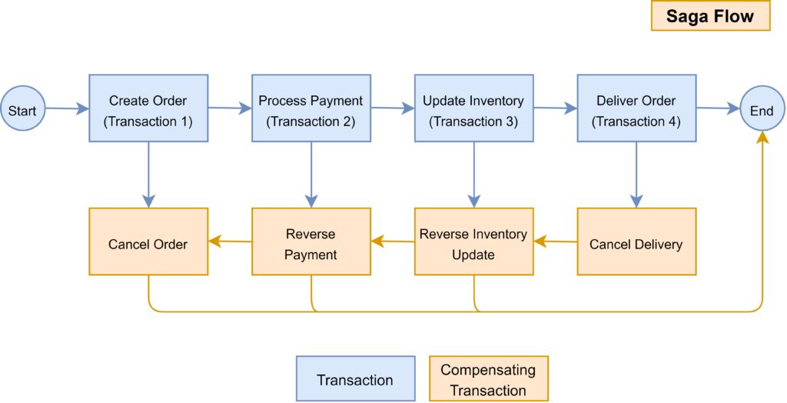

Slide 5
The above diagram shows how to visualize the Saga pattern for the online order processing scenario we discussed earlier.
The Saga pattern manages transactions that span across multiple Microservices using a sequence of local transactions. The following diagram contains the rollback events in red color, which is a part of the SAGA workflow.
These events are triggered by the Saga Execution Controller in case of a failure happens to ensure the system’s stability.
Example :

Slide 6
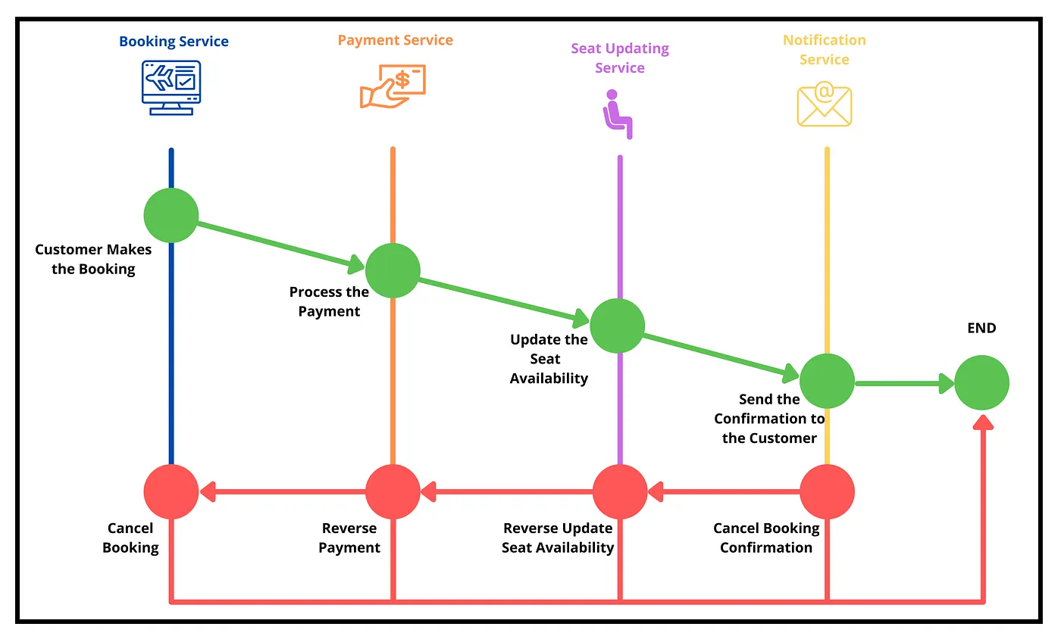

Slide 7
Why We Need Saga Pattern?
The Microservice architecture allows us to maintain applications services and their databases separately. However, with the complexity of modern-day requirements, it is common to have data changes that need to propagate across multiple services.
For example, let’s consider a simple online booking ticket system built with Microservices. There are separate Microservices for;
Ticket booking.
Payment processing.
Updating available seats.
Sending confirmations to customers.

Slide 8
Suppose a customer makes a booking. It requires invoking several Microservices in sequence to complete the flow starting from booking, payment, reserve seats, and send confirmation. But, what happens if any of these steps fail? We somehow need to roll back any previous steps to maintain data integrity

Slide 9
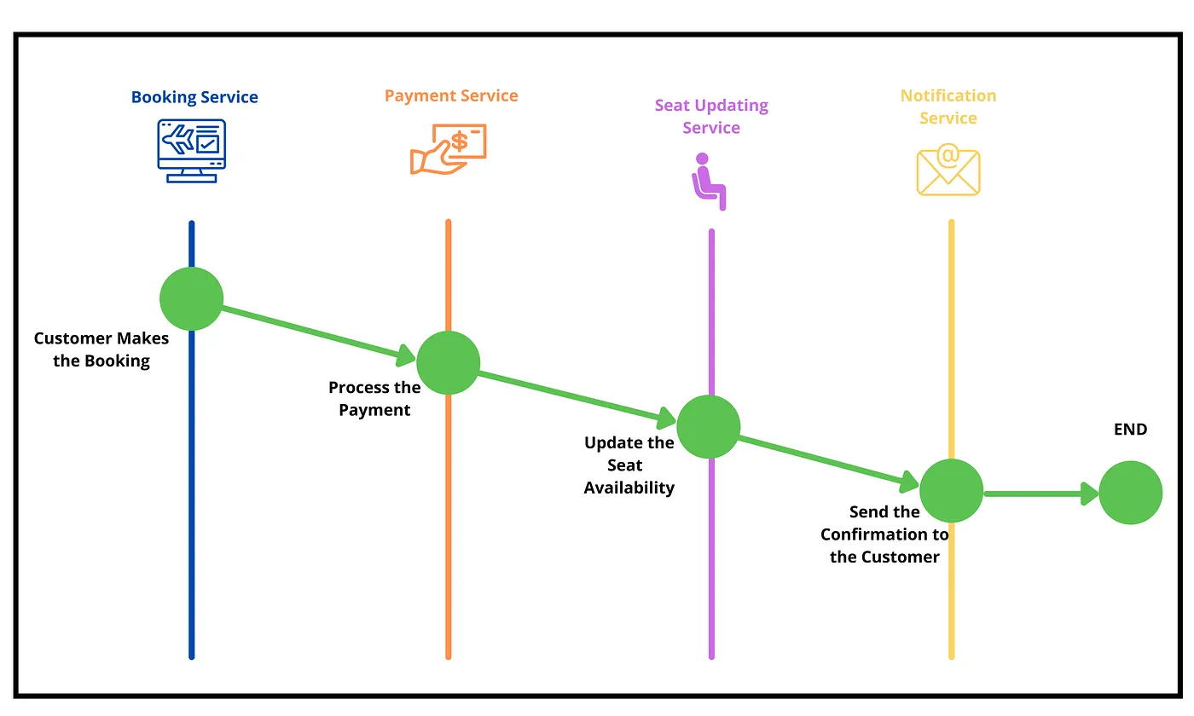

Slide 10
What is Saga Execution Controller?
Saga execution controller (SEC) is the centralized component that controls the local transactions and rollback events.
It tracks all the events of distributed transactions as a sequence and decides the rollback events in case of a failure.
Also, the SEC makes sure that rollback events do not have any additional effect other than reversing the local transactions.
I think now you have a high-level understanding of what the Saga pattern is and how it works. To get a better understanding, let’s see how we can implement it.
Note: SEC internally uses a log named Saga log to keep track of all transactions

Slide 11
Pros and Cons of Saga Pattern
Pros
Makes transaction management in a loosely coupled, message-driven environment possible.
Well-suited to transactions that have a small number of steps (4 -5).
Cons
Can be complex to manage, particularly if a transaction has a large number of steps and the environment is asynchronous.
Requires a good deal of programming, particularly to support rollback in an asynchronous, message-driven environment.

Slide 12
CHOREOGRAPHY
In the Saga Choreography pattern, each microservice that is part of the transaction publishes an event that is processed by the next microservice.
To use this pattern, we need to decide if the microservice will be part of the Saga. Accordingly, the microservice needs to use the appropriate framework to implement Saga.
In this pattern, the Saga Execution Coordinator is either embedded within the microservice or can be a standalone component.
In the Saga, choreography flow is successful if all the microservices complete their local transaction, and none of the microservices reported any failure.

Slide 13
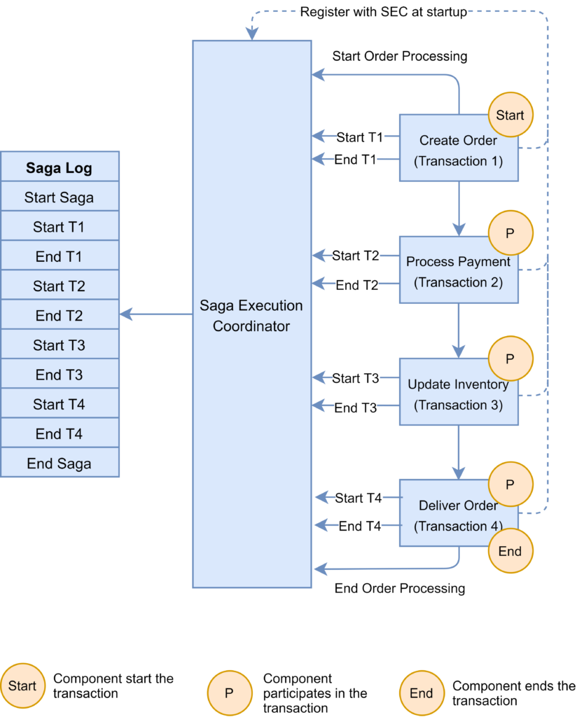

Slide 14
Benefits
Good for simple workflows that require few participants and don't need a coordination logic.
Doesn't require additional service implementation and maintenance.
Doesn't introduce a single point of failure, since the responsibilities are distributed across the saga participants.

Slide 15
Drawbacks
Workflow can become confusing when adding new steps, as it's difficult to track which saga participants listen to which commands.
There's a risk of cyclic dependency between saga participants because they have to consume each other's commands.
Integration testing is difficult because all services must be running to simulate a transaction.

Slide 16
ORCHESTRATION

Slide 17
Orchestration Saga Pattern With Spring Boot
In this pattern, we will have an orchestrator, a separate service, which will be coordinating all the transactions among all the Microservices. If things are fine, it makes the order-request as complete, otherwise marks that as cancelled.
In the Orchestration pattern, a single orchestrator is responsible for managing the overall transaction status.
If any of the microservices encounter a failure, the orchestrator is responsible for invoking the necessary compensating transactions:

Slide 18
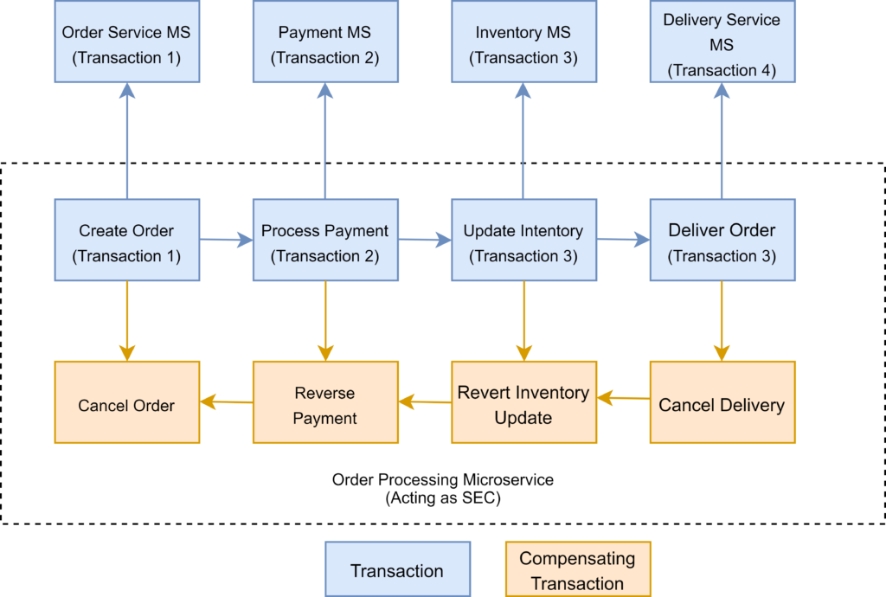

Slide 19
The Saga orchestration pattern is useful for brownfield microservice application development architecture.
In other words, this pattern works when we already have a set of microservices and would like to implement the Saga pattern in the application.
We need to define the appropriate compensating transactions to proceed with this pattern.

Slide 20
Here are a few frameworks available to implement the orchestrator pattern:
Camunda is a Java-based framework that supports Business Process Model and Notation (BPMN) standard for workflow and process automation.
Apache Camel provides the implementation for Saga Enterprise Integration Pattern (EIP)

