Slide 1

Credit Card Data Set Review & Analysis

Slide 2
Objective
Identify the credit limit customer’s can use, based on the customer features & payment history
Make recommendation & solution to reduce the increasing number of default customers

Slide 3
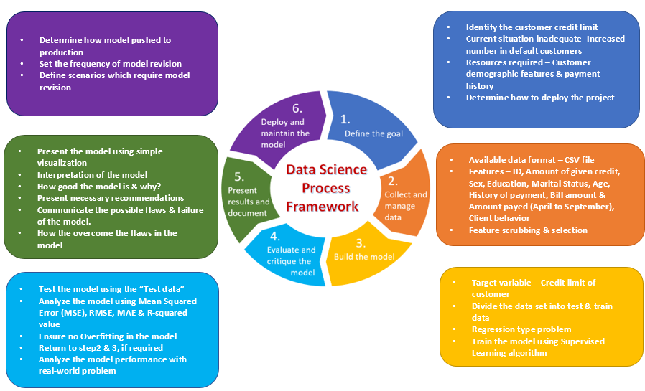
Data Framework

Slide 4
Why this framework?
Identify determinants of behavior.
Inform data collection
Enhance conceptual clarity
Guide implementation planning
Marks each step starting from identifying the goal till the deployment
Each step ensures, the right direction

Slide 5
Data Set
Data Source - default of credit card clients.csv
Description of the features - DataSourceUpdated
The data is available in the csv format

Slide 6

Data Set - Features
ID
LIMIT_BAL
Sex
EDUCATION
MARRIAGE : Marital Status
Amount of given credit(NT dollar)
1 = male
2 = female
1 = graduate school
2 = university
3 = high school
0, 4, 5, 6 = others
1 = married
2 = single
3 = divorce
Age
PAY_0 - PAY_6
History of payment(April to September)
-2: No consumption
-1: Paid in full
0: The use of revolving credit;
1 = payment delay for one month
2 = payment delay for two months
8 = payment delay for eight months
9 = payment delay for nine months and above.
BILL_AMT1 - BILL_AMT6
Bill amount from April to September
PAY_AMT1 - PAY_AMT6
Client behavior
Amount payed in each month
Default
Non-Default
Age in Years
0=others

Slide 7

Potential Issues & solution
Validation of Client behavior
The values “default” or “not default” is a prediction made in the dataset.
Is that accurate?
Solution :
This is one among the many features provided.
Utilize feature selection to select the features of more priority for feeding
into the model
Non- Numeric features : Sex, Education & Default_payment_next_month
“Sex, Education & Default_payment_next_month” are of Object data types
Solution:
Convert the non-numeric features to numeric values using matplotlib functions

Slide 8

Thank you

