Slide 1
Household Electric Power Consumption
Domain Research and IniTIAL Data Analysis

Slide 2
OBJECTIVE
Analyze the given data set and determine missing data & outliers
Find the hidden patterns
Verify if during any time period, there is a pattern mismatch
Determine if the pattern holds true during Summer of 2008

Slide 3
ATTRIBUTES OF THE DATA SET
Variable | Description | Format
Date | Date in which data is collected | dd/mm/yyyy
Time | Time while the data is collected | hh:mm:ss
global_active_power | Household global minute-averaged active power | Kilowatt
global_reactive_power | Household global minute-averaged reactive power | Kilowatt
Voltage | Minute-averaged voltage | Volt
Global_intensity | Household global minute-averaged current intensity | Ampere
Sub_metering_1: | Energy consumption corresponds to the kitchen appliance, containing mainly a dishwasher, an oven and a microwave (hot plates are not electric, but gas powered). | Watt-hour
Sub_metering_2 | Energy consumption corresponds to the laundry room, containing a washing-machine, a tumble-drier, a refrigerator and a light. | Watt-hour
Sub_metering_3 | Energy consumption corresponds to an electric water-heater and an air-conditioner. | Watt-hour

Slide 4
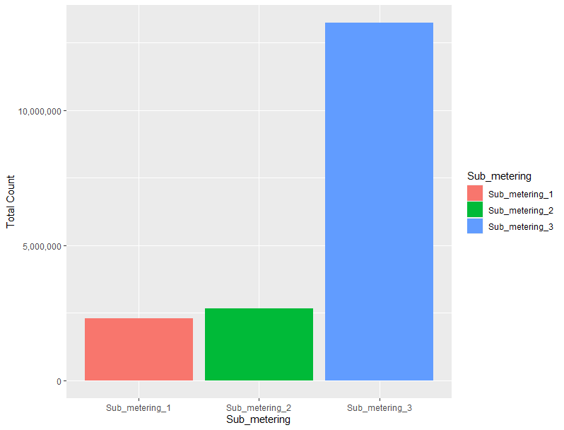
OVERVIEW ON THE SUB_METERING
 | Sub_metering_1 | Sub_metering_2 | Sub_metering_3
Min | 0 | 0 | 0
Max | 88 | 80 | 31
Mean | 1.22 | 1.29 | 6.45
Median | 0 | 0 | 1
Total power consumption is high for Sub_metering_3 equipment even though highest value noted is only “31”
While for Sub_metering_1 equipment total power consumption is low even though highest value noted is “88”

Slide 5
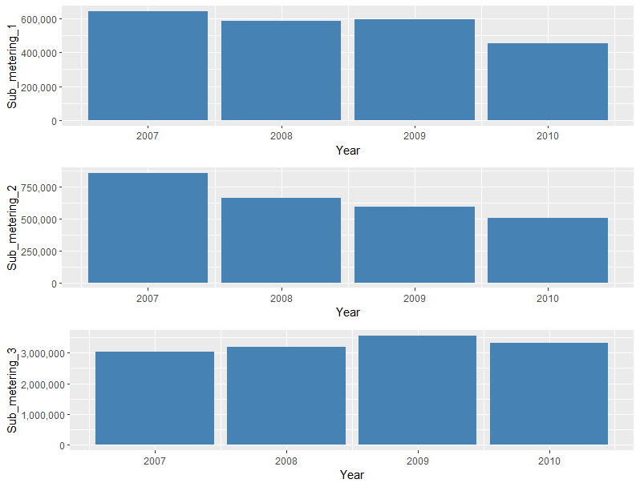
SUB_METERING OVER THE YEAR
Energy usage by the Sub_metering_3 appliances are comparatively high while it is low for Sub_metering_1 appliances
For both Sub_metering_1 & Sub_metering_2, 2007 has the highest consumption while it is less for 2010.
There is gradual reduction energy consumption for both Sub_metering_1 & Sub_metering_2
In case Sub_metering_3, high energy usage is during the year 2009

Slide 6
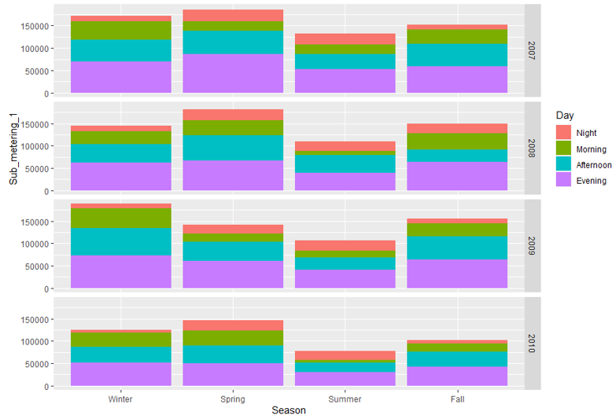
SUB_METERING_1 - DETAIL ANALYSIS
In most of the cases, appliance in the sub_metering_1 is used at the evening time
The amount of power usage have seen an increase from the year 2007 to 2009, but have shown decreased in 2010
During Summer usage of the equipment is comparatively less
Spring 2009, is the only period corresponding to all the years, where the usage is less
Summer 2008 afternoon power usage is slightly high when compared to the evening

Slide 7
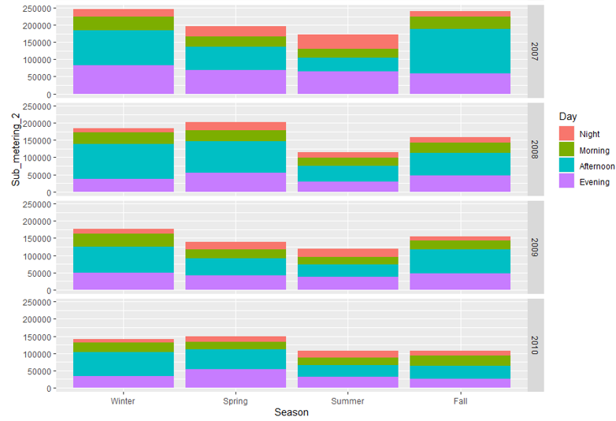
SUB_METERING_2 - DETAIL ANALYSIS
In most of the cases, appliance in the sub_metering_2 is used at the afternoon time
During Summer 2007, evening time usage seems to be high comparatively and has high nighttime usage among all
In 2007 & 2009, the usage in winter is high while it is high in spring for 2008 & 2010
Summer usage is less comparatively

Slide 8
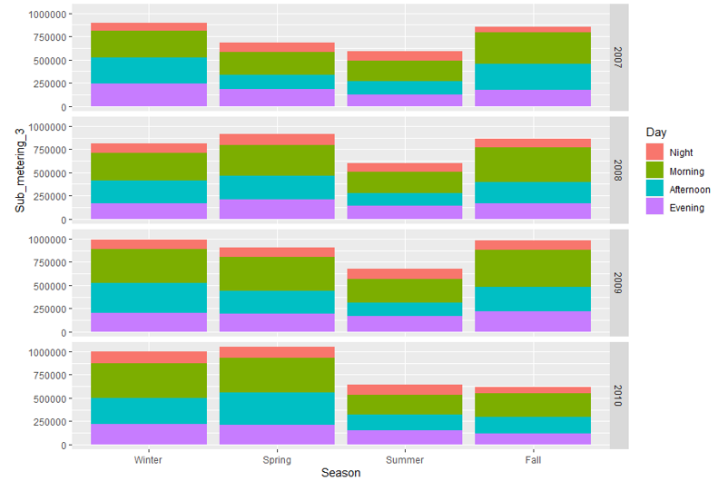
SUB_METERING_3 - DETAIL ANALYSIS
In most of the cases, appliance in the sub_metering_3 is used at the morning time
The least usage of power is during the nighttime.
In the year 2007 & 2009, winter season has high usage while in 2008 & 2010, it is in Spring season
The least usage is during the Summer season

Slide 9
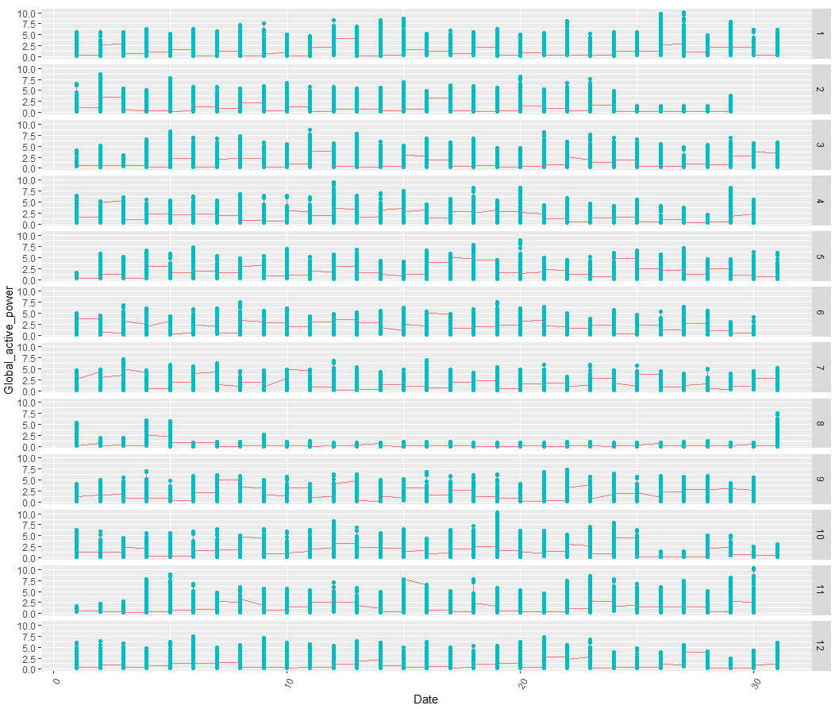
IS ANY DATA MISSING?
The graph shows the Global active power usage for each month during the year 2008.
According to the graph, the reading during the month August is very low when compared to the rest of the month.
Possible Reasons
Most of the residents in the area could be in a vacation as it is during the Summer
Faulty reading, which in turn resulted in missing data

Slide 10
SUMMARY ON THE INITIAL ANALYSIS
Energy usage by the Sub_metering_3 appliances are comparatively high while it is low for Sub_metering_1
Sub_metering_1 appliances usage is usually high during the evening time
Sub_metering_2 appliances consumption is high during the afternoon time
Sub_metering_3 equipment usage is usually high during the morning time
During Summer, the consumption of power is less comparatively
Summer of 2008, shows a different pattern comparatively

