Slide 1
Choosing for a NoSQL Database
MongoDB v.s. Cassandra
Prepared by VR2WCG - Rayony
February, 2013
Notes:
Preapared by VR2WCG - Rayony, Feb 2013
Dedicated to ecVision

Slide 2
ROADMAP
NoSQL
Cassandra
MongoDB
Quick Compare
Conclusion
Reference

Slide 3

NoSQL
Not only SQL

Slide 4


NOSQL
Not only SQL
- Sequential Query Language is a popular and old language for execute query for database information
Not (only) Relational Database
- no traditional concept of schema
Meeting the needs for Web2.0
- ∵ increasing user contribution to the database
Easy for expansion
- easy to upgrade due to fast growing data size
Eventually Consistency
- allows for data inconsistency for raising performance

Slide 5






NOSQL
Column Oriented
Key - Value
Document Oriented
And more…
Cassandra
MongoDB
Types of NoSQL Database Model

Slide 6
Cassandra
Develop by Facebook Team

Slide 7

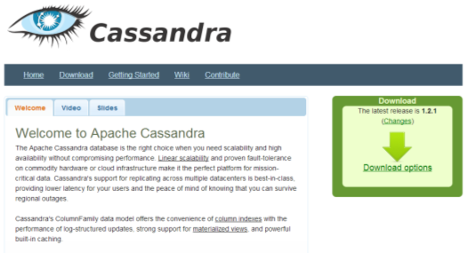
Cassandra
Background
- Key-Value Store distributed database system
- Developed by Facebook
- Sponsored by Apache

Slide 8
Cassandra
High Lights
- Java Platform Compatible
- Automatic load balance, backup, storage
among the nodes
- Scalable (very easy to set up a new node)
- Support Column Family
e.g. User Account → Personal Data →Birthday : 15Nov,90
(search key) (value)

Slide 9
MongoDB
Develop by 10Gen

Slide 10
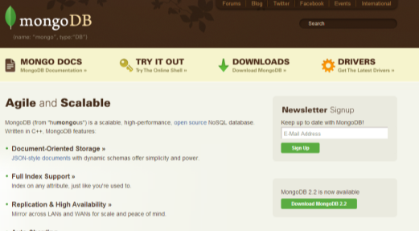
Cassandra
Background
- Document oriented database system
- Developed by 10Gen
- Open Source, But maintained by 10Gen

Slide 11
Cassandra
High Lights
- C++ Based, stores data in JSON document
- Drivers in many language (Java, PHP, Ruby…)
- Good Documentation
- Dynamic Schema
- Scalable (automatic sharding)
- Fault tolerant (Node Replicate Set)
- Good to deal with big data(GridFS)

Slide 12
Quick Compare
MongoDB v.s. Cassandra

Slide 13


MongoDB v.s. Cassandra
API
MongoDB
Cassandra
→ BSON
→ thirift languages (raw)
BSON is a binary-encoded serialization of JSON-like documents, which is efficient, while thirift API is primarily intended for client developer, but one may still use high level clients like Python, Java to do the job.
www.​mongodb.​org
cassandra.​apache.​org

Slide 14
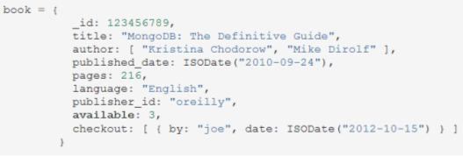
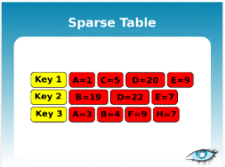
MongoDB v.s. Cassandra
Storage
MongoDB
Cassandra
→ JSON-like
→ Key-Value
This is the major difference between the two models, MongoDB is more like the traditional way, but use of JSON like language, while Cassandra uses key-value pair in storage, with timestamp for version control.

Slide 15
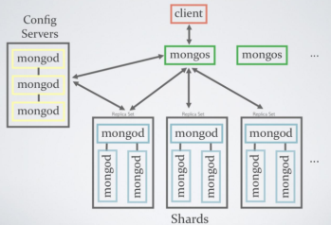
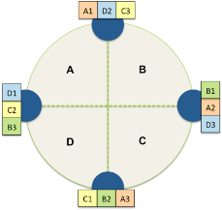
MongoDB v.s. Cassandra
Replication
MongoDB
Cassandra
→ Master Slave
& Auto-Sharding
→ Every node is the same
MongoDB will automatically choose the best node as a master (auto-sharding), but remain a master-slave model;
Cassandra’s cluster does not rely on a master, every node is the same, and based on the eventually consistent principle

Slide 16


MongoDB v.s. Cassandra
Support
MongoDB
Cassandra
→ Better Documentation, supported by company
→ Less structured documentation, rely heavily on volunteer
MongoDB is managed 10gen, native support C, C++, C#, Java, JS, Node.js, Perl, PHP, Ruby, etc. Cassandra only support Java and python in native, and the documentation are mainly managed by volunteers, but not full time engineer.

Slide 17
MongoDB v.s. Cassandra
Performance
MongoDB
Cassandra
→ Balanced, Steady*
→ Optimized for writing
MongoDB keeps a steady rate in reading and writing, with acceptable perframance even the data size increased. Thanks to the topology, Cassandra do much faster in inserting and updating the database. Although the reading is lowered when the datasize grows, but it is still suitable for some application.
*This passage state the steady sacrifices the fault-tolerance, but there are still arguments on it
http://hackingdistributed.com/2013/01/29/mongo-ft/

Slide 18
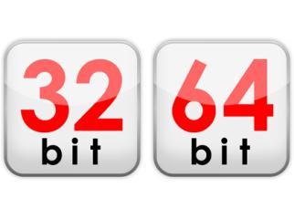
MongoDB v.s. Cassandra
Miscellaneous
MongoDB
→ Limited database size on 32-bit system
MongoDB 32 bit version only support a database size up to about 2.5GB. Thus it may not be suitable for system upgrade in old systems.

Slide 19
MongoDB v.s. Cassandra
Miscellaneous
MongoDB
→ GridFS
A large file will be spited into smaller chuck, and thus can be process more quickly when searching information

Slide 20

MongoDB v.s. Cassandra
Miscellaneous
Cassandra
→ Lack of Keyword Index Search
Cassandra does not regular expression in nature, so more wrapping of code is needed to perform such keyword search

Slide 21
Conclusion
Wrap up of the pros and cons

Slide 22


Conclusion
- Good Support
- Easy to upgrade from a old DBMS
- Balanced performance and reliable
www.​mongodb.​org
Good performance if “insert” and “update” is more common than “query”
Suitable for users with Java / Python platform
cassandra.​apache.​org

Slide 23

Reference
Hidden
It’s (not only) my own work

Slide 24


MongoDB v.s. Cassandra
Hidden
Too much info on the internet
→ Wrap up important points and include the quotes in reference
www.google.com
cassandra.​apache.​org
www.​mongodb.​org

Slide 25
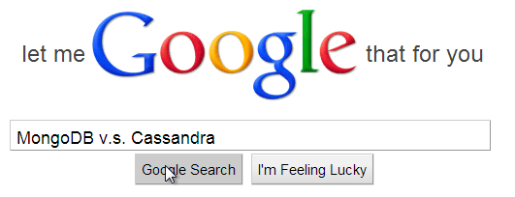
MongoDB v.s. Cassandra
Hidden
Importance of online searching
The developer will never disclose their weakness in their own website
A fair comment can only be found with a 3rd party with experienced in both system
Evaluation and testing on all platform could be too time costy to a company development stage
www.google.com

Slide 26
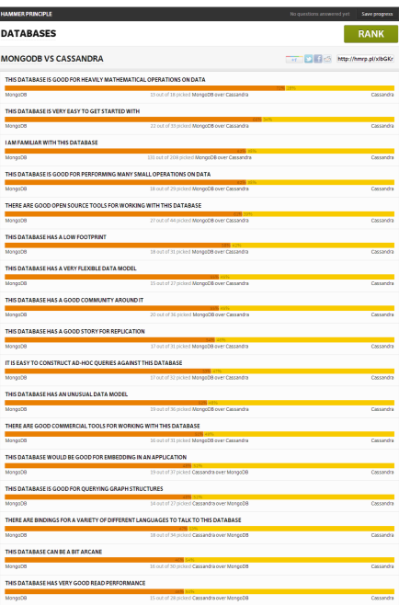
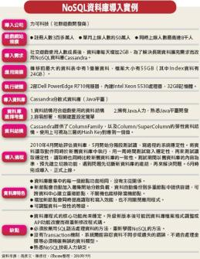
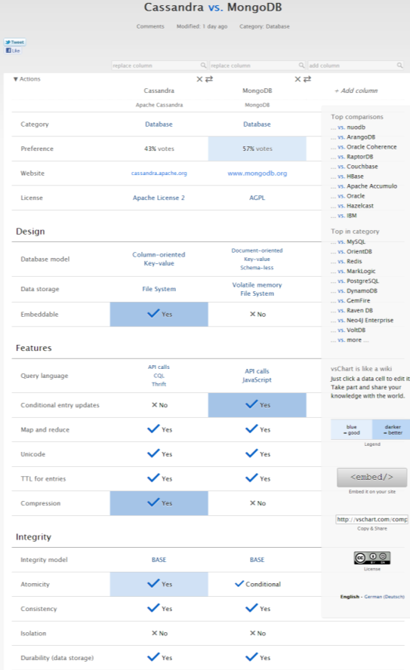
MongoDB v.s. Cassandra
Hidden
refer to reference for full details

Slide 27
Reference
http://www.mongodb.org/
http://cassandra.apache.org/
http://kkovacs.eu/cassandra-vs-mongodb-vs-couchdb-vs-redis
http://amesar.wordpress.com/2011/10/19/mongodb-vs-cassandra-benchmarks/
http://hammerprinciple.com/databases/items/mongodb/cassandra
http://blog.serverdensity.com/mongodb-vs-cassandra/
http://vschart.com/compare/apache-cassandra/vs/mongodb
http://www.ithome.com.tw/itadm/article.php?c=63360&s=1
http://hackingdistributed.com/2013/01/29/mongo-ft/

Slide 28








