Slide 1

Week 2 Lab Exercises
A/Prof Jian Zhang
School of Computing and Communication
University of Technology, Sydney

Slide 2
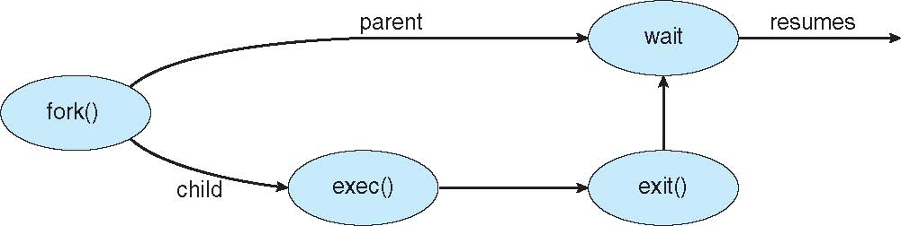
Process Creation (Cont.)
Address space
Child duplicate of parent
Child has a program loaded into it
UNIX examples
fork() system call creates new process
exec() system call used after a fork() to replace the process’ memory space with a new program

Slide 3
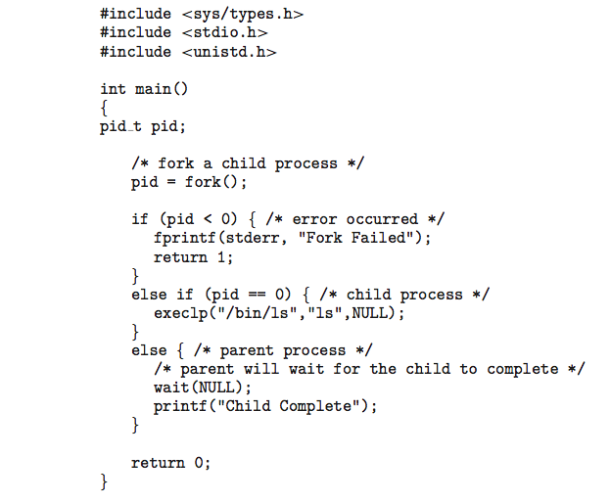
C Program Forking Separate Process

Slide 4
Process Termination
Process executes last statement and then asks the operating system to delete it using the exit() system call.
Returns status data from child to parent (via wait())
Process’ resources are deallocated by operating system
Parent may terminate the execution of children processes using the abort() system call. Some reasons for doing so:
Child has exceeded allocated resources
Task assigned to child is no longer required
The parent is exiting and the operating systems does not allow a child to continue if its parent terminates

Slide 5
Inter-process Communication
Processes within a system may be independent or cooperating
Cooperating process can affect or be affected by other processes, including sharing data
Reasons for cooperating processes:
Information sharing
Computation speedup
Modularity
Convenience
Cooperating processes need inter-process communication (IPC)
Two models of IPC
Shared memory
Message passing

Slide 6
Inter-process Communication -Message Passing
Mechanism for processes to communicate and to synchronize their actions
Message system – processes communicate with each other without resorting to shared variables
IPC facility provides two operations:
send(message)
receive(message)
The message size is either fixed or variable

Slide 7
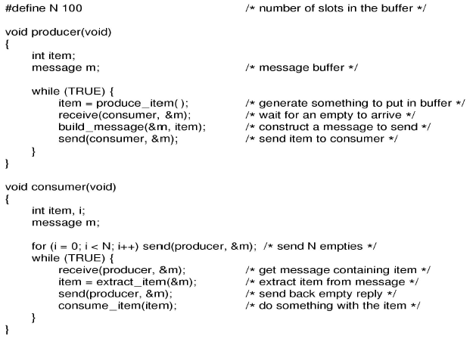
Message Passing: Producer-Consumers Problem with N messages

Slide 8
Makefiles
make is a UNIX cornerstone
Its purpose is to assist in compilation
It refers to a Makefile for instructions on invoking the compiler, linker and many other tools and utilities
Most programs of meaningful purpose are composed of many source files, make helps in building the executable (and can do much more)
make looks at the Makefile to identify dependencies and targets
It can also incorporate environment variables
When porting source code between UNIXes, the Makefile usually needs to be modified by the programmer
An example follows:
Notes:
11

Slide 9
make in use
A very simple program that consists of four (4) source files. Make is used to build two different executables - one that prints Hi, another that prints Bye.
/* main.h */
void printMessage(void);
/* main.c */
#include <stdlib.h>
#include "main.h”
int main(void)
{
printMessage();
return 0;
}
/* hi.c */
#include <stdio.h>
void printMessage(void)
{
printf("Hi\n");
return;
}
/* bye.c */
#include <stdio.h>
void printMessage(void)
{
printf("Bye\n");
return;
}
Notes:
13

Slide 10
Makefiles
#Makefile
CC = gcc
CFLAGS = -Wall -O2
all: hi bye clean
P8-1-main.o: P8-1-main.c P8-1-main.h
$(CC) -c P8-1-main.c
hi:P8-2-hi.o P8-1-main.o
$(CC) -o hi P8-2-hi.o P8-1-main.o
bye:P8-3-bye.o P8-1-main.o
$(CC) -o bye P8-3-bye.o P8-1-main.o
clean:
rm -rf *.o core hi bye

