Slide 1
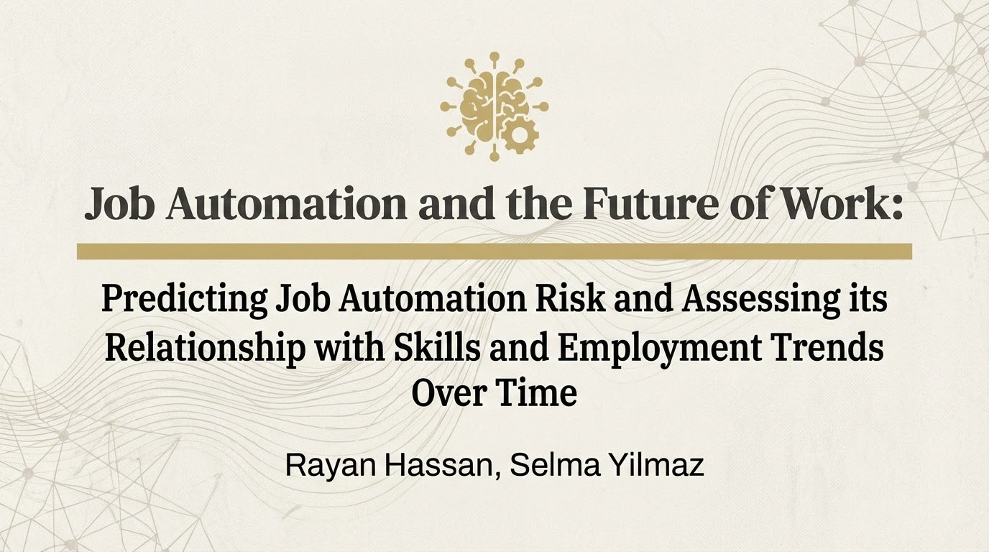

Slide 2
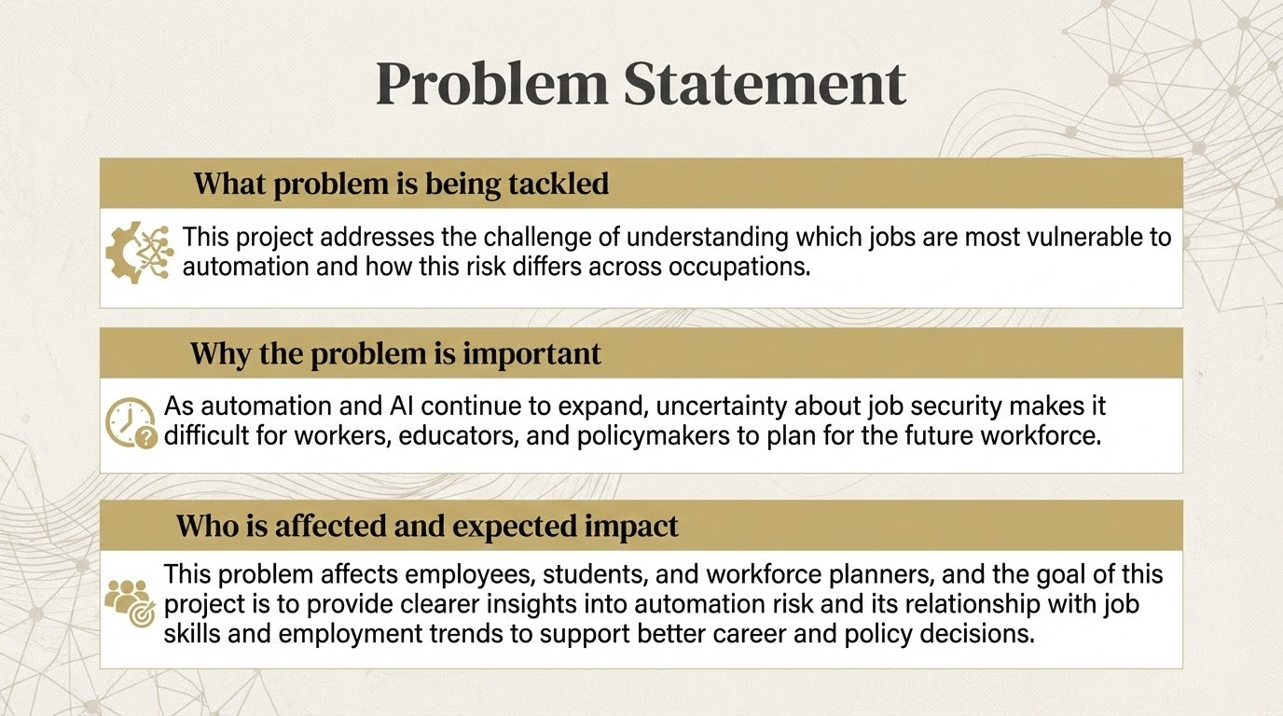

Slide 3
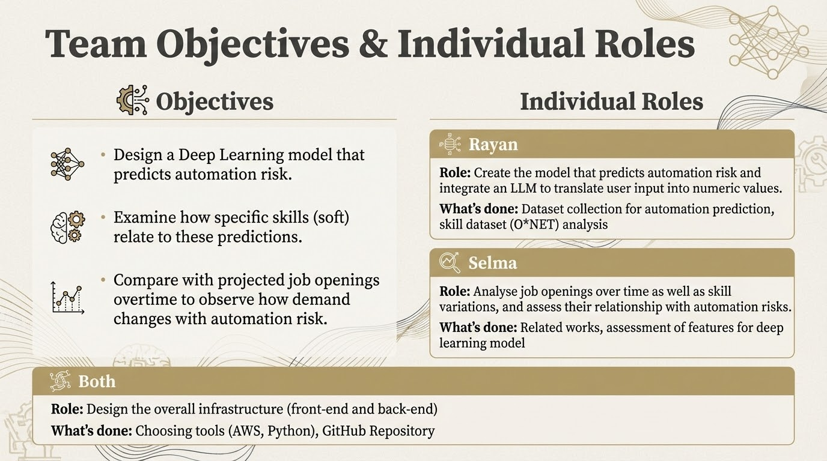

Slide 4
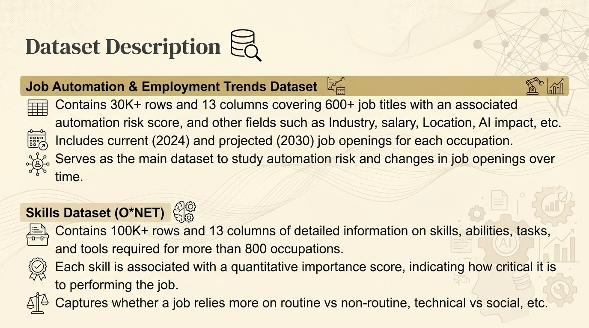

Slide 5
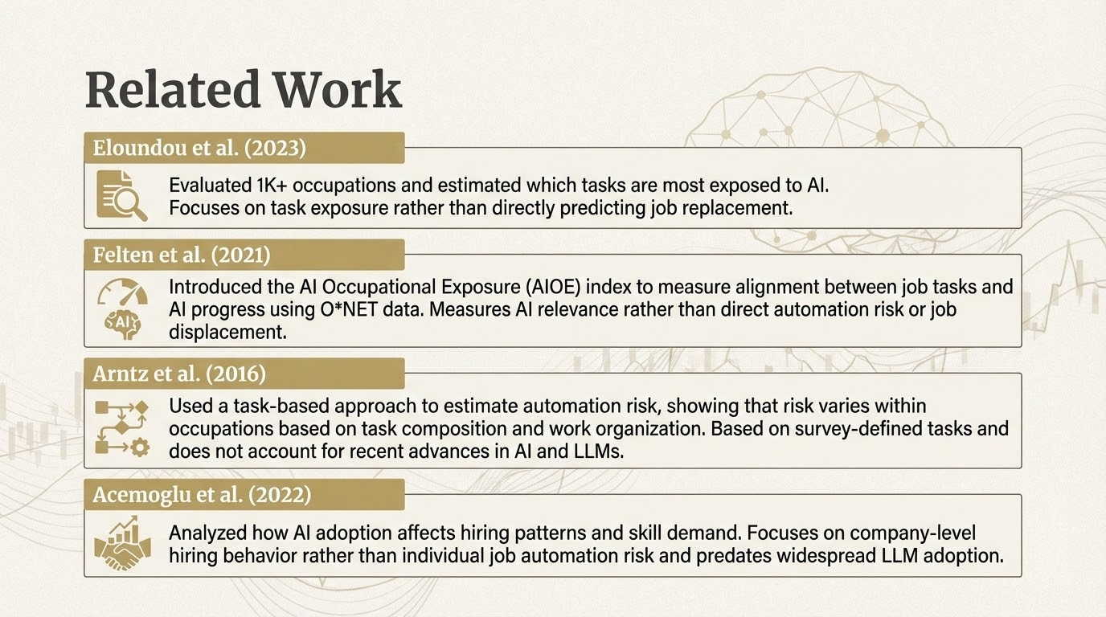

Slide 6
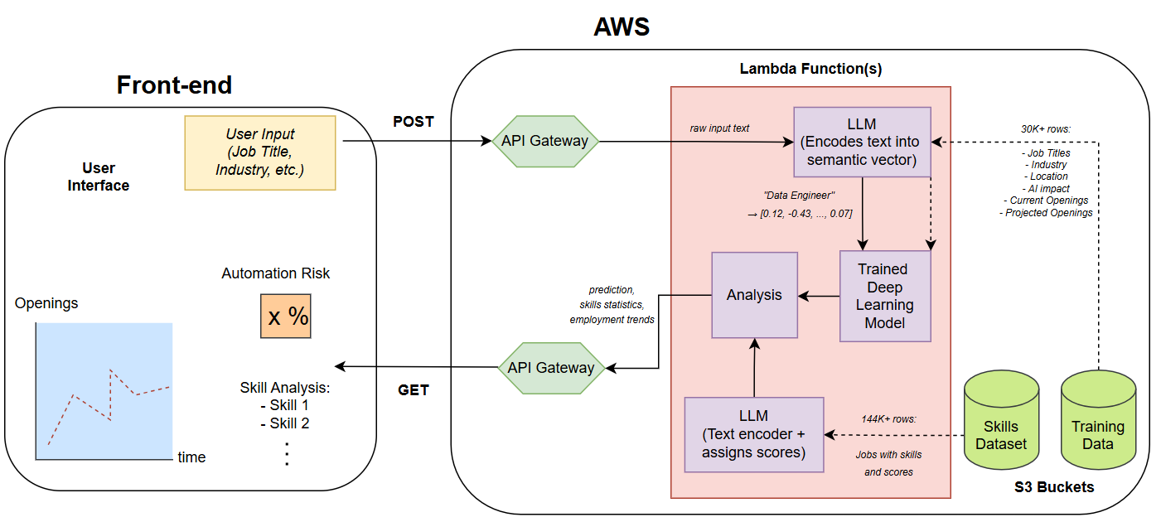
System Design

Slide 7
References
Eloundou, T., Manning, S., Mishkin, P., & Rock, D. (2024). GPTs are GPTs: Labor market impact potential of LLMs. Science, 384(6703), 1306-1308.
Paper: https://arxiv.org/abs/2303.10130
Code: https://github.com/openai/GPTs-are-GPTs
Felten, E., Raj, M., & Seamans, R. (2021). Measuring the exposure of occupations to artificial intelligence. Strategic Management Journal.
Paper: https://sms.onlinelibrary.wiley.com/doi/epdf/10.1002/smj.3286
Code: https://github.com/AIOE-Data/AIOE
Arntz, M., Gregory, T., & Zierahn, U. (2016). The risk of automation for jobs in OECD countries. OECD Social, Employment and Migration Working Papers, No. 189.
Paper: https://www.oecd.org/content/dam/oecd/en/publications/reports/2016/05/the-risk-of-automation-for-jobs-in-oecd-countries_g17a27d8/5jlz9h56dvq7-en.pdf
Acemoglu, D., Autor, D., Hazell, J., & Restrepo, P. (2022). Artificial intelligence and jobs: Evidence from online vacancies. Journal of Labor Economics, 40(S1), S293–S340.
Paper: https://shapingwork.mit.edu/wp-content/uploads/2023/10/Paper_Artificial-Intelligence-and-Jobs-Evidence-from-Online-Vacancies.pdf
AI Impact on Job Market (2024-2030) - Sahil Islam007
Source: https://www.kaggle.com/datasets/sahilislam007/ai-impact-on-job-market-20242030
Skills Dataset - O*Net
Source: https://www.bls.gov/emp/data/skills-data.htm

