Slide 1
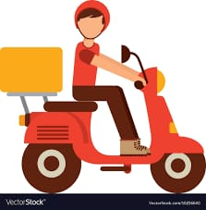


SMART INDIA HACKATHON 2020
Organization name : Amazon Web Services(AWS)
Category : Hardware
Domain Bucket : Robotics and Drones
Team Name : Optimus
Team leader Name : Pratik Ray
College Code :
PROBLEM STATEMENT: These days we are pretty habituated of home- delivery system through e-commerce platform, however there is a big dependency on delivery boys and vehicles for timely delivery of the items. We could potentially use Drones for last mile delivery of items. An effective solution to accurately deliver the order using a drone is yet to be achieved.
VS

Slide 2
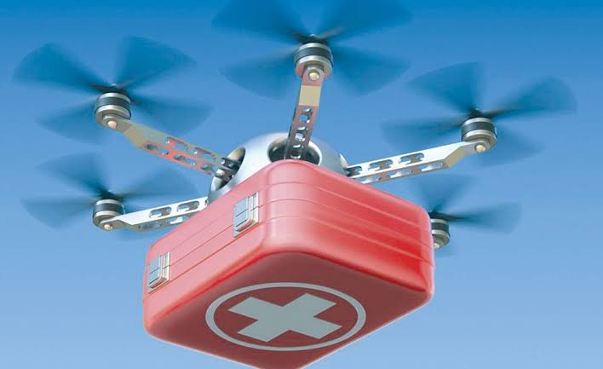
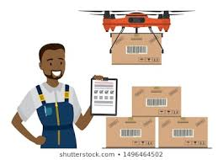
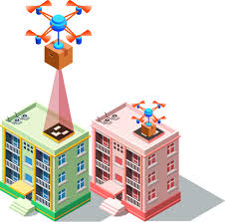
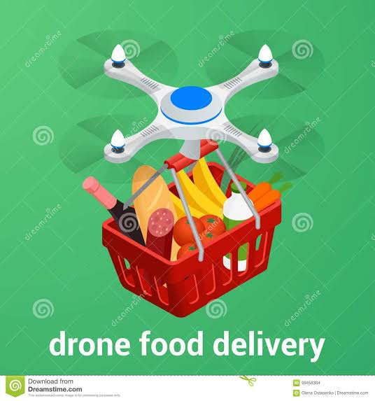

OUR IDEA TO SOLVE THE PROBLEM
We aim to achieve greater heights of accuracy in last mile delivery of items using drones by creating a technologically efficient model that is fed with the location details of delivery at the nearest facility of conveyance. The drone leaves the hub with the information-when confirmed by the customer-identifies and prevents all the obstructions on its path to the location given. The customer has the authority to choose the time and place of the delivery when questioned through a notification sent to him/her.

Slide 3
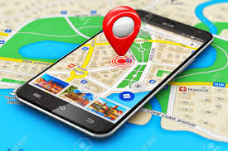
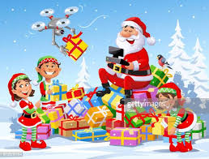
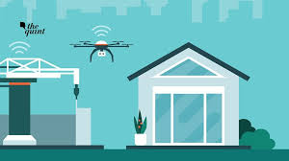
IDEA AND APPROACH DETAILS
The customer when places an order, gives the basic details about the delivery location of the item.
The customer is asked to enter the location through pinning it in the satellite view of the area given to him or by selecting the option of live location or by choosing through a list of previously entered location suggestions.
When the order is confirmed , a QR code is sent to the customer .
When the required order reaches the nearest courier facility to the location given, a notification asking the further details are sent to the customer.
The following enquiry is done before the item is out for delivery:
1. Whether he/she is available to receive the order in a prescribed amount of time (for example : within an hour ) in the location given or not .
2. Upon answering yes to the notification , the drone is sent to the location carrying the given item.
3. If the customer is unavailable in the time frame and answers “no”, the notification is still available in its respective region in the app and hence the customer can answer “yes” whenever he/she is ready to receive it.

Slide 4
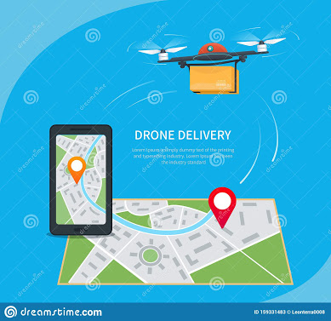
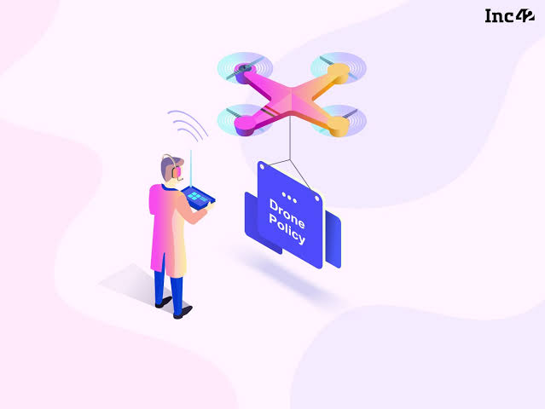

IDEA AND APPROACH DETAILS CONTINUED
The location given to the drone is through the latitude – longitude crossing position obtained through GPS- Global Positioning System.
During the flight period of the drone , it is stabilised by a flight controller which is being governised by a microcontroller installed in it.
The camera and the ultrasonic sensors used in the drone enable the it to identify the potential security threats to itself and its environment using the concept of image processing .
When the drone reaches the location provided to it , an OTP is sent to the customer which serves as the passcode to the Hotspot of the drone .
The drone’s capacity of carrying the weight depends from model to model. But it’s possible for a model to carry several packages at once for delivery.
For the above point to be implemented , the drone has numbered QR codes corresponding to each of the package.
Proper loading discretion is advised, to ensure the safe and proper delivery of items.

Slide 5
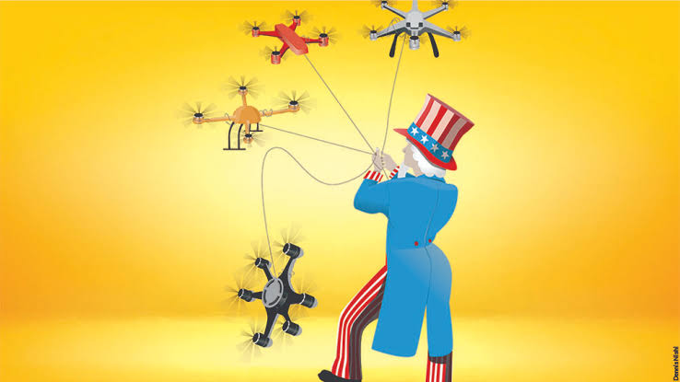
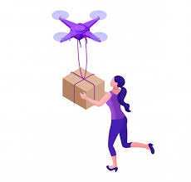
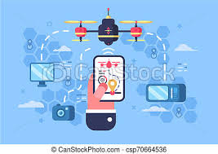
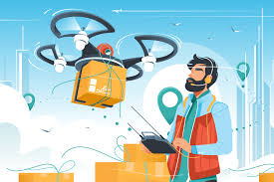
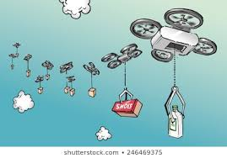
IDEA AND APPROACH DETAILS...
The phone of the customer is then connected to the drone upon confirmation of the OTP, which will be valid for a time
period of maximum 10 minutes.
RSSI- Received Signal Strength Indicator – helps the
drone find the customer, who needs to be present in an
open area for the drone to level itself down to a lower
altitude detecting the higher signal strength of signal
emanating from the phone of customer.
If there are more than one packages with the drone the user
is sent the QR code according to his number of package. For
eg: QR 1, QR 2…so on.
Finally the drone drops to a level of two metres from
ground level and the customer needs to scan the QR code
provided in the first step to him in the drone camera.
The item is then delivered to the customer and the drone
returns to the delivery facility.

Slide 6
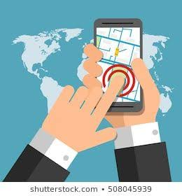
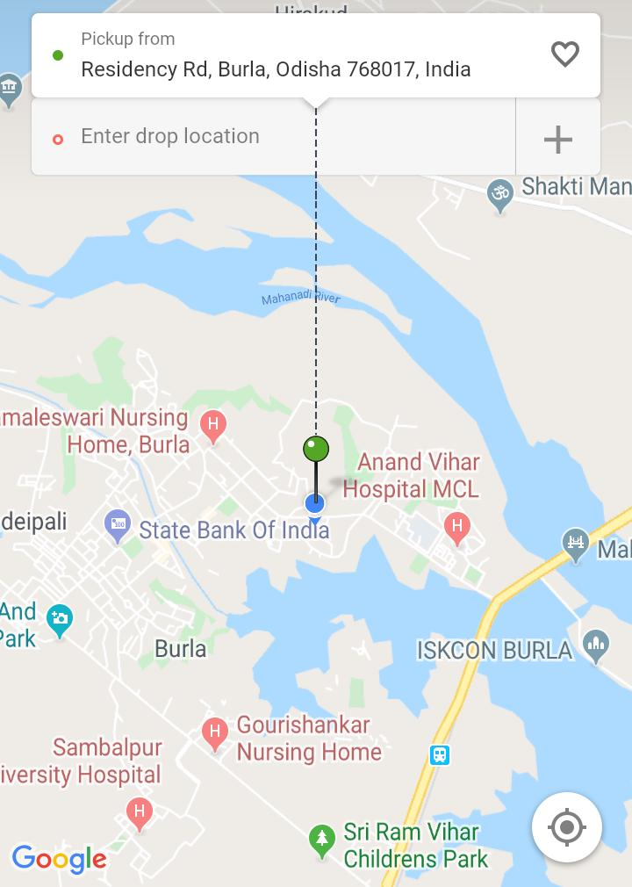
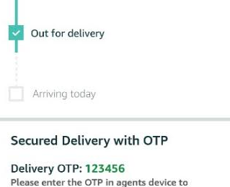
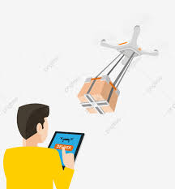
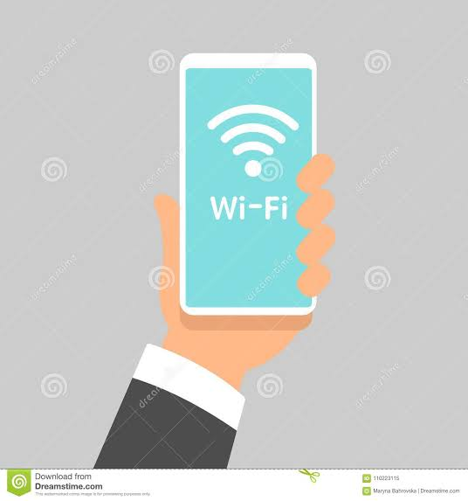
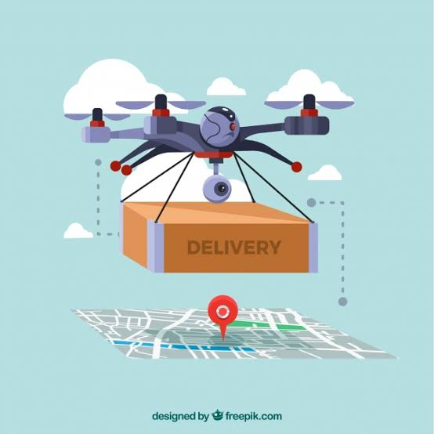
GRAPHICAL FLOWCHART

Slide 7

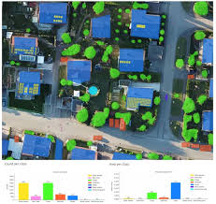
TECHNOLOGICAL ALGORITHM..
IMAGE PROCESSING:
Technology that makes it possible for the drone to actually identify its threats and react to them accordingly. For eg: If the drone detects some obstruction ,such as walls on its left and right sides , it moves in upward direction to prevent collision.
Scanning of QR code is performed by image processing only.
MACHINE LEARNING:
The drone when reaches its destination, captures the characteristics of the house it delivered to and learns to move closer to the exact position of customer without the signal strength detection(RSSI) if ordered from the same location again.
It facilitates the movement of drone comparatively to a lower height if it recognizes the house and could find a road connected to the building it can see.
More the number of times it learns , more is its efficiency in delivering. .
Example: It stores the information regarding the color, shape and dimensions etc. while recognizing a house.

Slide 8
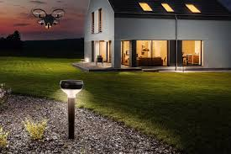
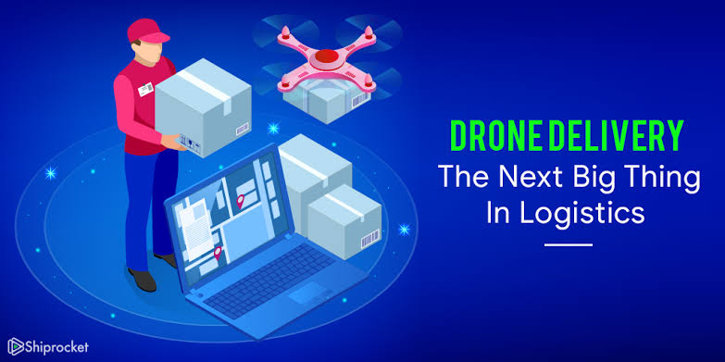
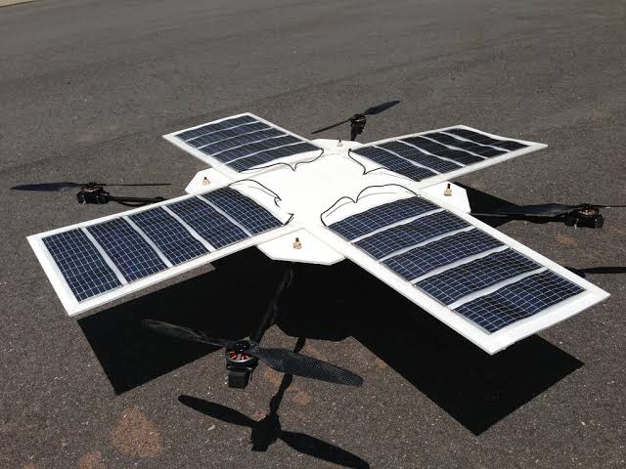
BENEFITS OF DRONE DELIVERY SYSTEM
The main advantages of this idea is:
The idea presented before you is economically efficient
and convenient.
Our idea can be efficiently implemented in a hardware model in a price range of Rs 7000 – Rs 8000.
Whereas if assembled or bought readymade costs around Rs 40000 – Rs 45000.
Use of solar panel in the drone increases it’s battery backup and hence , the flight time is sufficiently increased.
It is environment friendly as no fuel consumption is required and no harmful substances are emitted from the drone.
It can deliver packages to virtually any location.
Improves time management for all the ends of the system. Consumers receive their goods faster, companies can increase their turnover rate , which leads to higher level of productivity.
Safer delivery system.

Slide 9

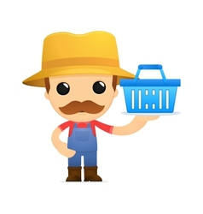
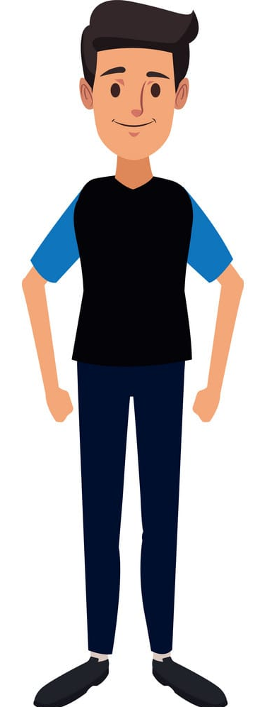
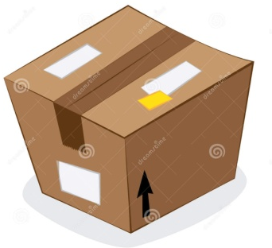

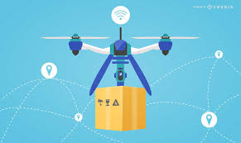
APPLICATIONS CASES
CITIZEN
RETAILER
E-COMMERCE
Take orders from customer using app interface.
Send the items to the home delivery location .
Delivery possible to virtually any location possible.
Load items to the drone.
Pin the address .
Used to send gifts to family .
Take orders from customer.
Send the items to the home delivery location .
Close range delivery .
OUT FOR DELIVERY

Slide 10

THANK YOU EVERYONE !!!
IMAGINE…IMPLEMENT...LAUNCH…

