Slide 1
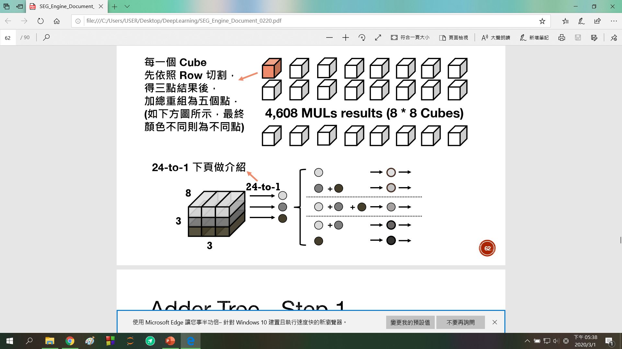
stride
27bits
round
A(5*5)
A1
FA(row 1)
FSA
Ain
Aout
SA
A2_0
FA (row 2)
wsize
stride
2*23 bits
= 46 bits
A2_1
FA (row 3)
round
46 bits
2*27bits
= 54bits
21 bits
FSA(24 to 1): 共64個
每個都對應到MUL的每個CUBE
FA: 用來算每row的和
SA: 依照wsize, stride , round決定要怎麼加
因為可能會輸出兩種和，所以FSA的
Output data是46bits(2* 23bits)
27bits
B(7*7)
B1
Bin
B2_0
16*54bits
= 864 bit
(max 5*5)
Ps.還沒決定好
怎麼擺
Bout
B2_1
46 bits
B3
stride
2*27bits
= 54bits
round

Slide 2
A1
A2
i0
i1
i0
i2
i3
i1
dff
dff
dff
dff
23 bits
24 bits
27 bits
23 bits
24 bits
27 bits

Slide 3
B2
B1
i0
i0
i1
i1
i2
i2
i3
i3
i4
i4
i5
i5
i6
23 bits
25 bits
27 bits
i7
dff
dff
i8
B3
23 bits
25 bits
27 bits
i0
dff
dff
23 bits
27 bits
i1
25 bits
i2

Slide 4
5*5 / 7*7
FSA
A/B
FA(adder)
SA
Ain/Bin
A1,A2,B1,B2,B3(adder)
Aout/Bout
L1
L2
L3
L4
FSAout
i /data
L1
L2
MUL_DATA_valid_dff
MUL_results_dff
stride_dff
wround_dff
wsize_dff
A1i,A2_0i,A2_1i
B1i,B2_0i,B2_1i,B3i
Psum
Psum_vaild
3*3
Psum
Psum_vaild

