Slide 1
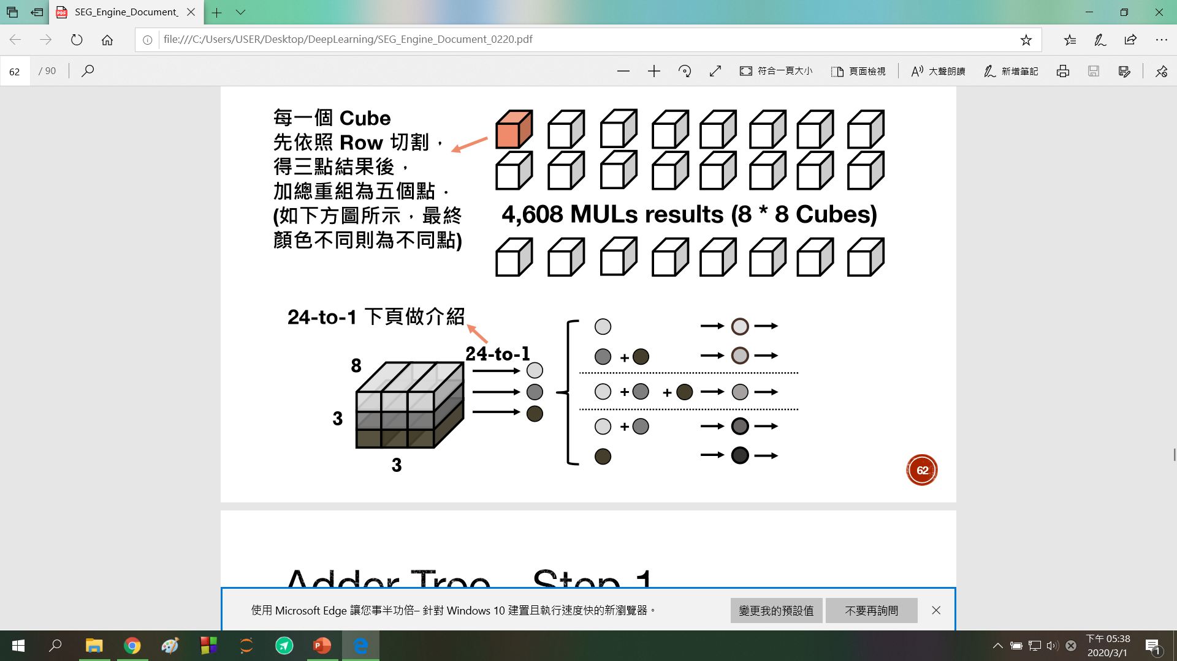
stride
27bits
round
A(5*5)
A1
FA(row 1)
FSA
Ain
Aout
SA
A2_0
FA (row 2)
wsize
stride
2*23 bits
= 46 bits
A2_1
FA (row 3)
round
46 bits
2*27bits
= 54bits
21 bits
FSA(24 to 1): 共64個
每個都對應到MUL的每個CUBE
FA: 用來算每row的和
SA: 依照wsize, stride , round決定要怎麼加
因為可能會輸出兩種和，所以FSA的
Output data是46bits(2* 23bits)
27bits
B(7*7)
B1
Bin
B2_0
16*54bits
= 864 bit
(max 5*5)
Ps.還沒決定好
怎麼擺
Bout
B2_1
46 bits
B3
stride
2*27bits
= 54bits
round

Slide 2
3*3
1: FA(row1)’s output
2: FA(row2)’s output
3: FA(row3)’s output
NO3_0 ~NO3_ 5 : 1 + 2 + 3
NO3_6 : 3 , 1 + 2
NO3_7 : 1 , 2 + 3
5*5
Stride1,round1
(NO5_0 ~ NO5_3)
Stride1,round2
NO5_0
NO5_1
NO5_2
NO5_3
0
1
2
3
4
4
5
6
7
1
5
6
7
0
1
6
7
0
1
2
ID0,1
1 + 2
3
7
0
1
2
3
ID0,1
1
2 + 3
ID0,1
1 + 2 + 3
ID0,1
1 + 2 + 3
ID0,1
1 + 2 + 3
ID2,3
1 + 2 + 3
ID2,3
1
2 + 3
ID2,3
1 + 2 + 3
ID2,3
1 + 2 + 3
ID2,3
1 + 2 + 3
0- 1+2
0- 1
0
0
0
1- 1+2
1- 1
1
1
1
0-3
0- 2+3
2
2-1
1-3
1-2+3
3-1
2
3
2
2
2- 2+3
3
3- 2+3
3
3

Slide 3
Stride2
NO5_0
NO5_1
NO5_2
NO5_3
0
1
2
3
4
2
3
4
5
6
4
5
6
7
1
ID0,1
1 + 2 + 3
6
7
0
1
2
ID0,1
1 + 2
3
ID0,1
1 + 2 + 3
ID0,1
1 + 2 + 3
ID2,3
1 + 2 + 3
ID2,3
1 + 2 + 3
ID2,3
1
2 + 3
ID2,3
1 + 2 + 3
0
0
0- 1+2
0
1
1
1- 1+2
1
0-3
2
2-1
2
3-1
1-3
3
3
2- 2+3
2
3- 2+3
3

Slide 4
A1
A2
i0
i1
i0
i2
i3
i1
L1 dff
L2 dff
L1 dff
L2 dff
23 bits
24 bits
27 bits
23 bits
24 bits
27 bits

Slide 5
Stride1
round1
Stride1
round2
Stride2
5*5
ID0
0
A1
0
1
A1
1
A1
NO3_0
1
2
2
2
3
3
A2
3
0
0
0
A1
A2
A1
1
1
1
NO3_1
2
2
2
3
3
A2
3
0
A2
0
A1
0
1
A1
1
NO3_2
1
2
2
2
A1
A2
3
3
3
0
0
A2
0
A2
1
A1
1
1
NO3_3
2
2
A1
2
A1
3
3
3

Slide 6
7*7
1: FA(row1)’s output
2: FA(row2)’s output
3: FA(row3)’s output
Stride1,round1
(NO7_0 , NO7_1)
Stride1,round2
NO7_0
Stride1,round3
NO7_0
Stride1,round4
NO7_0
N07_1
N07_1
N07_1
0
1
2
3
4
5
6
ID0,1,2
1 + 2 + 3
2
3
4
5
6
7
0
3
4
5
6
7
0
1
4
5
6
7
0
1
2
5
6
7
0
1
2
3
6
7
0
1
2
3
4
ID0,1,2
1 + 2
3
7
0
1
2
3
4
5
ID0,1,2
1
2 + 3
ID0,1,2
1 + 2 + 3
ID0,1,2
1 + 2 + 3
ID0,1,2
1 + 2 + 3
ID0,1,2
1 + 2 + 3
ID3,4,5
1 + 2 + 3
ID3,4,5
1 + 2 + 3
ID3,4,5
1 + 2
3
ID3,4,5
1
2 + 3
ID3,4,5
1 + 2 + 3
ID3,4,5
1 + 2 + 3
ID3,4,5
1 + 2 + 3
ID6,7,8
1 + 2 + 3
ID6,7,8
1 + 2 + 3
ID6,7,8
1 + 2 + 3
ID6,7,8
1 + 2 + 3
ID6,7,8
1 + 2 + 3
ID6,7,8
1 + 2 + 3
ID6,7,8
1 + 2 + 3
0
0
0
0
0
0- 1+2
0- 1
1
1
1
1
1
1- 1+2
1- 1
2
2
2
2
2
2- 1+2
2- 1
3
3- 1+2
3- 1
0 -3
0- 2+3
3
4- 1+2
3
1 -3
1- 2+3
4
4
5- 1+2
4- 1
5- 1
4
2 -3
2- 2+3
5
5
3- 3
4- 3
3- 2+3
5
3
3
6
6
5- 3
4- 2+3
6
4
4
7
7
6
5- 2+3
7
5
5
8
8
7
6
6
6
8
8
7
7
7
8
8
8

Slide 7
Stride2,round1
NO7_0
Stride2,round2
NO7_0
N07_1
N07_1
0
1
2
3
4
5
6
2
3
4
5
6
7
0
ID0,1,2
1 + 2 + 3
4
5
6
7
0
1
2
6
7
0
1
2
3
4
ID0,1,2
1 + 2
3
ID0,1,2
1 + 2 + 3
ID0,1,2
1 + 2 + 3
ID3,4,5
1 + 2 + 3
ID3,4,5
1 + 2 + 3
ID3,4,5
1
2 + 3
ID3,4,5
1 + 2 + 3
ID6,7,8
1 + 2 + 3
ID6,7,8
1 + 2 + 3
ID6,7,8
1 + 2 + 3
ID6,7,8
1 + 2 + 3
0
0
0
0- 1+2
1
1
1- 1+2
1
2
2- 1+2
2
2
0 -3
3- 1
3
3
4- 1
1 -3
4
4
5- 1
2 -3
5
5
3- 2+3
3
6
4- 2+3
4
6
5- 2+3
5
7
7
6
8
6
8
7
7
8
8

Slide 8
B2
B1
i0
i0
i1
i1
i2
i2
i3
i3
i4
i4
i5
i5
i6
23 bits
25 bits
27 bits
i7
L1 dff
L2 dff
i8
B3
23 bits
25 bits
27 bits
i0
L1 dff
L2 dff
23 bits
27 bits
i1
25 bits
i2

Slide 9
Stride1
round1
Stride1
round2
Stride1
round3
Stride1
round4
7*7
ID0
0
0
0
B3
1
1
B2
1
2
B2
1
B1
2
2
2
3
3
3
3
4
4
4
NO7_0
5
4
B1
5
5
5
6
6
B3
6
B2
6
7
7
7
7
8
8
8
8
0
0
0
B3
0
B3
1
1
B2
1
1
2
B1
2
2
2
3
3
3
3
NO7_1
4
4
4
4
B1
5
5
5
B2
5
6
6
B2
6
6
7
7
7
7
8
8
8
8

Slide 10
Stride2
round1
Stride2
round2
7*7
ID0
0
1
1
2
B2
B1
2
3
3
NO7_0
4
4
5
5
6
6
B2
7
7
8
8
0
0
B3
1
B2
1
2
2
NO7_1
3
3
4
4
B1
5
5
6
B3
6
7
7
8
8

Slide 11
5*5 / 7*7
FSA
A/B
FA(adder)
SA
Ain/Bin
A1,A2,B1,B2,B3(adder)
Aout/Bout
L1
L2
L3
L4
FSAout
i /data
L1
L2
MUL_DATA_valid_dff
MUL_results_dff
stride_dff
wround_dff
wsize_dff
A1i,A2_0i,A2_1i
B1i,B2_0i,B2_1i,B3i
Psum
Psum_vaild
3*3
Psum
Psum_vaild

Slide 12
0
0
0- 1+2
0
1
1
1- 1+2
1
2
2-1
0-3
2
3
3-1
1-3
3
2- 2+3
2
3- 2+3
3
0- 1
1- 1
0- 2+3
1-2+3
2
3

Slide 13
0
0
0
0
1
1
1
2
1
2
3
2
4
2
5
3- 1
6
3- 1+2
7
3
4- 1
8
4- 1+2
4
5- 1
5
5- 1+2
3- 2+3
6
3- 3
4- 2+3
7
4- 3
5- 2+3
0- 1+2
5- 3
1- 1+2
8
6
2- 1+2
0- 1
6
7
1- 1
7
8
0 -3
8
1 -3
2- 1
0- 2+3
0- 2+3
2 -3
1- 2+3
1- 2+3
3
2- 2+3
2- 2+3
4
3
5
6
4
7
6
5
8
7
6
8
7
8

