Slide 1

Lab. of Microcomputer
Practical Utility Software
B11102111 Jingze He/ B11102112 Chiajui Lee

Slide 2

Contents
 | 01 |  | Creative Ideation The Beginning of an Idea
 | 02 |  | Feature Introduction Password, Timer, Calculator
 | 03 |  | Work Assignment Team Roles
 | 04 |  | Feature Video Video Demonstration

Slide 3

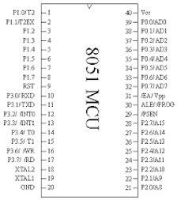
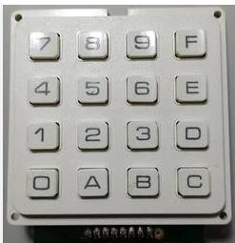
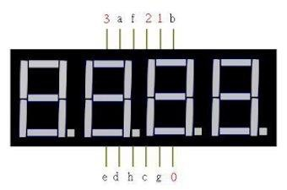
Hardware Structure

Slide 4

Feature Introduction
Password Function 1234 | Function Selection 0/1 | Function “0" Timer | Function "1“ Calculator | Function Selection 0/1
Password Function | Function Selection | Timer | Calculator | Return to Function Selection
Input via 8051 Keypad | Function Selection via Keypad | Countdown Initiation via Keypad Input | Calculator Functions: "F" key: Addition (+) "E" key: Subtraction (-) "D" key: Multiplication (*) "C" key: Division (/) | Return to Function Selection for Re-evaluation

Slide 5

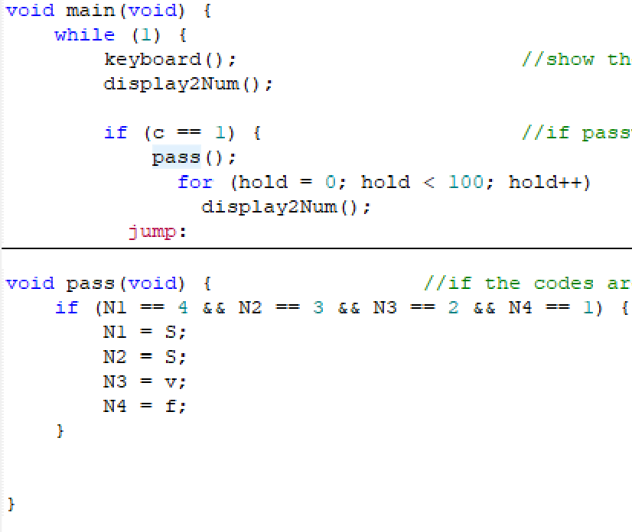
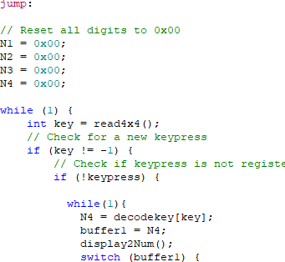
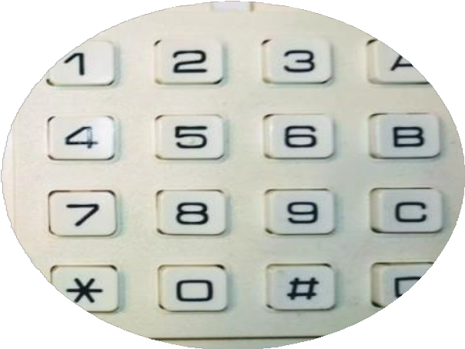

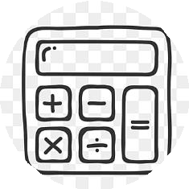
Password & Function Selection
Function Descriptions
計時器
計算器

Slide 6
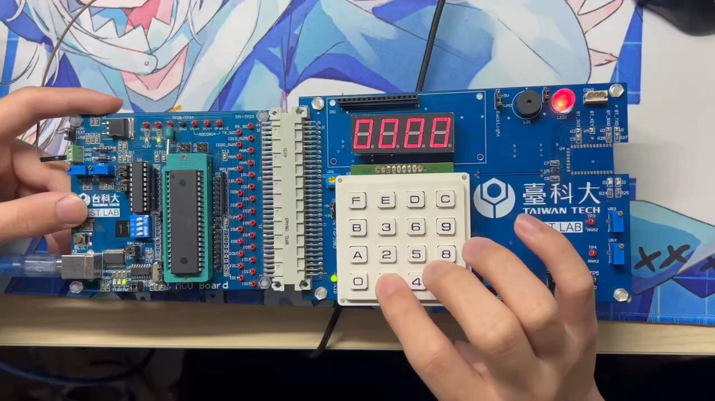
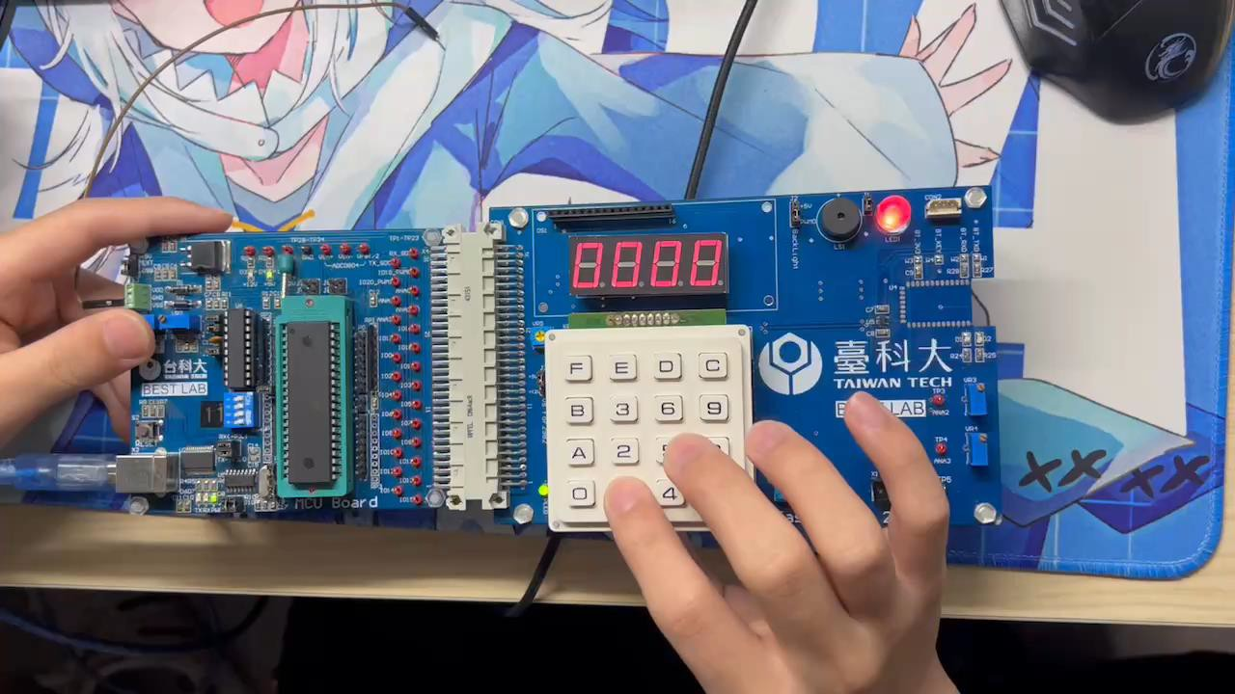
Function Demonstration
Password Correct
Password Incorrect

Slide 7
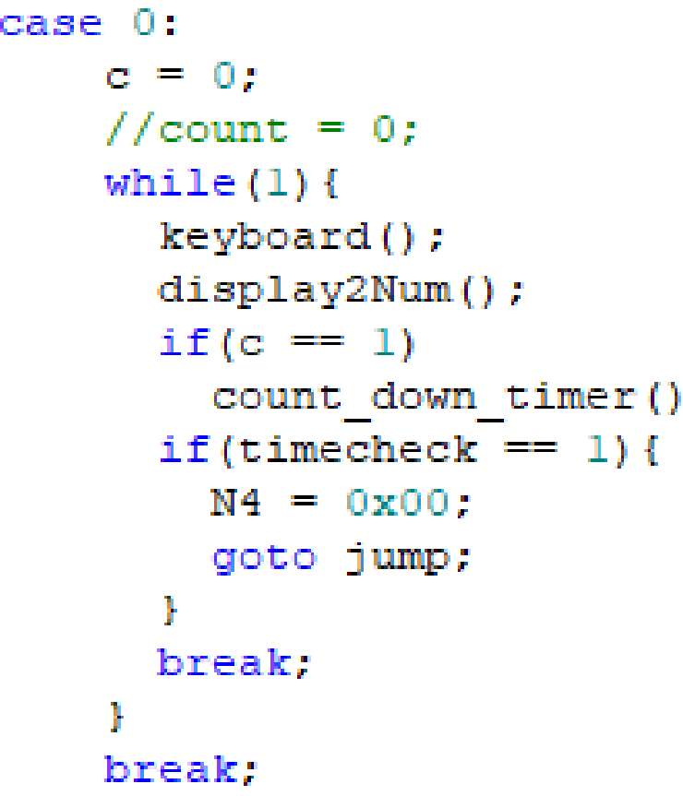
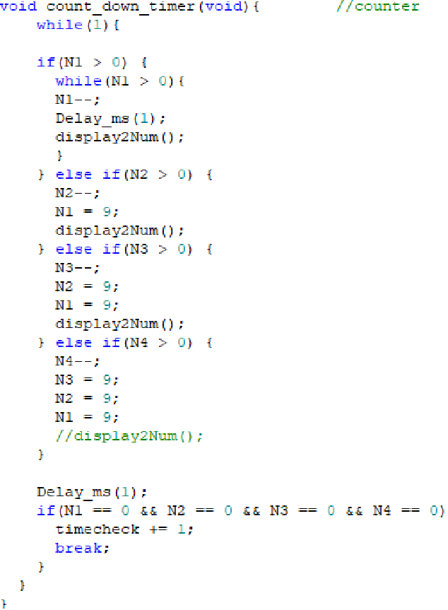
Timer
Function "0" - Timer Overview
Operation Flow: Pressing the N4 key selects Function 0 (Timer), triggering the keyboard() subroutine for time input (e.g., "0300" for 3 minutes), then activates the count_down_timer() subroutine to execute the countdown in MM:SS format with real-time display updates until completion.

Slide 8
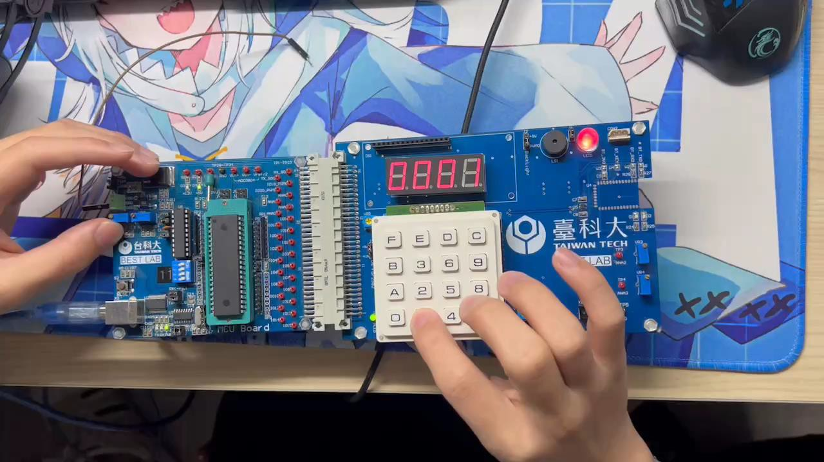
Function Demonstration
Countdown Function

Slide 9
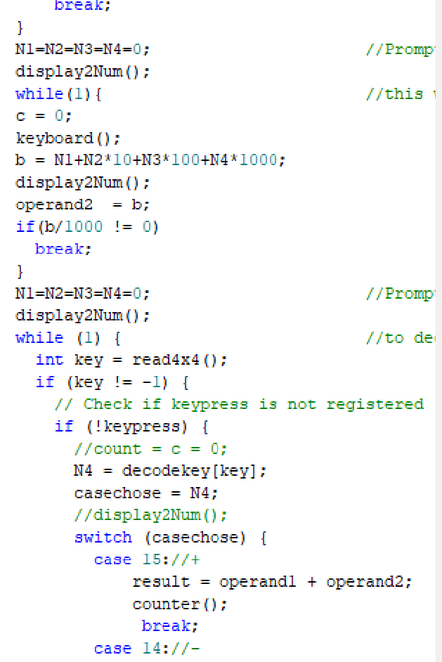
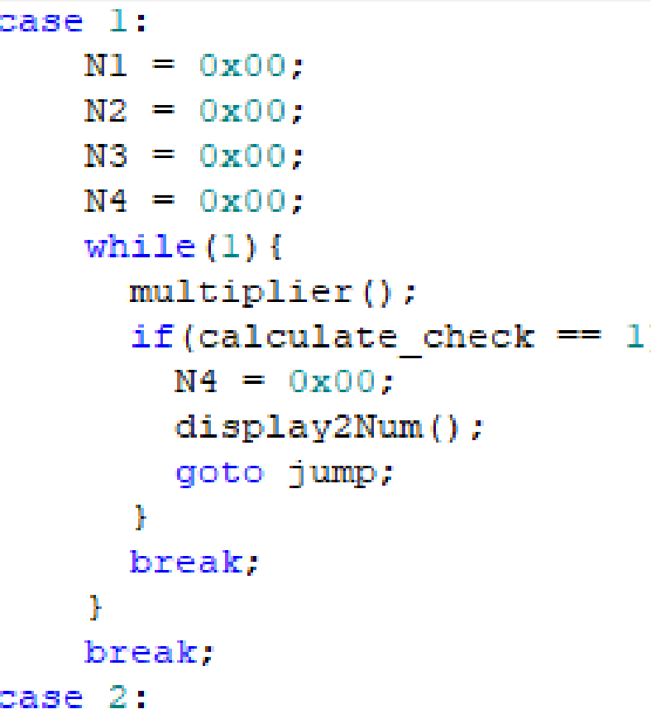
Calculator
Function “1" - Calculator Overview
Operation Flow: Pressing the N4 key selects Function 1 (Calculator), invoking the multiplier() subroutine for dual number input (e.g., "5" and "3"), then pressing N4 again enables operation selection via "F" (addition), "E" (subtraction), "D" (multiplication), or "C" (division), with the computed result passed to the counter() subroutine for final output display.

Slide 10
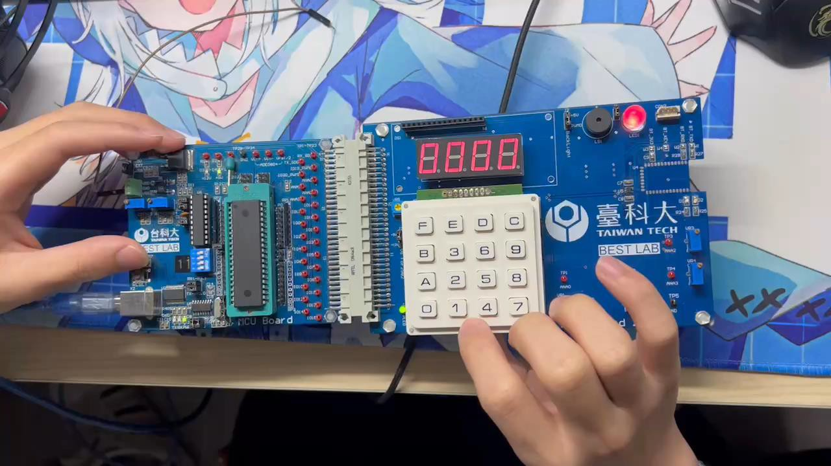
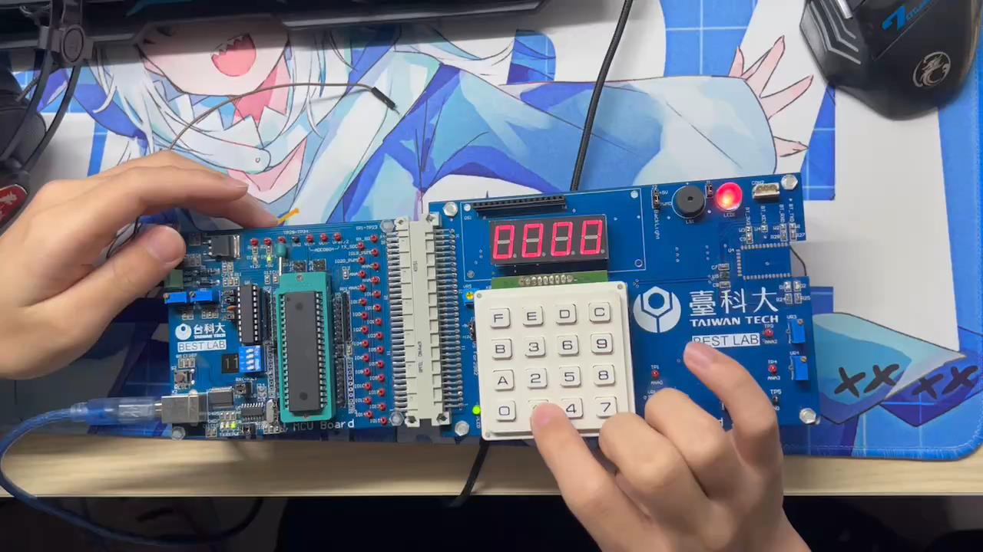
Function Demonstration
Addition Function
Division Function

Slide 11
Work Assignment
 | Project
Jingze He | The project begins with topic conceptualization to define system specifications (password/timer/calculator) and hardware selection (8051 MCU, 4x4 keypad, 7-segment display). Next, 7-segment display programming implements digit encoding (0-9) and multiplexed output, while keypad programming develops row-column scanning with debounce logic. The integration phase combines subsystems with rigorous I/O testing. For core functionalities, countdown programming adds MM:SS timing with alarm triggers, and calculator programming handles arithmetic operations (+, -, *, /) including divide-by-zero checks. Finally, report compilation documents all design stages with schematics, flowcharts, and validation data.
Chiajui Lee | The project begins with topic conceptualization to define objectives and scope, followed by LCD research to understand its interface protocols and control methods. Next, LCD countdown programming implements a timer function with real-time display updates, while LCD calculator programming develops arithmetic operations (+, -, *, /) with result output. The integration phase combines all modules, ensuring seamless interaction between hardware and software. Finally, report writing documents the entire development process, including design choices, code snippets, test results, and conclusions.

Slide 12

THANK YOU

