Slide 1
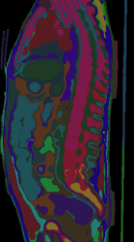
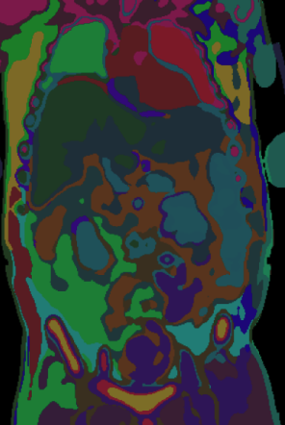

Exploratory Analysis of SegRap2023 for 3D CT Segmentation
Scan and Annotation Characteristics for Low-Label Training
Adi, Arnav, Mina, Rayhan

Slide 2
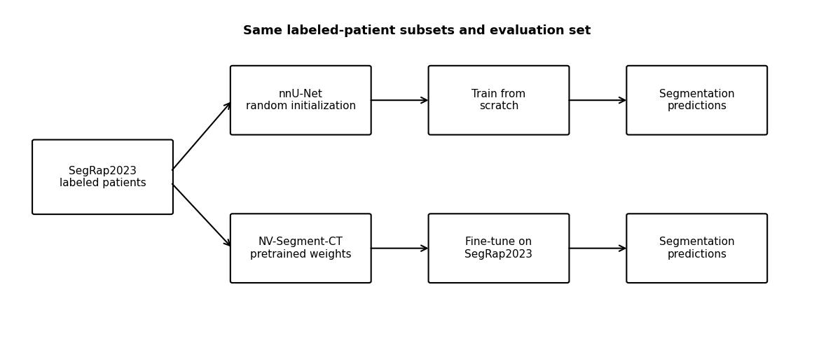
Project Recap
Research Question: Does pretraining improve 3D CT segmentation performance when labeled training data are limited?
nnU-Net (train from scratch) vs. NV-Segment-CT (fine-tune foundation model)
Notes:
nnu-net relies on trad unet architectures
nv-segmentct released nvidia,2024,

Slide 3
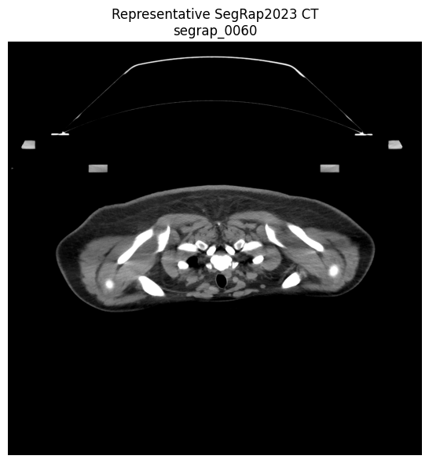
SegRap2023 Dataset Overview
Why SegRap2023? Its patient-level 3D CT scans and detailed anatomical annotations allow us to systematically reduce the amount of labeled training data while keeping evaluation consistent
120 + 20 + 60 patients (training, validation, test)
Head & neck CT
ncCT + ceCT
3D patient-level volumes
Detailed anatomical labels
Notes:
Insert One ncCT and one ceCT Representative CT

Slide 4
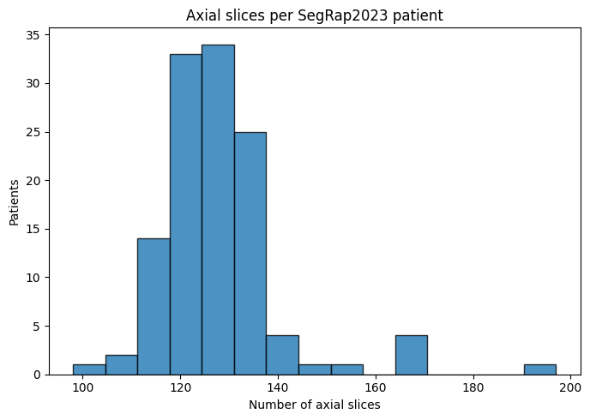
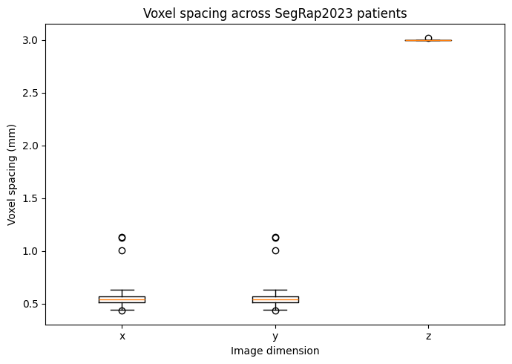
SegRap2023 Slices Vary Spatially
Takeaway: Variation in scan dimensions and spatial resolution determines whether spatial standardization is needed before model training.

Slide 5
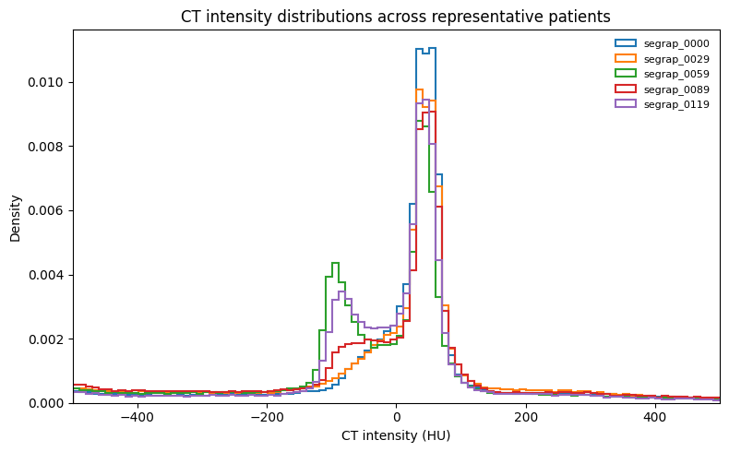
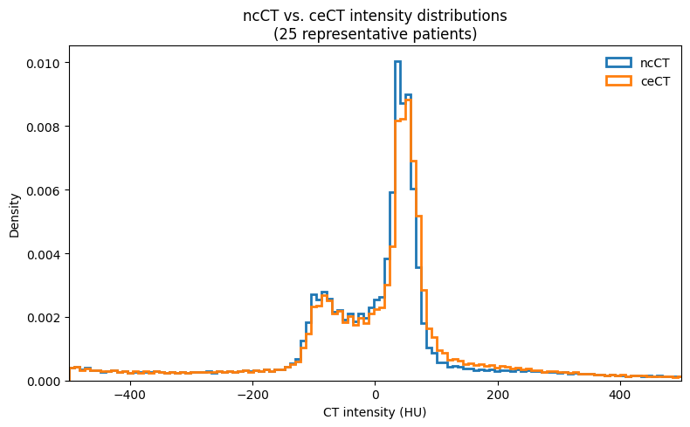
CT Intensity Distributions and Normalization
Takeaway: Comparing intensity distributions across scans and modalities will inform the intensity preprocessing used before training.

Slide 6
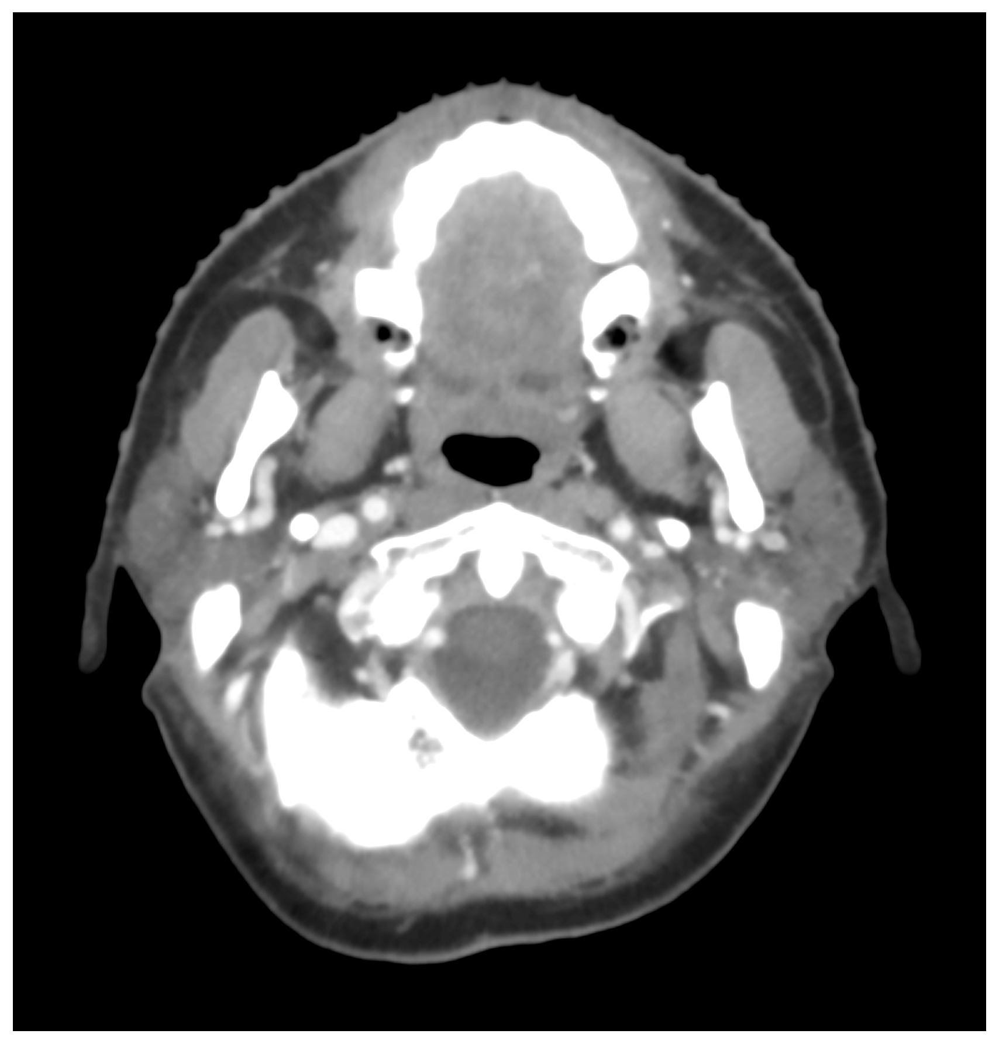
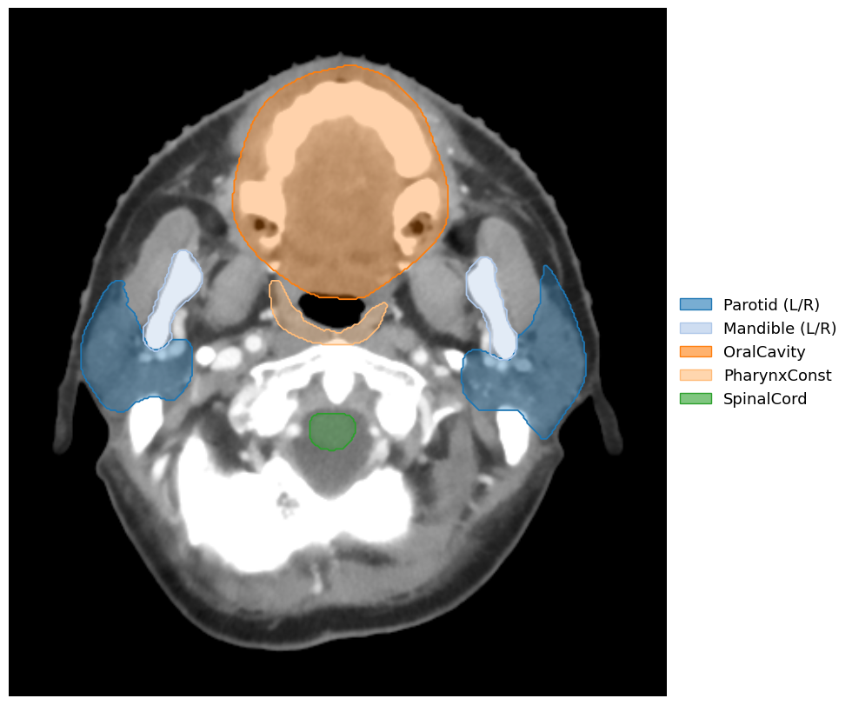
Visualizing SegRap2023 Annotations
Takeaway: SegRap2023 includes labeled structures across individual 2D slices
Individually annotated regions
Raw Axial CT
Labeled Axial CT
Notes:
Insert raw axial CT
Insert axial CT with representative organ masks
Insert axial CT with complex multi-structure annotations
Insert coronal view with overlapping/nested annotations
https://www.sciencedirect.com/science/article/pii/S1361841524003748?via%3Dihub#sec5

Slide 7
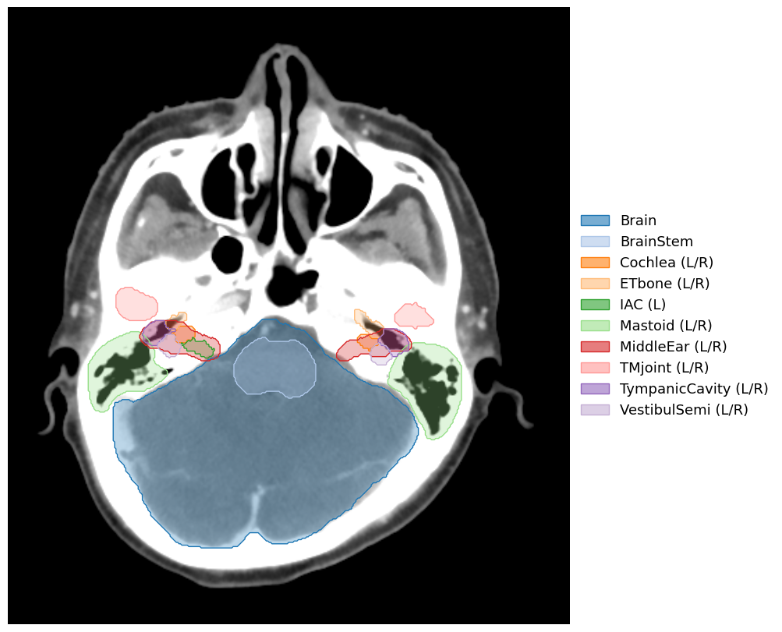
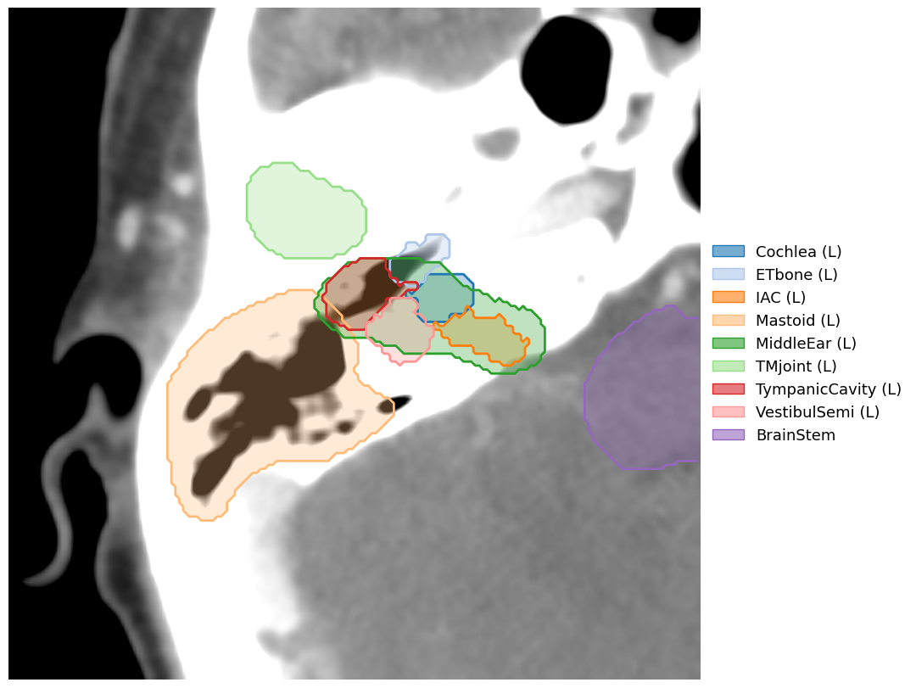
SegRap2023 Annotations Include Complexity
Takeaway: SegRap2023 contains structures with substantially different spatial relationships, including nested and overlapping anatomical regions.
Detailed Segmentation
Overlapping regions

Slide 8
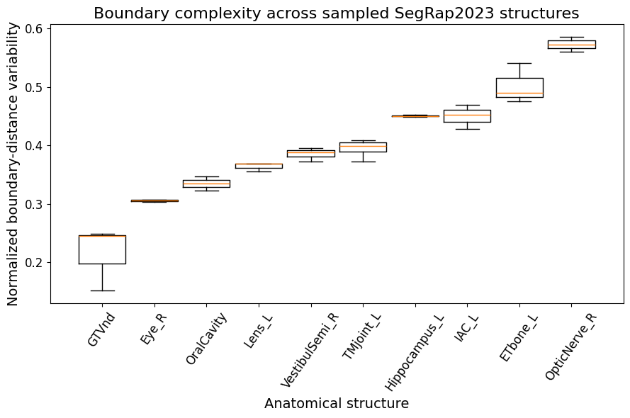
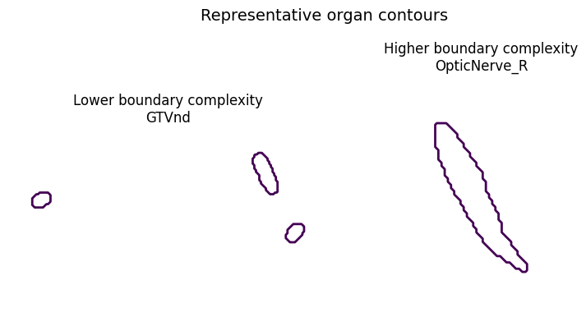
Annotation Boundaries Vary Between Organs
Takeaway: Differences in boundary geometry provide an additional dimension of segmentation difficulty beyond structure size alone.
Evaluation implication: motivates complementing overlap-based metrics with a boundary-sensitive metric.
Notes:
Insert boxplot of normalized centroid-to-boundary distance by OAR
Insert representative organ contours with low vs. high boundary complexity

Slide 9
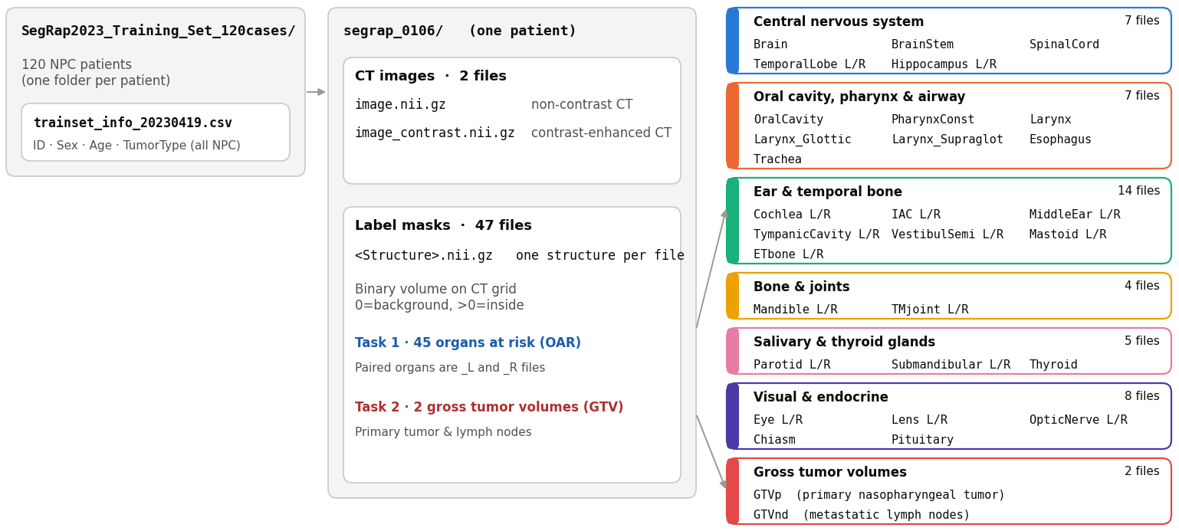
Annotation Characteristics
Takeaway: SegRap includes annotations on many different head neck and neck regions with metadata

Slide 10
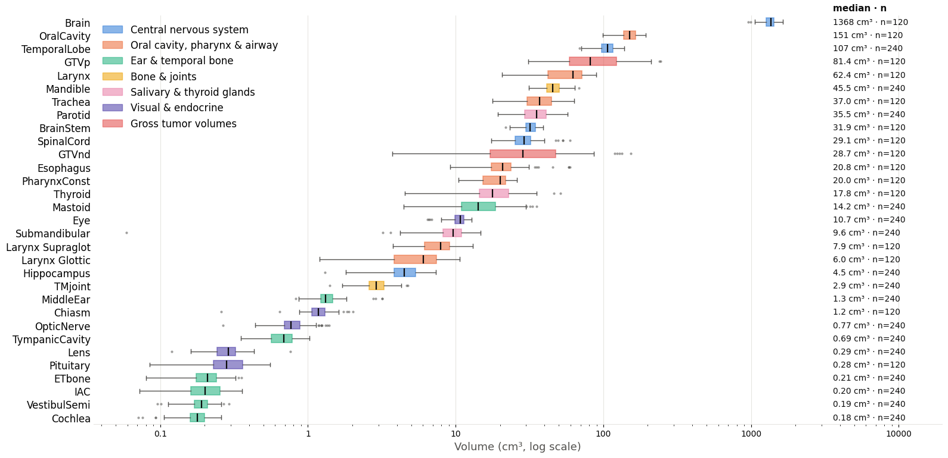
SegRap Labeled Regions Have Size Differences
Takeaway: Large differences in structure size may cause segmentation performance to vary across anatomical structures.
Notes:
explain n = 240

Slide 11
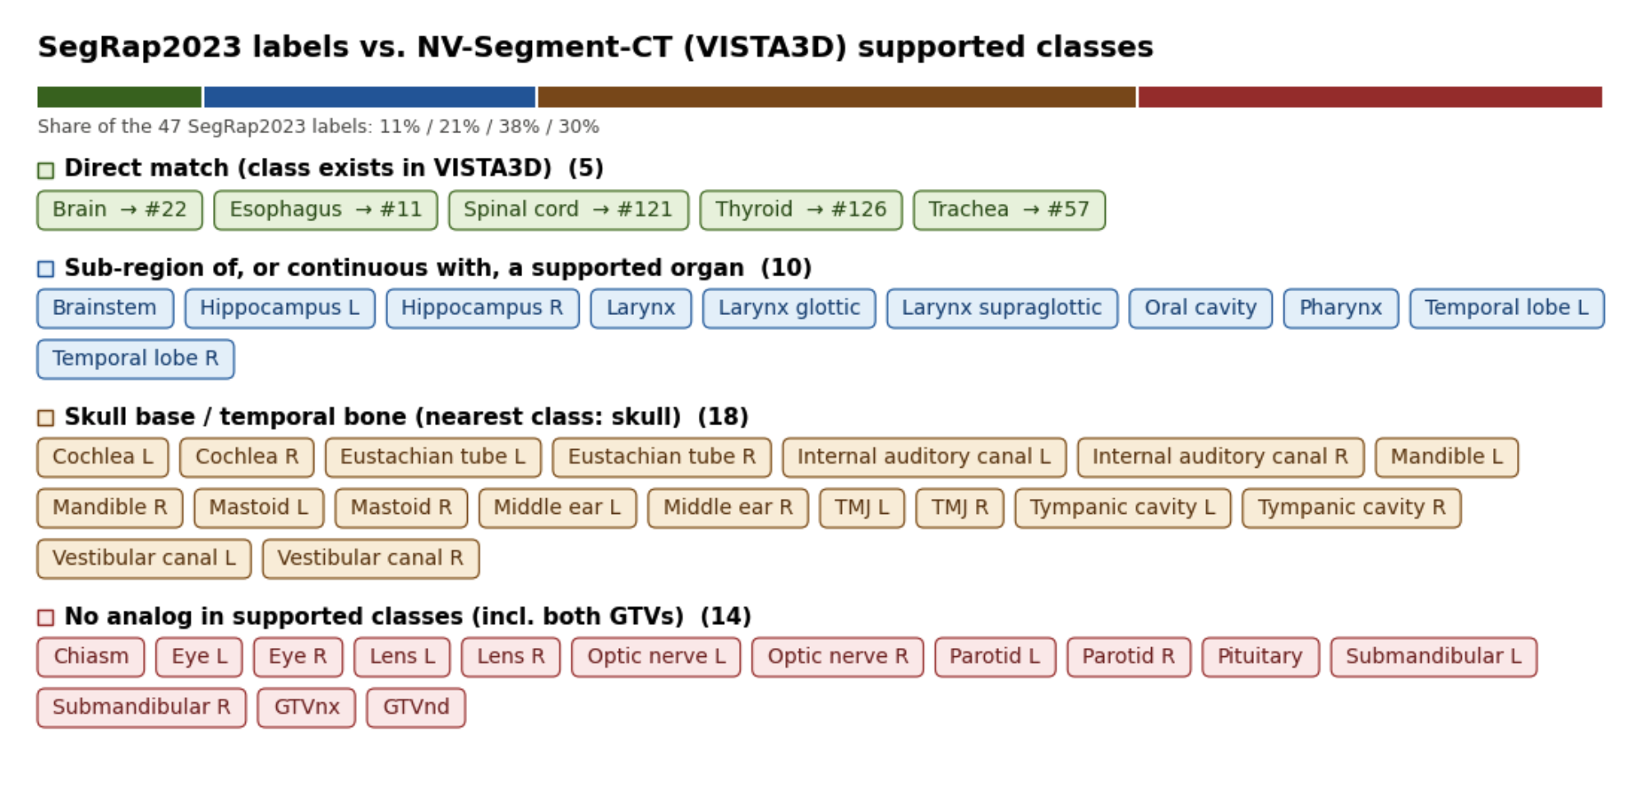
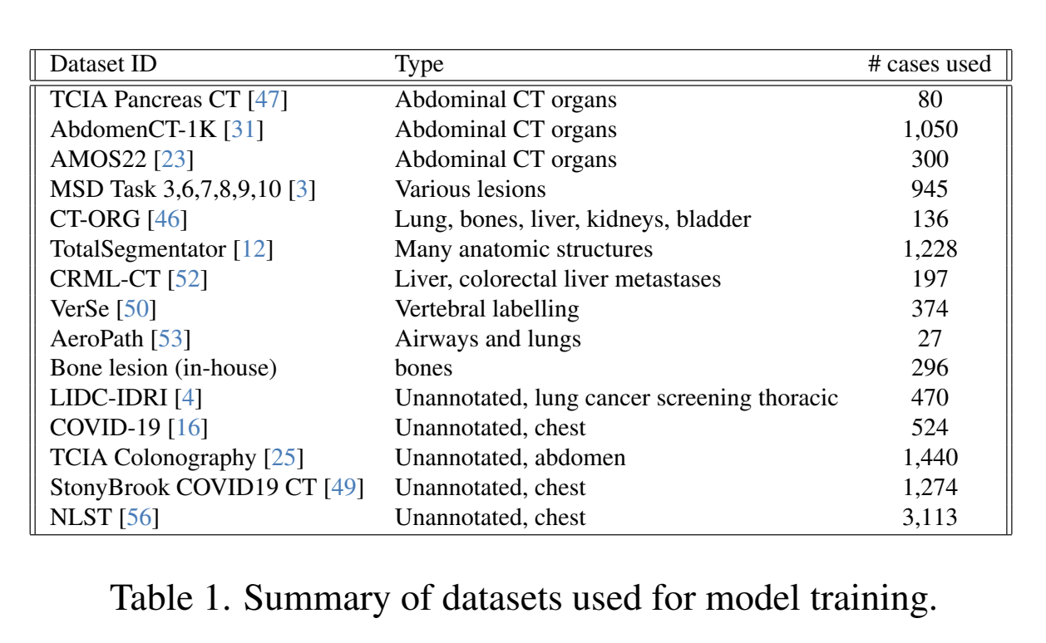
NV-Segment-CT validation of training labels
Takeaway: NV-Segment-CT allows for automatic segmentation of 127 classes, but only a subset may be applicable for predicting SegRap2023 labels

Slide 12
Plan for Next Week
Complete SegRap2023 EDA and finalize preprocessing
Finalize patient-level train/validation/test splits
Create 5, 10, 20, 40, and 80-patient training subsets
Set up the nnU-Net baseline training pipeline
Run initial nnU-Net experiment on the 5-patient subset
Verify training, inference, and Dice evaluation pipeline

Slide 13
Questions?

Slide 14
Do Foundation Models Help When Labels are Scarce?
Comparing nnU-Net and NV-Segment CT for 3D CT Segmentation
Adi, Arnav, Mina, Rayhan
09/24/26

Slide 15
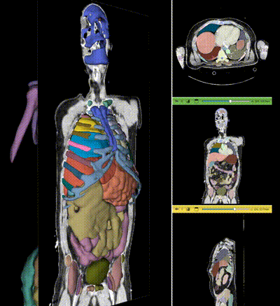
Biomedical Problem
3D segmentation requires voxel-level labels, but expert annotation is costly and time-consuming.
Can pre-training reduce annotation needs?
He, et al. 2025
Notes:
What is the biomedical/data problem?
He, Yufan, et al. "VISTA3D: A unified segmentation foundation model for 3D medical imaging." 2025 IEEE/CVF Conference on Computer Vision and Pattern Recognition (CVPR). IEEE, 2025.

Slide 16
Research Questions
1
Can pre-training reduce annotation needs?
2
When does pre-training outperform training from scratch?
3
Does the advantage decrease as labels increase?
4
Does the distribution of available labels matter?

Slide 17
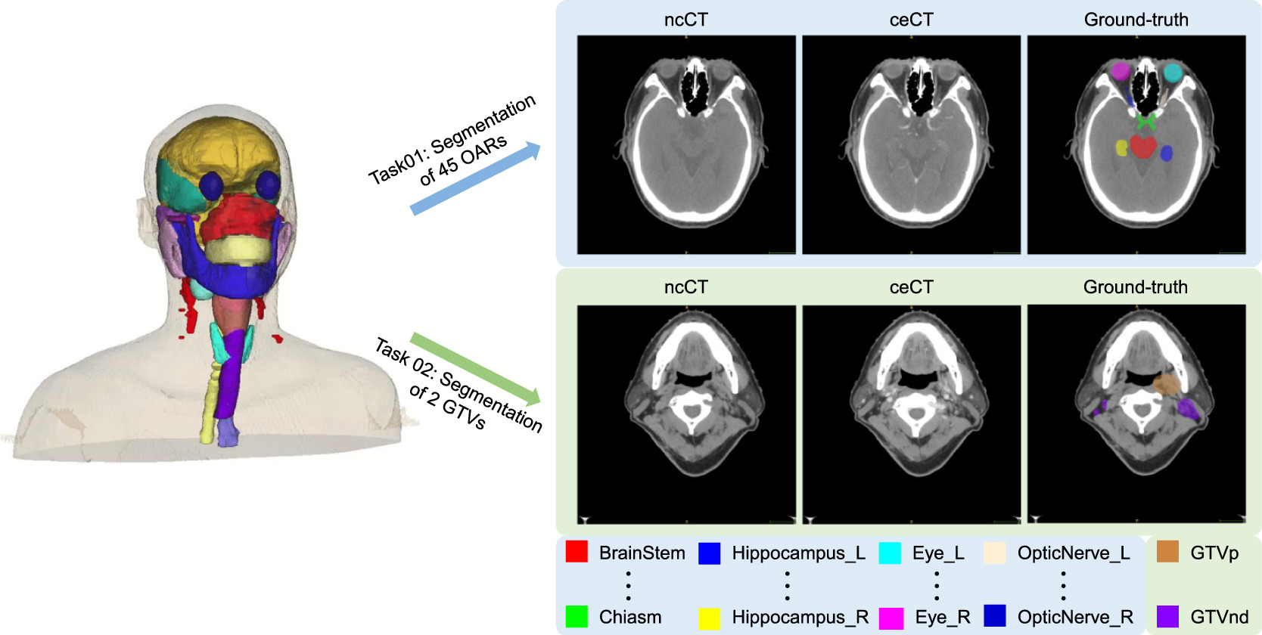
SegRap2023 Dataset: 200 patients with CT scans, 120 labeled patients for training, 45 organ expert labels (+ 2 tumor volumes)
Target output: 3D anatomical segmentation masks + labels
Dataset/Target Output
SegRap2023 nasopharyngeal cancer CT dataset
200 total patients with paired CT scans
120 labeled training patients used for experiments
45 organs-at-risk + 2 tumor volumes
Target output: 3D anatomical segmentation masks
Luo et al., 2025
Notes:
Luo, Xiangde, et al. "Segrap2023: A benchmark of organs-at-risk and gross tumor volume segmentation for radiotherapy planning of nasopharyngeal carcinoma." Medical image analysis 101 (2025): 103447.

Slide 18
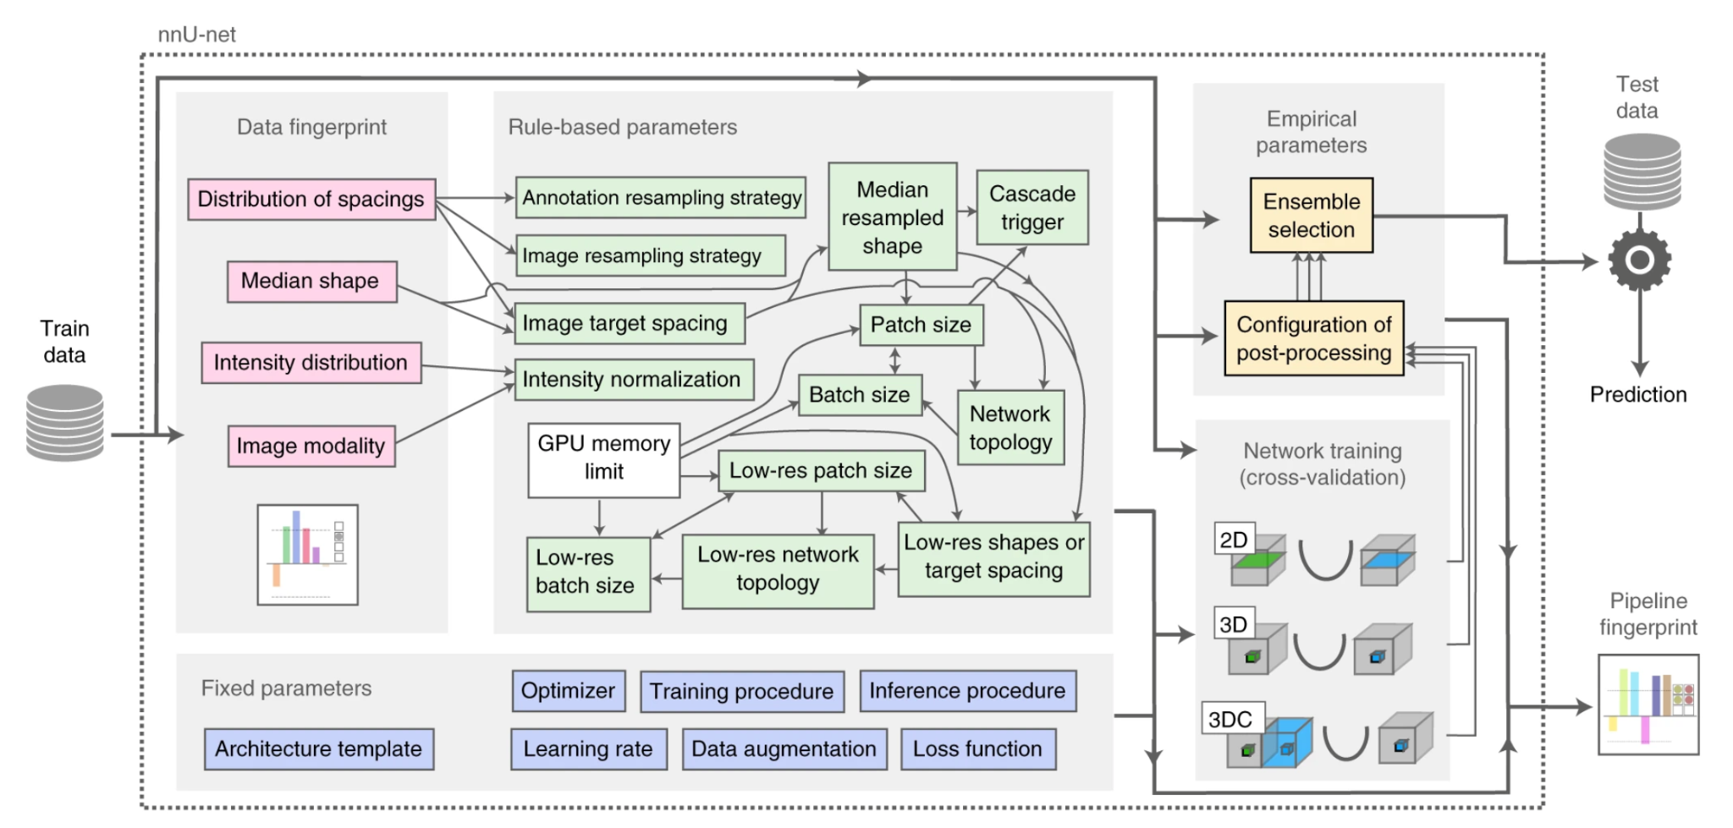
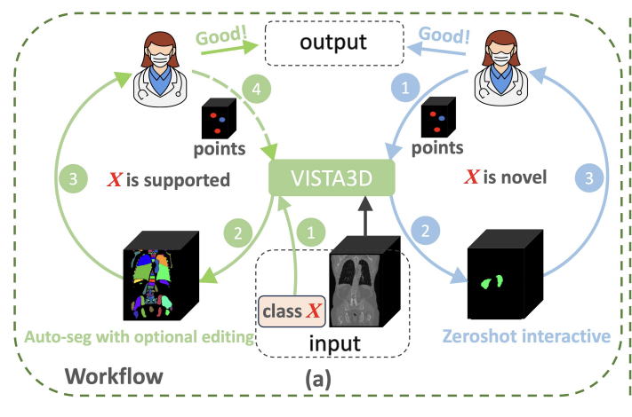
Models being compared:
Target Output
NV-Segment-CT
Pretrained 3D CT foundation model
Begins with learned anatomical representations
Fine-tuned using SegRap2023 labels
nnU-Net
Task-specific segmentation model
Trained from random initialization
Automatically configures the training pipeline
Isensee et al., 2020
He, et al. 2025
Notes:
https://liner.com/review/vista3d-unified-segmentation-foundation-model-for-3d-medical-imaging
https://www.nature.com/articles/s41592-020-01008-z#Fig2
He, Yufan, et al. "VISTA3D: A unified segmentation foundation model for 3D medical imaging." 2025 IEEE/CVF Conference on Computer Vision and Pattern Recognition (CVPR). IEEE, 2025.

Slide 19
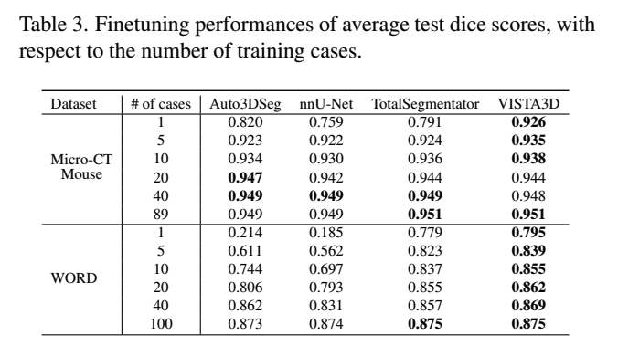
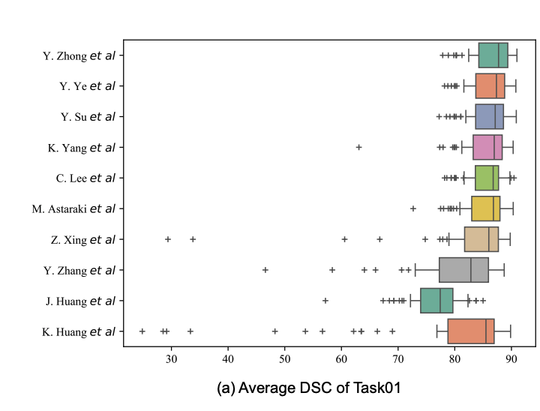
Previous Work
VISTA3D showed stronger performance on abdominal CT (WORD) with fewer cases, but this performance gap narrowed as labeled cases increased.
He et al., 2025
SegRap2023 solutions were largely nnU-Net-based, but pretrained universal models such as UniSeg were also competitive.
Luo et al., 2023
Notes:
Double check He et al., 2025 paper for VISTA3D and fine-tuning

Slide 20
Next Steps
1
Data validity: Verify SegRap2023 was not used during pre-training of NV-Segment-CT
2
Model adaptation with fully labeled patients
→ Select 5, 10, 20, 40, or 80 patients
→ Keep all target structure labels
→ Train nnU-Net from scratch + Fine-tune NV-Segment-CT
→ Compare on the same fixed test set
3
Model adaptation with partially labeled patients
→ Control the overall annotation budget
→ Select number of patients and number of structure labels (e.g. 10 patients x 45 structures vs 90 patients x 5 structures)
→ During training, missing structures treated as unknown, not background
→ Compare with the fully labeled setting

Slide 21

Compute Requirement
GPU cluster likely required
nnU-Net: ~16–32 GB GPU memory
Foundation-model fine-tuning: ~32–48+ GB useful

Slide 22
Expected Insights
Determine when pre-training provides the largest benefit
Determine whether labels are better spent densely or sparsely
Identify the most effective strategy under limited annotation resources

Slide 23
Questions?

Slide 24
First Questions We Will Investigate
Data validity: confirm no SegRap2023 overlap with foundation-model pretraining
Label budget: compare fully labeled patients vs. partially labeled patients
Model adaptation: compare nnU-Net training from scratch with NV-Segment-CT fine-tuning
Fine-tuning strategy: test partial vs. full fine-tuning across label budgets

Slide 25
Pre-training and Data Checks
Verify SegRap2023 was not used during pre-training
Check documented VISTA3D training datasets
No documented SegRap2023 overlap found
Identify SegRap structures represented in NV-Segment-CT
Map compatible labels between the two datasets
Notes:
Isensee et al., 2020

Slide 26
Experiment 1: Fully Labeled Patients
Select 5, 10, 20, 40, or 80 patients
Keep all target structure labels
Train nnU-Net from scratch
Fine-tune NV-Segment-CT
Compare on the same fixed test set

Slide 27
Experiment 2: Partial Labels
Use CT scans from a larger patient pool
Keep only selected structure labels per patient
Missing structures treated as unknown, not background
Control the overall annotation budget
Compare with the fully labeled setting

Slide 28
Overall Experimental Setup
Fixed training / validation / test split
Compare nnU-Net vs. NV-Segment-CT
Two label-scarcity settings
  Fully labeled patients
  Partially labeled patients
Label budgets: 5, 10, 20, 40, 80
Repeat sampling to measure variability
Compare two interpretations of label scarcity

Slide 29
First Questions to Investigate
Effect of label budget
Effect of label distribution
Partial vs. full fine-tuning
Foundation model vs. train-from-scratch baseline

Slide 30
Fine-Tuning NV-Segment-CT
Partial Fine-Tuning
Freeze most pretrained layers
Train task-specific layers
Lower risk of overfitting with few labels
Full Fine-Tuning
Update the entire model
Use a lower learning rate
Test across the same label budgets

Slide 31
Evaluation
Accuracy
Dice score — segmentation overlap
HD95 — boundary error
Stability
Variation across repeated patient samples
Failure Modes
Missed structures
False positives / boundary leakage
Cost
GPU memory
Training and inference time

