Slide 1

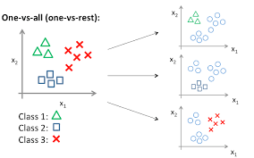
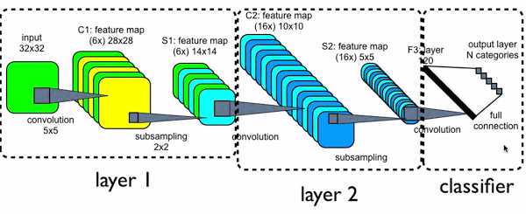
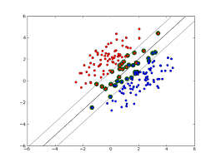
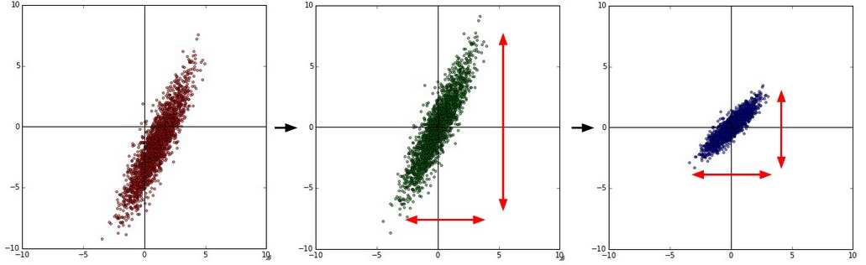
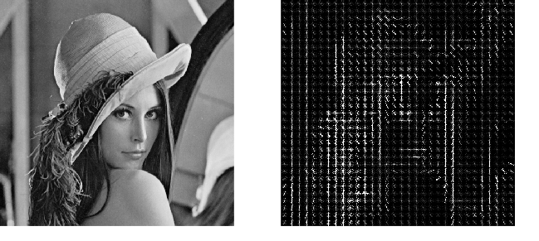
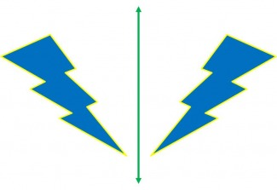
References
Classification of the CIFAR-10 Dataset
Raymond Cano, Xilin Liu
COMP 540 Machine Learning, Rice University
Abstract
The CIFAR-10 dataset is a set of 60,000 images of objects. There are 10 classes of objects, ranging from cats to airplanes. The goal of this project was to create a machine learning model that could successfully classify these images. We ran multiple different classification methods on the dataset with varying success. At first, we tried using one vs. all (OVA) logistic regression. This yielded an accuracy of about 34%. Our next method was to use support vector machines (SVM) with a polynomial kernel, which yielded an accuracy of 54%. Finally, our best results came from running a convolutional neural network (CNN). Our current best accuracy is 86%.
Types of Models
Our Current Model
Stanford University CS231n http://cs231n.github.io/convolutional-networks/#norm
Kaggle CIFAR-10 Competition http://blog.kaggle.com/2015/01/02/cifar-10-competition-winners-interviews-with-dr-ben-graham-phil-culliton-zygmunt-zajac/
He, et al. Residual Learning Network http://arxiv.org/pdf/1512.03385v1.pdf
Tensorflow Library and Cifar10-Tutorial
One vs. All Logistic Regression
Convolutional Neural Networks
Pre-processed
Image
conv1
pool1
norm1
Support Vector Machines:
conv2
norm2
Pool 2
fc
Convolutional Neural Networks:
CNNs work to learn features of an image by convolving portions of the image through layers. Neurons are stacked in layers separated by nonlinearities and can peer into portions of their input image. Our convent takes in preprocessed
fc
Acknowledgement
images as mentioned in the section below sends it first through it’s first convolution, which takes the activation and applies a ReLU nonlinearity. We then max pool and normalize to decrease dimensions and recenter the image. Layer 2 does follows a similar pattern except that it normalizes before pooling. Finally, we have two fully connected layers followed by ReLUs that flow into a final Softmax classifier.
We would like to thank Professor Devika Subramanian for facilitating this project, as well as Michael Xie for great advice and motivation during the course of the project
Image Preprocessing
Results
Normalizing Data by Mean and Standard Deviation
Through a combination of discovering more complex models and preprocessing and augmenting features in a more sophisticated manner, we were able to increase our accuracy over time. Our biggest leaps in accuracy were when we changed the models we used, as seen between models 0 and 1, 1 and 2, and 4 and 5.
Our newest model, a convolutional neural network, is full of potential. Currently, without optimizing hyperparameters, we have achieved an accuracy of 86%. We hypothesize that it will reach an accuracy of 90% or more once we have maximized the model’s potential through increased layering, use of dropout, and leaky ReLUs. Potential alterations to model architecture, such as Residual Learning models could also improve our score.
Histogram of Orienting Gradients
One of the key factors in creating a reliable model is image preprocessing. Normalizing the data, also known as whitening, as well as flipping clipping into smaller images play huge rolls in normalizing a photo into the features a model should learn.
Model # | Date | Accuracy | Method
0 | 3/7/2016 | 0.1 | Random Guess
1 | 3/10/2016 | 0.34 | One Vs. All
2 | 3/12/2016 | 0.44 | HOG + OVA
3 | 3/13/2016 | 0.49 | HOG + SVM RBF Kernel
4 | 3/13/2016 | 0.54 | HOG + SVM Polynomial Kernel
5 | 4/19/2016 | 0.79 | Leaky ReLUs ConvNet
6 | 4/19/2016 | 0.86 | Standard ReLU FFConvNet
7* | 4/22/2016 | 0.9 | Leaky ReLUs and Dropout?
Feature Augmentation via Flipping and Clipping

