Slide 1

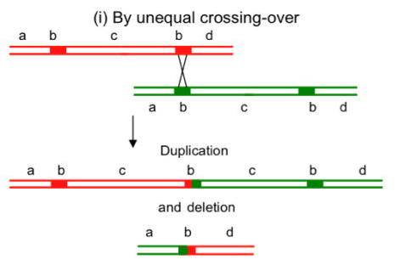
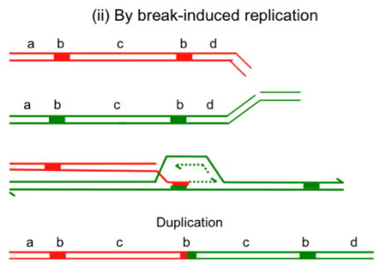
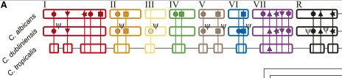
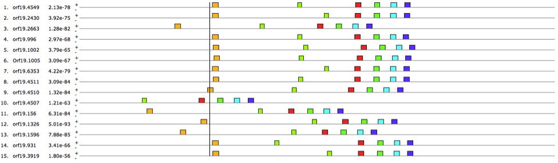
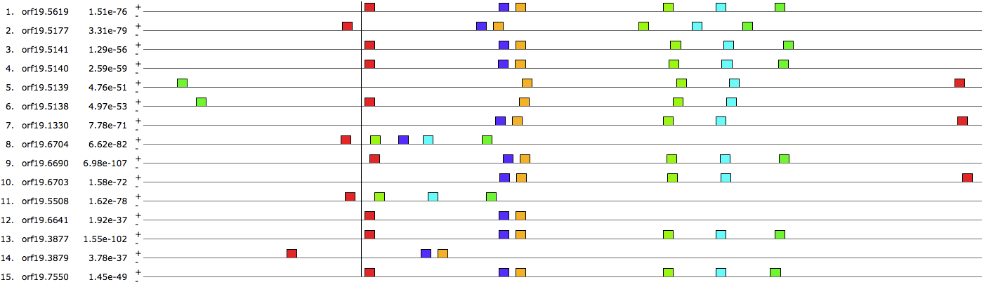
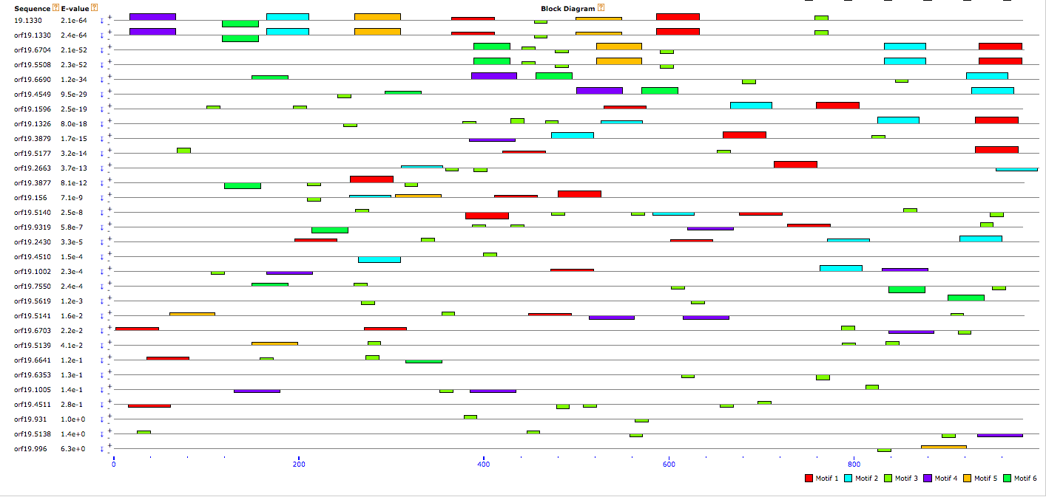
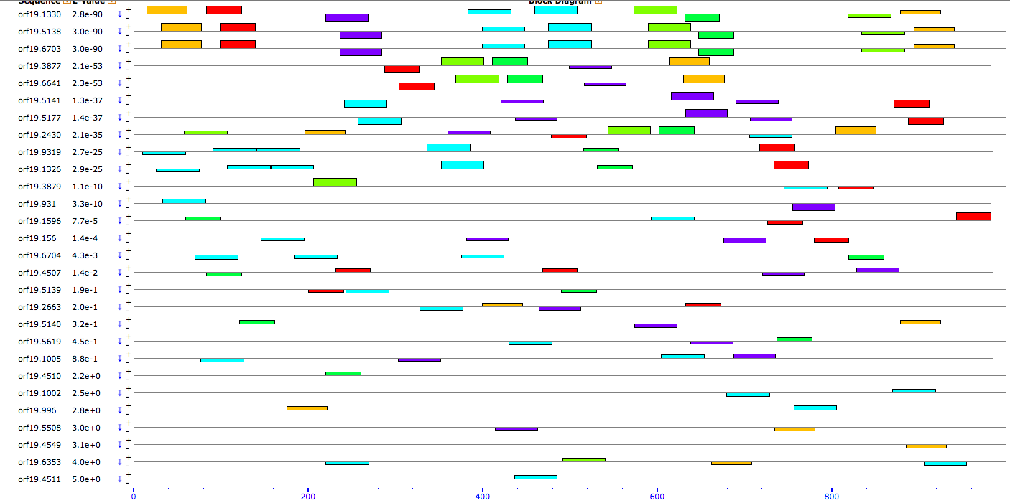
References
Is IFA Gene Amplification In c. albicans Mediated By Homologous Recombination?
Julie Ren, Dr. Michael Gustin
Department of Biosciences, Rice University
Abstract
Candida albicans possess a gene class known as IFA genes. The function of these genes is to encode trans-membrane proteins with weak affinity to leucine repeat-rich proteins in viruses. Widespread gene loss as well as function loss is seen in different lines of Candida (Jackson et al., 2009). Not many studies have been previous conducted on this subject matter, thus this study began with many preliminary DNA analyses and MEME searches in hopes of shedding some light on the mechanism of recombination of this family of genes. Some interesting patterns were found in regards to patterns of conserved sequences in protein coding regions as well as non-protein-coding regions of many IFA genes.
Genome Evolution via Homologous Recombination
Figure 1 (i) and (ii) demonstrates two mechanism of non-allelic homologous recombination that results in a change of copy number in genes
Figure 2 shows the ancestry of IFA genes within the candida family. It is apparent that the copy number of IFA genes increased from c. tropicalis to c. dubliniensis, and from c. dubliniensis to c. albicans
Hastings, PJ et al. “Mechanisms of Change in Gene Copy Number.” Nature reviews. Genetics 10.8 (2009): 551–564. PMC. Web. 11 Apr. 2016.
Timothy L. Bailey and Charles Elkan, "Fitting a mixture model by expectation maximization to discover motifs in biopolymers", Proceedings of the Second International Conference on Intelligent Systems for Molecular Biology, pp. 28-36, AAAI Press, Menlo Park, California, 1994.
Jackson, Andrew P. et al. “Comparative Genomics of the Fungal Pathogens Candida Dubliniensis and Candida Albicans.” Genome Research 19.12 (2009): 2231–2244. PMC. Web. 11 Apr. 2016.
Figure 1
Figure 2
Acknowledgement
I would like to thank Dr. Gustin for assisting me in the research process, and the NSF for funding the research.
Methods
Results
The preliminary results consists 1000 base pairs upstream of the protein coding regions, plus the actual protein coding region of each IFA gene in c. ablicans. A pattern is apparent in these results. We then tried to narrow down the putative sites of recombination by running more MEME searches on smaller segments of the gene. The putative recombination sites upstream and downstream of the IFA genes consist of only 1000 base pairs upstream, or 1000 base pairs downstream of the IFA gene protein coding region, and not the actual protein coding region. These results does not show as distinctive a pattern as did the preliminary around of data. Further analysis will need to be down to determine whether any of these sites is a site of homologous recombination in IFA genes.
Preliminary Results
BLAST
Search the IFA gene genome for repeated DNA sequences via BLAST
MEME
Discover motifs of reoccurring patterns of a specific length in the DNA sequences provided via statistical modeling techniques
Prediction and further analysis
Prediction that the motifs found by MEME are possibly sites of homologous recombination—further analysis is required at this point
Putative Recombination Sites Upstream of IFAs
Putative Recombination Sites Downstream of IFAs

