Slide 1
SFPD Activities trends 2010 through 2017
Beatriz Shetkar Ray Sheng
Abdullah Alfai Alex Leontiev Jan. 20, 2018

Slide 2
summary
Motivation
Investigate a relevant local topic
Work with up-to-date data sets
SF Open Data our starting point – sfdata.org
Questions of interest
What are general trends and makeup of types of crime in SF?
Are there temporal and geographic area correlations with criminal activity?
Are there any socioeconomic relationships?
Data sources
Primary source: SFPD Incident Report https://data.sfgov.org/Public-Safety/Police-Department-Incidents/tmnf-yvry
Census Bureau ACS reports https://www.census.gov/programs-surveys/acs/data.html

Slide 3
Challenges
Logistics and definitions
Large data set – SFPD Incident Report CSV 2.2M records
Focused on current decade – 2010 - 2017
Crime vs. police incident – 39 categories of incidents, not all criminal activity
Focused on select types of incidents – top ten list
No common definition of locales – SFPD district vs. city neighborhoods
Decided on zip code
Used http://ws.geonames.org for zip code lookup Metering issue mitigated by keeping track of locations
Data cleanup
Moving large CSV and loading them time consuming – zip to the rescue
Used shape, columns, statistics, duplicate, dtypes to examine data

Slide 4
approach, findings, follow-on work
Collaborative an iterative
All worked on data wrangling, then focused on individual questions
Code structure reflected the independent nature of questions
Started high level, drilled down into details, focused on relevant areas of interest
High level findings
Overall increase in annual incidents commensurate with population increase; fairly similar mix of incident types for zip codes
Additional insights by individual team members
What new areas would we explore, given more time?
Map zip codes to neighborhoods
Apply geospatial techniques to identify hot spots
Use google API to relate hot spot info to landmarks – tourist attraction areas, schools

Slide 5
Individual slides
Screen shots of plots & Jupyter notebooks
2-4 slides per person

Slide 6
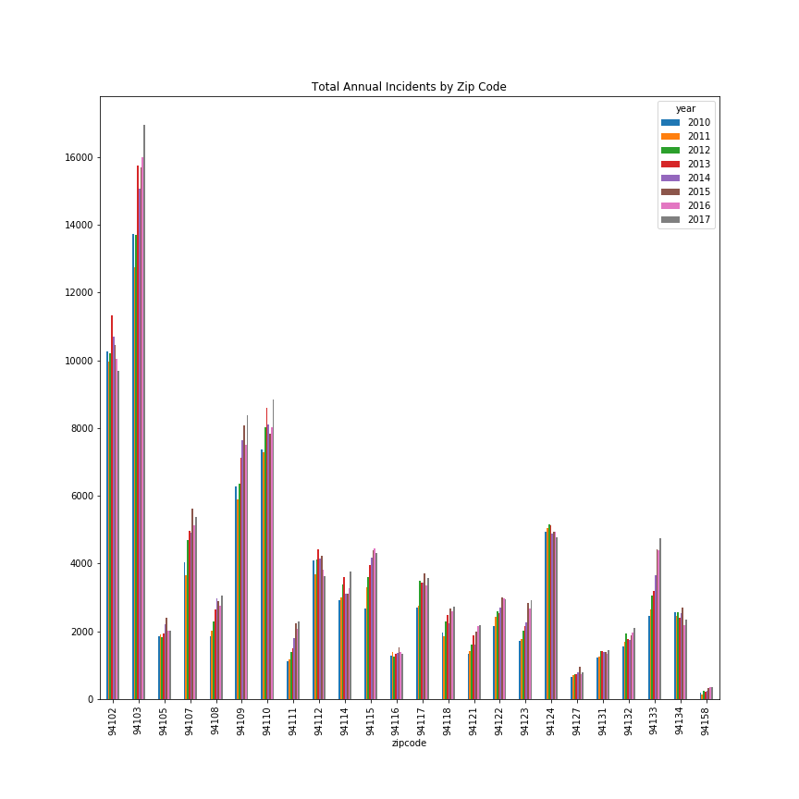
Annual pattern
BACK

Slide 7
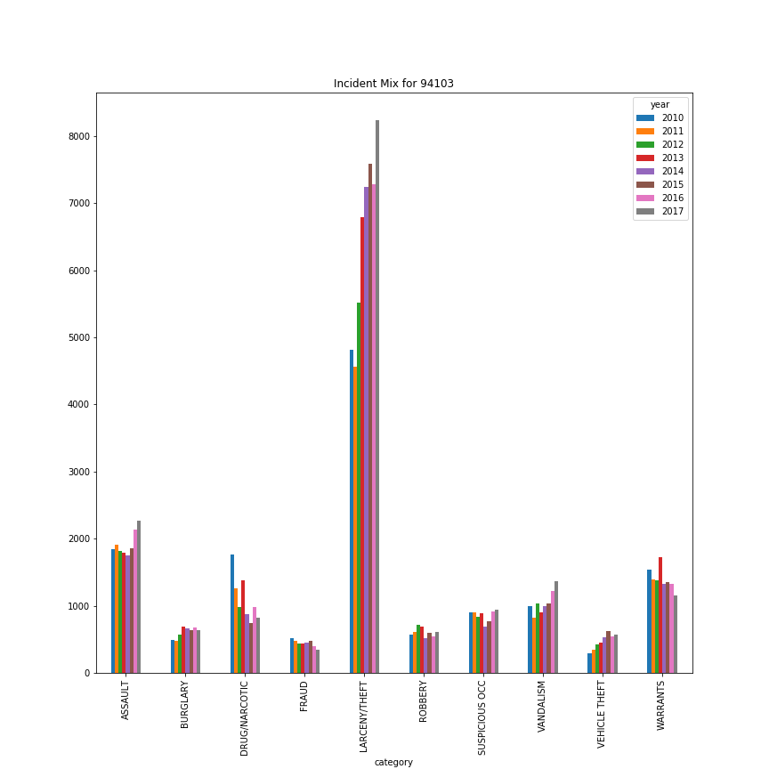
Incident mix pattern
BACK

