Slide 1
Chapter 03:
8086 Microprocessor

Slide 2
Introduction to 8086 Microprocessor
Features of 8086 microprocessor
Intel 8086 is a widely used 16 bit microprocessor.
The 8086 can directly address 1MB of memory.
The internal architecture of the 8086 microprocessor is an example of register based
microprocessor and it uses segmented memory.
It pre-fetches up to 6 instruction bytes from the memory and queues them in order to speed up
the instruction execution.
It has data bus of width 16 bits and address bus of width 20 bits. So it always accesses a 16 bit word to or from memory.
The 8086 microprocessor is divided internally into two separate units which are Bus interface unit (BIU) and the execution unit (EU).
The BIU fetches instructions, reads operands and write results.
The EU executes instructions that have already been fetched by BIU so that instructions fetch overlaps with execution.
A 16 bit ALU in the EU maintains the MP status and control ﬂags, manipulates general register and instruction operands.

Slide 3
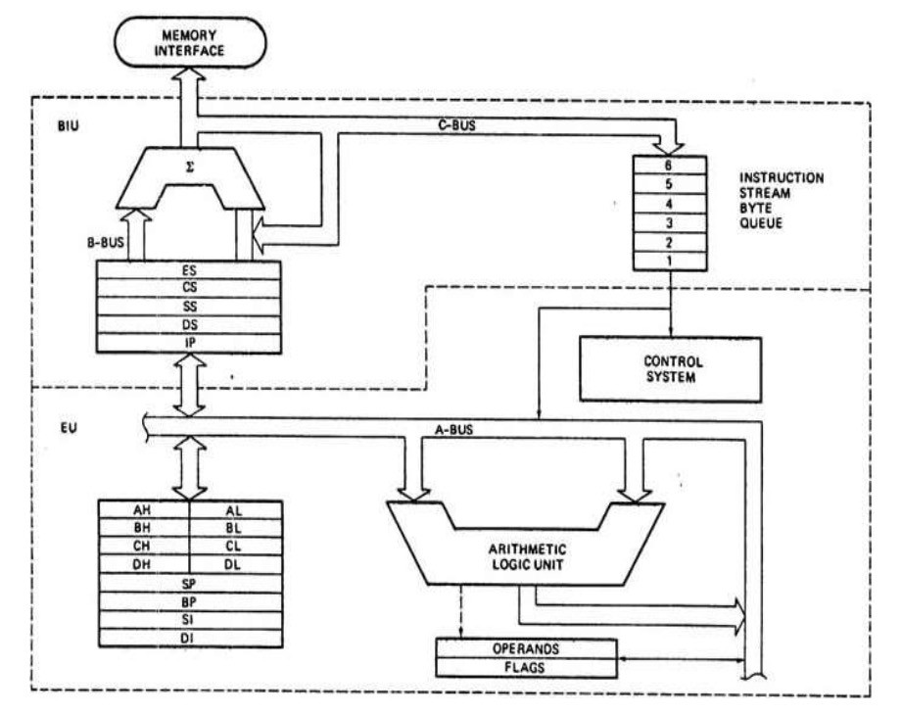
8086 architecture

Slide 4
Bus Interface Unit(BIU) and its Components
The BIU sends out addresses, fetches instructions from memory reads data from memory or ports and writes data to memory or ports.
So it handles all transfers of data and address on the buses for EU. It has main 2 parts instruction queue and segment registers.
The BIU can store up to 6 bytes of instructions with FIFO (First in First Out)
manner in a register set called a queue.
When EU is ready for next instruction, it simply reads the instruction from the
queue in the BIU. This is done in order to speed up program execution by
overlapping instruction fetch with execution. This mechanism is known as
pipelining.
The BIU contains a dedicated address, which is used to produce 20 bit address.
Four segment registers in the BIU are used to hold the upper 16 bits of the
starting address of four memory segments that the 8086 is working at a particular
time.
These are code segment, data segment, stack segment and extra segment. The 8086’s 1 MB memory is divided into segments up to 64KB each.

Slide 5
Code segment register and instruction pointer (IP)
The CS contains the base or start of the current code segment.
The IP contains the distance or offset from this address to the next instruction byte to be fetched.
Code segment address plus an offset value in the IP indicates the address of an instruction to be fetched for execution.

Slide 6
Data Segment
Data segment Contains the starting address of a program’s data segment. Instructions use this address to locate data. This address plus an offset value in an instruction, causes a reference to a specific byte location in the data segment.
Stack segment (SS) and Stack Pointer (SP)
Stack segment Contains the starting address of a program’s stack segment. This segment address plus an offset value in the stack pointer indicates the current word in the stack being addressed.
Extra Segment(ES)
It is used by some string (character data) to handle memory addressing. The string instructions always use the ES and destination index (DI) to determine 20 bit physical address.

Slide 7
Execution Unit (EU)
The EU decodes and executes the instructions.
The EU contains arithmetic and logic (ALU), a control unit, and a number of registers.
These features provide for execution of instructions and arithmetic and logical operations.
It has nine 16 bit registers which are AX, BX, CX, DX, SP, BP, SI, DI and ﬂag. First four can be used as 8 bit register (AH, Al, BH, BL, CH, DH, DL)

Slide 8
AX Register
AX register is called 16 bit accumulator and AL is called 8 bit accumulator. The I/O (IN or OUT) instructions always use the AX or AL for inputting/Outputting 16 or 8 bit data from or to I/O port.
BX Register
BX is known as the base register since it is the only general purpose register that can be used as an index to extend addressing. The BX register is similar to the 8085’s H, L register. BX can also be combined with DI or SI as C base register for special addressing.
CX register:
The CX register is known as the counter register because some instructions such as SHIFT, ROTATE and LOOP use the contents of CX as a Counter.
DX register:
The DX register is known as data register. Some I/O operations require its use and multiply and divide operations that involve large values assume the use of DX and AX together as a pair. DX comprises the rightmost 16 bits of the 32-bit EDX.

Slide 9
Stack Pointer (SP) and Base Pointer (BP):
Both are used to access data in the stack segment. The SP is used as an offset from the current stack segment during execution of instructions. The SP’s contents are automatically updated (increment/decrement) during execution of a POP and PUSH instructions.
The BP contains the offset address in the current stack segment. This
offset is used by instructions utilizing the based addressing mode.
Index register:
The two index registers SI (Source index) and DI (Destination Index) are used in indexed addressing. The instructions that process data strings use the SI and DI index register together with DS and ES respectively, in order to distinguish between the source and destination address.

Slide 10

Flags
Flag register:
The 8086 has nine 1 bit flags. Out of 9 six are status and three are control flags.
The control bits in the flag register can be set or reset by the programmer.

Slide 11
O- Overflow flag This flag is set if an arithmetic overflow occurs, i.e. if the result of a signed
operation is large enough to be accommodated in a destination register.
D-Direction Flag This is used by string manipulation instructions. If this flag bit is ‘0’ , the string is
processed beginning from the lowest address to the higher address, i.e. auto incrementing mode
otherwise the string is processed from the highest address towards the lowest address, i.e. autodecrementing mode.
I-Interrupt flag If this flag is set the maskable interrupts are recognized by the CPU, otherwise they are ignored.
T- Trap flag If this flag is set the processor enters the single step execution mode. In other words,
a trap interrupt is generated after execution of each instruction. The processor executes the
current instruction and the control is transferred to the Trap interrupt service routine.
S - Sign flag: This flag is set when the result of any computation is negative. For signed computations, the sign flag equals the MSB of the result.
Z- Zero This flag is set when the result of the computation is or comparison performed by the previous instruction is zero. 1 for zero result, 0 fir nonzero result
A- Auxiliary Carry This is set if there is a carry from the lowest nibble, i.e. bit three during the
addition or borrow for the lowest nibble i.e. bit three, during subtraction.
P- Parity flag This flag is set to 1 if the lower byte of the result contains even number of 1s otherwise reset.
C-Carry flag This flag is set when there is a carry out of MSB in case of addition or a borrow in case of subtraction.

Slide 12
SEGMENT AND OFFSET ADDRESS:
Segments are special areas defined in a program for containing the code, data and stack. A segment begins on a paragraph boundary. A segment register is of 16 bits in size and contains the starting address of a segment.
A segment begins on a paragraph boundary, which is an address divisible by decimal 16 or hex 10. Consider a DS that begins at location 038EOH. In
all cases, the rightmost hex digit is zero, the computer designers decided that it would be unnecessary to store the zero the zero digit in the segment register. Thus 038E0H is stores in register as 038EH.
The distance in bytes from the segment address to another location within the segment is expressed as an offset or displacement. Suppose the offset of 0032H for above example of data segment. Processor combines the address of the data segment with the offset as:
SA: OA (segment address: offset address) 038E: 0032 H = 038E * 10 +0032
= 038EO + 0032 Physical address = 03912H

Slide 13
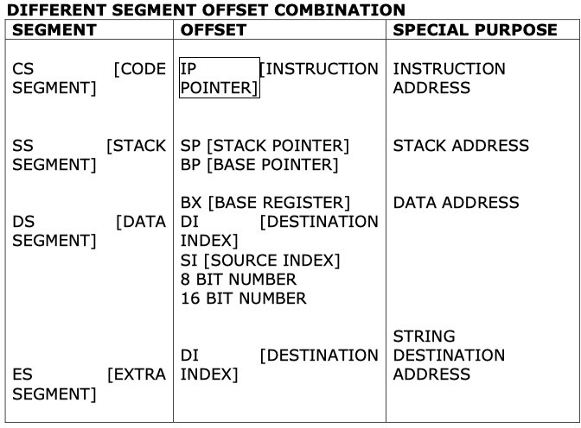

Slide 14
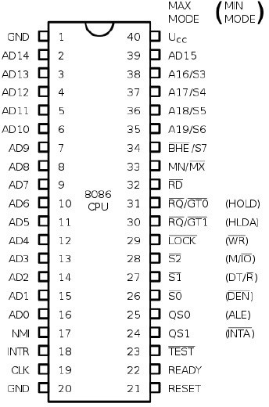
Pin diagram of 8086

Slide 15
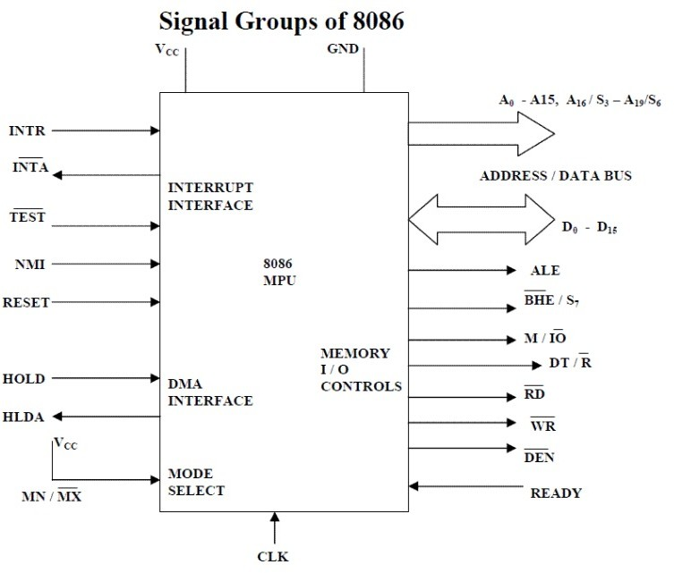

Slide 16
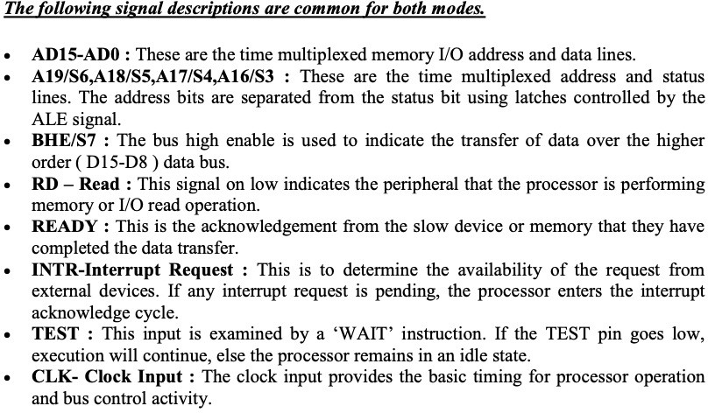

Slide 17
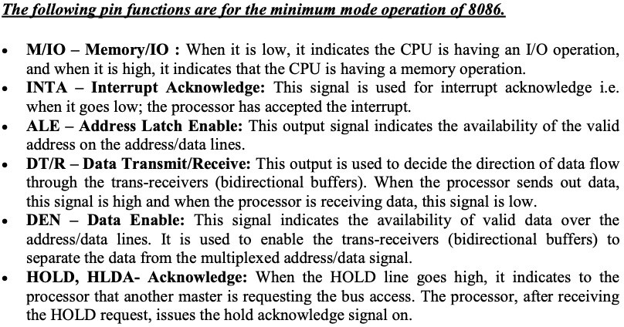

Slide 18
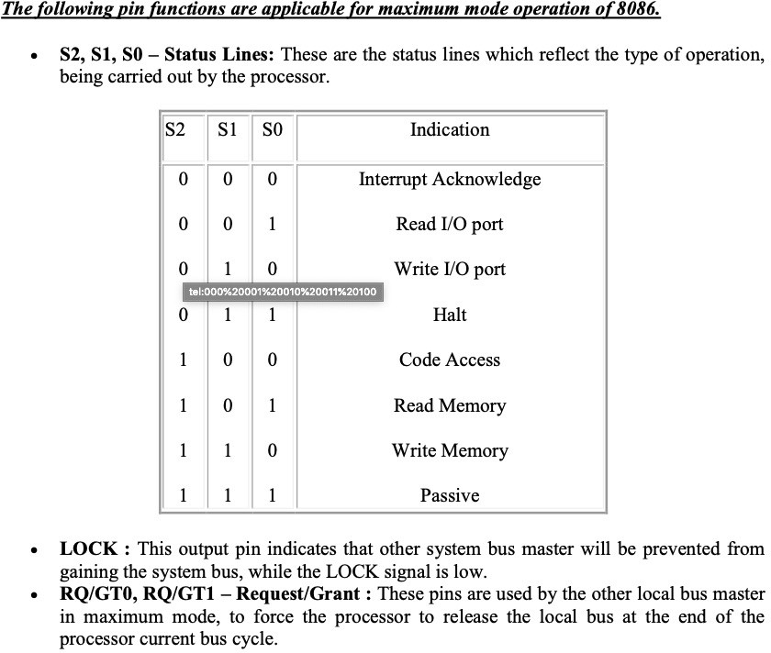

Slide 19
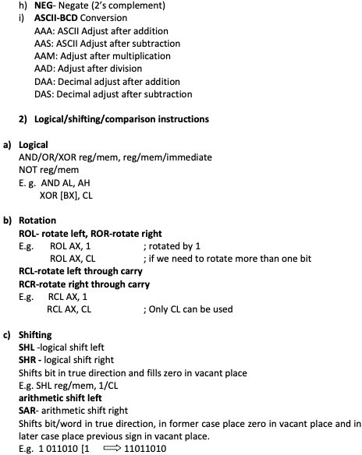
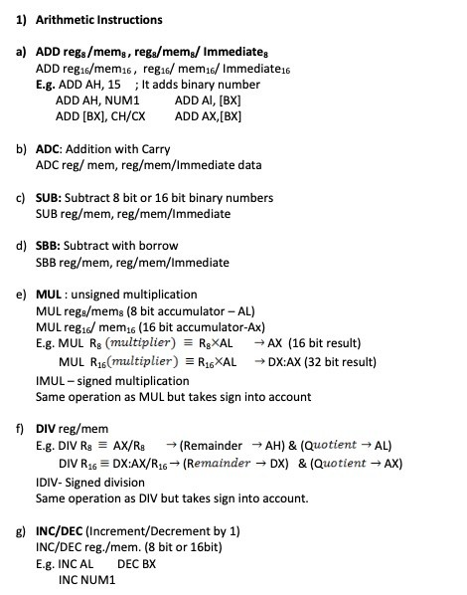
8086 instructions

Slide 20
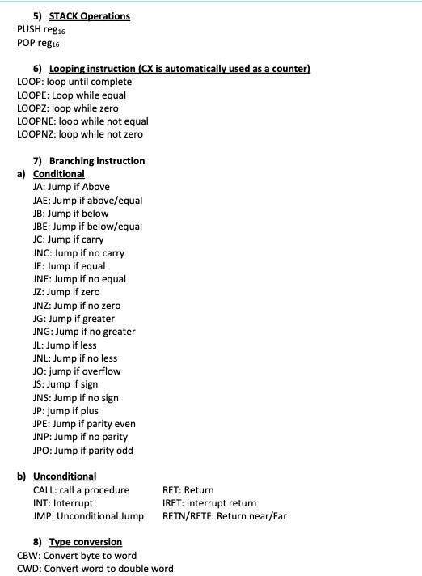
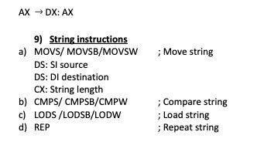
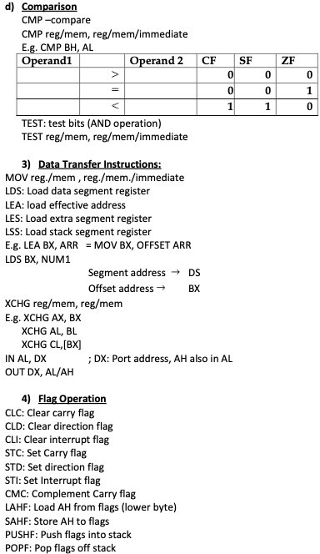

Slide 21
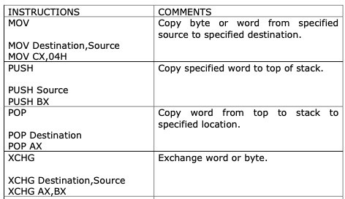
3) Data Transfer Instructions

Slide 22
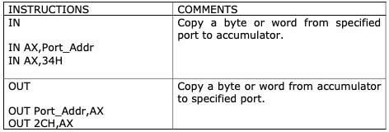
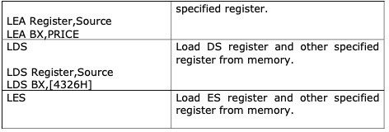

Slide 23
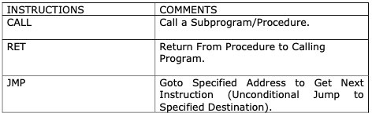
4) Program execution transfer instructions

Slide 24
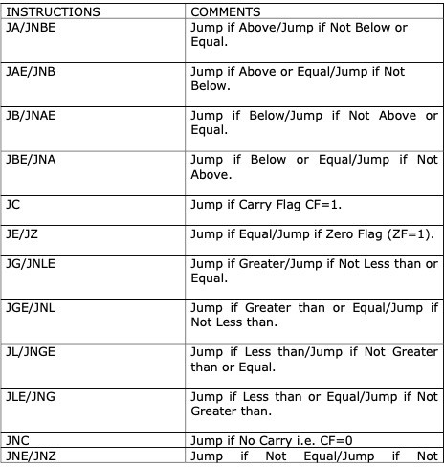

Slide 25
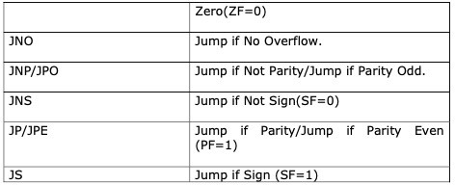
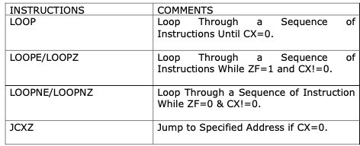

Slide 26
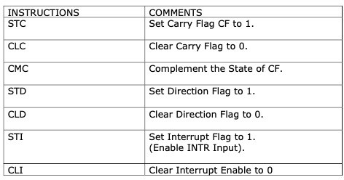

5) Processor control flag instructions
Auto decrement
Auto increment

Slide 27
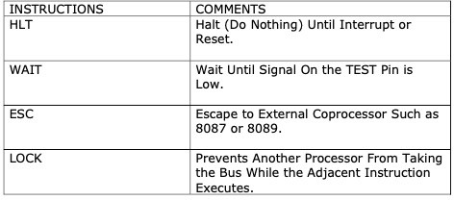


Slide 28
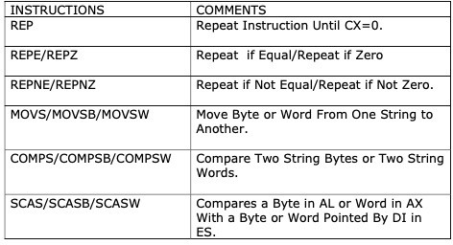
6) String instructions

Slide 29
8086 Assembly language programming
Assembly Language uses two, three or 4 letter mnemonics to represent each instruction type.
Low level Assembly Language is designed for a specific family of Processors : the symbolic instruction directly relate to Machine Language instructions one for one and are assembled into machine language
In the past to make programming easier, many programmers used to write programs in assembly language
They then translate Assembly Language program to machine language so that it can be loaded into memory and run.

Slide 30
ADVANTAGES OF ASSEMBLY LANGUAGE
A Program written in Assembly Language requires considerably less Memory and execution time than that of High Level Language.
Assembly Language gives a programmer the ability to perform highly technical tasks.
Resident Programs (that resides in memory while other programs execute) and Interrupt Service Routine (that handles I/P and O/P) are almost always developed in Assembly Language.
Provides more control over handling particular H/W requirements.
Generates smaller and compact executable modules.
Results in faster execution.

Slide 31
TYPICAL FORMAT OF AN ASSEMBLY LANGUAGE INSTRUCTION
LABEL OPCODE FIELD OPERAND COMMENTS FIELD
NEXT: ADD AL,07H ; Add correction factor
Assembly language statements are usually written in a standard form that has 4 fields.
A label is a symbol used to represent an address. They are followed by colon .
Labels are only inserted when they are needed so it is an optional field.
The opcode field of the instruction contains the mnemonics for the
instruction to be performed
The instruction mnemonics are sometimes called as operation codes.
The operand field of the statement contains the data, the memory address, the
port address or the name of the register on which the instruction is to be
performed.
The final field in an assembly language statement is the comment field which
starts with semicolon. It forms a well documented program.

Slide 32
ASSEMBLY LANGUAGE PROGRAM DEVELOPMENT TOOLS
1. TEXT EDITOR – Notepad, Vscode
An Editor is a Program which allows you to create a file containing the Assembly Language statements for your Program.
2. ASSEMBLER – MASM, NASM, GAS
An Assembler Program is used to translate the assembly language mnemonics for instruction to the corresponding binary codes.
3. LINKER
A Linker is a Program used to join several files into one large .obj file. It produces .exe file so that the program becomes executable.
4. LOCATOR
A Locator is a program used to assign the specific address of where the segment of object code are to be loaded into memory.
It usually converts .exe file to .bin file.
A Locator program EXE2BIN converts .exe file to .bin file.
5. DEBUGGER
A Debugger is a program which allows you to load your .obj code program into system memory, execute program and troubleshoot.
It allows you to look at the content of registers and memory locations after your program runs.
It allows to set the breakpoint.
6. EMULATOR
An Emulator is a mixture of hardware and software.
It is used to test and debug the hardware and software of an external system such as the prototype of a Microprocessor based
system.

Slide 33
ASSEMBLY LANGUAGE PROGRAM FEATURES
#PROGRAM COMMENTS
The use of Comments throughout a program can improve its clarity, especially in Assembly Language.
A Comment begins with Semicolon. EXAMPLE
MOV AX, BX ; Adds the Content of BX with AX
#RESERVED WORDS
Instructions
Directives - .DATA, .CODE, .CONST
Operators
Predefined Symbols – Stack Pointer[SP], Program Counter [PC], [PI]
#IDENTIFIERS
An Identifier (or symbol) is a name that you apply to an item in your program that you expect to reference.
The two types of identifiers are NAME and LABEL.
NAME : Refers to the Address of a data item. Eg: COUNTER DB 0
LABEL: Refer to the Address of an instruction, procedure, or segment. Eg: A20: MOV AL,BL

Slide 34
#STATEMENTS
• An Assembly Program consists of a set of statements. The two types of statements are:
1. INSTRUCTION
Instructions such as MOV & ADD which the Assembler translates to Object Code.
2. DIRECTIVES
Directives tell the Assembler to perform a specific action, such as define a data item etc.

Slide 35
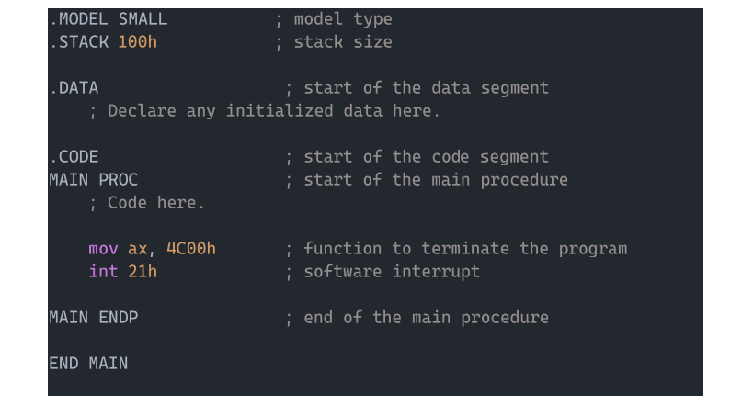
ASSEMBLY LANGUAGE PROGRAMMING USING MASM GENERAL PATTERN FOR WRITING ALP IN MASM
[PAGE DIRECTIVE] [TITLE DIRECTIVE]
[MEMORY MODEL DEFINITION] [SEGMENT DIRECTIVES] [PROC
DIRECTIVES]
...................................................
[END DIRECTIVES]

Slide 36
BASIC FORMAT OF ALP BASED UPON THE GENERAL PATTERN
PAGE 60,80
TITLE "ALP TO PRINT FACTORIAL NO"
.MODEL [MODEL NAME] .STACK
.DATA
........................... ; INITIALIZE DATA VARIALBLES .CODE MAIN PROC
................................
................................ ; INSTRUCTION SETS
.................................
................................
.................................
................................
................................. MAIN ENDP END MAIN

Slide 37
Directive
Assembly Language supports a number of statements that enable to control the
way in which a source program assembles and lists. These Statements are called Directives.
They act only during the assembly of a program and generate no machine
executable code.
The most common Directives are PAGE, TITLE, PROC, and END.
# PAGE DIRECTIVE
The PAGE Directive helps to control the format of a listing of an assembled
program.
It is optional Directive.
At the start of program, the PAGE Directive designates the maximum number of
lines to list on a page and the maximum number of characters on a line.
Its format is
PAGE [LENGTH],[WIDTH]
Omission of a PAGE Directive causes the assembler to set the default value to
PAGE 50,80

Slide 38
# TITLE DIRECTIVE
The TITLE Directive is used to define the title of a program to print on line 2 of each page of the program listing.
It is also optional Directive.
Its format is
TITLE [TEXT]
TITLE "PROGRAM TO PRINT FACTORIAL NO"
# SEGMENT DIRECTIVE
The SEGMENT Directive defines the start of a segment.
A Stack Segment defines stack storage, a data segment defines data
items and a code segment provides executable code.
MASM provides simplified Segment Directive.

Slide 39
The format (including the leading dot) for the directives that defines the stack, data and code segment are
.STACK [SIZE]
.DATA
................... Initialize Data Variables .CODE
The Default Stack size is 1024 bytes.
To use them as above, Memory Model initialization should be carried out.

Slide 40
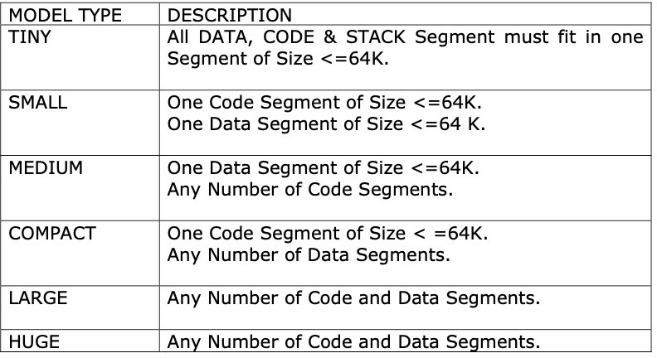
MEMORY MODEL DEFINTION
The different models tell the assembler how to use segments to provide space and ensure optimum execution speed.
The format of Memory Model Definition is .MODEL [MODEL NAME]
The Memory Model may be TINY, SMALL, MEDIUM, COMPACT, LARGE AND HUGE.

Slide 41
THE PROC DIRECTIVE
The Code Segment contains the executable code for a program, which consists of one or more procedures, defined initially with the PROC Directive and ended with the ENDP Directive.
Its Format is given as:
PROCEDURE_NAME PROC ....................
...................
...................
PROCEDURE_NAME ENDP

Slide 42
END DIRECTIVE
As already mentioned, the ENDP Directive indicates the end of a procedure.
An END Directive ends the entire Program and appears as the last statement.
Its Format is
END [PROCEDURE NAME]

Slide 43
THE EQU DIRECTIVE
It is used for redefining symbolic names
EXAMPLE:
DATAX DB 25 DATA EQU DATAX

Slide 44
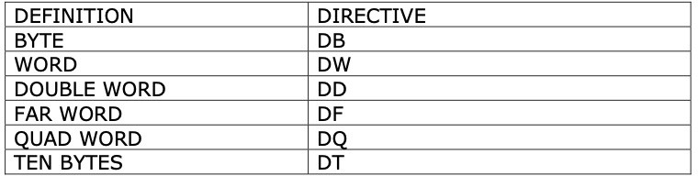
DEFINING TYPES OF DATA
The Format of Data Definition is given as [NAME] DN [EXPRESSION]
EXAMPLES
STRING DB 'HELLO WORLD' NUM1 DB 10 NUM2 DB 90

Slide 45
1. CHARACTER STRINGS
Character Strings are used for descriptive data.
Consequently DB is the conventional format for defining character data of any length
An Example is
DB 'Computer City' DB "Hello World"
2. NUMERIC CONSTANTS
#BINARY #DECIMAL #HEXADECIMAL
VAL1 DB 10101010B
VAL1 DB 230
VAL1 DB 23H

Slide 46
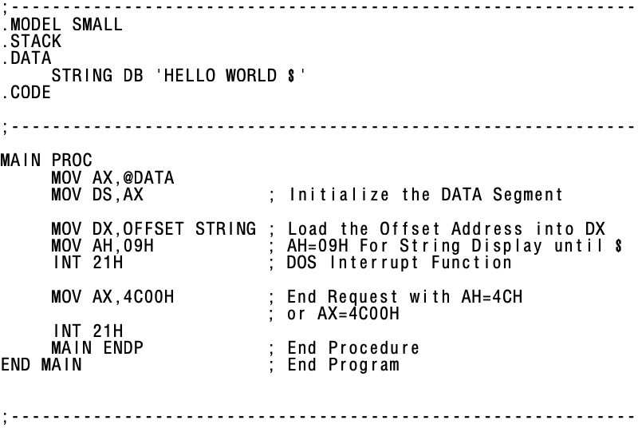
; Program to print hello world

Slide 47
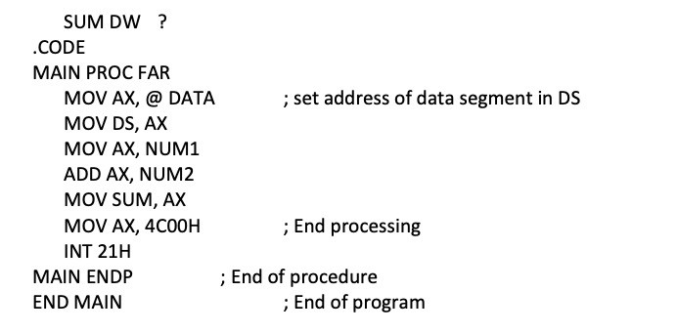
;addition
Page 60, 132
TITLE Sum program to add two numbers.
.MODEL SMALL
.STACK 64
.DATA
NUM1 DW 3241 NUM 2 DW 572

Slide 48
Assembling
Assembling, Linking and Executing
1) Assembling:
Assembling converts source program into object program if syntactically correct and generates an intermediate .obj file or module.
It calculates the offset address for every data item in data segment and every instruction in code segment.
A header is created which contains the incomplete address in front of the
generated obj module during the assembling.
Assembler complains about the syntax error if any and does not generate the object module.
Assembler creates .obj .lst and .crf files and last two are optional files that can be
created at run time.
For short programs, assembling can be done manually where the programmer
translates each mnemonic into the machine language using lookup table.
Assembler reads each assembly instruction of a program as ASCII character and translates them into respective machine code.

Slide 49
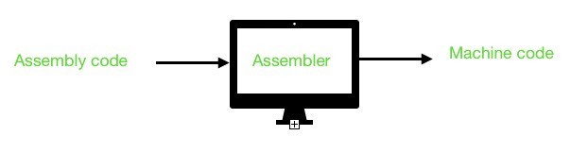
Assembler Types:
Source code object code
There are two types of assemblers:
a) One pass assembler:
This assembler scans the assembly language program once and converts to object code at the same time.
This assembler has the program of defining forward references only.
The jump instruction uses an address that appears later in the program during scan, for that case the programmer defines such addresses after the program is assembled.

Slide 50
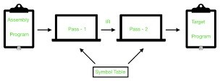
b) Two pass assembler
This type of assembler scans the assembly language twice.
First pass generates symbol table of names and labels used in the program and calculates their relative address.
This table can be seen at the end of the list file and here user need not define anything.
Second pass uses the table constructed in first pass and completes the object code creation.
This assembler is more efficient and easier than earlier.

Slide 51
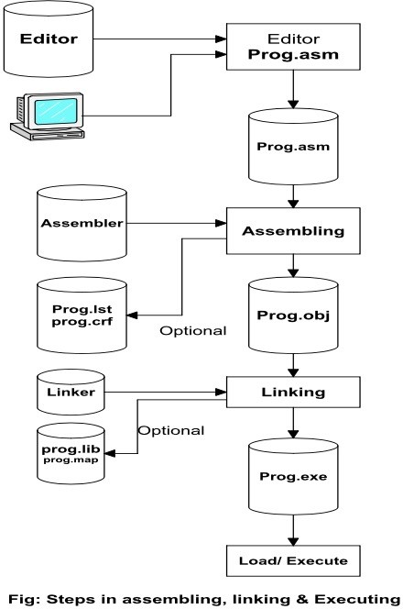

Slide 52
2) Linking:
This involves the converting of .OBJ module into .EXE(executable) module
i.e. executable machine code.
It completes the address left by the assembler.
It combines separately assembled object files.
Linking creates .EXE, .LIB, .MAP files among which last two are optional files.
3) Loading and Executing:
It Loads the program in memory for execution.
It resolves remaining address.
This process creates the program segment prefix (PSP) before loading.
It executes to generate the result.
Sample program assembling object Program linking executable program

Slide 53
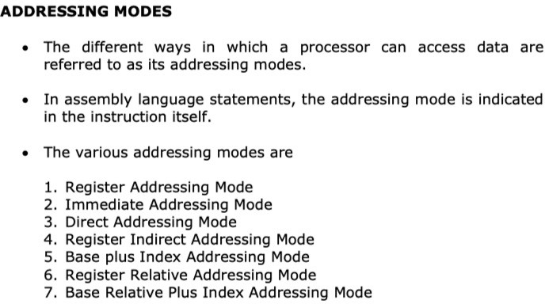
Addressing modes in 8086:

Slide 54
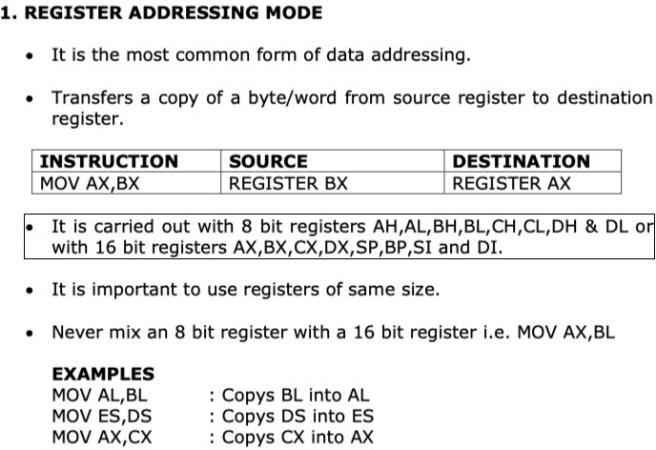

Slide 55
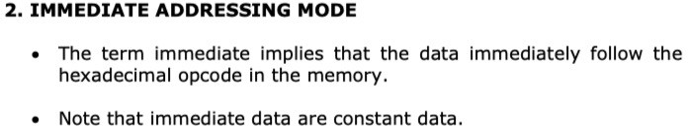
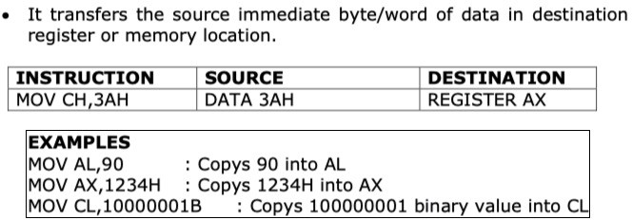

Slide 56
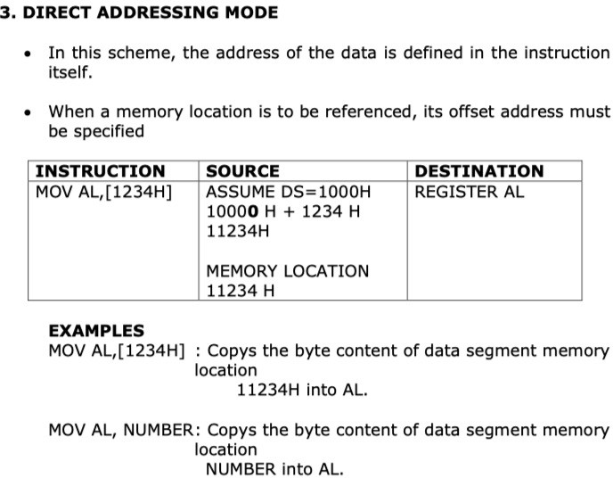

Slide 57
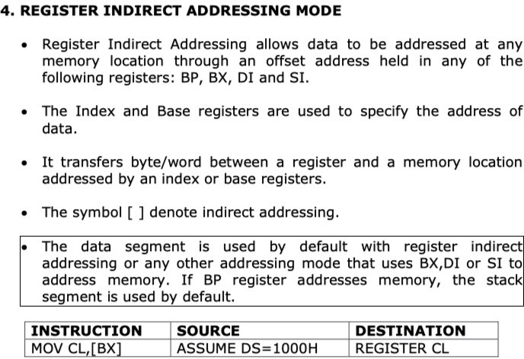
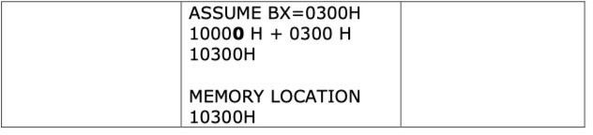

Slide 58
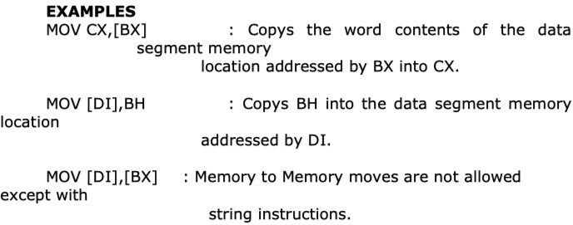

Slide 59
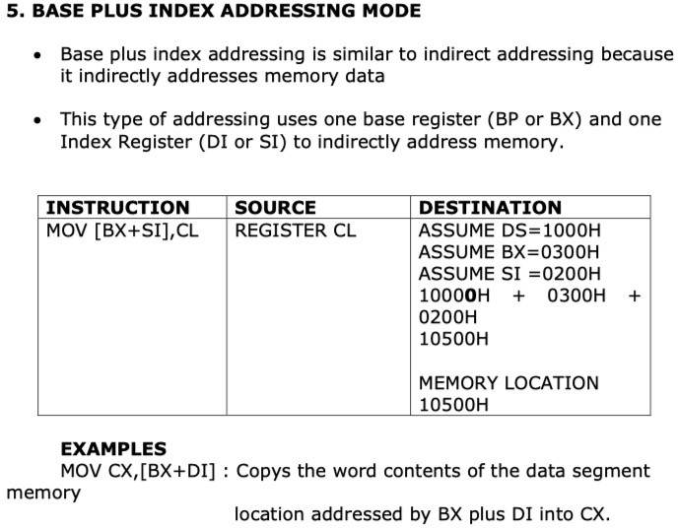

Slide 60
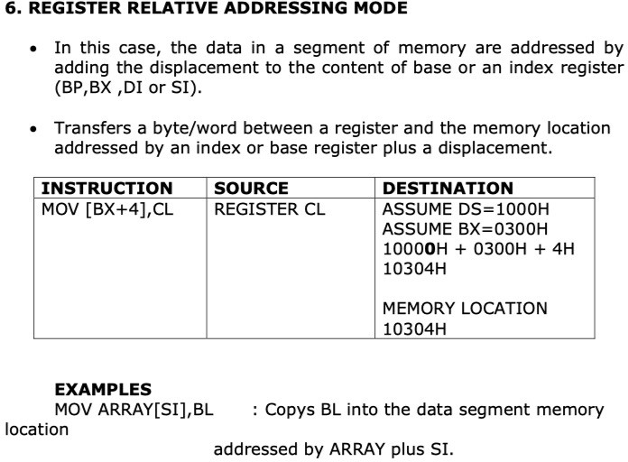

Slide 61
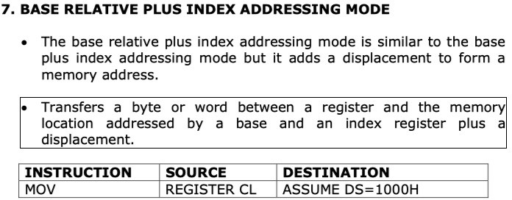
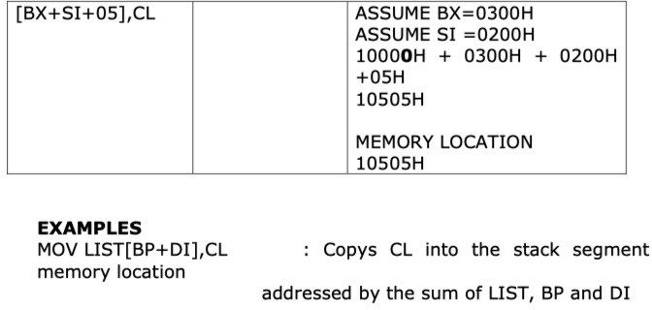

Slide 62
;program to add ten numbers
TITLE Program to add ten numbers .MODEL SMALL
.STACK 64
.DATA
ARR DB 73, 91, 12, 15, 79, 94, 55, 89 SUM DW ?
.CODE MAIN PROC
MOV AX, @DATA
MOV DS, AX MOV CX, 10
MOV AX, 0 LEA BX, ARR
L2: ADD Al, [BX] JNC L1
INC AH L1: INC BX
LOOP L2
MOV SUM, AX MOV AX, 4C00H INT 21H
MAIN ENDP END MAIN

Slide 63
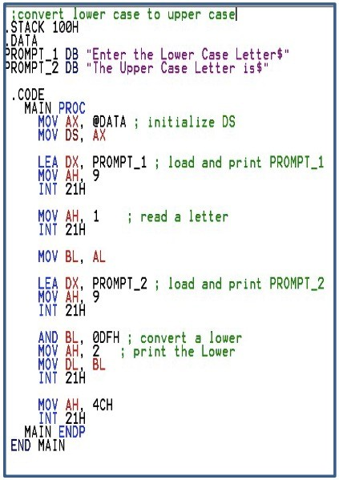
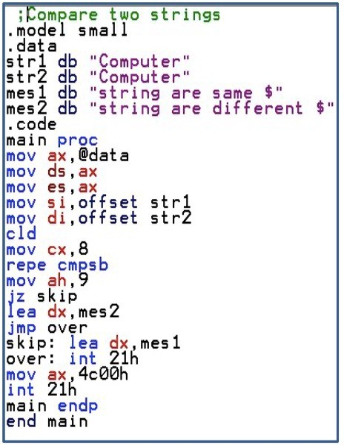

Slide 64
DOS FUNCTIONS AND INTERRUPTS (KEYBOARD AND VIDEO PROCESSING)
The Intel CPU recognizes two types of interrupts namely hardware interrupt when a peripheral devices needs attention from the CPU and software interrupt that is call to a subroutine located in the operating system.
The common software interrupts used here are INT 10H for video services and INT 21H for DOS services.
INT 21H:
It is called the DOS function call for keyboard operations follow the function number. The service functions are listed below:

Slide 65
# 00H- It terminates the current program.
Generally not used, function 4CH is used instead.
# 01H- Read a character with echo
Wait for a character if buffer is empty
Character read is returned in AL in ASCII value
# 02H- Display single character
Sends the characters in DL to display
MOV AH, 02H
MOV DL, ‘A’ ; move Dl, 65
INT 21H
# 03H and 04H Auxiliary input/output
INT 14H is preferred.
# 05H Printer service
Sends the character in DL to printer
# 06H- Direct keyboard and display
Displays the character in DL.
# 07H- waits for a character from standard input
does not echo
MOV DX, offset message ; Load the offset of the string into DX
MOV AH, 09H ; Set function AH=09H (print string)
INT 21H ; Call the DOS interrupt
MOV AH, 4CH ; Set function AH=4CH (program termination)
INT 21H ; Call the DOS interrupt
message DB 'Hello, world!', 0Dh, 0Ah, '$' ; Define the string to be echoed
*These characters are commonly used to move the cursor to the beginning of the next line after printing a string.

Slide 66
# 08H- keyboard input without echo (reads a character from the standard input (keyboard) without displaying it on the screen.)
Same as function 01H but not echoed.
# 09H- string display
Displays string until ‘$’ is reached.
DX should have the address of the string to be displayed.
# 0AH Read string
# OBH- Check keyboard status
Returns FF in AL if input character is available in keyboard buffer.
Returns 00 if not.
# 0CH- Clear keyboard buffer and invoke input functions such as 01, 06, 07, 08 or 0A.
AL will contain the input function.

Slide 67
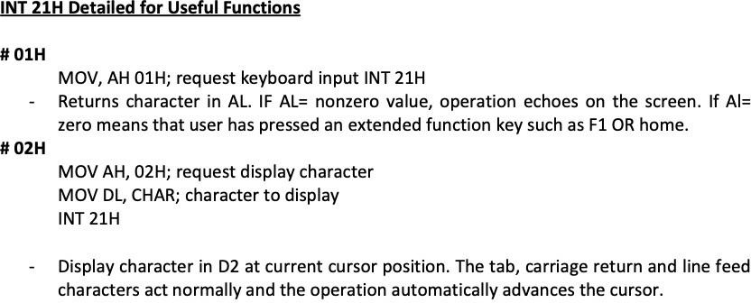

Slide 68
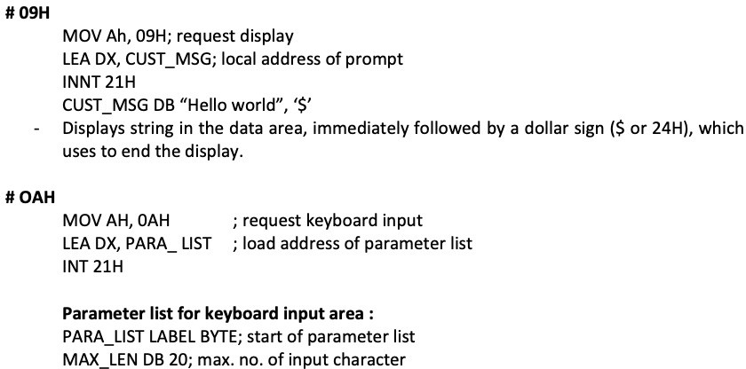

Slide 69
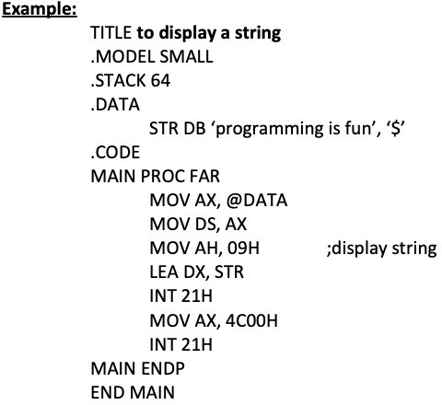

Slide 70
End of Chapter 04

