Slide 1
Smart Cards
Realized by:
SADDEM Naceur Rayen
FATNASSI Aymen

Slide 2
Outlines
Context
Kit presentation
Goals
Realized work
- First exercise
- Second exercise
Encountered difficulties
Conclusion

Slide 3
Context

Slide 4


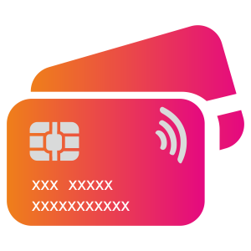
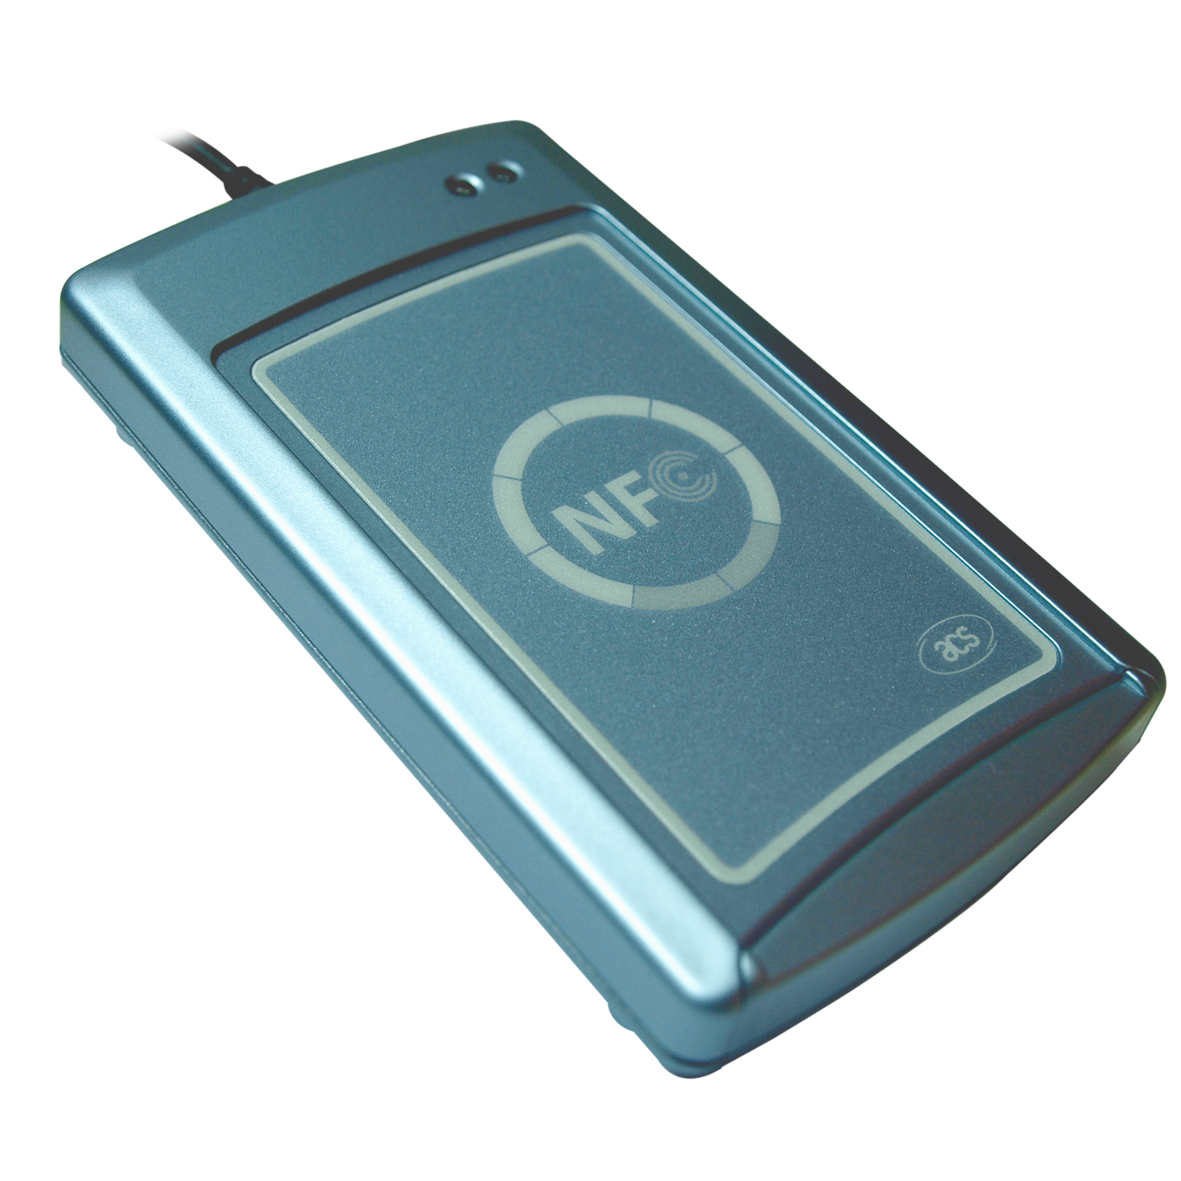
Context
Id cards
Tracking
Transport
Banking

Slide 5
Kit presentation

Slide 6
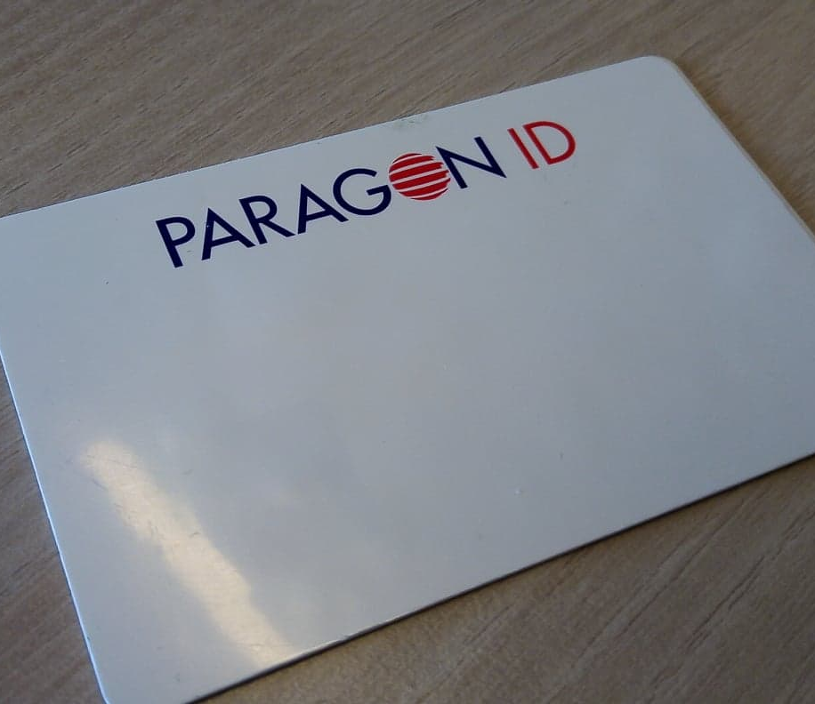
Tag NFC forum type 4
Security (ISO 7816)
Modification of NDEF
Public transport tickets

Slide 7
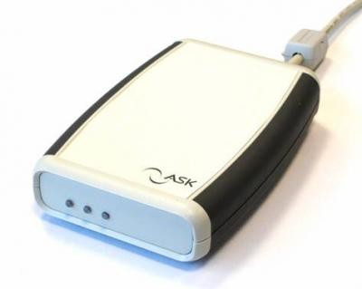
NFC Reader
Paragon ID (ASK)
ASK RDR 417

Slide 8
Goals

Slide 9
Goals
Read tag’s data with the ASK Reader
Update tag’s data with the ASK Reader
Simulate a tag with an Android application

Slide 10
Realized Work

Slide 11
Realized work Exercise 1
C# app is for reading and modifying the contents of the Tag.
Reading is done with sending APDU commands to the tag.
Steps:
Application selection (AID)
File selection (CID)
NDEF selection (File ID)

Slide 12
Realized work Exercise 1
Writing is also done with sending APDU commands to the tag.
Multiple data format:
URI: http://www.apple.com
Text: “La belle Histoire”
Data: POLYTECH
Steps:
File Selection (File ID)
Update command (Offset, Length, Data)

Slide 13
Realized work Exercise 2
Android application that acts like a tag
The android app can store data
The Android application returns errors when the reader violate the standard
The android application can exchange data with the reader
The Reader can read the data stored by the application
The Reader can update the data stored in the application (uncompleted)

Slide 14
Encountered difficulties

Slide 15
Encountered difficulties
Working with low level instructions
Working with bytes
Working with bits
Using elementary instructions
Complexity of the standard restrictions
Complex algorithms
Creating generic application
Understanding the commands

Slide 16
Thank you for your attention

