Slide 1
Hands on with Drupal 8
Part 1: Site Builder

Slide 2


@blink reaction

Slide 3



Slide 4
Your OS

Slide 5
Virtual OS
Your OS

Slide 6




Slide 7
I work with Virtualbox!

Slide 8
I work with Virtualbox!
Containers
Are different!

Slide 9

W L
M
AMP

Slide 10





simplytest.me

Slide 11
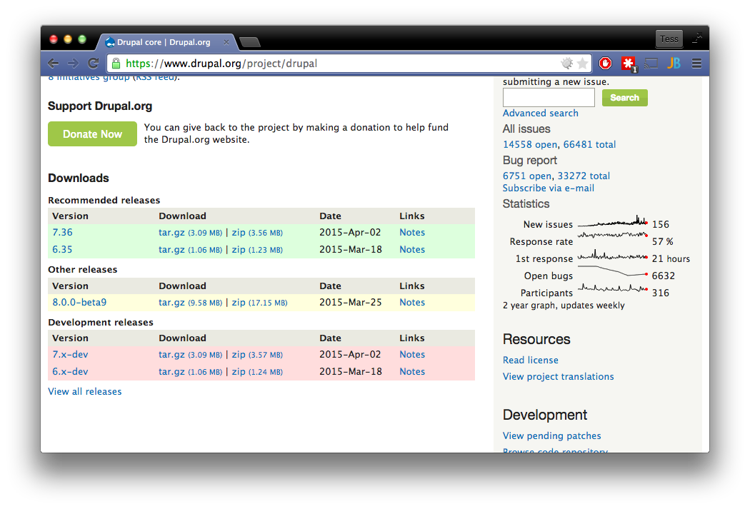
Click here!

Slide 12
Drupal 7
Drupal 8

Slide 13
Drupal 7
Drupal 8
PHP 5.2.3+

Slide 14
Drupal 7
Drupal 8
PHP 5.2.3+
PHP 5.4.5+

Slide 15
Drupal 7
Drupal 8
PHP 5.2.3+
PHP 5.4.5+
MySQL 5.0.15

Slide 16
Drupal 7
Drupal 8
PHP 5.2.3+
PHP 5.4.5+
Mysql 5.1.21 w/ InnoDB
MySQL 5.0.15

Slide 17
Drupal 7
Drupal 8
PHP 5.2.3+
PHP 5.4.5+
Mysql 5.1.21 w/ InnoDB
MySQL 5.0.15
32 MB min

Slide 18
Drupal 7
Drupal 8
PHP 5.2.3+
PHP 5.4.5+
Mysql 5.1.21 w/ InnoDB
MySQL 5.0.15
32 MB min
128 MB Min? 320 for dev

Slide 19
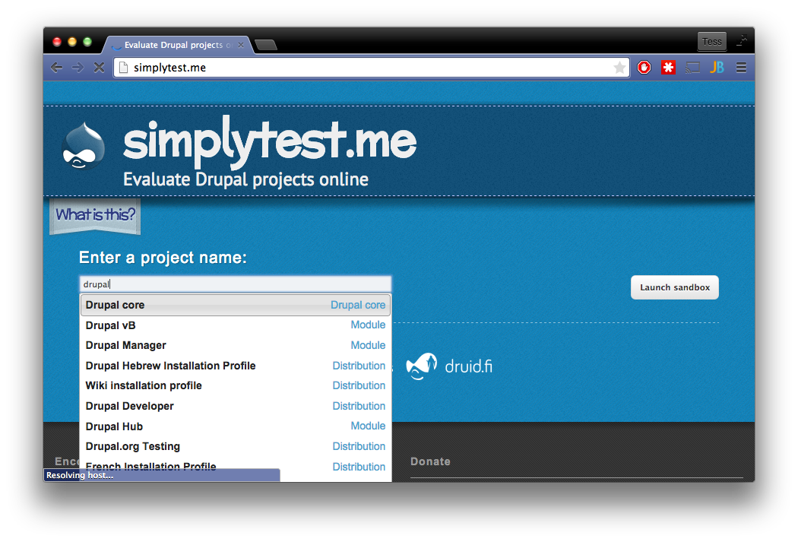
Enter “Drupal”

Slide 20
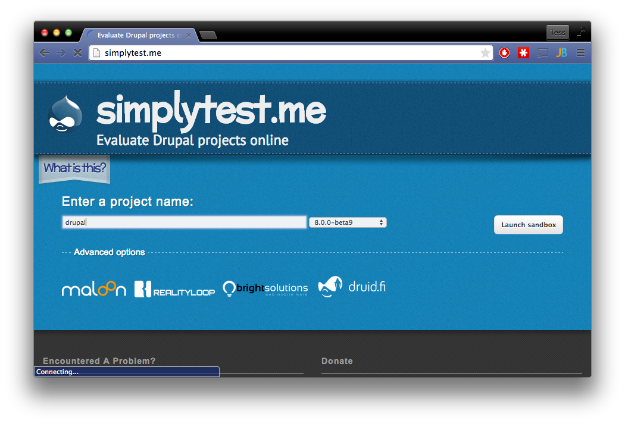
Select the latest beta, then…
…click “Launch Sandbox”.

Slide 21
Content

Slide 22
What kind of content am I?
Content

Slide 23
What kind of content am I?
What kind of data do I have?
Content

Slide 24
What kind of content am I?
What kind of data do I have?
Content
What’s my functional Intent?

Slide 25
Content
Content
Content
NODE TYPE “Gallery”
NODE TYPE “Callout”
NODE TYPE “blog”

Slide 26
Content
Content
Content
NODE TYPE “Gallery”
NODE TYPE “Callout”
NODE TYPE “blog”
Common content type

Slide 27
Content
Content
Content
NODE TYPE “Gallery”
NODE TYPE “Callout”
NODE TYPE “blog”
Common content type
Different Fields

Slide 28
Content
Content
Content
NODE TYPE “Gallery”
NODE TYPE “Callout”
NODE TYPE “blog”
Common content type
Different Fields
Different intent

Slide 29
Node type

Slide 30
Entity

Slide 31
Entity
Key-value (variables)

Slide 32
Entity
Key-value (variables)
Raw tables

Slide 33
Entity
Key-value (variables)
Raw tables
Database

Slide 34
Entity
Key-value (variables)
Raw tables
Which is fine, Until I need
To deploy to Prod.
Database

Slide 35
How do I separate configuration from Content
?

Slide 36
How do I separate configuration from Content
Without it being a mess?

Slide 37
Database
What if we
Take that
Database…

Slide 38
Database
Configuration
Content
What if we
Take that
Database…
And split it in two?

Slide 39
Database
Configuration Entity
Content
Entity
And then use Entities everywhere?

Slide 41
Node types

Slide 42
Node types
Roles

Slide 43
Node types
Roles
Key-value (“simple config”)

Slide 44
Drupal 7
Drupal 8

Slide 45
Nodes

Slide 46
Nodes
Users

Slide 47
Nodes
Users
Blocks

Slide 48
Configuration Entity
Content
Entity

Slide 49
Configuration Entity
Content
Entity
Database

Slide 50
Configuration Entity
Content
Entity
Database
*.yml

Slide 51
Configuration Entity
Content
Entity
Database
*.yml

Slide 52
NODE TYPE

Slide 53
NODE TYPE
Title

Slide 54
NODE TYPE
Title
Custom Fields

Slide 55
NODE TYPE
Title
Custom Fields
Field Storage

Slide 56
Drupal 7
Drupal 8

Slide 57
Drupal 7
Drupal 8
Fields

Slide 58
Drupal 7
Drupal 8
Fields
Database

Slide 59
Drupal 7
Drupal 8
Fields
Entity
Database
Database

Slide 60
Drupal 7
Drupal 8
Fields
Entity
Database
Database

Slide 61
Node
Link field

Slide 62
fields
Blocks
Input formats

Slide 63
User

Slide 64
User
Is a member of one or more…
Roles

Slide 65
User
Is a member of one or more…
Roles
Which grants zero or more
Permissions

Slide 66
Module

Slide 67
Module
Hook_permission()

Slide 68
Module
Hook_permission()
Permissions

Slide 69
Module
Hook_permission()
Permissions

Slide 70
Module
My_module.permission.yml
Permissions

Slide 71
=
Role
Configuration Entity

Slide 72
PERMISSION (GRANT)

Slide 73
PERMISSION (GRANT)
OPERATION

Slide 74
PERMISSION (GRANT)
OPERATION
NODE TYPE

Slide 75
PERMISSION (GRANT)
OPERATION
NODE TYPE
PERMISSION (GRANT)
OPERATION
SPECIFIC NODE

Slide 76
PERMISSION (GRANT)
OPERATION
NODE TYPE
PERMISSION (GRANT)
OPERATION
SPECIFIC NODE
PERMISSION (DENY)
OPERATION

Slide 77
Anonymous

Slide 78
Anonymous
GRANTS to all roles and visitors

Slide 79
Anonymous
GRANTS to all registered users
Authenticated
GRANTS to all roles and visitors

Slide 80
Anonymous
Typically used for site admins
administrator
GRANTS to all registered users
Authenticated
GRANTS to all roles and visitors

Slide 81
Anonymous
Typically used for site admins
administrator
Custom roles
GRANTS to all registered users
Authenticated
GRANTS to all roles and visitors

Slide 82
Z
Z
Z

Slide 84
Drupalgeddon
Anyone?

Slide 85
Drupalgeddon
Anyone?

Slide 86
<drupal_root>
core
modules
Index.php

Slide 87
<drupal_root>
core
Modules
modules
Index.php

Slide 88
<drupal_root>
core
Modules
modules
Index.php

Slide 89
<drupal_root>
core
modules
Your_module_here
Index.php

Slide 90
<drupal_root>
core
modules
themes
Index.php

Slide 91
<drupal_root>
core
modules
themes
Your_THEME_here
Index.php

Slide 92
<your_module_root>
config
install
Views.view.my_view.yml
src
Your_theme.info.yml

Slide 93
<your_module_root>
Default
Configuration YML
config
install
Views.view.my_view.yml
src
Your_theme.info.yml

Slide 94
<your_module_root>
Default
Configuration YML
config
install
Views.view.my_view.yml
Other module code
src
Your_theme.info.yml

Slide 96
<your_theme_root>
config
install
CSS
templates
Page.html.twig
Your_theme.info.yml

Slide 97
<your_theme_root>
Default
Configuration YML
config
install
CSS
templates
Page.html.twig
Your_theme.info.yml

Slide 98
<your_theme_root>
Default
Configuration YML
config
install
Twig Templates
CSS
templates
Page.html.twig
Your_theme.info.yml

Slide 99
My_blog
config
install
My_BLOG.info.yml
My_BLOG.module

Slide 100
Drupal console

Slide 101

GRANTS
PERMISSION
OPERATION
NODE TYPE
?
Install on Web server
Find no examples
Search for examples
*headdesk*
*headdesk*
Download Examples!
What the heck is a module?

Slide 102
Where do I even start?

