Slide 1
Hands on with Drupal 8
Part 1: Site Builder

Slide 2


@blink reaction

Slide 3



Slide 4
Your OS

Slide 5
Virtual OS
Your OS

Slide 6
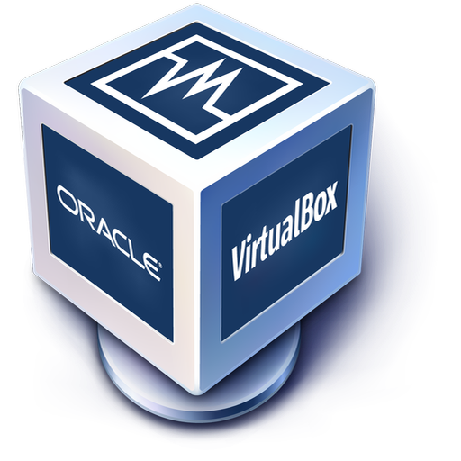



Slide 7
I work with Virtualbox!

Slide 8
I work with Virtualbox!
Containers
Are different!

Slide 9

W L
M
AMP

Slide 10





simplytest.me

Slide 11
Where do I even start?

