Slide 1
Predict Youtube Videos’ Performance

Slide 2
Outline
Topic
Dataset
Training
Result

Slide 3
Topic
Topic : Predict Youtube Videos’ Performance
Goal : Generate a dataset comprising fundamental information for videos from several Youtube channels, followed by training a model on this dataset to predict the performance of a video in the channel based on newly given information.

Slide 4
Dataset
Channel Type : Taiwan News Channel
Reason :
Notes:
訂閱數 客群

Slide 5
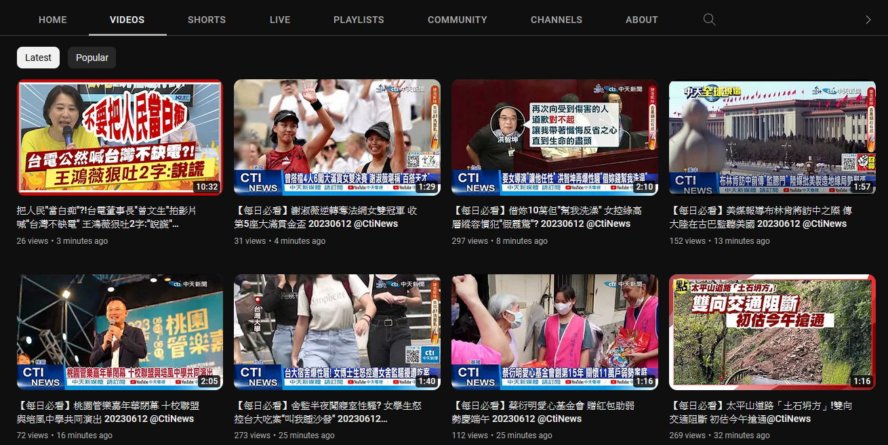
Dataset
Data :
Notes:
訂閱數 客群

Slide 6
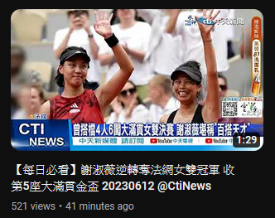
Dataset
Data :
Thumbnail
Video length
Title
Views
Upload time
Notes:
訂閱數 客群

Slide 7
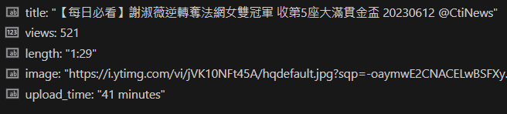
Dataset
Channel Type : Taiwan News Channel
Data :

Slide 8
Dataset
Method : Selenium
Step :
Open channels’ video page in browser
Scroll Down to load earlier news and image
Repeat step 2 until all needed video loaded
Process HTML to get every videos’ data
Dataset information :
Crawl at 2023/06/03
11 Channels
29,697 Videos
Upload time less than a month

Slide 9
Dataset
Issue

Slide 10
Dataset
Dataset Analyze :
Notes:
時間收斂
Max Min Var Mean
View 分布
CDF

Slide 11
Training
Two Types of Training Methods : Regression and classification
Datasets Split: 80% for training, 20% for validation
Data Augmentation: None for texts and cropping for images
Optimizer: SGD
Learning Rate: Initialized to 0.001, and it will decay 2 times during the training process, with the decay ratio set to 0.1
Loss Function: Cross entropy for classification, root mean square error for regression
Notes:
Crop: 等比例縮放到讓短邊變成224，接著再center crop 224x224下來。

Slide 12
Architecture: Classification by Text Only
512
FC
256
FC
Pretrained Bert
0 (Views less than the median)
News Titles
1 (Views more than the median)
Notes:
Crop: 等比例縮放到讓短邊變成224，接著再center crop 224x224下來。

Slide 13
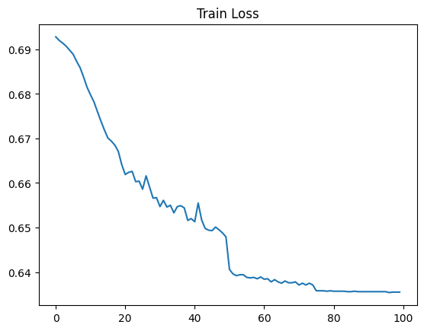
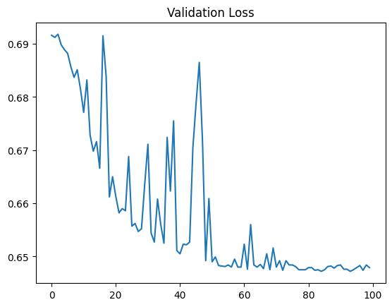
Loss: Classification by Text Only
Notes:
Crop: 等比例縮放到讓短邊變成224，接著再center crop 224x224下來。

Slide 14
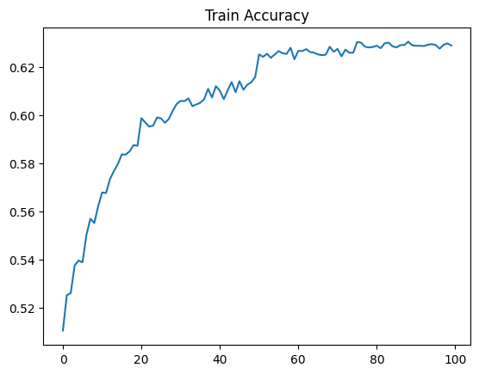
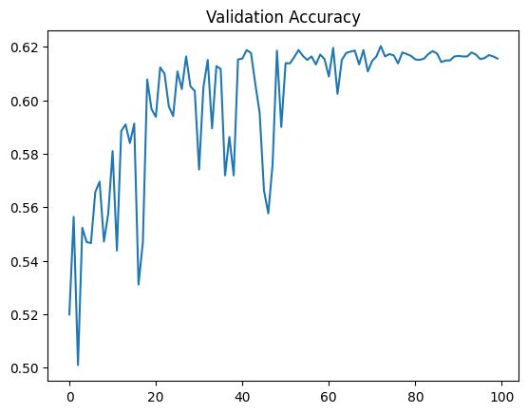
Accuracy: Classification by Text Only
Notes:
Crop: 等比例縮放到讓短邊變成224，接著再center crop 224x224下來。

Slide 15
Architecture: Classification by Image and Text
512 + ?
FC
256
Pretrained ViT
(last layer removed)
FC
Cover Image
0 (Views less than the median)
Concatenate
Pretrained Bert
1 (Views more than the median)
News Titles

Slide 16
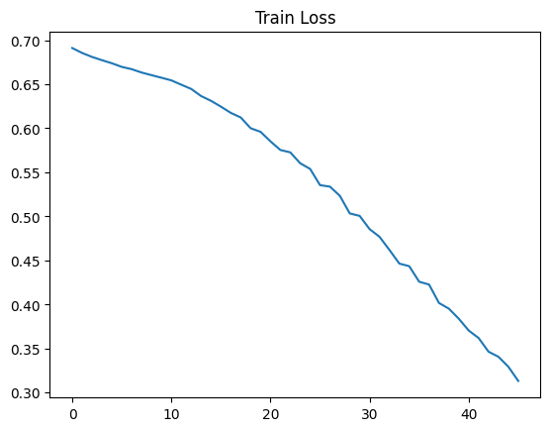
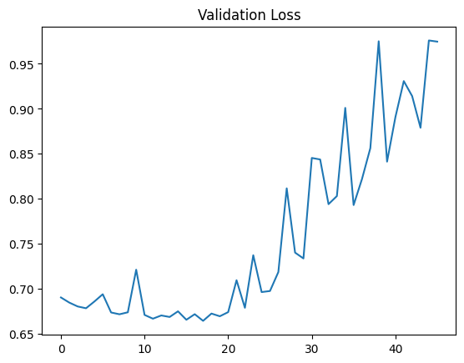
Loss: Classification by Image and Text
Notes:
Crop: 等比例縮放到讓短邊變成224，接著再center crop 224x224下來。

Slide 17
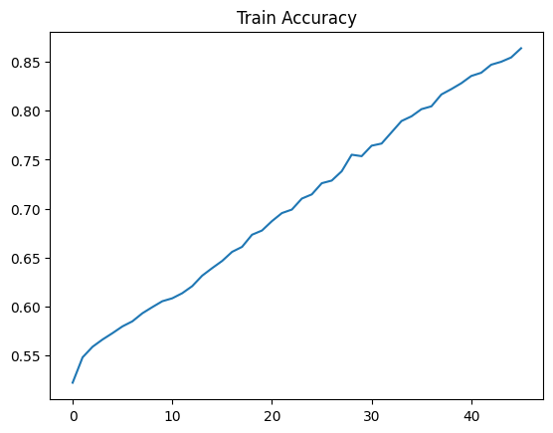
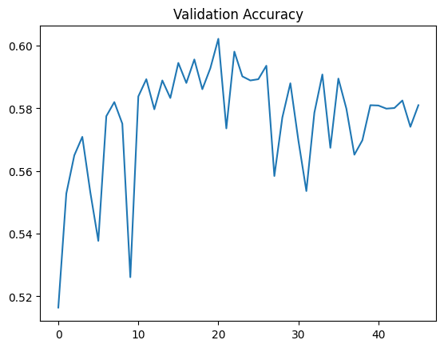
Accuracy: Classification by Image and Text
Notes:
Crop: 等比例縮放到讓短邊變成224，接著再center crop 224x224下來。

Slide 18
Architecture: Regression by Text Only
512
FC
256
FC
Pretrained Bert
News Titles
[0, 1] (Normalized Views)
Notes:
Crop: 等比例縮放到讓短邊變成224，接著再center crop 224x224下來。

Slide 19
RMSE Loss: Regression by Text Only
Notes:
Crop: 等比例縮放到讓短邊變成224，接著再center crop 224x224下來。

