Slide 1
Session #7 Graphics + Debugging
Questions on Programming?, Python?
Homework questions?
Who did it? To easy? To hard?
Questions on problems
Long answers in Q/A session

Slide 2
Graphics - Display / Control beyond text
A number of choices
tkinter (shipped with python)
wxPython (must be installed)
tkinter—interface to Tcl/Tk
Shipped with Python
Good example
Similar across python / languages
Notes:
File, as a named group of bytes is an abstraction.
Years ago the programmer needed to understand more about the structure.
Your Python program is a data file to some program(s).

Slide 3
Graphics – continued
Event driven
Object Oriented
Notes:
File, as a named group of bytes is an abstraction.
Years ago the programmer needed to understand more about the structure.
Your Python program is a data file to some program(s).

Slide 4
Graphics – Creating a window my_window.py
import tkinter as tk
root = tk.Tk()
root.mainloop()
Notes:
File, as a named group of bytes is an abstraction.
Years ago the programmer needed to understand more about the structure.
Your Python program is a data file to some program(s).

Slide 5
Graphics – Simple Messages
Simple "Hello" program
exercises/graphics/gr_hello.py
Notes:
File, as a named group of bytes is an abstraction.
Years ago the programmer needed to understand more about the structure.
Your Python program is a data file to some program(s).

Slide 6
Graphics – widgets – graphics tools
Frame – Holder, can hold other Frames
Label – Has text / picture
Button – control point
Entry - Input
Text – holds free text
Scrollbar – controls scrolling
Notes:
File, as a named group of bytes is an abstraction.
Years ago the programmer needed to understand more about the structure.
Your Python program is a data file to some program(s).

Slide 7
Graphics – Frame, Button
graphics/tutorial_hello_world.py
Notes:
File, as a named group of bytes is an abstraction.
Years ago the programmer needed to understand more about the structure.
Your Python program is a data file to some program(s).

Slide 8
Graphics – continued
Event driven
Object Oriented
Simple tkinter tutorial:
https://www.pythontutorial.net/tkinter/tkinter-hello-world/
Notes:
File, as a named group of bytes is an abstraction.
Years ago the programmer needed to understand more about the structure.
Your Python program is a data file to some program(s).

Slide 9
Debugging – Dealing with program problems
print statements in the program
"too noisy"- include "if trace_flag:"
Break up complex operations
Use descriptive variables

Slide 10
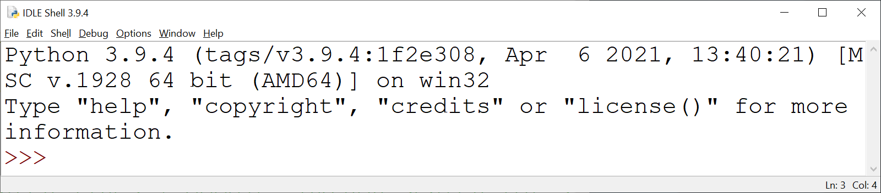
Debugging – IDLE Debugger
Open program file to be debugged
Run ➔Python Shell

Slide 11
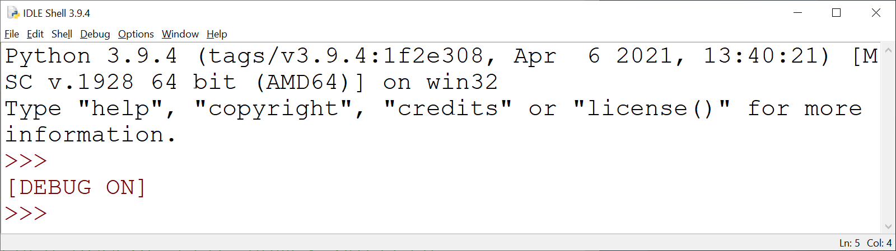
Debugging – IDLE Debugger
From IDLE Shell
Debug → Debugger

Slide 12
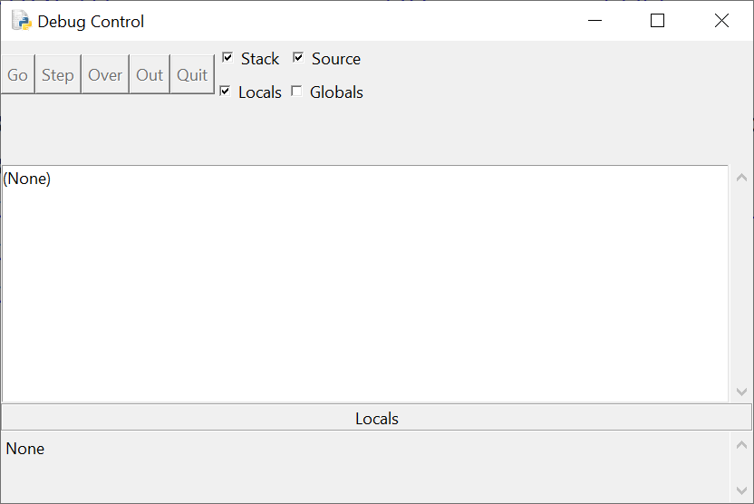
IDLE Debugger – Debug Control Window

Slide 13
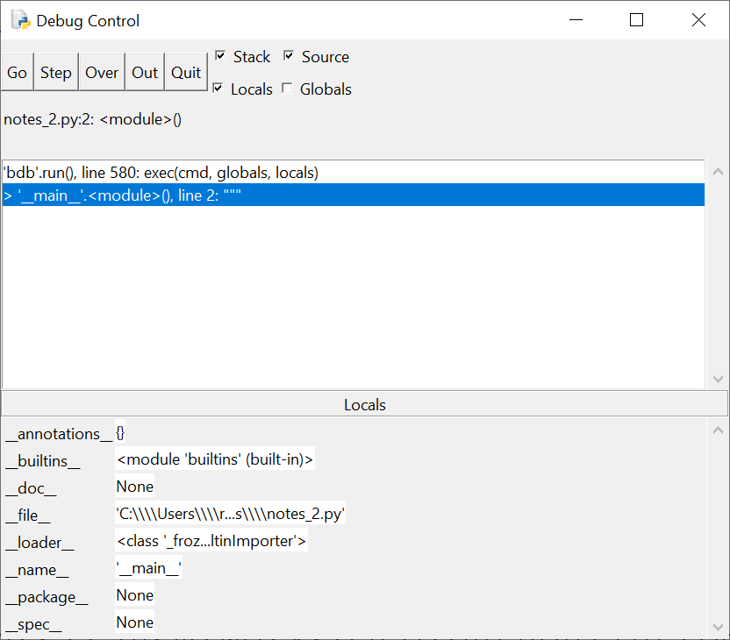
Debug Control Opperation
File window (with DEBUG ON) → Run ➔ Run Module

Slide 14
Debug Control Operation
Go – start program
Step – do one statement
Over – do one statement over internal
Out – execute till out of current routine
Quit – quit program debugging

Slide 15
Debug Control Operation
[] Stack – display program stack
[] Source – show source location
[] Locals – display local variables
[] Globals – display global variables

Slide 16
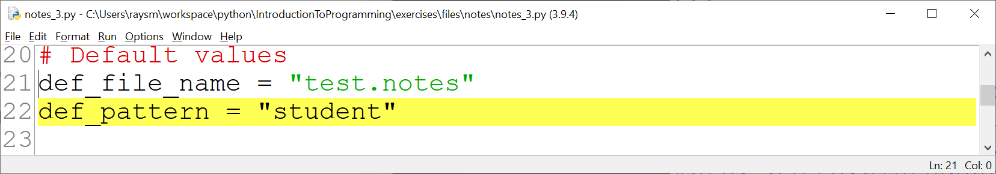
Debug Control Operation
In Edit File – Set Break Point
→ Debugging execution will pause

