Slide 1
Session #7 Graphics + Debugging
Questions on Programming?, Python?
Homework questions?
Who did it? To easy? To hard?
Questions on problems
Long answers in Q/A session

Slide 2
Time to Ask Questions
Please Ask any question about Programming or Python you are unsure, confused or interested in.

Slide 3
Graphics - Display / Control beyond text
A number of choices
tkinter (shipped with python)
wxPython (must be installed)
tkinter—interface to Tcl/Tk
Shipped with Python
Good example of Graphics Ideas
Similar across python / languages

Slide 4
Graphics – continued
Event driven
Action happens when events occur
Mouse clicks, time passing
Object Oriented
Programming is done in parts

Slide 5
Graphics – Creating a window exercises/graphics/my_window.py
import tkinter as tk
root = tk.Tk()
root.mainloop()

Slide 6
Graphics – Simple Messages
Simple "Hello" program
exercises/graphics/gr_hello.py
Get input
exercises/graphics/gr

Slide 7
Graphics – widgets – graphics tools
Frame – Holder, can hold other Frames
Label – Has text / picture
Button – Accepts mouse control (click)
Entry - Input
Text – holds free text
Scrollbar – controls scrolling
Notes:
File, as a named group of bytes is an abstraction.
Years ago the programmer needed to understand more about the structure.
Your Python program is a data file to some program(s).

Slide 8
Graphics – Frame, Button
exercises/graphics/tutorial_hello_world.py

Slide 9
Graphics – continued
Event driven
Object Oriented
Simple tkinter tutorial:
https://www.pythontutorial.net/tkinter/tkinter-hello-world/
Notes:
File, as a named group of bytes is an abstraction.
Years ago the programmer needed to understand more about the structure.
Your Python program is a data file to some program(s).

Slide 10
Graphics – Example Simple Notes data base
Display file lines containing pattern
Terminal based
exercises/notes/notes_3e.py
Graphics version
exercises/graphics/notes_graphics.py
exercises/graphics/notes_data_win.py
Notes:
File, as a named group of bytes is an abstraction.
Years ago the programmer needed to understand more about the structure.
Your Python program is a data file to some program(s).

Slide 11
Debugging – Dealing with program problems
print statements in the program
"too noisy"- include "if trace_flag:"
Break up complex operations
Use descriptive variables
Notes:
Like life programs, of almost any complexity, will have problems – they often do not operate as desired/expected.
Good News – finding and fixing them is often easy and even fun.

Slide 12
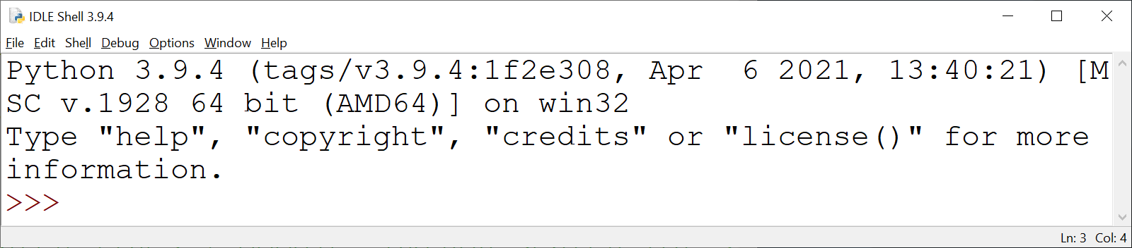
Debugging – IDLE Debugger
Open program file to be debugged
Run ➔Python Shell
Notes:
Options → Show Line Numbers

Slide 13
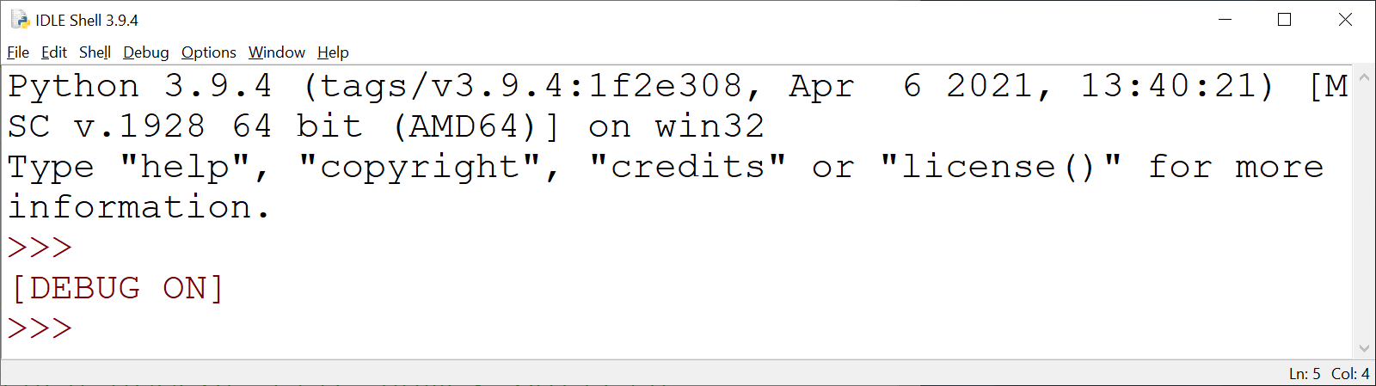
Debugging – IDLE Debugger
From IDLE Shell
Debug → Debugger

Slide 14
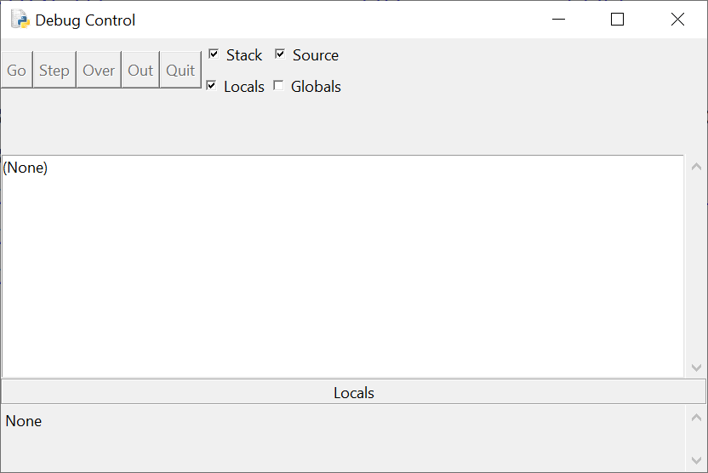
IDLE Debugger – Debug Control Window

Slide 15
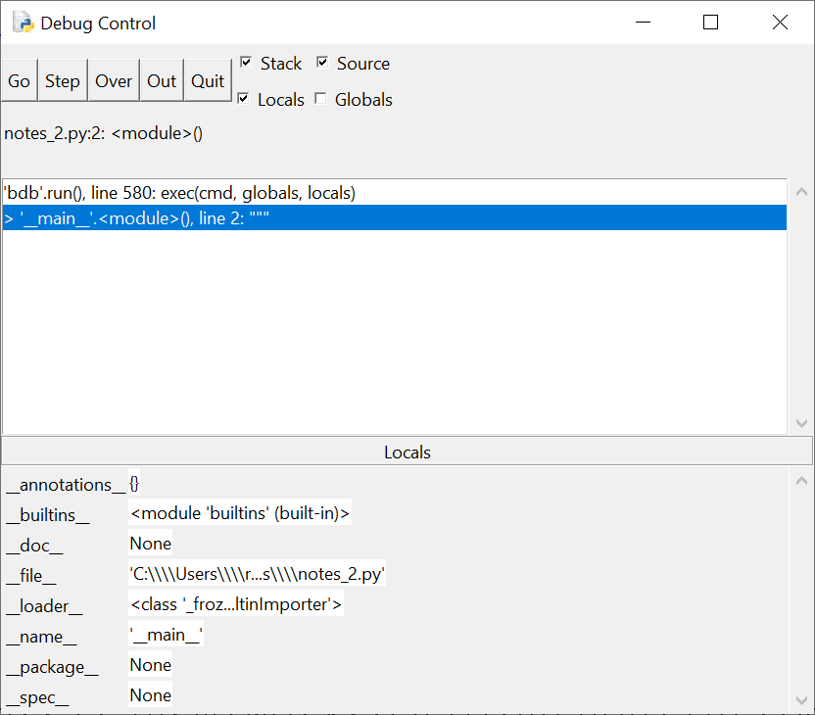
Debug Control Operation
File window (with DEBUG ON) → Run ➔ Run Module

Slide 16
Debug Control Operation
Go – start program
Step – do one statement
Over – do one statement over internal
Out – execute till out of current routine
Quit – quit program debugging

Slide 17
Debug Control Operation
[] Stack – display program stack
[] Source – show source location
[] Locals – display local variables
[] Globals – display global variables

Slide 18
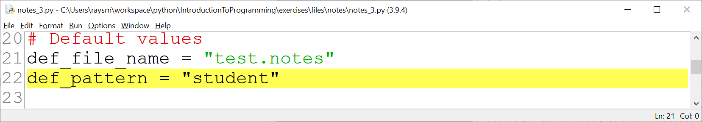
Debug Control Operation
In Edit File – Set Break Point
→ Debugging execution will pause

