Slide 1
Overview to Introduction to Programming Using Python

Slide 2
Session Objectives
Short - One Session Introduction
Programming for non-programmers
Demonstrate Operations / Methods
Enable / Energize new programmers
Learning by DOING
Notes:
Non-programmers benefit from an understanding of programming.
What do you want from this course?
What do you want from programming?

Slide 3
Instructor – Ray Smith raysmith@alum.mit.edu
Many years of Programming – engineering, scientific, financial
Commercial, Scientific, Systems
Languages – C, C++, Perl, Java, Python, Assembly
NEW Areas - Games for young 3-8 years
Notes:
What would you like to know about me?

Slide 4
Our Online Class – Using Zoom
If any background noise, please mute – minimizes cumulative noise
Disable own video – too many reduces clarity- Unless ASKING A QUESTION
Can question via Chat – can be to ALL
Expecting Response: Start "QUESTION:"
Notes:
We'll try enabling video for speaker(s)

Slide 5
Session Structure
Similar to Programming – This Session
Skips, Repeats / Revisits
Student Guideline:
If you know it – Have Patience
If confused / unsure – ASK A QUESTION

Slide 6
Introduction Touching on the topic
Any questions in general?
Notes:
Who has had any computer programming experience? Python experience?

Slide 7
Computer Programming Telling a Story Telling the Computer What to Do
The language, PYTHON, is a way
Popular, Powerful, and EASY
Like most human languages
You don’t have to know it all to do a lot
Notes:
What should the computer do for you?
What should the programming language (Python) do?

Slide 8
The Python language – is small
Compared to English, Spanish, French
A lot fewer words, punctuation…
Need to be precise
Say exactly what you want
Python can't ask you again

Slide 9
Learn by DOING
Start with ready-made programs
Run unchanged and see results
Make small changes
Run again
Notes:
Who hasn't downloaded python (from www.python.org)?

Slide 10
IDLE Python's built in tool
Integrated Development and Learning Environment
Interactive execution of Python
Python Program editor and execution (we use it)
Lots of documentation, examples, help
Notes:
Who hasn't downloaded python (from www.python.org)?

Slide 11
IDLE – Arithmetic Galore
2 + 2, 123+321, 10**100
99999999999999999999999+1
60*60*24*365 # seconds in a year

Slide 12
IDLE – IF/WHEN I change my mind…
Redo a line by "up arrow" to line
then press ENTER, then make changes
ALT-P(Cth-P on MAC) will "open" last command for changes
After changing code, press ENTER to execute changed command (twice if part of a compound statement)

Slide 13
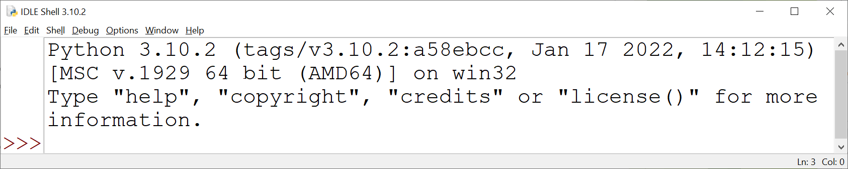
A Quick Look Samples to Run Now - Change Later
File → Open
… /…overview/samples/01_intro/
hello_world.py

Slide 14
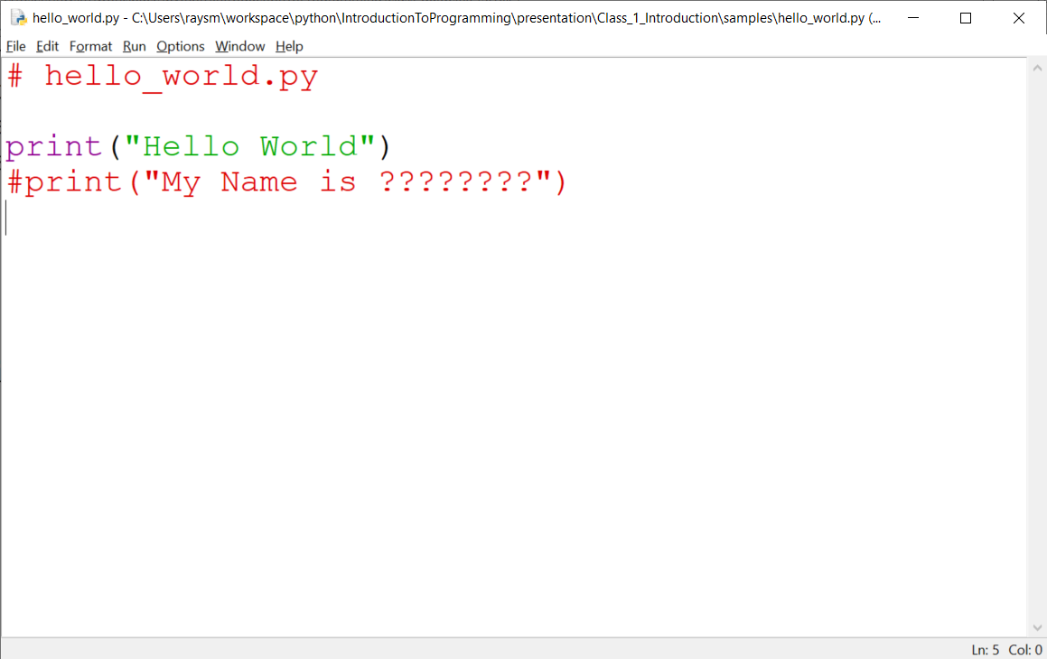
First Program

Slide 15
Run Opened Program
Run → Run Module
Program runs, printing on IDLE console
Hello World

Slide 16
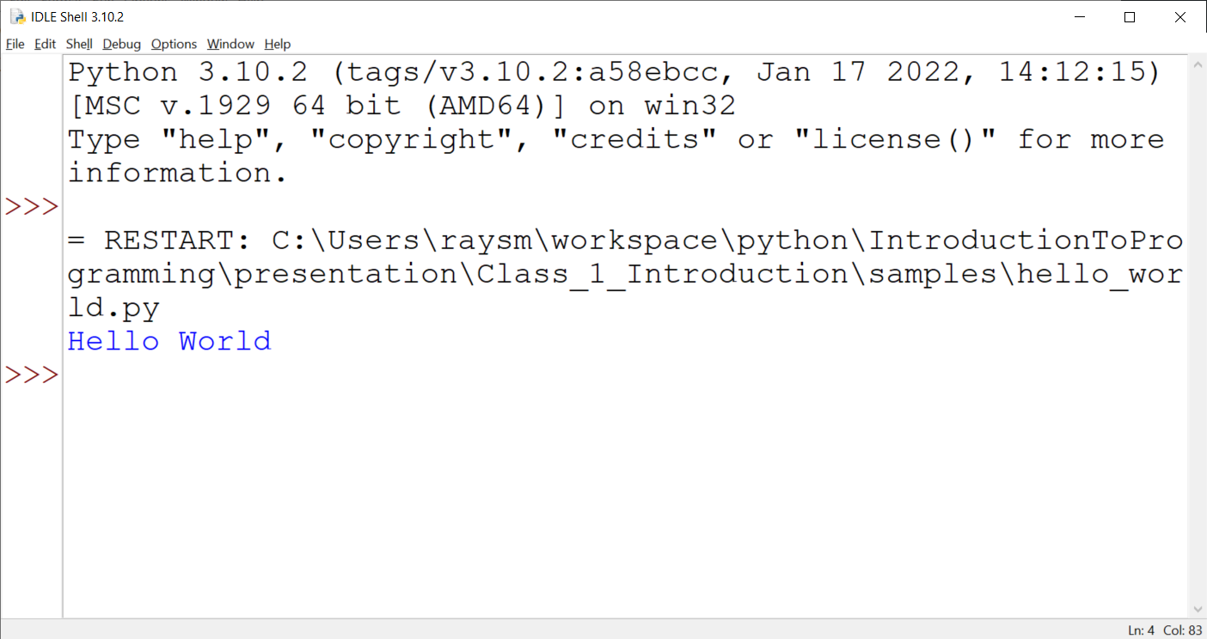
Output listed on IDLE Shell

Slide 17
Additional Samples
… /Introduction…/presentation/
Class_1…/samples/
Don't be square – square.py, square_loop.py
Be a star… spokes.py
Some input… some_input.py
Some time… sometime.py
A little dramatics… starry_night.py

Slide 18
Python ←→ English A lot in common
Arithmetic:
1 2 3 4 5 6 7 8 9 10... 3.1415
+ add, - subtract, * multiply, / divide
= assign one thing to another
> greater, < less, == equal (= was taken)
name() – functions do something

Slide 19
Python ←→ English A lot in common
Key words:
if - choose or test
else – or not
while – do while something is true
for – do for a list of items
print – print things

Slide 20
Python ←→ English A lot in common
Key words - continued
in – within a list or string
import – bring in from elsewhere
from – where we got something

Slide 21
Python ←→ English A lot in common
Punctuation:
Indentation – groups process indented
[ stuff ] – grouping items
( stuff ) – grouping items
"stuff here is taken literally"
'The same here as in "here" '

Slide 22
Python ←→ English Different / New in Python
Punctuation:
# - disregard to end of line as a comment
= - assign value from left to right
== - test for equality (not big change)
Indentation level is VERY IMPORTANT

Slide 23
Python ←→ English Different / New to Python
Punctuation:
"single limited to ONE line"
'single limited to ONE line'
"""Starts a possibly multi-line string """
'''Same for this triple single quote'''
indented:
Things indented
to the same level
are executed together

Slide 24
Python ←→ English Different / New in Python
variables:
named place in which you can store stuff, e.g. number, string
names start with a-z_ followed by any number of 0-9,a-z,_ letters
Initialized by variable_name = value
min_value = 10
max_value = min_value + 15

Slide 25
Python ←→ English Different / New in Python
lists:
A group of things, numbers, strings, other lists
Created by: [ comma separated list ]
Example: colors = ["red", "orange", "yellow" ]

Slide 26
Some samples of basics
If
if.py
while
while_1.py
for
for_1.py
for_range_beg_end.py

Slide 27
Lists - Ordered group
list1 = [1,2]
print(list1)
list1.append(4)
print(list1)
for mem in list1:
print(mem)

Slide 28
range() – sequence – like a list of numbers
range(start, end) – start,…,end-1
range(end) – 0,…,n-1
for n in range(1,10): # 1-9
print("n:", n)
for n in range(10): # 0-9
print("n:", n)
Notes:
range is an easy way of generating a sequence of numbers.
Not a list but an object, called an iterable, which gives the contents in order when invoked.
list(range(5)) returns a list of [0,1,2,3,4]

Slide 29
List / Range Samples
lists1.py – setup, appending, printing, traversing
colors.py – traversing (iterating through)
list_range.py – using range() for list of numbers

Slide 30
Programming Concepts
Computer == VERY Obedient Servant
programming - controls the computer
Car Example ( or bike, or TV)
Most cars are alike
Does what you tell it – hopefully what you want
Same response every time – almost – e.g. press peddle – forward
Troubles - Car gets the blame…
Notes:
What does a car do for you?
What does a car do that you don't really need / want?
What is the most difficult thing about using a new car?

Slide 31
Like Computer Programming, They do / have
Build once – use many times
Builder and user(s) often different
Building errors show up many times
Mistakes don't always show up immediately

Slide 32
Functions – Divide and Conquer
Group process / plan – e.g., chapters
Each part placed in a function
Benefits:
Reduce duplicated work
Hide the particulars
Delay detailed work
Notes:
Often called subroutines, procedures
One, if not the most, powerful concepts/tools of programming
With almost nothing else one can start programming quite complex things.

Slide 33
Functions (you write) – Example
Definition:
def add2(value1, value2):
sum = value1 + value2
return sum
Use:
sum1 = add2(1,2) # sum1 gets 1+2
sum2 = add2(3,4) # sum2 gets 3+4
Notes:
Function Calling / Invocation
How do we call the function?
Called with the function name
Including parenthesized list of values
The values are passed to the function

Slide 34
Function Samples
spokes_function.py
square_list.py – make square
Parameters
Default values
Document
bouncing_balls.py – a bit more…

Slide 35
Classes – Programmer Defined Objects
Complex data types
Person: name, home_address, work_address
Address: number, street, state
Complex Activity /Organization
Airport: name, address, runways
Runway: length, width, location, direction
Notes:
Can the students provide examples?
Data types
Activity/Organization

Slide 36
Classes – Structure – Object Oriented
Function: group actions performed as a unit
Class: group function plus data
Data – object's state
Function – object's actions

Slide 37
Classes – definition
Definition - member functions:
Predefined functions
def __init__(self,…): - initialize data
def __str__(self,…): - used show as string
User defined functions
def my_names(self,…): –do my object's actions
Notes:
"__" leading, and sometimes trailing, double underscore "dunder" – informally reserved for special type variable or function names

Slide 38
Classes – definition - continued
__init__, __str__, __...
- You write them, Python calls them
__init__ - called when ClassName(…) to setup object
__str__ - called when object used as a string .e.g., print(your_obj)
Notes:
"__" leading, and sometimes trailing, double underscore "dunder" – informally reserved for special type variable or function names

Slide 39
Class / Object Examples
rectangle_simp.py – Rectangle (shortened)
square_simp.py – based on Rectangle

Slide 40
Question and Answer

