Slide 1
Introduction to Programming Using Python

Slide 2
Course Objectives
Programming for non-programmers
Demonstrate Operations / Methods
Enable / Energize new programmers
Learning by DOING – Have Fun!
Notes:
Non-programmers benefit from an understanding of programming.
What do you want from this course?
What do you want from programming?

Slide 3
Instructor – Ray Smith raysmith@alum.mit.edu
Many years of Programming – engineering, scientific, financial
Commercial, Scientific, Systems
Languages – C, C++, Perl, Java, Python, Assembly
NEW Areas - Games for young 3+ years
Notes:
What would you like to know about me?

Slide 4
Our Online Class – Using Zoom
If any background noise, please mute – minimizes cumulative noise
Disable own video – too many reduces clarity- Unless ASKING A QUESTION
Can question via Chat – can be to ALL
Expecting Response: Start "QUESTION:"
Notes:
We'll try enabling video for speaker(s)

Slide 5
Class Session Structure – Each Week
Lecture and practice: 1.5 Hours
Follow-up Questions: .5 Hours
Similar to Programming – This Course
Skips, Repeats / Revisits
Student Guideline:
If you know it – Have Patience
If confused / unsure – ASK A QUESTION

Slide 6
Course Outline (An Estimate)
Course Introduction – Up to here
Introduction
Touching on the topic through simple examples
A Very Brief look at Python Language, Programming Environment
Course Project – Start
First Homework
Notes:
What should the computer do for you?
What should the programming language (Python) do?

Slide 7
Course Outline (An Estimate)
Ideas, Tools, Functions
Programming Concepts
Functions
Python Quick Review
Notes:
What should the computer do for you?
What should the programming language (Python) do?

Slide 8
Course Outline - continued
More Review of Python
More on program development … Iteration
Functions
Functions Why and How
Extended examples
More on Strings
Classes and More
Notes:
What should the computer do for you?
What should the programming language (Python) do?

Slide 9
Course Outline - continued
Files
File I/O
system module Slide 106
Graphics – Just a Touch
Tk
More if possible
Notes:
What should the computer do for you?
What should the programming language (Python) do?

Slide 10
Session #1 Introduction Touching on the topic
Any questions in general?
Notes:
Who has had any computer programming experience? Python experience?

Slide 11
Computer Programming Telling the Computer What to Do
The language, PYTHON, is a way
Popular, Powerful, and EASY
Like most human languages
Don’t have to know it all to do a lot
Notes:
What should the computer do for you?
What should the programming language (Python) do?

Slide 12
The Python language – is small
Compared to English, Spanish, French
Lot fewer words, punctuation…
Need to be precise
Say exactly what you want
Python can't ask you again

Slide 13
Learn by DOING
Start with readymade programs
Run unchanged - see results
Make small changes
Run again
Notes:
Who hasn't downloaded python (from www.python.org)?

Slide 14
IDLE Python's built in Learning Tool
Integrated Development and Learning Environment
Interactive execution
Program Edit and Run
Documentation, Examples, Help
Notes:
Who hasn't downloaded python (from www.python.org)?

Slide 15
IDLE IDLE Shell – A sandbox for exploration
Python 3.10.2 …
Type "help", …
>>> 2+2
4
>>> 1**3 + 12**3 == 9**3 + 10**3
True
Notes:
Who hasn't downloaded python (from www.python.org)?

Slide 16
IDLE – IF/WHEN I change my mind…
Redo a line by "up arrow" to line
then press ENTER, then make changes
ALT-P(Cth-P on MAC) will "open" last command for changes
After changing code, press ENTER to execute changed command (twice if part of a compound statement)

Slide 17
Python Code Files
>>> IDLE shell
GREAT for short/simple/one-time testing
NOT as GREAT for longer/complex/reuse

Slide 18
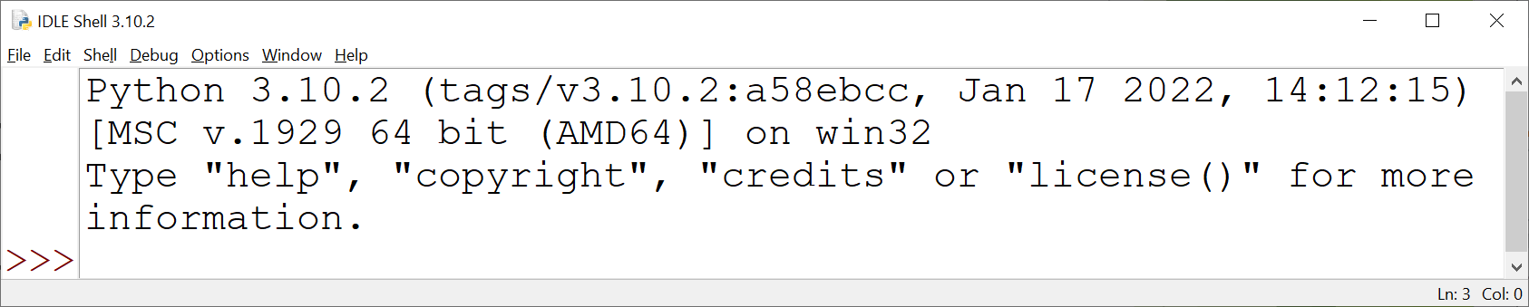
A Quick Look Samples to Run Now - Change Later
File → Open
… /intro_prog/presentation/
Class_1_Intro…/samples/hello_world.py

Slide 19
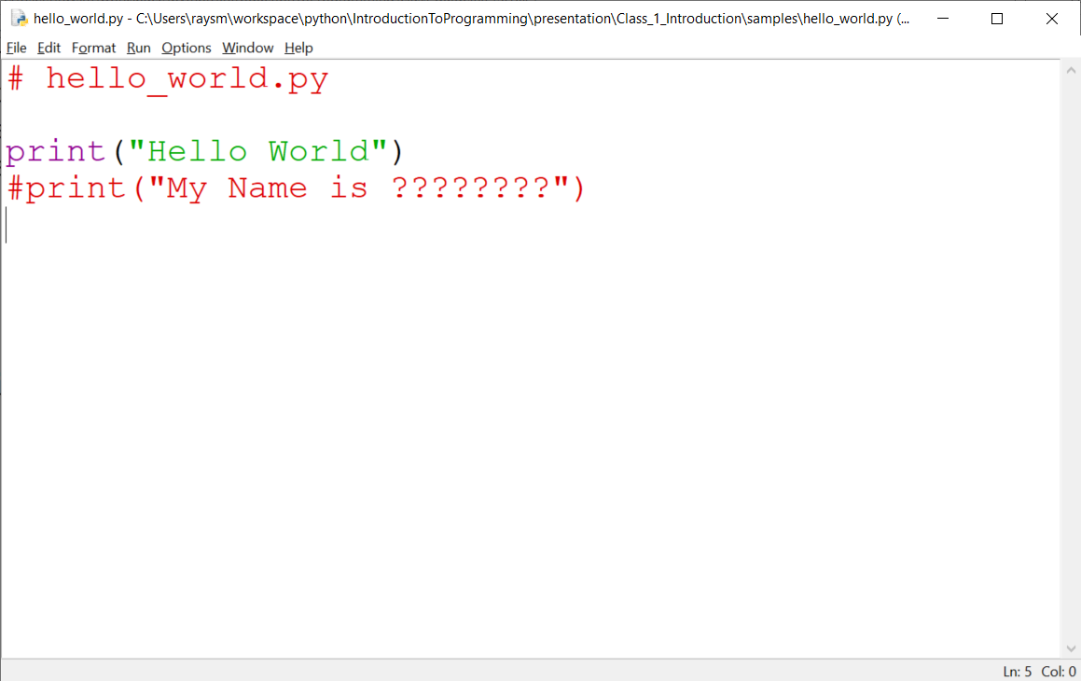
First Program

Slide 20
Run Opened Program
Run → Run Module
Program runs, printing on IDLE console
Hello World

Slide 21
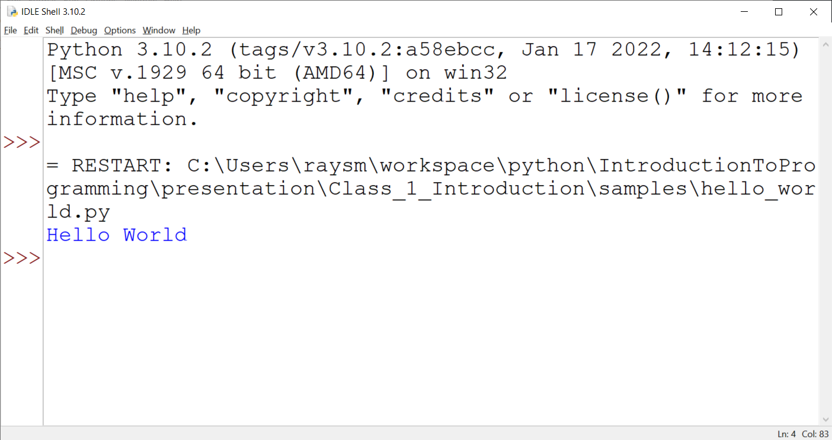
Output listed on IDLE Shell

Slide 22
Additional Samples
… samples/
Don't be square… square.py, square_loop.py
Be a star… spokes.py
Some input… some_input.py
Some time… sometime.py
A little dramatics… starry_night.py

Slide 23
Python ←→ English A lot in common
Arithmetic:
1 2 3 4 5 6 7 8 9 10... 3.1415
+ add, - subtract, * multiply, / divide
= assign one thing to another
> greater, < less, == equal (= was taken)
name() – functions do something
may return a value

Slide 24
Python ←→ English A lot in common
Key words:
if - choose
else – or not
while – do while something is true
for – do for a list of items
print – print things

Slide 25
Python ←→ English A lot in common
Key words - continued
in – within a list or string
import – bring in from elsewhere
from – where we got something

Slide 26
Python ←→ English A lot in common
Punctuation:
Indentation – groups process indented
[ stuff ] – grouping items
( stuff ) – grouping items
"stuff here is taken literally"
'The same here as in "here" '

Slide 27
Python ←→ English Different / New in Python
Punctuation:
# - python disregards to end of line
= - assign value from right to left
== - test for equality (not big change)
Indentation level is VERY IMPORTANT

Slide 28
Python ←→ English Different / New to Python
Punctuation:
"limited to ONE line"
'limited to ONE line'
""" Triple double quote Starts a
multi-line
string """
'''Same for triple single quote'''

Slide 29
Python ←→ English Different / New to Python
indention:
Things indented
to the same level
are executed together

Slide 30
Python ←→ English Different / New in Python
variables:
named place in which you can store stuff, e.g. number, string
names start with a-z_ followed by any number of 0-9,a-z,_ letters
Initialized by variable_name = value
min_value = 10
max_value = min_value + 15

Slide 31
Python ←→ English Different / New in Python
lists:
A group of things, numbers, strings, other lists
Created by: [ comma separated list ]
Example: colors = ["red", "orange", "yellow" ]
Notes:
Computer languages often give precise additional meanings to words or punctuation that have general use in the generally spoken or written language. This is similar to traffic signals giving special meanings to color, e.g., "red" – stop, "green" - go

Slide 32
Some samples of basics see …Intro…/exercises/*
exercises/if_statement/*
if - if.py
else - if_else.py
elif - if_elif_else.py

Slide 33
Some examples of basics see …Intro…/exercises/*
while – exercises/while_statement/
while_1.py, while_nested_simple.py, while_nested.py
for – exercises/for_statement/
for_1.py, for_2.py, for_3.py
for_range_beg_end.py, for_range_beg_end_by.py
List – exercises/lists
colors.py

Slide 34
Course Project A Real Life Program YOU Will Create: Twenty Questions
… I’m thinking of a number …
Program loops:
Player guesses
Program tells if higher/lower/equal
Program offers to play again
Notes:
What sort of programs are there? Could there be?
Calculators – financial, industrial
Games

Slide 35
Sample Output
I'm thinking of a number between 1 and 20
Can you guess it? Remember to press the ENTER key
to enter your guess. Good Luck!
Enter Guess:10
Number: 10
Sorry your input of 10 is too high
Enter Guess:5
Number: 5
Congratulations 5 is my number
Play a new game?
Enter N to quit: n
See you next time.
Notes:
Demonstrate: exercises/twenty_questions_dev/iteration_7.py
Have the class play/guess.
What improvements / extensions to this program?
What should we be able to do with programs?

Slide 36
Twenty Questions - continued
Programing → Iteration - improve along the way
Simplification also helps the user
Notes:
What sort of programs are there? Could there be?
Calculators – financial, industrial
Games

Slide 37
Class Project – Twenty Questions
exercises/twenty_questions_dev/
iteration_1.py – loop prompting user
iteration_2.py – check for match
…
iteration_6.py - multiple game support
iteration_7.py – protect against typos

Slide 38
Guessing Game – Iteration 1
Create new file named “iteration_1.py”
Do the smallest part
Loop
Ask number, get input
Print number entered
Notes:
What is iteration?
Why iterate?
Why use file name "iteration_1.py"? Our first choices were first.py, second.py, ….
Any problems with iteration?
What's in a game?
goals
interaction
input
output
beginning, middle, end

Slide 39
Guessing Game – Iteration 1 - Hints
Place comments describing task
Use while True:
What variables?
Use string = input("…")
Notes:
You're going to do this.
I'm showing some hints.

Slide 40
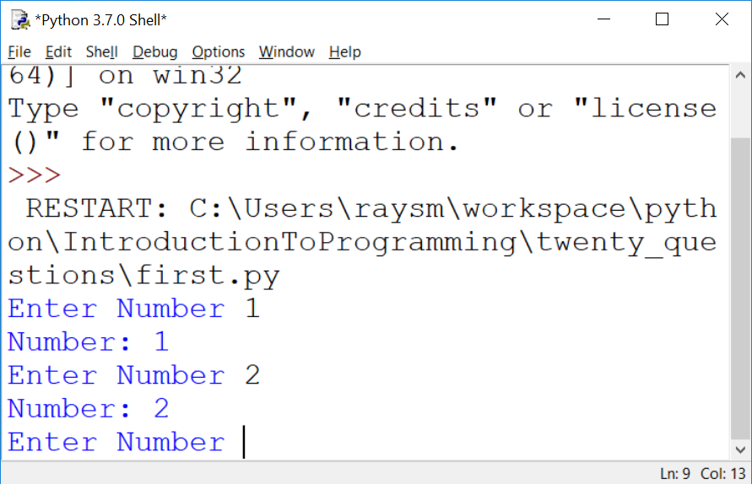
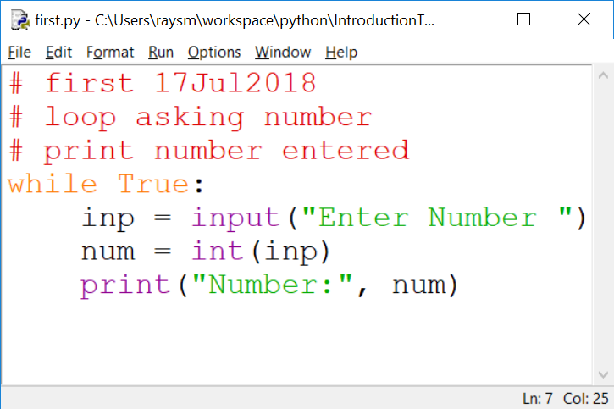
The First Iteration – Code / Output
Notes:
What do we get from doing this iteration?
learning
testing
early fun?
What does it cost us?

Slide 41
HOMEWORK
presentation/Class_1_Introduction/homework/Introduction.docx
For your benefit / fun
As much / little as you can
Contact me if problems / questions
Have fun!
Notes:
Let's take a quick look.

Slide 42
Question and Answer

