Slide 1
Introduction to Programming Using Python

Slide 2
Course Outline (An Estimate)
Course Introduction – Up to here
Introduction
Touching on the topic
A Very Brief look at Python Language, Programming Environment
Course Project – Start
First Homework
Notes:
What should the computer do for you?
What should the programming language (Python) do?

Slide 3
Course Outline (An Estimate)
Ideas, Tools, Functions
Programming Concepts
Functions
Python Quick Review
Notes:
What should the computer do for you?
What should the programming language (Python) do?

Slide 4
Course Outline - continued
More Review of Python
More on program development … Iteration
Functions
Functions Why and How
Extended examples
More on Strings
Classes and More
Notes:
What should the computer do for you?
What should the programming language (Python) do?

Slide 5
Course Outline - continued
Files
File I/O
system module Slide 106
Graphics – Just a Touch
Tk
More
Notes:
What should the computer do for you?
What should the programming language (Python) do?

Slide 6
Instructor – Ray Smith raysmith@alum.mit.edu
Many years of Programming – engineering, scientific, financial
Commercial, Scientific, Systems
Languages – C, C++, Perl, Java, Python, Assembly
NEW Areas - Games for young 3-8 years
Notes:
What would you like to know about me?

Slide 7
Course Objectives
Programming for non-programmers
Demonstrate Operations / Methods
Enable / Energize new programmers
Learning by DOING
Notes:
What do you want from this course?
What do you want from programming?

Slide 8
Our Online Class – Using Zoom
If any background noise, please mute – minimizes cumulative noise
Disable own video – too many reduces clarity
Can question via Chat – can be to ALL
Expecting Response: Start "QUESTION:"
Notes:
What do you want from this course?
What do you want from programming?

Slide 9
Class Session Structure – Each Week
Lecture and practice: 1.5 Hours
Follow-up Questions: .5 Hours
Similar to Programming – This Course
Skips, Repeats / Revisits
Student Guideline:
If you know it – Have Patience
If confused / unsure – ASK A QUESTION

Slide 10
Session #1 Introduction Touching on the topic
Any questions in general?
Notes:
Who has had any computer programming experience? Python experience?

Slide 11
Computer Programming Telling the Computer What to Do
The language, PYTHON, is a way
Popular, Powerful, and EASY
Like most human languages
You don’t have to know it all to do a lot
Notes:
What should the computer do for you?
What should the programming language (Python) do?

Slide 12
Learn by DOING
Using Python's built in tool IDLE
Integrated Development and Learning Environment
Interactive execution of Python
Python Program editor and execution
Lots of documentation, examples, help
Notes:
Who hasn't downloaded python (from www.python.org)?

Slide 13
Our Sandbox – IDLE Demonstration and Testing
https://www.python.org
Download latest python example: 3.7.0
Python shell
Documentation
IDE - editor, execution, debugger
Notes:
What would you like from a programming tool / helper?
IDLE can provide the environment for us to directly use Python to do things.
What's necessary?

Slide 14
IDLE – continued
Python Documentation:
Help ➔ Python Docs
Help on IDLE:
Help ➔ IDLE Help
Python Program Examples:
Help ➔ Turtle Demo
Notes:
What should IDLE do for you?

Slide 15
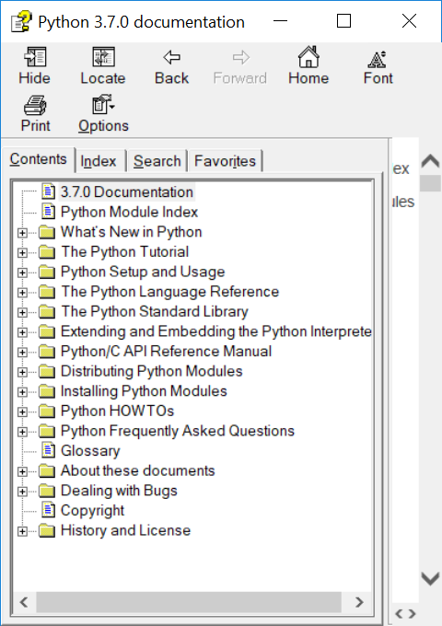
Documentation – Lots of Nice STUFF

Slide 16
A Quick Introduction to Python wordy offline guide file - IDLE
A file with some beginning examples
open python_introduction.txt
File → Open →… exercises → introduction → Text files(*.txt) → python_introduction.txt

Slide 17
Blazing Introduction to Parts of Python
Run Python IDLE
Follow along with instructor
– copy, experiment, question
>>> 1 + 1
2
Saved IDLE Session Example:
exercises\introduction\python_introduction.py
Notes:
Make shortcut?

Slide 18
Blazing Introduction – continued IDLE primer
>>>: IDLE shell prompt (to you the user)
# : start of comment to be ignored
Otherwise: printout from IDLE
>>> 1 + 1 # Comment on 1 + 1
Notes:
Offline self-guide file: exercises/python_introduction.txt

Slide 19
Blazing Introduction Part 1 – Did we mention...
# Beginning comments
1+1, *, /, -, %, **, //, 1+2;3+4, 2+3*4,(2+3)*4
"a", 'b', """c""", '''d''',
"Ray" + " " + "Smith"
print(1, "one", 2, "two")
var_name = 1, a, b
NOT 1a, a b

Slide 20
Blazing Introduction Part 1B – Did we mention...
>>> a
SyntaxError: cannot assign to literal
NameError: name 'a' is not defined
Traceback (most recent call last):
File "<pyshell#7>", line 1, in <module>
Python tries to be helpful
Can't always guess
Tries to be exact
Notes:
What do "assign", "literal", "defined" mean?

Slide 21
IDLE – IF/WHEN I change my mind…
Redo a line by "up arrow" to line
then press ENTER, then make changes
ALT-P(Cth-P on MAC) will "open" last command for changes
After changing code, press ENTER to execute changed command (twice if part of a compound statement)

Slide 22
Blazing Introduction Part 2 Python Code Files
>>> IDLE shell
GREAT for short/simple/one-time testing
NOT SO GREAT for longer/complex/reuse

Slide 23
Blazing Introduction Part 2 Python Code Files
Putting Python code in a file
Fairly easy
Enables reuse
Helps modification

Slide 24
Blazing Introduction Part 2 Python Code Files
Create file File ➔ New File (my_work.py)
… add text (#my_work.py)
File ➔ Save
Maybe in folder “class_work” ???
Reuse - File ➔ Save As ➔ …new name

Slide 25
Blazing Introduction Part 2 - continued Hello World! - You Try!
Write simple program (hello_world.py):
File→New
print("Hello World!")
print("My name is your name.")
Save file – File ➔ Save
OR File->Save As…
Run program – Run ➔ Run Module
Notes:
Howabout: File→File-->Recent Files (select my_work.py)
Then: File→Save As… (hello_world.py)

Slide 26
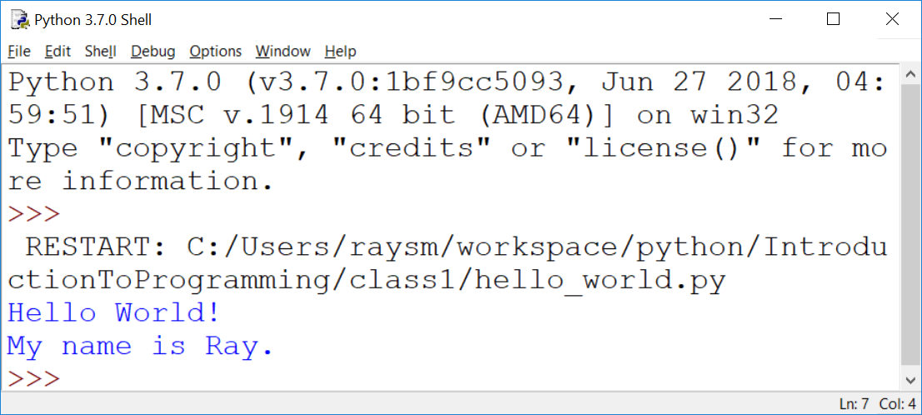
Hello World! – output – my example

Slide 27
Blazing Introduction Part 2 - continued Make a New Program – goodbye_world.py
"Goodbye World…"
Hint - Start with program closest to our goal - hello_world.py (File→Recent Files)
Save As… to new name BEFORE changing
Make changes creating new program
Run new program – Run ➔ Run Module
Notes:
How about goodbye_world.py ?

Slide 28
Blazing Introduction Part 3 – Did we mention...
What so far?
…Arithmetic… Error Messages
if, else, elif, True, False,
a == b, a != b, a > b, a < b, a >= b
while, for, break, continue, range()
input(), int()

Slide 29
Blazing Introduction Part 4 – lists...
list1 = [1,2]
print(list1)
list1.append(4)
print(list1)
for mem in list1:
print(mem)

Slide 30
Blazing Introduction Part 4 – Adding Dictionaries...
d1 = {'name1':1, 'n2':2}
print(d1)
d1['n1b'] = "1a"
print(d1)
for nm in d1:
print(nm, d1[nm])

Slide 31
Course Project A Real Life Program YOU Will Create: Twenty Questions
… I’m thinking of a number …
Your program picks a number
Player guesses
Program tells if higher/lower
Program offers to play again
Notes:
What sort of programs are there? Could there be?
Calculators – financial, industrial
Games

Slide 32
Sample Output
I'm thinking of a number between 1 and 20
Can you guess it? Remember to press the ENTER key
to enter your guess. Good Luck!
Enter Guess:10
Number: 10
Sorry your input of 10 is too high
Enter Guess:5
Number: 5
Congratulations 5 is my number
Play a new game?
Enter N to quit: n
See you next time.
Notes:
Demonstrate: exercises/twenty_questions_dev/iteration_7.py
Have the class play/guess.
What improvements / extensions to this program?
What should we be able to do with programs?

Slide 33
Twenty Questions - continued
Programing → Iteration - improve along the way
Simplification also helps the user
Notes:
What sort of programs are there? Could there be?
Calculators – financial, industrial
Games

Slide 34
Guessing Game – Iteration 1
Create new file named “iteration_1.py”
Do the smallest part
Loop
Ask number, get input
Print number entered
Notes:
What is iteration?
Why iterate?
Why use file name "iteration_1.py"? Our first choices were first.py, second.py, ….
Any problems with iteration?
What's in a game?
goals
interaction
input
output
beginning, middle, end

Slide 35
Guessing Game – Iteration 1 - Hints
Place comments describing task
Use while True:
What variables?
Use string = input("…")
Notes:
You're going to do this.
I'm showing some hints.

Slide 36
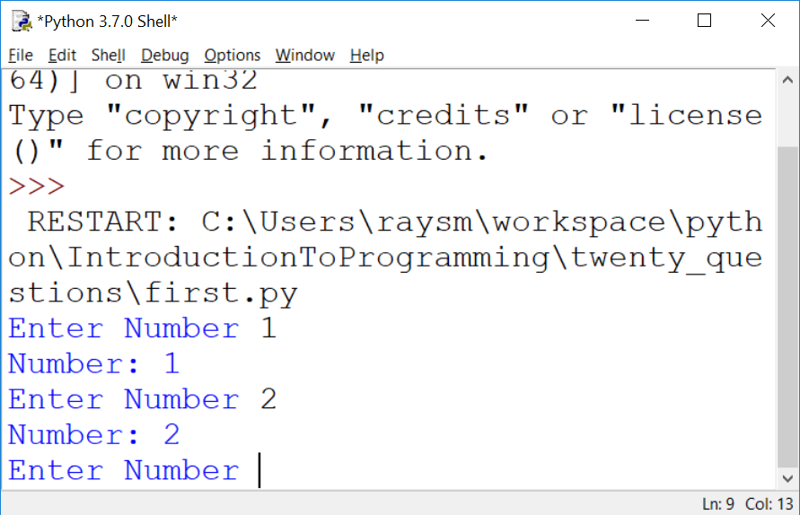
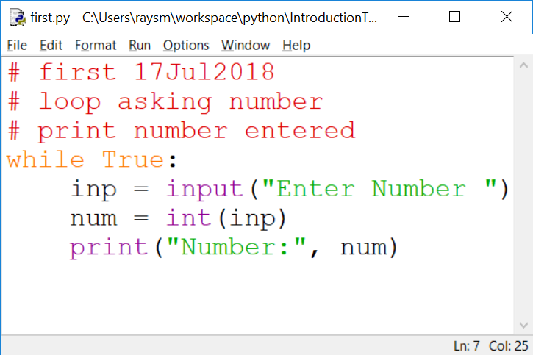
The First Iteration – Code / Output
Notes:
What do we get from doing this iteration?
learning
testing
early fun?
What does it cost us?

Slide 37
HOMEWORK
intro/presentation/Class_1_Introduction/homework/Class_1_Introduction.pptx
For your benefit / fun
As much / little as you can
Contact me if problems / questions
Have fun!
Notes:
Let's take a quick look.

Slide 38
Question and Answer
Notes:
Use the previous iteration as a start to the next.
I'll go around and watch.
Raise had if a question.

