Slide 1
Session #7 Graphics + Debugging
Questions on Programming?, Python?
Homework questions?
  Who did it? To easy? To hard?
  Questions on problems
  Long answers in Q/A session

Slide 2
Time to Ask Questions
Please Ask any question about Programming or Python you are unsure, confused or interested in.

Slide 3
Graphics - Display / Control beyond text
A number of choices
  tkinter (shipped with python)
  wxPython (must be installed)
tkinter—interface to Tcl/Tk
  Shipped with Python
  Good example of Graphics Ideas
  Basis for turtle

Slide 4
Graphics - wxPython
  Must be installed
  Similar event style to other graphics
  More connected to screen readers

Slide 5
Graphics – continued
Event driven
  Action happens when events occur
    Mouse clicks, time passing
Object Oriented
  Programming is done in parts

Slide 6
Graphics – Creating a window exercises/graphics/my_window.py
    import tkinter as tk
    root = tk.Tk()
    root.mainloop()

Slide 7
Graphics – Simple Messages
Simple "Hello" program
  exercises/graphics/gr_hello.py
Get input
  exercises/graphics/gr

Slide 8
Graphics – widgets – graphics tools
  Frame – Holder, can hold other Frames
  Label – Has text / picture
  Button – Accepts mouse control (click)
  Entry - Input
  Text – holds free text
  Scrollbar – controls scrolling
Notes:
File, as a named group of bytes is an abstraction.
Years ago the programmer needed to understand more about the structure.
Your Python program is a data file to some program(s).

Slide 9
Graphics – Frame, Button
  exercises/graphics/tutorial_hello_world.py

Slide 10
Graphics – continued
Event driven
Object Oriented
Simple tkinter tutorial:
https://www.pythontutorial.net/tkinter/tkinter-hello-world/
Notes:
File, as a named group of bytes is an abstraction.
Years ago the programmer needed to understand more about the structure.
Your Python program is a data file to some program(s).

Slide 11
Graphics – Example
Simple Notes data base
Display file lines containing pattern
  Terminal based
    exercises/notes/notes_3e.py
  Graphics version
  exercises/graphics/notes_graphics.py
  exercises/graphics/notes_data_win.py
Notes:
File, as a named group of bytes is an abstraction.
Years ago the programmer needed to understand more about the structure.
Your Python program is a data file to some program(s).

Slide 12
Debugging
– Dealing with program problems
print statements in the program
"too noisy"- include "if trace_flag:"
Break up complex operations
Use descriptive variables
Notes:
Like life programs, of almost any complexity, will have problems – they often do not operate as desired/expected.
Good News – finding and fixing them is often easy and even fun.

Slide 13
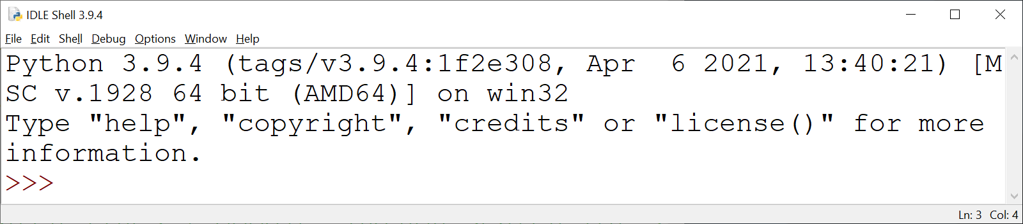
Debugging
– IDLE Debugger
Open program file to be debugged
Run ➔Python Shell
Notes:
Options → Show Line Numbers

Slide 14
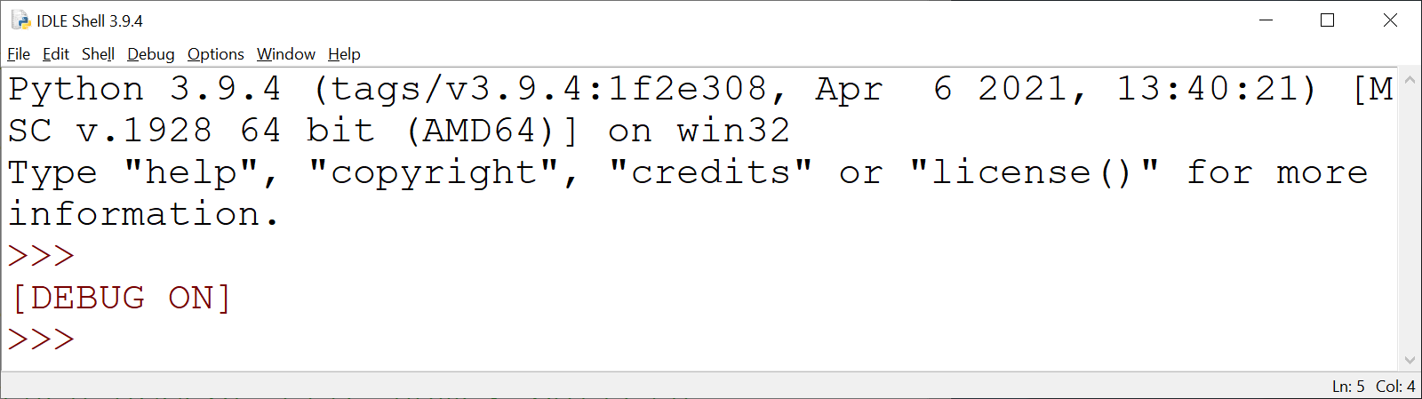
Debugging
– IDLE Debugger
From IDLE Shell
Debug → Debugger

Slide 15
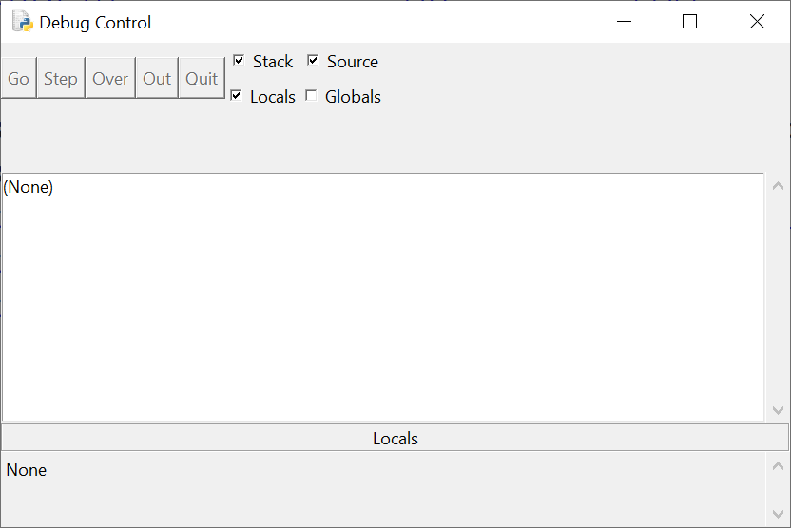
IDLE Debugger
– Debug Control Window

Slide 16
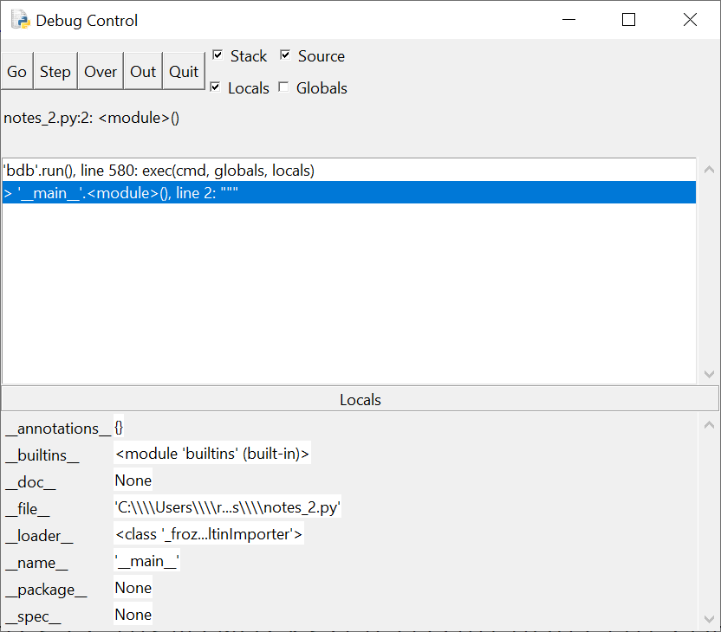
Debug Control
Operation
File window (with DEBUG ON) → Run ➔ Run Module

Slide 17
Debug Control
Operation
Go – start program
Step – do one statement
Over – do one statement over internal
Out – execute till out of current routine
Quit – quit program debugging

Slide 18
Debug Control
Operation
[] Stack – display program stack
[] Source – show source location
[] Locals – display local variables
[] Globals – display global variables

Slide 19
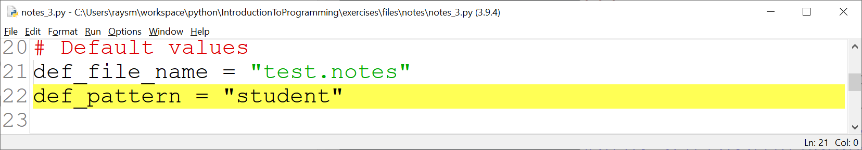
Debug Control
Operation
In Edit File – Set Break Point
→ Debugging execution will pause

