Slide 1
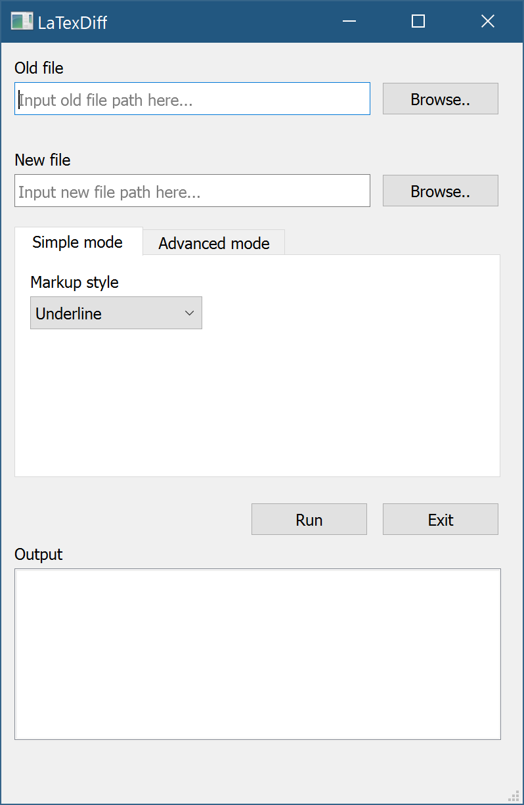
Step 1: Choose the old (draft) file
Step 2: Choose the new (revision) file
Step 3: Choose the markup style you want to use
Step 4: Click on Run. If you are lucky enough, you will get an ‘output.tex’ in the folder😄

