Slide 1
AppCode Advantages Over Xcode
Prepared by Ray Trask
June 11, 2015

Slide 2
AppCode Is Not a Replacement for Xcode
By JetBrains own admission, their aim is not to replace Xcode but supplement it.
“AppCode is fully compatible with Xcode, including its latest previews. You can open existing Xcode projects and work on a project in both IDEs in parallel. No additional configuration is needed, and your projects always stay 100% Xcode-compatible.”
Use Xcode for Storyboards and lifecycle management. Use AppCode for code development.
Both IDEs can work on the same project at the same time and the files stay seamlessly in sync.
[I switch back and forth with a display swipe.]

Slide 3
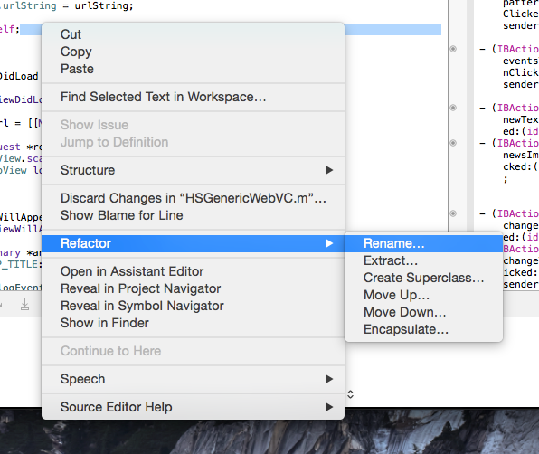
Refactoring - Xcode

Slide 4
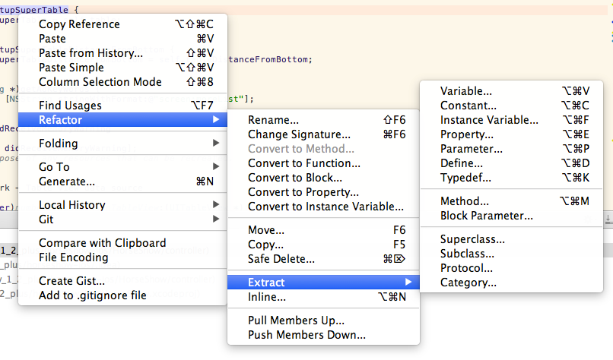
Refactoring - AppCode

Slide 5
Refactoring Observations
Some example Xcode shortcomings.
Xcode class rename does not change the filenames. You need to do that separately.
Xcode has problems with storyboard items renaming such as outlets etc.
An example AppCode “extra mile”.
AppCode renames work for everything including the option of renaming things in comments!!

Slide 6
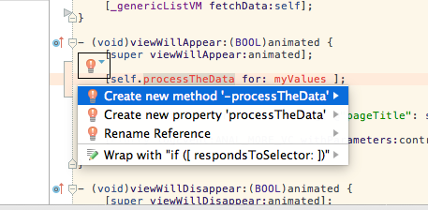
Code Generation
AppCode detects an undeclared symbol and based on the
context recommends a code generation.

Slide 7
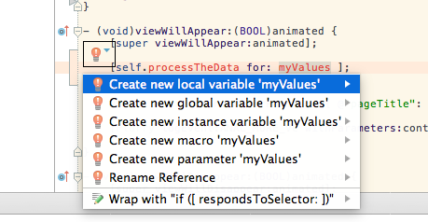
Code With Intention
AppCode detects the undeclared symbol and based on the
context recommends a code generation.

Slide 8
Quote Regarding Coding By Intention Support
Creating new classes in Xcode is the worst. When I’m in the middle of writing a test, the last thing I want to do is lose my train of thought [losing flow is expensive]. Since we practice TDD at Atomic, often times I’m writing tests using classes that don’t exist yet or are not yet imported. When I need to create that class in Xcode (to get the tests to compile) I have to find the folder I’d like to add that class to, right click, new file, yadda yadda. Then when I settle on a good method name for that new object, I have to go to the header, declare it, and then stub out the implementation. Finally, I’m ready to navigate to the top of my current file and add the #import "filename".
AppCode takes away all of that pain… Ryan Abel

Slide 9
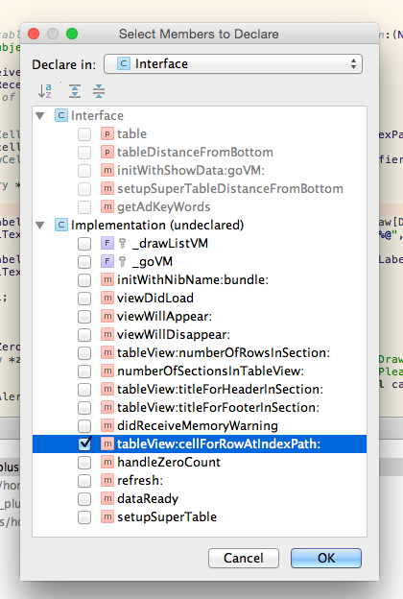
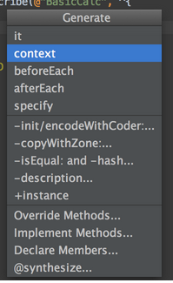
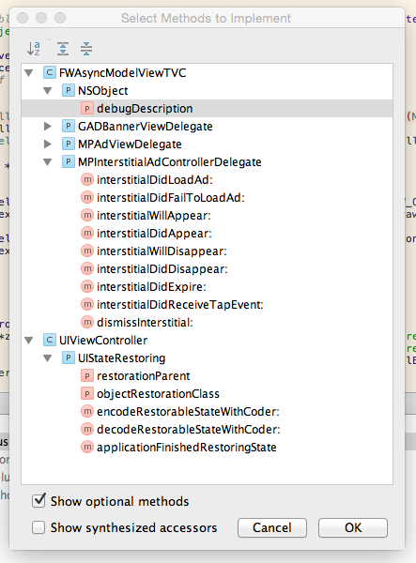
Code Generation Supported Contexts

Slide 10
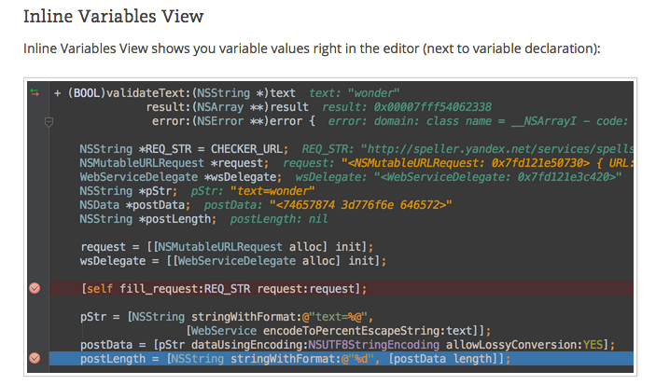
Debugging

Slide 11
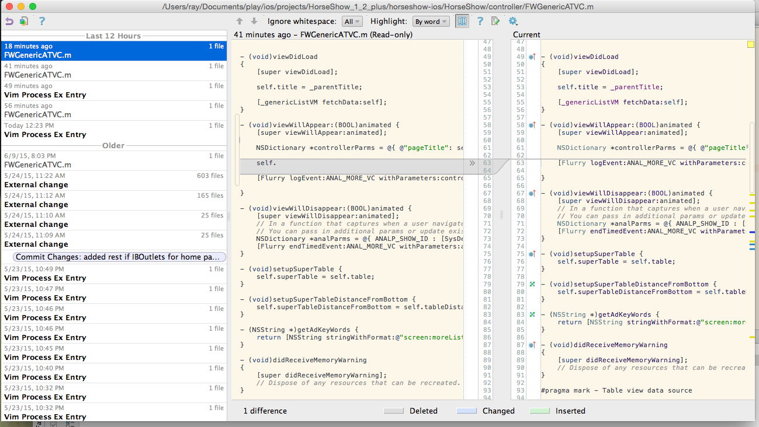
Local History AppCode Only

Slide 12
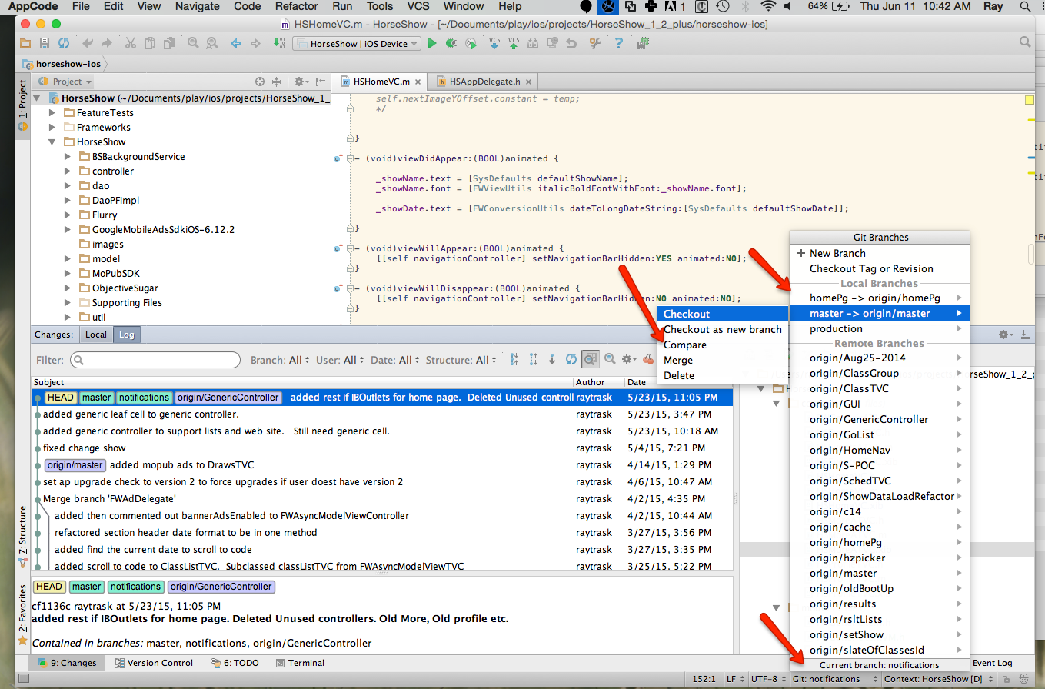
Third Party Integration Change Control

Slide 13
Third Party Integration JIRA Integration
“When your ToDo list is in an issue tracking system, you can configure AppCode to work with the issues without switching away from the IDE. Specify your issue tracker server and you will be able to:
Select the tasks to work on from the list defined by your filter
Automatically group VCS changes under the corresponding task
Commit to VCS with task name/ID pre-filled for you
Switch between tasks keeping the IDE context saved (open editor tabs, breakpoints, etc.)”

Slide 14
Miscellaneous
AppCode offers two kinds of code completion: basic as-you-type completion, and more advanced SmartType completion for more precise filtering of suggestions. Both completion types support CamelHumps and Middle Matching; that is, you can complete any item by entering only its uppercase characters or any part of its name at all.
Automatic import adding and cleanup.
Multiple Caret editing.
FileTemplates, Live Templates, Surround With templates.

Slide 15
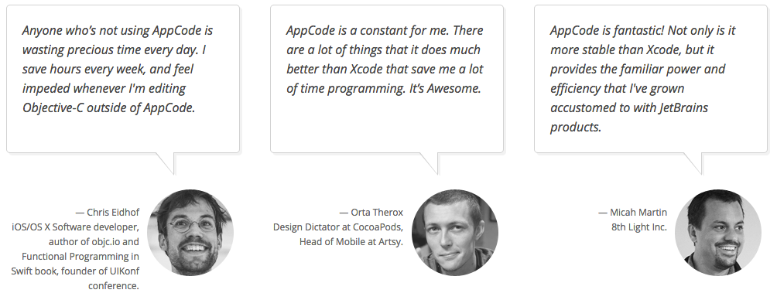
Productivity Quotes

