Slide 1
Healthy Brain Study wearable data requests, integration, synchronization and access
Frederik D. Weber
Rayyan Tutunji

Slide 2
Goals
preprocess raw data from wearable/mobile devices
synchronize data
In a software for data access requests
python

Slide 3
Codename
wearanize "wearable data -> synchronize"

Slide 4
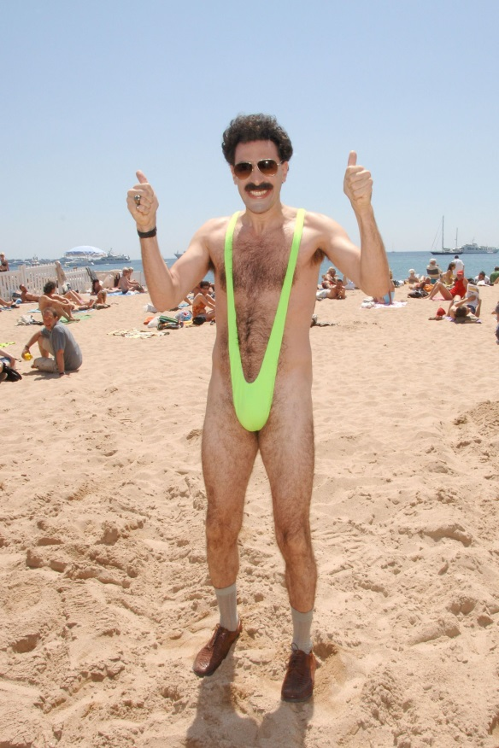
Codename
wearanize "wearable data -> synchronize"
Its weara nize!

Slide 5
Wearable devices and data
Hypnodyne zmax
Accelerometer (3-Dimensional, -2 to 2 g, 256 Hz)
Heart (Photoplethysmography or blood volume pulse BVP, 256 Hz)
EEG/EOG (2 channels, forehead)
battery
Empatica E4
Accelerometer (3-Dimensional, -2 to 2 g, 32 Hz)
Heart (Photoplethysmography or blood volume pulse BVP, 64 Hz)
Electordermal activity (EDA, 4 Hz)
Temperature skin (4 Hz)
activPAL
Accelerometer (3-Dimensional, -2 to 2 g, 20 Hz)
EMA mobile survey app
Timestamps (start_beep, end_beep) with questionnaire answers

Slide 6
Steps (a wearanize plan)
0: parsing the file structure and finding the relevant wearable files
1.1: reading, preprocessing, concatenation and data export
1.2: checking data and file structure integrity
2.1: recording date and time extraction
2.2: data quality extraction
3: internal representation for computation and feature generation
4: common feature/modalities generation (for synchronization)
5.1: aligning and synchronization
5.2: align and synch info generation
6.1: find all relevant data given a request command line software
6.2: get the relevant files and snippets
6.3: visualize alignment and data availability
6.4: (optional) merge all the data in a common data format

Slide 7
step 0: parsing the file structure and finding the relevant wearable files
storing in an wearabout.csv: ['subject_id', 'filepath', 'period', 'datatype', 'device_wearable', 'session']
status: done, needs testing on all data
QUESTION: read-only access to full data?

Slide 8
HB root folder structure for wearables
sub-HB0136338856769 --|date_visit1.txt --|date_visit2.txt --|date_visit3.txt --|crf --|lab-1 --|lab-2 --|lab-3 --|pre-1 --|--|app --|--|--|sub-HBEMA5183016_pre-1_app-ema.csv --|--|wrb --|--|--|sub-HB1AP1618436_pre-1_wrb_apl.datx --|--|--|sub-HB1AP1618436_pre-1_wrb_apl.pml --|--|--|sub-HB1AP1618436_pre-1_wrb_apl_combined_pd_data.csv --|--|--|sub-HB1AP1618436_pre-1_wrb_apl_combined_wk_data.csv --|--|--|sub-HB1AP1618436_pre-1_wrb_apl_logdata.csv --|--|--|sub-HB1AP1618436_pre-1_wrb_apl_slnwlist.csv --|--|--|sub-HB1AP1618436_pre-1_wrb_apl_sumdata.csv --|--|--|sub-HB1AP1618436_pre-1_wrb_apl_tagged_events.csv --|--|--|sub-HB1AP1618436_pre-1_wrb_apl_valid_periods.csv --|--|--|sub-HB1AP1618436_pre-1_wrb_apl-evs.csv --|--|--|sub-HB1EM6570669_pre-1_wrb_emp_01.zip --|--|--|sub-HB1EM6570669_pre-1_wrb_emp_02.zip --|--|--|sub-HB1EM6570669_pre-1_wrb_emp_03.zip --|--|--|sub-HB1EM6570669_pre-1_wrb_emp_04.zip --|--|--|sub-HB1EM6570669_pre-1_wrb_emp_05.zip --|--|--|sub-HB1EM6570669_pre-1_wrb_emp_06.zip --|--|--|sub-HB1EM6570669_pre-1_wrb_emp_full.zip --|--|--|sub-HB1EM8057291_pre-1_wrb_emp.zip --|--|--|sub-HB1EM8057291_pre-1_wrb_emp_01.zip --|--|--|sub-HB1EM8057291_pre-1_wrb_emp_02.zip --|--|--|sub-HB1EM8057291_pre-1_wrb_emp_03.zip --|--|--|sub-HB1EM8057291_pre-1_wrb_emp_04.zip --|--|--|sub-HB1EM8057291_pre-1_wrb_emp_05.zip --|--|--|sub-HB1EM8057291_pre-1_wrb_emp_06.zip --|--|--|sub-HB1ZM3321037_pre-1_wrb_zmx_1.zip
--|--|--|sub-HB1ZM3321037_pre-1_wrb_zmx_1_merged.zip --|--|--|sub-HB1ZM3321037_pre-1_wrb_zmx_2.zip --|--|--|sub-HB1ZM3321037_pre-1_wrb_zmx_3 - empty.zip --|--|--|sub-HB1ZM3321037_pre-1_wrb_zmx_4.zip --|--|--|sub-HB1ZM3321037_pre-1_wrb_zmx_5.zip --|--|--|sub-HB1ZM3321037_pre-1_wrb_zmx_6.zip --|--|--|sub-HB1ZM3321037_pre-1_wrb_zmx_7.zip --|--|--|sub-HB1ZM3321037_pre-1_wrb_zmx_raw.zip --|pre-2 --|pre-3 --|pst-1 --|pst-2 --|pst-3 --|qst sub-HB0139930729424 sub-HB0037923118974 sub-HB0063396839740 sub-HB0070445226012 sub-HB0087095682539 sub-HB0096744832326 sub-HB0108728545230 sub-HB0109563627639 sub-HB0116859417067

Slide 9
step 1.1: reading, preprocessing, concatenation and data export
Hypnodyne zmax -> merging of channels in one file per session, saving as a zipped and compressed EDF
Empatica E4 -> merging all in one file per session to have data of multiple files in a timestamped csv
recreating wearabout.csv (with reprocessing the new exported files)
status: zmax & E4 and writing to zipped files done, activPAL & EMA in progress

Slide 10
step 1.2: checking data and file structure integrity
e.g. if all the zmax file dates and data length make sense or need to be adjusted what files are present and which not but are expected
status: in testing for zmax and E4 data, missing activPAL and EMA
QUESTION: is there enough space to store the wearable data a second time? What about writing access? Separate file structure for writing?

Slide 11
step 2.1: recording date & time extraction
extending wearabout.csv by info all devices: [... 'rec_start_datetime', 'rec_stop_datetime', 'rec_duration_datetime', 'sampling_rate_max_Hz']
status: done for zmax and E4, missing for activPAL and EMA
step 2.2: data quality extraction
[... 'data_quality_indicator' ] e.g.:
Battery status at end of zmax
SD of signals
Proportion of flat lines
or number of heart beats per recording duration
???
status: in progress for zmax and E4, missing for activPAL and EMA

Slide 12
step 3: internal representation for computation and feature generation
Time series data (zmax, E4, activPAL) is put into similar data format (python mne.io.Raw format)
EMA data is retained as original format
status: zmax & E4 done, missing activePAL & EMA data (i.e. "filtering" of spreadsheets)
SUGGESTION: restructure EMA spreadsheet data into "long" format.

Slide 13
step 4: common feature/modalities generation (for synchronization)
signals for alignment:
continuous accelerometer signal (at 1 Hz)
continuous heart rate signal (at 1 Hz)
zmax & E4 share PPG
-> heart rate estimation
zmax & E4 & activPAL accelerometer
-> integrated activity of 3-axis (at 1 Hz)
status: in progress for zmax and E4, needs testing, missing activPAL

Slide 14
step 5.1: aligning and synchronization
Empatica is reference time for alignment (both PPG and accel.)
activPAL alternative reference if only accelerometer is available
Algorithm: Cross-correlation in short segments to align data with common modalities
handles missing boundaries/data or gaps in synch data
indicates if the data is synchable
EMA data is not synchable (?)
status: general algorithm implemented for pairwise arbitrary signal alignment, missing alignment in a set of recordings
QUESTION: Are there some external cues, markers as reference for start of recordings?

Slide 15
Aligning and synching
Best case
zmax
E4
activPAL
Often case
corrupted parts?
zmax
warping?
synch-reach?
E4
non-overlap/missing?
activPAL
non-linear warping?

Slide 16
Simplified SYNCH algorithm
align signal
reference signal
1
2
(In reality generated chunks overlap)
3
4
5
6
7
8
9
reference signal
lag
lag
lag
2
3
5
6
8
9
reference signal
Linear/non-linear prediction of lags = stretch/warp of the align signal
1
4
7
Unaligned due to inconsistent lags above tolerance
stretched align signal
reference signal
offset

Slide 17
step 5.2: align and synch info generation
extending wearabout.csv by info of all four devices: [... 'rec_start_datetime_reference', 'rec_stop_datetime_reference', 'rec_duration_datetime_reference', 'sampling_rate_max_Hz_reference_adaption']
status: not done
QUESTION: how to handle and representing non-linear warping? Will that matter?

Slide 18
step 6.1: find all relevant data given a request command line software
Request via a software interface
datetime start
datetime stop
subject ids
visits(1|2|3|all)
periods(pre-1|pre-2|pre-3|all)
session(), datatype(wrb|app|all)
wearables(zmx|emp|apl|ema|all)
dateref(aligned|original)
age(range)
gender(m|f)
…?
done by filtering wearabout.csv and create subset of wearaboutnow.csv
adding info to wearaboutnow.csv time offsets in seconds for each file
compiled python code via pyInstaller package
optional if data should be aligned or if the original times are requested
status: not done
admin@hbs-cluster: wearanize request -date-start='2018-09-12' …

Slide 19
step 6.1: find all relevant data given a request (continued)
QUESTION: is age, gender, date of visit available in a spreadsheet?
(date visit is available in files in the subfolder) sub-HB0136338856769 --|date_visit1.txt --|date_visit2.txt --|date_visit3.txt
Where to get reliable annotation?
QUESTION: what are the selectable features to implement?

Slide 20
step 6.2: get the relevant files and snippets
copy and load the relevant files for alignment into a temporary location together with the wearaboutnow.csv with paths relative to the temporary folder
status: not done
QUESTION: what other folders and info should be found for later copying? Should they also be parsed and preprocessed? How will the researchers access this data? QUESTION: is this enough support for researchers to work out the rest regarding the wearable and mobile app data?

Slide 21
6.3: visualize alignment and data availability
Quick overview of available data
…in a text: wearaboutnow.csv
…and visualized:
zmax
1
2
3
1
2
3
E4
1
2
3
1
2
3
activPAL
1
EMA
QUESTION: data quality also visible? What other features

Slide 22
step 6.4: (optional) merge all the data in a common data format
resample of the data to align with the reference time line?
Costs a lot of computation and/or extra space needed by researchers to have a common format beyond the preprocessed?
empty periods are constant 0
zipped EDF (saves space)
EDF Annotations like EMA timestamps/ids
status: not done
QUESTION: shall this be attempted? Will people use the common data format?

Slide 23
wearanize two step commands
wearanize init … → the preprocessing, done once in a while)
Merge data and create wearabout.csv
Recreate wearabout.csv
Extend wearabout.csv with timestamp and quality data
Extend wearabout.csv with subject-wise synch infos
wearanize request … → after init is done
Parse wearabout.csv to fulfil request
Create wearaboutnow.csv
Copy requested files and wearaboutnow.csv to a final destination keeping folder structure (subject wise)
Create a merged visualization
(optional: merging and syncing of data in one format)
QUESTION: is it sufficient to process all only once, or needs to be processed "amended as data arrives"? Other functionalities?

Slide 24
Remaining issues
Zmax original file attributes not available that stores original recording time?
Information lost? Storing of all file attributes of the micro SD card files?
EDF reader (python MNE) fixes for zmax data to merge with main branch
Feature extraction and what to select from the activPAL data to export
Documentation of wearanize commands and code
Maintainability
Extendibility (more devices or data later?)

