Slide 1
Title Page Project Title: “Examination Seating Arraganement System”
Student name: N.Uditha, R.Amrutha
Roll Number: 2520040107, 2520040058
Department: ECE
Guide Name: Dr.G. Sudhakar

Slide 2
AGENDA:
Abstract
Hardware Requirements
Software Requirements
Existing System ,Existing System Architecture
Proposed System ,Proposed System Architecture
Methodology
Python Code
Output Screenshots
Conclusion

Slide 3
Abstract:
The Examination Seating Arrangement System automates the process of assigning students to seats in an examination hall.
It reduces manual effort and saves time.The system ensures that every student is assigned a unique seat.It helps avoid confusion and seating errors.The program calculates total students, total seats, and vacant seats automatically.The project is developed using Python programming language.The system can be extended for large-scale examinations in colleges and universities.

Slide 4
Hardware Requirements:
Laptop/Desktop Computer
Intel Core i3/i5/i7 Processor
Minimum 4 GB RAM
500 MB Free Disk Space
Keyboard and Mouse
Display Monitor
Internet Connection (Optional)

Slide 5
Software Requirements:
Operating System: Windows/macOS/Linux
Python 3.x
Visual Studio Code (VS Code) or PyCharm
Terminal/Command Prompt
Python Libraries (Built-in Modules)
Web Browser (Optional)

Slide 6
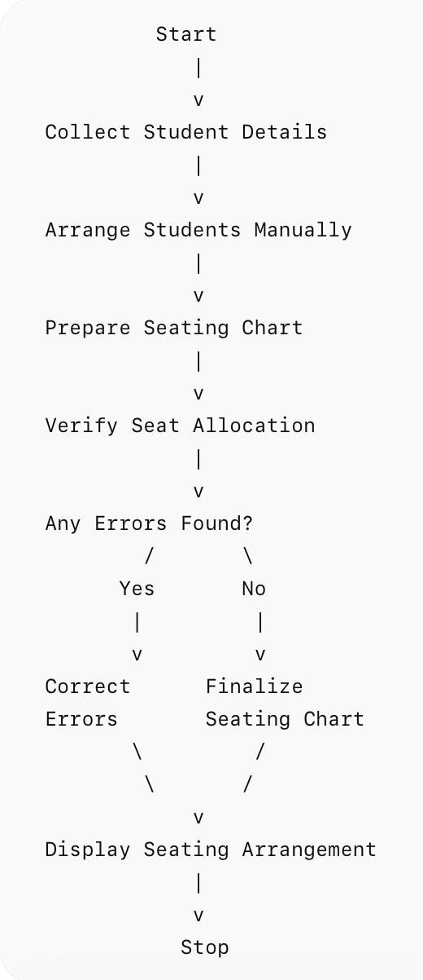
Existing System:
Seating arrangements are prepared manually.
Requires more time and effort.
Possibility of human errors.
Difficult to modify arrangements at the last minute.
Managing a large number of students is challenging.
Record maintenance is difficult.

Slide 7
Advantages:
Simple for a very small number of students.
Disadvantages:
Time-consuming.
Error-prone.
Less efficient.

Slide 8
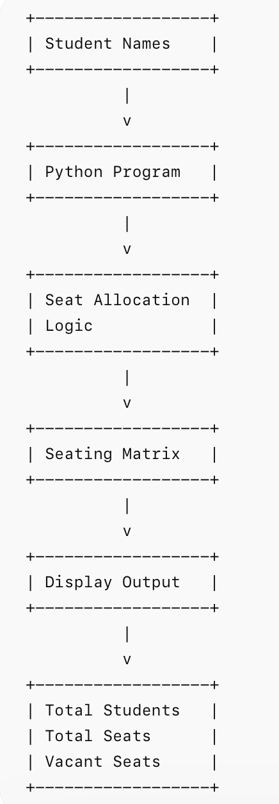
Proposed System:
Features of the Proposed System:
Automatic seat allocation.
Faster and more accurate.
Reduces manual work.
Displays seating arrangement clearly.
Calculates vacant seats automatically.
Easy to update student information.
Can handle a large number of students efficiently.

Slide 9
Methodology:
Initialize student names list.
Define examination hall rows and columns.
Calculate total seats available.
Count total students.
Assign students to seats sequentially.
Check if seats are available.
Mark remaining seats as vacant.
Display seating arrangement.
Display total students, total seats, and vacant seats.
End process.

Slide 10
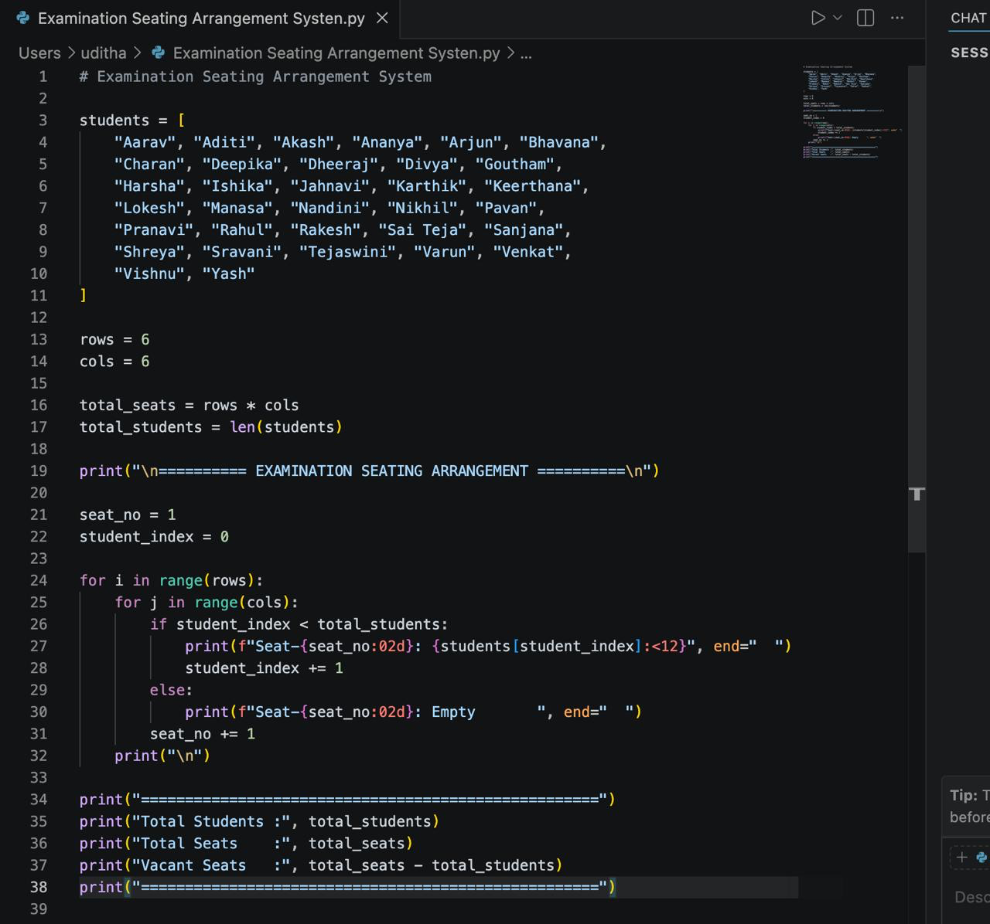
Python code:

Slide 11
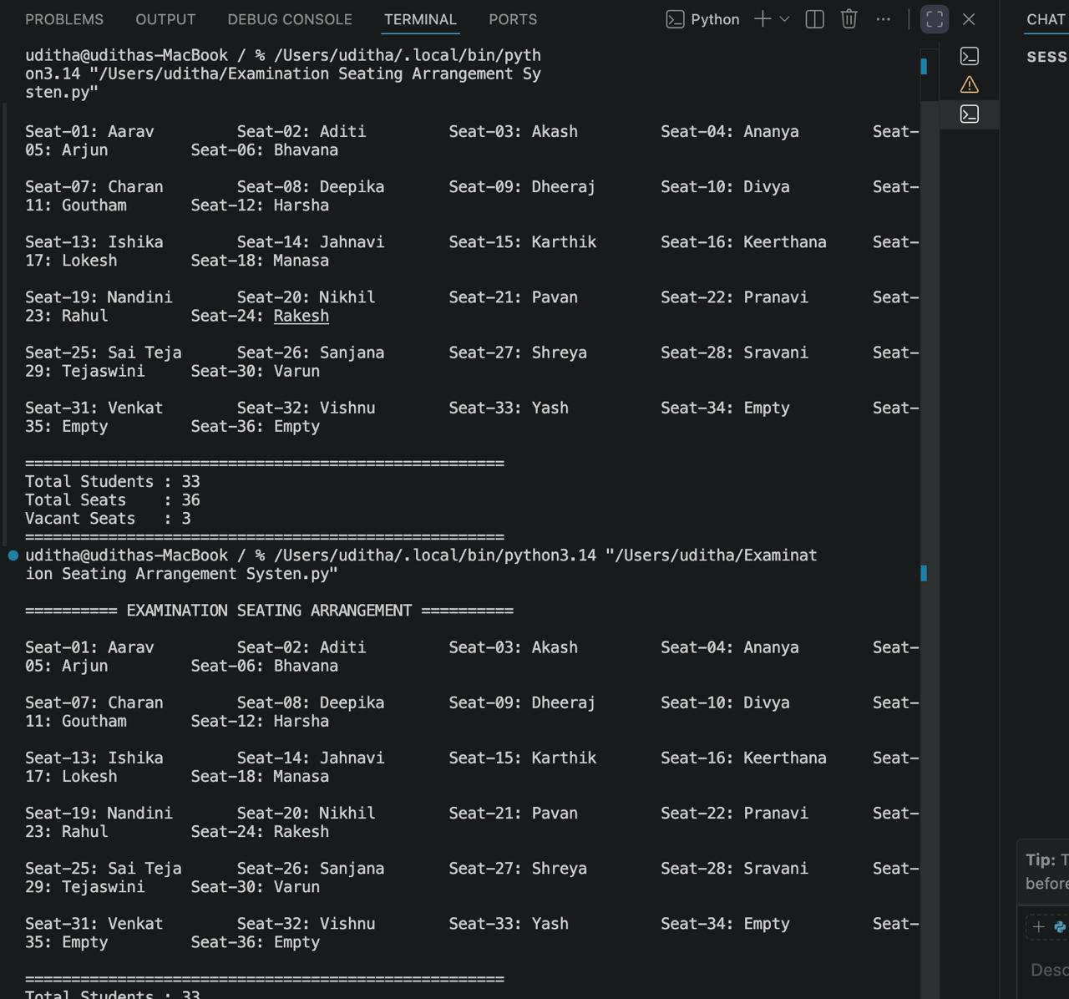
OUTPUT Screenshots:

Slide 12
Conclusion:
The “Examination Seating Arrangement System” successfully automates the process of assigning students to seats in an examination hall. The system efficiently allocates seats, reduces manual effort, minimizes human errors, and saves time. It also provides details such as total students, total seats, and vacant seats. This project demonstrates how Python programming can be used to simplify examination management and improve accuracy in seating arrangements. Overall, the proposed system is reliable, user-friendly, and suitable for educational institutions.

Slide 13
THANK YOU.......

