Slide 1

Catching
Student Dropout Risk
Earlier
A two-stage early-warning approach for more timely and targeted student support
Raymond Varilla
Student Attrition Capstone | Business Presentation |
AI-ML PGD

Slide 2




02
The challenge is identifying who needs support early enough
TIMING
CAPACITY
TARGETING
Enrollment gives the earliest opportunity to intervene, but with less behavioral evidence.
Student-support resources are limited, so not every student can receive the same level of intervention.
Too many false alerts waste support capacity; missed cases mean students at risk may not receive help.
WHAT SUCCESS LOOKS LIKE
Catch more students who will drop out, reach them earlier, and reduce unnecessary interventions
*** The goal is to prioritize support—not automate decisions about students..

Slide 3


03
A two-stage approach balances early action with better accuracy
STAGE 1 - ENROLLMENT
STAGE 2 - SEMESTER 1
Broad, lower-cost support
Broad, lower-cost support
  Uses enrollment-stage information
  Flags risk earlier
  Best for scalable interventions such as reminders, check-ins, or resource guidance
  Adds actual academic-progress data
  Improves prediction quality
  Better for advising, case management, or more intensive intervention
Start broad and early. Escalate support when stronger evidence
becomes available.

Slide 4


04
Semester 1 improves both detection and targeting efficiency
ENROLLMENT MODEL
SEMESTER 1 MODEL
  72.2% of Dropout cases detected
  52.6% precision
  205 correctly identified Dropout cases
  185 false alerts
  77.5% of Dropout cases detected
  69.8% precision
  220 correctly identified Dropout cases
  95 false alerts
Compared with Enrollment, Semester 1 delivers:
  +15 more Dropout cases identified
  −15 missed Dropout cases
  −90 false alerts
Later academic data makes support decisions more precise without sacrificing recall

Slide 5



05
The strongest risk signals shift once academic progress becomes visible
ENROLLMENT
AFTER SEMESTER 1
Risk is driven more by background and entry-stage signals:
  scholarship status
  course
  application mode
  admission grade
  age at enrollment
-
\
Academic progress becomes much more important:
-
  units approved
  Semester 1 grade
  units enrolled
  approval rate
  completion gap
-
Business implication: Enrollment is useful for early screening, but Semester 1 gives a clearer view of who may need stronger support.

Slide 6
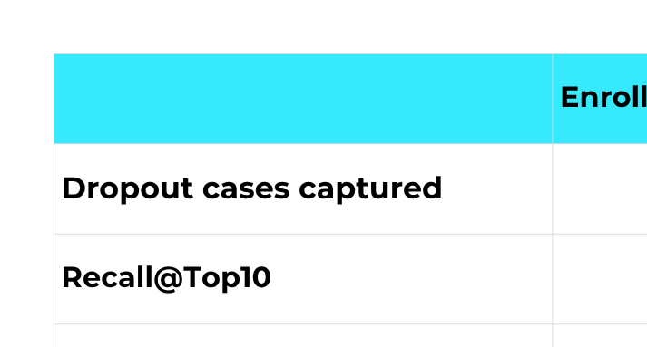

06
Limited support capacity makes prioritization critical
With the same 89 intervention slots, Semester 1 identifies 15 more Dropout cases and uses the available capacity more efficiently.

Slide 7




A staged intervention model turns predictions into action
07
SCREEN EARLY
MONITOR PROGRESS
REFRESH RISK
ESCALATE SUPPORT
Use the Enrollment model to identify students who may benefit from broad support.
Track Semester 1 academic performance and engagement signals.
Re-score students after Semester 1 using stronger academic evidence.
Direct higher-touch interventions to students with the strongest risk signals.
The model should support a tiered intervention process—not a one-time label.

Slide 8
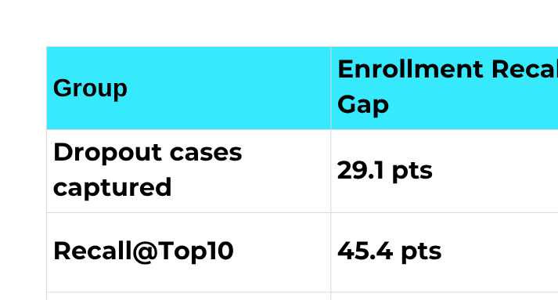

08
Responsible Use Requires Fairness Monitoring
WHAT THIS MEANS
  Semester 1 reduces every observed gap
  meaningful disparities still remain
  age and scholarship status require the closest monitoring
The model should never be used as an automatic decision-maker. Human review and subgroup monitoring are essential.

Slide 9
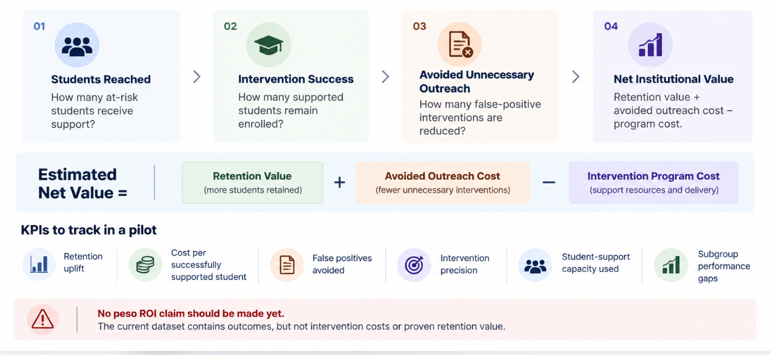
Business value should be measured through retention and intervention efficiency
09

Slide 10
