Slide 1
Presenter Best Practices
Practice your presentation, try to avoid ums and uhs​
Keep track of the time to ensure there is time for Q and A. Allow the audience to ask questions offer ideas during the presentation. Invite information sharing, ask for a show of hands. ​
Speak clearly and slowly and with confidence. Try to be more conversational and engage the audience. ​
Walk around the room and connect with your audience. When you’re talking to many people, they all want to feel as though you are presenting directly to them. Looking right at your audience can build engagement. Staying moving is often helpful for presentation nerves. ​
Have a back up of your presentation on a thumb drive

Slide 2
Presenter Best Practices-continued
Only use slides for visuals. Many presenters get caught up in trying to cram useful information and talk-guides into their slides. Instead, only use your slides for visual diagrams. ​
Repeat a question when asked to be sure everyone clearly hears it​
Network immediately after your presentation. It is key to connect with your audience (and key audience members) after your presentation. Take the time to thank each person or specific important people for coming and ask what they thought about the talk.​
Close with a summary of three key take aways and a thank you.

Slide 3
Tips for An Accessible Presentation
Make text and visuals big enough to be read from the back of the room. Try to keep your font size at 18 or above.
Use an easy-to-read font. Fonts are easiest to read when the thickness is consistent.
Check your color-contrast. Use a light text background and dark text when presenting in a bright room, or a dark background and a light text when presenting in a darkened room.
Run an accessibility check. Microsoft PowerPoint has a free accessibility checker to help you identify and adjust any issues.
Source: "Giving Accessible Presentations" by Lillian Hogendoorn, used under CC BY-SA 4.0 / Edited

Slide 4
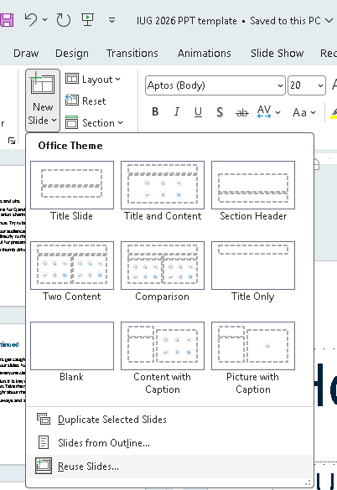
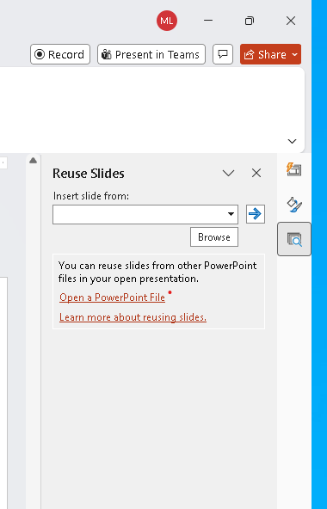
How to Import Slides into the Template
Use the “Reuse Slides” shortcut in the Home ribbon
Choose “Browse File” to select from your computer
Insert slides individually or select “Insert All” at the top.
  Optional: Uncheck source formatting to auto-convert to the new template
Use “Reset” in the Slides menu of the Home Ribbon to help reset the layout on individual slides

Slide 5


Slide 6

Title of Presentation
Presenter Names

Slide 7


