Slide 1
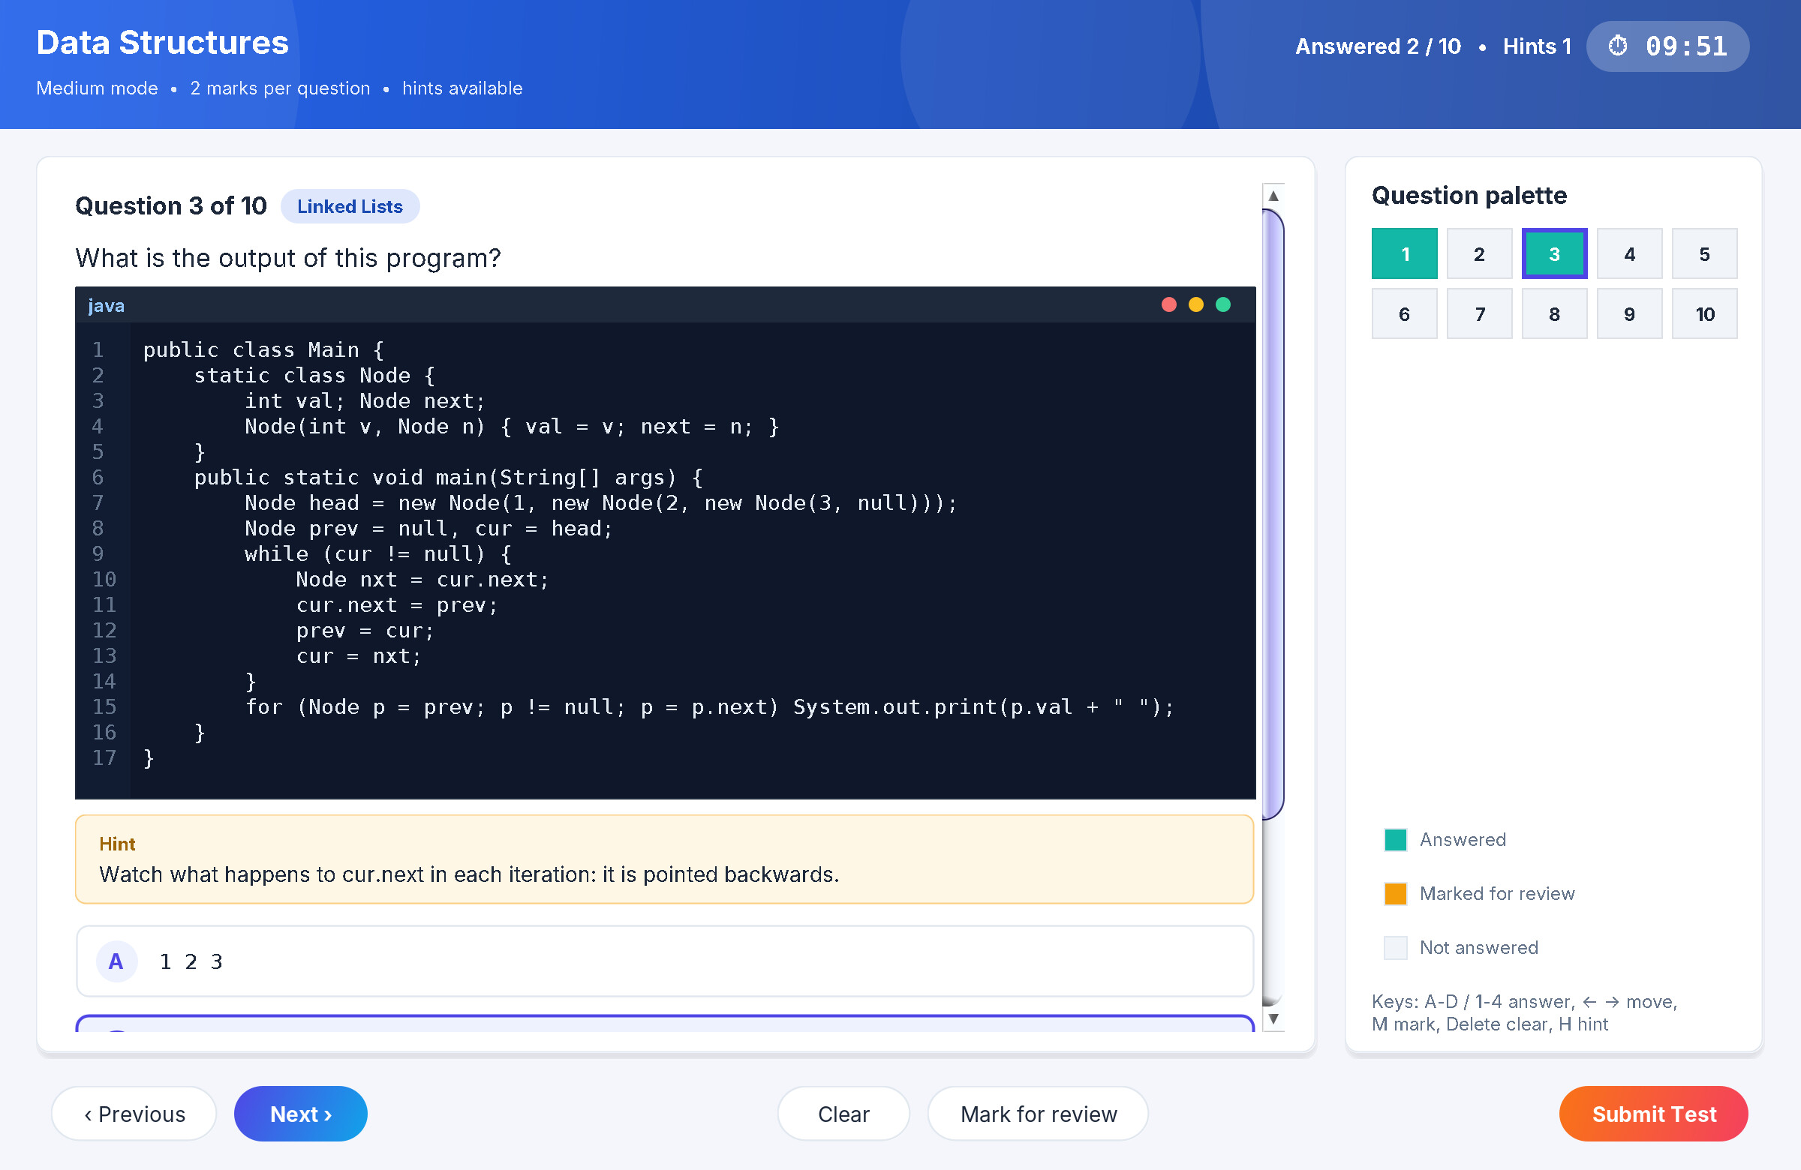
Online Examination & Quiz System
B.TECH CSE • ACADEMIC PROJECT
A desktop exam-practice application built with Java Swing, JDBC (SQLite) and Java I/O
Real screen: a Medium-mode code-output question with its hint revealed
PRESENTED BY
Notes:
Introduce the team and the project. The screenshot on the right is the real quiz screen from our application.

Slide 2








Why we built it
The problem
Our objectives
Paper tests are slow to evaluate
Organise MCQs by subject and subtopic for a 3rd-year CSE curriculum
Marks reach students days later, when the topic has moved on.
Three difficulty modes that test fundamentals, analysis and mastery
No feedback on mistakes
Timed, event-driven GUI with instant scoring and unanswered handling
A student sees a score, not why an answer was wrong.
Store questions and results with JDBC; import and export with Java I/O
Weak topics stay hidden
Nobody tells the student which subtopic to practise next.
Explanations and analytics that point out what to study next
Notes:
Explain the three problems with paper-based tests and the five objectives we set.

Slide 3




Core features
Subject-wise tests
Easy, Medium, Hard
Predict-the-output
8 subjects split into 46 subtopics. Test a whole subject or focus on one subtopic.
20 / 10 / 5 questions in 10 minutes, worth 1 / 2 / 3 marks each.
Medium and Hard show real Java, Python, C/C++, SQL or bash code in a code viewer.
Hints & explanations
Smart test screen
Performance analytics
Every Medium and Hard question has a starting hint and an explanation in the answer review.
Countdown with auto-submit, question palette, mark for review, keyboard shortcuts.
Scores by subject and mode, plus weak (<60%) and strong (80%+) subtopics.
Notes:
Walk through the six core features. Admin features (question bank management, .qb import/export) appear on the screenshots slide.

Slide 4
Three modes, one question bank
Easy
Medium
Hard
460
questions
20 questions
10 questions
5 questions
8
subjects
10 minutes • 1 mark each
10 minutes • 2 marks each
10 minutes • 3 marks each
46
subtopics
Core theory and definitions
Theory in depth + predict the output of code
In-depth concepts, edge cases and tricky code
Checks fundamentals
Observation and analytical thinking; hints available
Mastery; hints available
124
code answers verified by running the code
SUBJECTS
Data Structures
Java
Python
OOP Concepts
DBMS
Operating Systems
Computer Networks
Linux Commands
Notes:
Every code-output answer in the bank was checked by executing the snippet; numerical answers were recomputed with scripts.

Slide 5
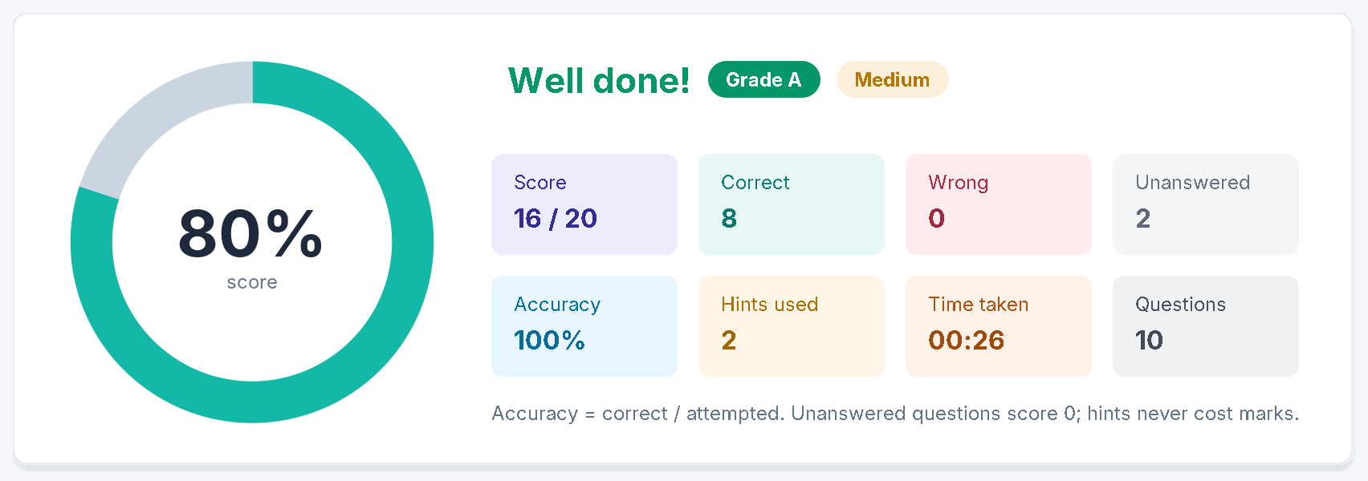
Taking a test
Result: score, grade, accuracy, hints used and time
1
Pick subject, subtopic and mode
2
Answer, mark for review or reveal a hint
3
Submit (or auto-submit when time is up)
4
Review answers with explanations
Medium test: code viewer, revealed hint, selected answer, palette and timer
Notes:
Real screenshots from the running application. Unanswered questions are listed before submitting and score zero.

Slide 6
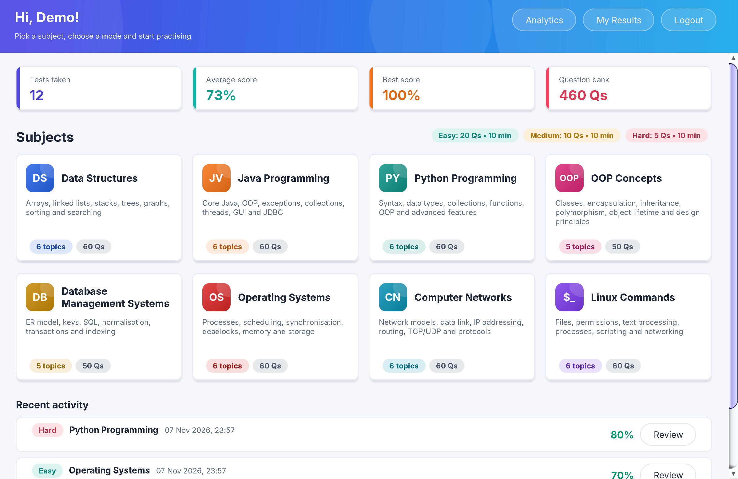
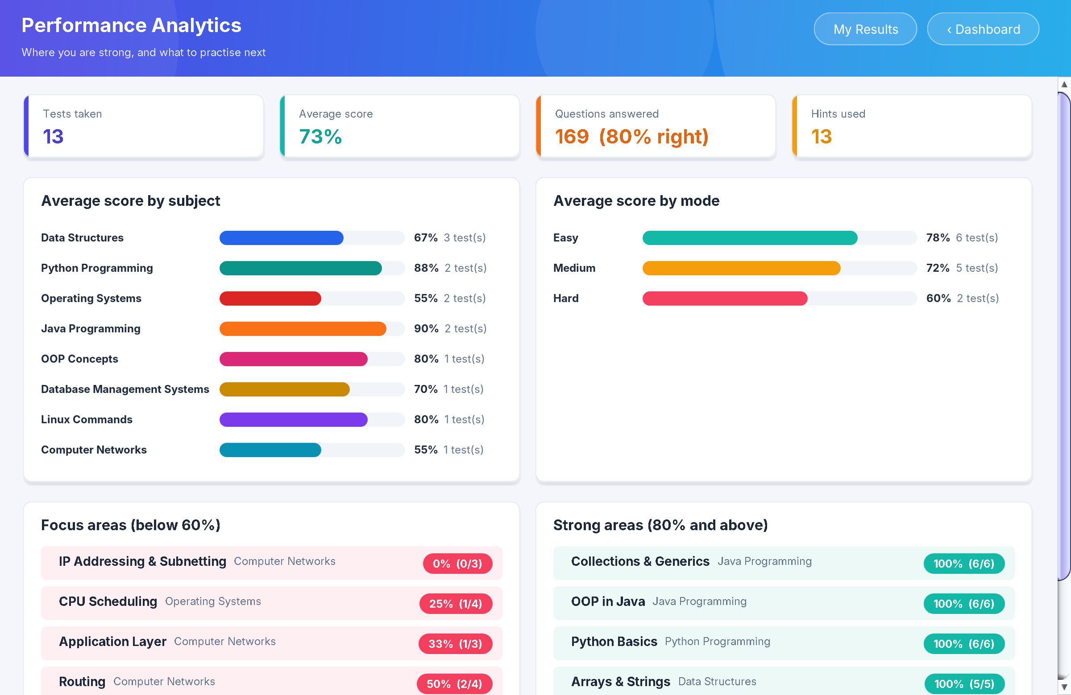
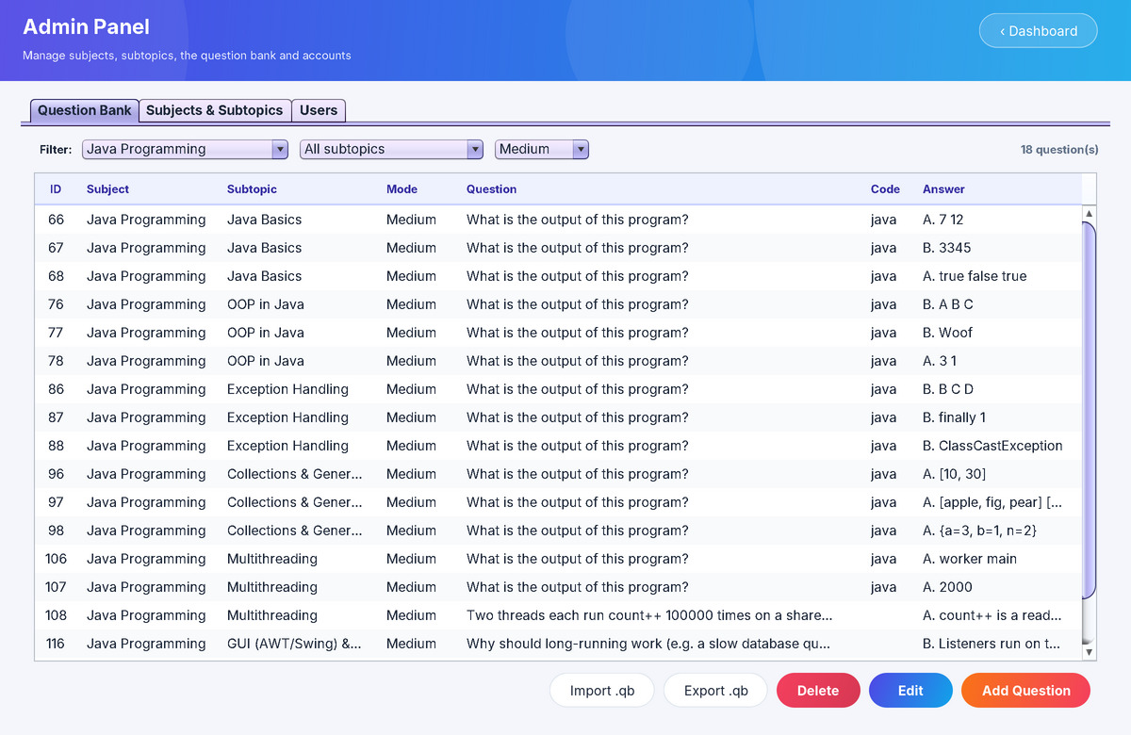
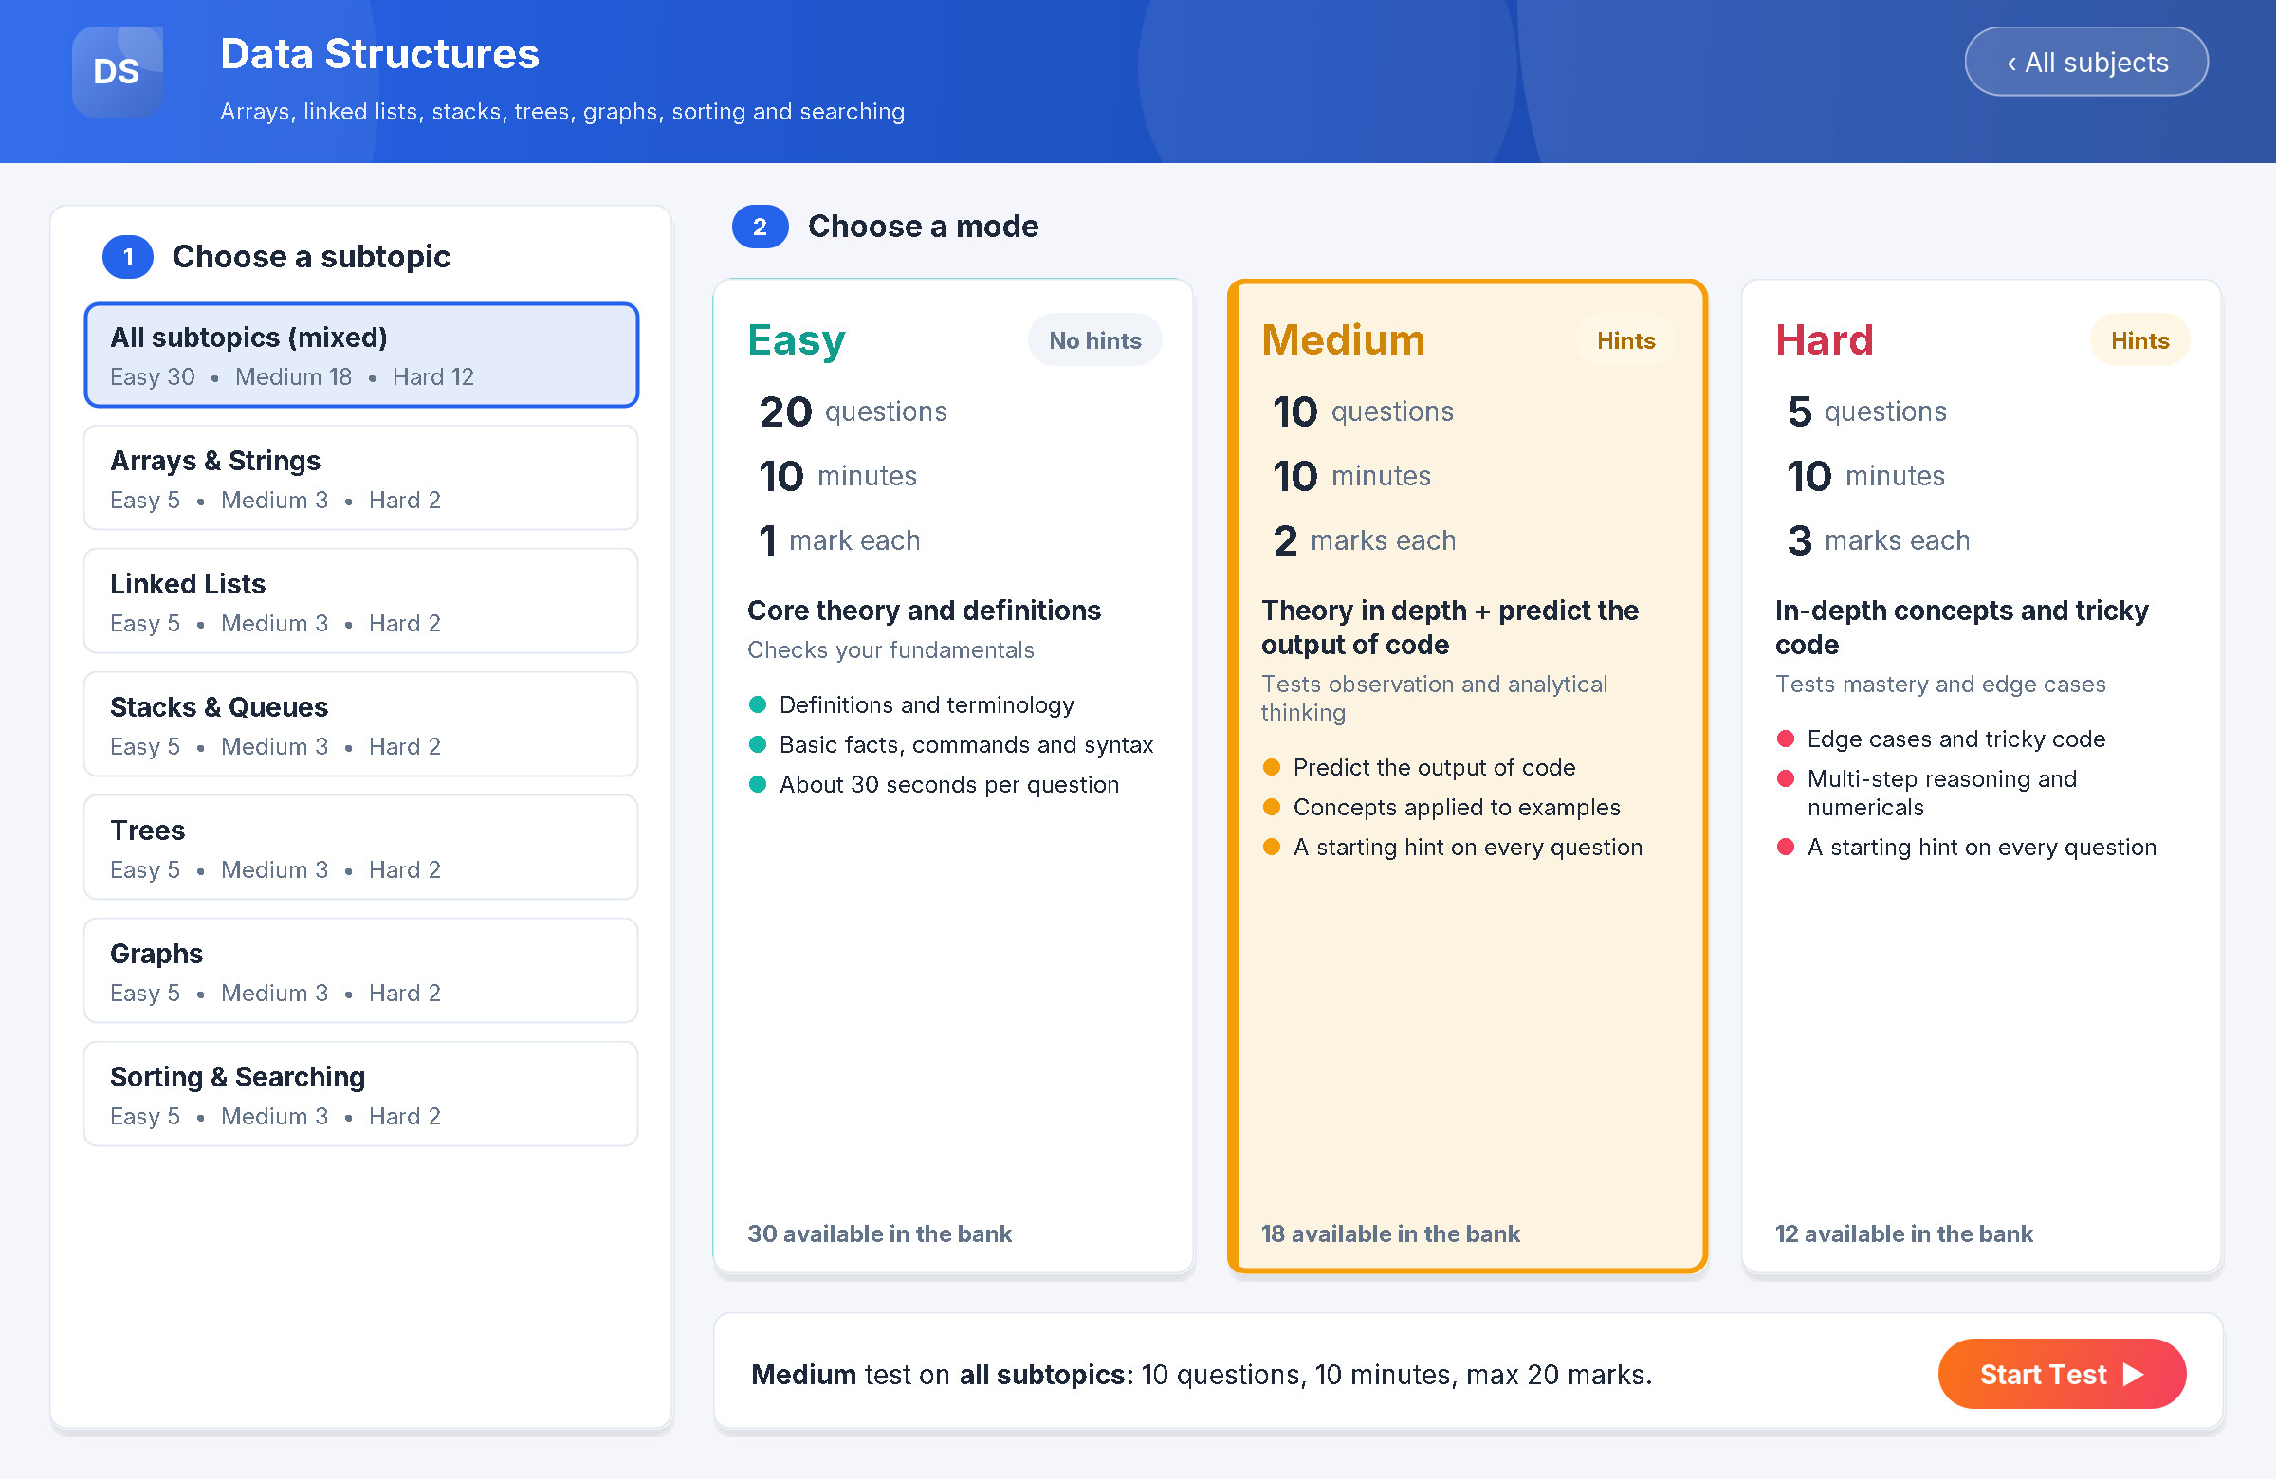
Dashboard, analytics and admin panel
Dashboard: progress stats and colour-coded subject cards
Analytics: averages by subject and mode, weak and strong subtopics
Admin: question bank with filters, add/edit, .qb import and export
Test set-up screen
Choose a subtopic (or all) and a mode; the screen shows question count, time, marks and how many questions are available.
Notes:
All screens are real captures of the application. Students see only their own data; admins see the whole class.

Slide 7
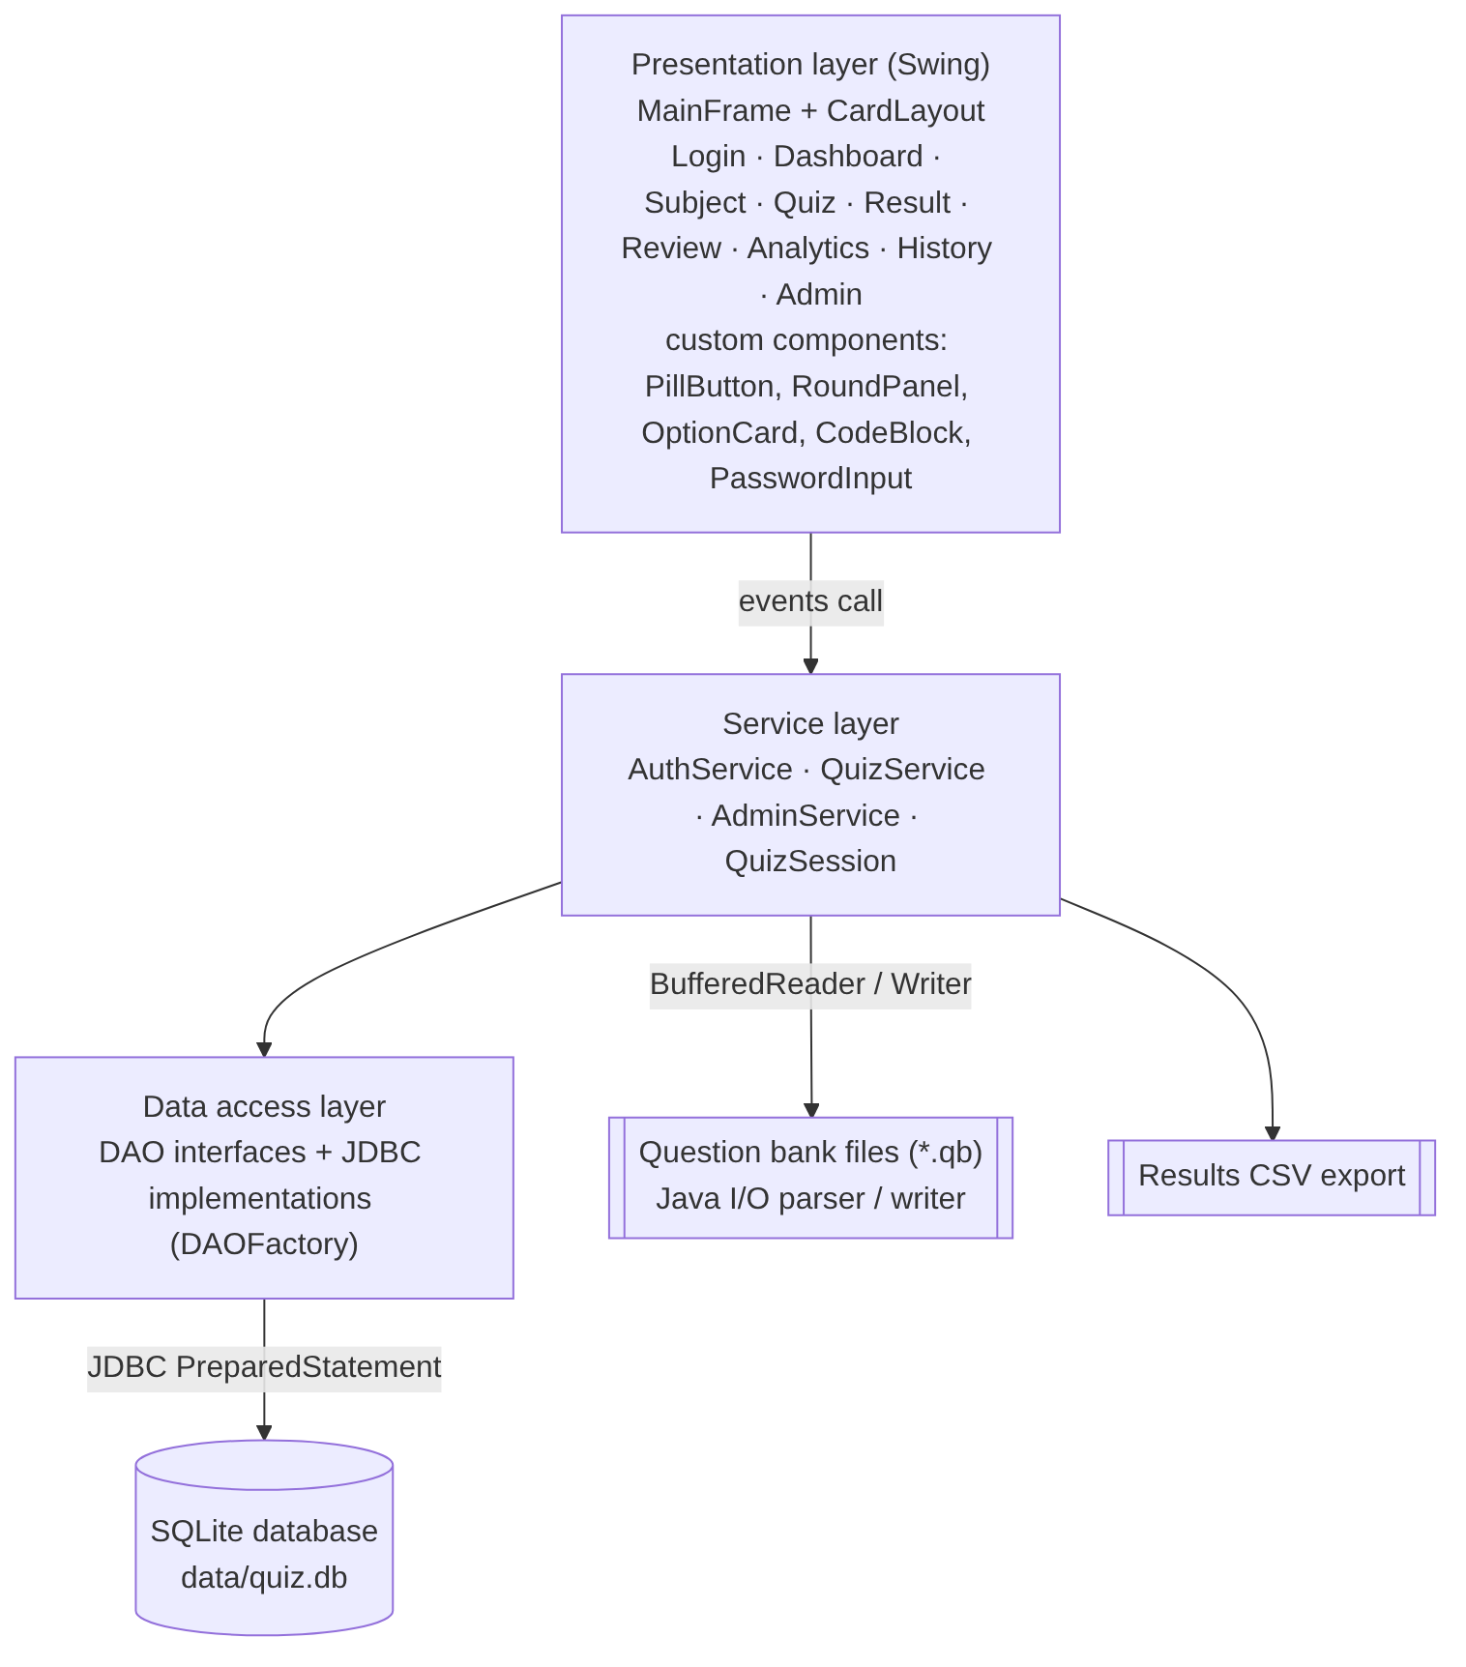



Architecture we followed
Presentation layer (Swing)
MainFrame + CardLayout swaps screens; custom-painted components (PillButton, OptionCard, CodeBlock, PasswordInput).
Service layer
QuizSession holds answers, marks and hints and does the scoring; QuizService, AdminService, AuthService apply the rules.
Data access layer (DAO + JDBC)
DAO interfaces with JDBC implementations via DAOFactory; PreparedStatement on a single SQLite file; transactions for results.
File I/O
Question banks as .qb text files (parser/writer on BufferedReader/Writer); results export to CSV.
OOP & patterns: encapsulation, inheritance (exception hierarchy), polymorphism through DAO interfaces, Singleton, Factory, DAO, Observer (listeners). Collections: List, HashMap, TreeSet, EnumMap.
Notes:
Three layers keep the GUI free of SQL; swapping SQLite for MySQL only changes the JDBC classes.

Slide 8






Advantages and quality
Instant, consistent evaluation
Tests reasoning
99
Scores the moment a test ends; the same rules for every student.
Code-output questions check observation and analysis.
automated tests passing
Shows what to study next
Runs offline, no server
124
Subtopic analytics find weak areas from every attempted answer.
One Java app and one SQLite file; works in any lab.
code answers verified by execution
460
Easy to extend
Secure and reliable
Faculty add questions in plain .qb files and import them.
Salted SHA-256 passwords, PreparedStatement, transactions.
questions across 8 subjects and 46 subtopics
Future scope: client-server mode for a whole class, adaptive tests from weak subtopics, PDF scorecards, multiple-correct and image questions.
Notes:
Quality numbers come from our self-test suite (99 checks) and the verification script that executed every code-output question.

Slide 9
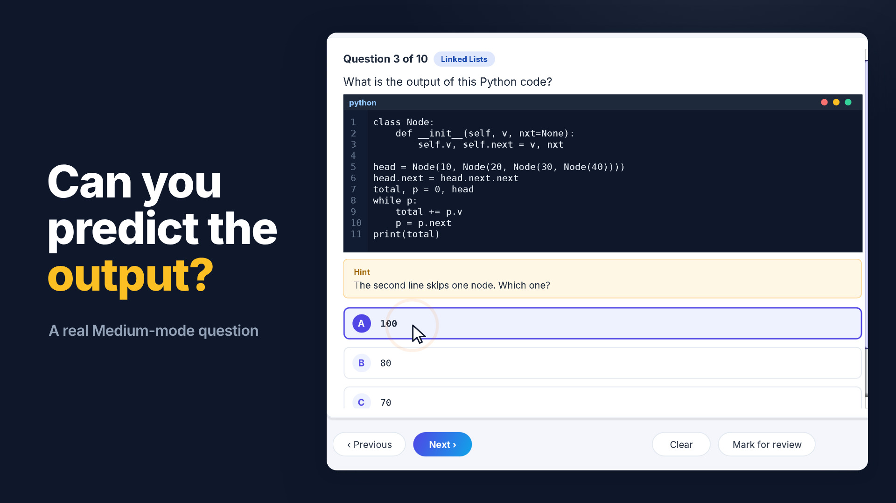
Project demo video
23-second walkthrough recorded from the running application • click to play
Notes:
Play the 23-second video. Every screen in it is a real capture of the app.

Slide 10

Thank you
Any questions?
Online Examination & Quiz System • Java Swing • JDBC • SQLite
Notes:
Invite questions. Demo logins: admin / admin123 and student / student123.

