Slide 1
Schuh
Strategy Review · September 2026
Markets UK · Ireland · Germany · Catalogue 42,221 live SKUs · 6 feeds · Cycle Look-back: Apr – Sep 2026

Slide 2
"The feed becomes transaction infrastructure - In agentic commerce, a feed error can affect not only visibility but also the agent's recommendation, cart logic, displayed total, legal notice and ability to complete checkout. Accuracy, identifiers and policy data become commercial controls"
Google

Slide 3
What we'll cover
Eight chapters, two sources: the project plan, and a live read of all three Google feeds this morning.
01 Review & project recap
61 of 96 initiatives closed · scheduled work, and where the hours went
02 Channel coverage
Six feeds across three markets · new-product volume
03 Number of wins / results
The A/B archive — keyword optimisation wins, the title tests did not
04 Feed optimisation score
74/100, dissected live — required, recommended, content quality
05 AI readiness
Tier 2 in the UK — the conversational six, and the Golden Score
06 Case studies / test wins
What the same levers returned on comparable FeedSpark accounts
07 Roadmap / next quarter
The open work and the unblocks, sequenced into Peak
08 Spark AI engine (Tachyon)
Intent generation and visual attribute harvest for footwear
Where the plan and the feed disagree, the feed wins — every chapter shows both numbers rather than the friendlier one.

Slide 4
Review & project recap
Chapter one
61 of 96 tracked initiatives closed, 13 of them in the last six months — and the margin architecture is now live on every UK SKU.

Slide 5
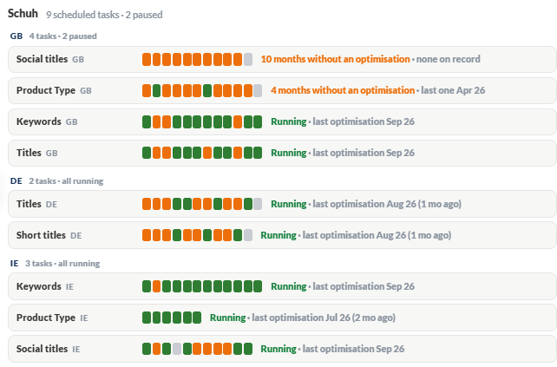
Scheduled Works
7 out of 9 paused.
Titles & Keywords are frequent work.
A pause means either there are no new products yet, or the retainer has gone negative and the work was halted.
Product Type is efficiently run by rules and only needed to review once every 6 months!

Slide 6
Review & project recap (cont.)
Action | Owner | Status | Outcome
Pound Margin — review negative margin | Ray | Done | Margin banding now on 100% of UK SKUs across CL0 and CL1
Remove blanket exclusion — exclude below £0 margin instead | Ray | Done | Loss-making lines excluded on margin, not on a flat rule
Keyword optimisation — Trainers (MSS) | Will / Isa | Done | Live on 28.5% of the UK catalogue today
EOSS — sale keywords | Isa | Done | Sale flag now carried in CL3 on 30.1% of UK SKUs
AI Score Card review — UK & IE, with recommendations | Ray | Done | The baseline this review measures against — chapter 05
CSS vs. CSS Google — retest split test | Ray / Will | Done | No CPC benefit in the UK market — read in full in chapter 03
A/B title test — [Search Intent], Fashion category | Steven | Done | Completed; no quantified read recorded against it
Custom Label overview shared | Ray | Done | Five-slot architecture agreed — margin, stock, sale, range
Where the margin work actually landed. The plan records four separate margin initiatives closing across April and May.

Slide 7
Review & project recap (cont.)
Action | Owner | Status | Outcome
Campaign-structure recommendation shared | Ray | Done | Feeds the PMax and CSS restructure now open
Image_tag structural work | Steven | Done | Imagery now uniform at exactly 4 images per SKU, all markets
Hero Sizes mapping — Mens / Womens / Childrens | Ray | In progress | Paired with the stock-quantity threshold review
Stock quantity threshold — from <5 to <2 | Ray | In progress | Would move stock banding in CL4, live on 100% of UK SKUs
s360 PDP description prompt | Will | Awaiting Schuh | Blocks description enrichment reaching DE and IE — chapter 04
Margin and pound margin through CN in Meta | Ray | Open | Carries the UK margin architecture into the social feeds
Product Rating — manual retailer submission | Ray | On hold | Waiting on ratings fields from Schuh's dev team
Where the margin work actually landed. The plan records four separate margin initiatives closing across April and May.

Slide 8
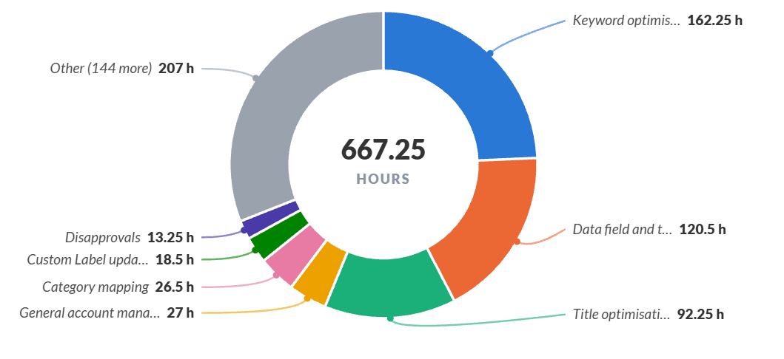
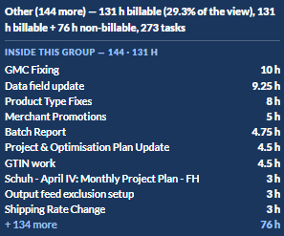
Hours Allocation
From 2026-Jan – Tasks Types
Majority of hours (healthy benchmark – 74.6%) are going through to optimisation

Slide 9
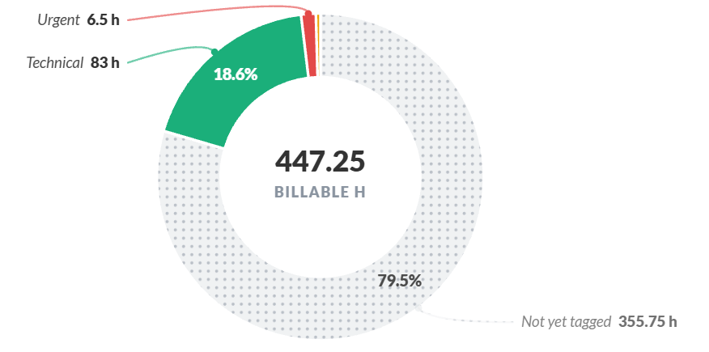
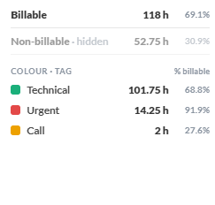
Hours Allocation
From 2026-Jan – Urgent/ Technical or Non-optimisation works
There’s still roughly 89.5 hours (~20% of hours are going into Technical work) – there’s an opportunity for automation here

Slide 10
Channel coverage
Chapter two
Six feeds live across three markets, two channels part-built, and five never switched on.

Slide 11
Service coverage
Every state below is read from the channel's own feed where one exists, and from the project plan where it does not.
Channel | State | Coverage | What the evidence shows
Google Shopping | Optimised | 3 markets · 42,221 SKUs | UK 21,055 · DE 10,606 · IE 10,560. Titles rewritten on 100% of all three; margin, stock and sale labelling live
Meta / Commerce Manager | Live | 3 markets | Own title rule (item type and colour stripped), sale custom label carried across, product-set structure aligned to product type
LIA — Click & Collect | Awaiting Schuh dev | Not yet live | Feed setup scoped and a separate PMax campaign agreed to cap traffic off the main one; waiting on Schuh's dev team to pick up GMC
Social DPA overlays | Open | — | Dynamic frames scoped for the Meta feeds, not yet built
Microsoft / Bing Shopping | Not in scope | — | No feed built and no activity today — an open opportunity
Pinterest | Not in scope | — | No feed built and no activity today — an open opportunity
Reexploring overlay on PPC following success from FY25 summer sale

Slide 12
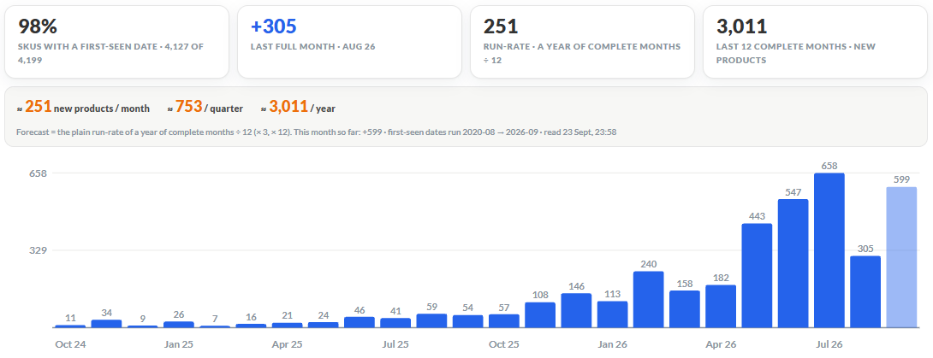
New products volume
42,221 Live SKUs (3 markets) · 2,353 New per month · 7,060 New per quarter · 28,240 New per year

Slide 13
Number of wins / results
Chapter three
Eleven quantified tests in the archive — keyword optimisation wins seven times in nine, and both title-placement tests lost to control.

Slide 14
Number of wins / results
Read from the A/B Test Archive: nine keyword tests, two title tests, every one with a logged figure.
CSS retest returned no CPC benefit
Both title-placement tests lost to control
A split test, run as a retest rather than a first look, comparing the current CSS arrangement against Google's own. The read was clean and the answer was no measurable CPC advantage in the UK market.
This is the most valuable result of the cycle. A negative read on a retest closes a question that would otherwise keep being reopened, and it redirects the CSS conversation from “which provider” to the feed restructure now open on the plan.
Schuh vs non-Schuh branding returned −56.79% impressions; the size-format variant −44.62%. The current title structure beat both.
That is why the roadmap changes title LENGTH toward the MASK band rather than its composition — chapter 07.

Slide 15
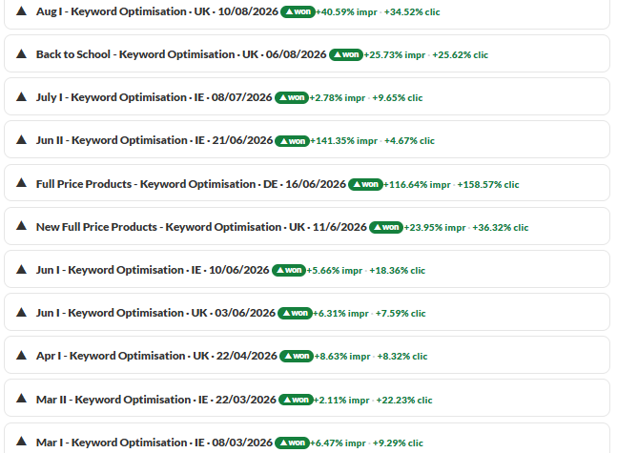
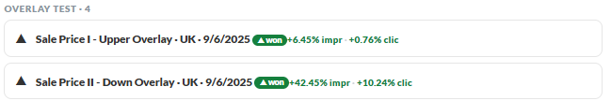
A/B Test Archive
Keywords Optimisation consistently wins – continuing theme granularity with Marketing Calendar

Slide 16
Feed optimisation score
(let’s dissect real-time!)
Chapter four
74 out of 100. The foundations are near-perfect; three lanes carry almost all of the remaining gap.

Slide 17
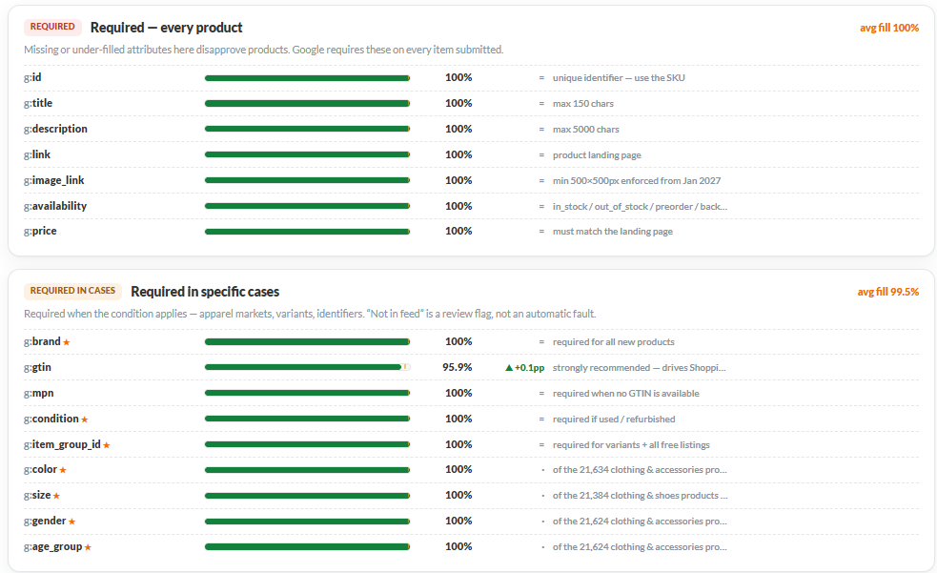
Required Attributes (Footwear)
99.9% completeness
All 7 required attributes present.
Germany is running a different title engine.
The UK and Ireland share one: Ireland inherits UK titles on 99.2% of its catalogue. Germany runs “Google product name” on 88.1% instead, and it is the only market where description enrichment has never run at all — 0%, against 100% in the UK.
Data Foundational level is strong!

Slide 18
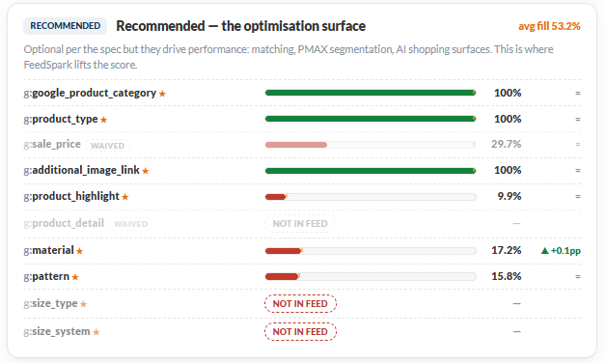
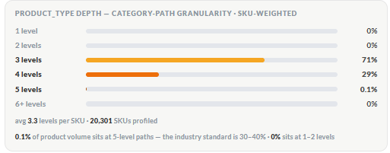
Recommended Attributes (Footwear)
53.2% completeness
Heavy back-fill recommendations for:
Material
Pattern
Product-Type depth is optimal! (3–4 levels deep, > industry standard benchmark)

Slide 19
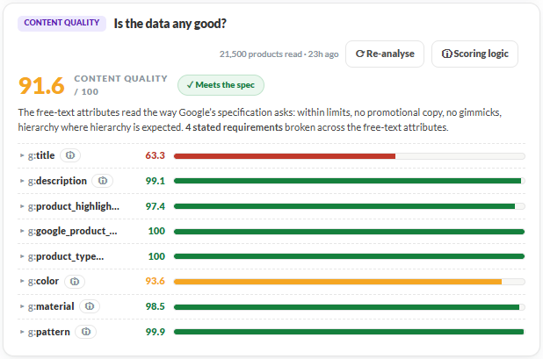
Content Quality
91.6 / 100 content score
Improvement recommendations:
Duplicated titles (Nike, Converse range..)
Short Titles (< 30 char)
Content score hits 91.6 / 100 — the key part is to fill up Material & Pattern to as fully as possible !

Slide 20
AI readiness
Chapter five
Tier 2 reached in the UK, and in the UK only — two conversational attributes are already live on every British SKU.

Slide 21
Google conversational attributes
question_and_answer is the highest-value attribute and the highest-risk one for a footwear retailer.
Attribute | UK | Germany | Ireland | Status
item_group_title | 100% | — | — | Live on all 21,055 UK SKUs — the clean parent name for a variant family
variant_option | 100% | — | — | Two pairs per UK SKU — Colour and Size, structured name/value
question_and_answer | — | — | — | Not submitted. Highest value and highest governance risk — fit and sizing answers carry return-rate consequences
popularity_rank | — | — | — | Not submitted. Computable from Schuh's own performance data
related_product | — | — | — | Not submitted. The mechanism for footwear-and-care or outfit pairing
document_link | — | — | — | Not submitted. Size guides and care instructions where stable URLs exist
“Do these run true to size?” is the single most-asked question in the category, and a wrong answer at feed scale drives returns

Slide 22
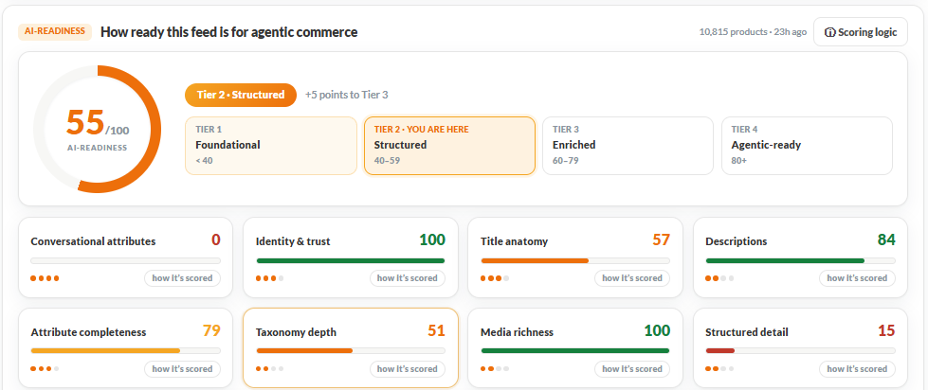
AI readiness
The key areas the 6 Conversational Attributes that’s been announced by Google & agent-friendly product highlights & details

Slide 23
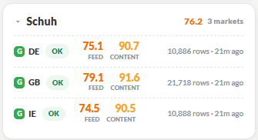
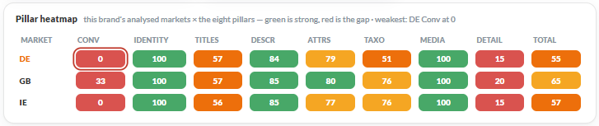
Golden Score & AI Readiness
After filling up Conversation Attributes & SparkAI generated Highlights & Details > we’re aiming to hit at least >85 before Peak/26

Slide 24
Case studies / test wins
Chapter six
What the same interventions returned on comparable FeedSpark accounts, and which of them apply here.

Slide 25
Case studies / test wins
Schuh's own archive is chapter 03. These are the same levers on comparable FeedSpark accounts — read alongside it, they say which Schuh has not tested yet.
Benefit-led copy beat feature-led copy
Naming the category term the shopper types
+24.7% — YuMOVE, pet supplements. Rewriting titles and descriptions around what the product does for the buyer rather than what it is.
Applies directly: Schuh's titles are accurate and descriptive (“Trainers in Grey, Size: 8”) but carry no use-case language at all.
+126.62% — YuMOVE, on the single term “Multivitamins”. Adding the plain category noun a buyer actually searches, rather than the brand's own product name.
Applies with care: Schuh titles already carry a category noun. The equivalent lever here is the second and third [Search Intent] — occasion, use-case, fit.

Slide 26
Roadmap / next quarter
Chapter seven
Three unblocks, one rollout that pays for itself twice, and a testing lane that needs widening before the next review.

Slide 27
Roadmap / next quarter
1
2
3
Clear what is waiting on Schuh
Take the UK build to DE and IE
Stable, no architecture changes
Oct 2026
s360 description prompt — Will
LIA / GMC setup — Schuh dev team
Product rating fields — Schuh dev
Hero Sizes mapping — close out
Oct – Nov 2026
Description enrichment — 0% DE, 2.3% IE
Conversational attributes — UK, DE, IE
Explore SparkAI – Visual highlights
Nov – Dec 2026
Margin + stock banding hold through sale
EOSS sale keywords re-applied
Disapproval monitoring across six feeds
Title-[Material] test reads out

Slide 28
Roadmap / next quarter (cont.)
# | Workstream | What it needs | Owner | Priority
W1 | Title length toward the MASK band | A rule change — 2.6% in band today at a 60-character mean; the engine already reaches 100% of the catalogue | Ray / Steven | High
W2 | Description enrichment to DE and IE | s360’s own area of work — can it run through to FeedSpark? | Will → Ray | High
W3 | Product highlights across all markets | Nothing external — 89.9% of UK and all of DE/IE carry none; the 10.1% that exist are already well-formed | Ray | High
W4 | Keyword rollout, UK | Following ingested Marketing Calendar to support 3 themes / month until EOY. | Steven | High
W5 | Category depth beyond two levels | Carry the UK’s 3–4-level depth across to DE and IE | Ray | Medium
W6 | LIA launch | Schuh's dev team on the Merchant Center side; feed and campaign design already agreed | Schuh dev / Ray | Medium
W7 | Conversational attributes to DE and IE | Replicate the UK configuration — item_group_title and variant_option are built and proven | Ray / Steven | Medium
W8 | Overlay test for both PPC & Social | Kickstart the use of PPC overlay on both channels to yield higher CTR | Mia / Ray | Medium

Slide 29
Spark AI engine (Tachyon)
Chapter eight
Intent generation, description enrichment and visual attribute harvest — run on a real SKU from today’s UK feed.

Slide 30
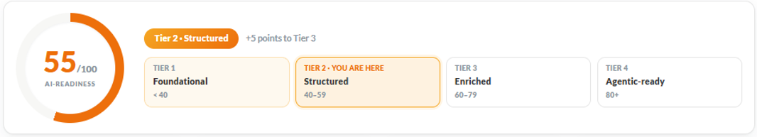
SparkAI engine
[Search Intent] generation
Visual [Product Details] extraction
A real SKU from today's UK feed. Input: Black · Patent Leather · Heart Detail · Girls · £60 · School Shoes
Title today (60 chars):
“Lelli Kelly Girls Sabrina Scarpa School Shoes in Black, Heart Detail, Patent Leather, Size: 12”
Intent terms Tachyon would generate:
“patent leather school shoes girls size 12”
“black school shoes with heart detail”
“lelli kelly first day of school shoes”
20–40 generated per SKU, top 4–6 used. The occasion language — school, first day — is exactly the lever that returned the largest gains on comparable accounts in chapter 06.
Tier 3 normally waits on imagery.
Vision models read those images for the attributes the feed is thinnest on — material at 17.4% and pattern at 15.9% in the UK, and 7.5% / 4.5% in Ireland. Both are visible in a product photograph.
The raw material for the most differentiated part of the stack is already sitting in the feed, complete, today.

Slide 31
Every structural win here — titles rewritten across three markets, identifiers and sizing at 100%, four images per product, margin banded on every UK SKU — is one pattern: fuller, more decomposable data, applied as a rule not a task. Tachyon and the attribute rollout are the next steps on that line.
The through-line

Slide 32
Questions?
Ray Vũ
Senior Account Manager
Also on the account
ray@feedspark.com
Steven Opuni — steven@feedspark.com
Schuh team — schuh@feedspark.com

