Slide 1
Superdry × FeedSpark
Strategy review — 2024–2026
19 MARKETS · SHOPPING + SOCIAL · JUL 2024 → JUL 2026 · PRIVATE & CONFIDENTIAL

Slide 2
The feed becomes transaction infrastructure. In agentic commerce, a feed error can affect not only visibility but also the agent’s recommendation, cart logic, displayed total, legal notice and ability to complete checkout. Accuracy, identifiers and policy data become commercial controls.
Google

Slide 3
Old School Feed Management Is Dead
You can’t just move the brand to the front of the title, add a colour attribute and expect results. Poor product data cannot be fixed by the application of simple rules or buying self-service software which becomes another thing you don’t have time to use. The landscape has fundamentally changed. Our approach fixes the foundation first, then scales performance across every channel.
Where the real opportunity lies
01 FOUNDATION Product Data Excellence
02 STRUCTURE Feed Categorisation
First, we fix the data. Our AI+Human mix means there are no gaps in product attributes. Deep pattern matching from search terms to feeds. Complete data wins auctions and eliminates wasted spend.
Next, fix the taxonomy. Accurate, granular categories let you control exactly where budget flows and stop money leaking into the wrong auctions. Powerful Custom Labels help you target spend better
03 CONTENT AI-Ready Content
04 INTELLIGENCE Deep Performance extraction
Then, we optimise content for both algorithms and AI. Descriptions, highlights and keywords tuned for Google, ChatGPT, Copilot and Gemini to win placements others miss.
Finally, layer in analytics. 1. Granular performance insights show exactly where spend works and where it doesn’t. 2. Iterate and learn with assets like title, image and now description. 3. Strategic insight on which channels you should be on

Slide 4
What we’ll cover
Two years, 19 markets, 1,294 tasks, 1,746 hours.
01 Service scope & scale — 19 markets, hours by market
02 The delivery stack — FeedHero, Tachyon AI, scrapers
03 Review & project recap — 169 done, 86 open, 5 parked
04 The look-back period — timeline, activity mix, task families
05 The value delivered — 1,746 hrs, 35% invested
06 Automation & readiness — rules versus hand
07 The A/B test archive — 36 tests and what they told us
08 Team & ways of working — the pod, the cadence
09 Feed optimisation score — 70/100, plus the GB feed audit
10 AI readiness — where Superdry sits, and the gap to close
11 Roadmap — next quarter — priorities and the testing queue
Chapters one to six recap the scope, the stack and the work delivered; seven to nine prove the value; ten and eleven set the direction.

Slide 5
Service scope & scale
01 · CHAPTER ONE
What FeedSpark runs for Superdry, and how big it is.

Slide 6
The programme in five numbers
Two years of continuous feed engineering across 19 markets.
19
2
1,294
Markets managed
Core channels — Shopping + Social + Rakuten Bloomreach
Tasks delivered · 2 yr
1,746
260
Hours delivered · 2 yr
Live plan tasks tracked
1,294 is the cumulative two-year work log. 260 is the live project plan’s current tracked total — history versus this quarter’s backlog, not competing totals.

Slide 7
Channels and coverage
One feed build per market, then split and localised per channel.
Channel | Feeds | Focus
Google Shopping / PMax | Per-market | Titles, category mapping, keywords, Range Completion, custom labels, disapprovals
Social / Meta | Per-market | catalogue hygiene, custom labels, DPA feed
LIA — Local Inventory | In progress | Store-ID / inventory work opened — store-visit diagnostics ongoing
LIA is the newest lane — store-ID and inventory work is open, with store-visit diagnostics ongoing.

Slide 8
Where the hours went — by market
Hours delivered across the two-year window.
GB is the engine at roughly 42 hours a month; the other 15 markets add about 28 — the same title, category and Range Completion logic in every one.

Slide 9
The delivery stack
02 · CHAPTER TWO
The tools doing the work behind Superdry.

Slide 10
3 layers, live on the account today
Everything below is in use on Superdry right now.
FeedHero
Tachyon AI
Feed management and rules engine: Range Completion exclusion, Hero Sizes, custom labels CL0–CL4, keyword injection and planner, output-feed exclusion.
In pilot — running the AI FAQ-description A/B test, and the enrichment pass the description work depends on.
Scrapers & supplemental
Visual Enhancement Tools
Sale line-list ingestion, margin-label data, zombie-SKU detection, competitor keyword capture, supplemental feeds for back-filling.
Image Cycler, Image tagging and dynamic overlay ready for trial !
The same enrichment built for Shopping — decomposed titles, deep categories, clean variants — is exactly the data an AI agent needs to read. Nothing here is throwaway.

Slide 11
Review & project recap
03 · CHAPTER THREE
The live project plan — where the 260 tracked tasks stand.

Slide 12
Where the plan stands
The live advanced ad-hoc project plan, 260 tracked tasks.
252
8
Done — closed and verified on the plan
Open / in flight
5
260
Parked — held pending inputs or calendar
Total tracked on the live plan
Two thirds of the scoped plan is closed; the open column is where the data-field and platform work now sits.

Slide 13
Action by action — what’s closed
The completed lanes on the project plan.
Action | Lane | Outcome
Category mapping to deepest node — all markets | Product type | 112 mapping tasks closed across 19 markets
Range Completion exclusion — 60% (all markets) | Technical | Live; US & CA tuned to 20%
Hero Sizes rule (currently OFF) | Optimisation | 98% of products carrying a hero size
Custom labels CL0–CL4 — margin, low-performer, seasonal | Custom labels | 16 of 18 label tasks closed
Title change — brand name moved to end of title | Titles | A/B tested — brand-at-end won
Keyword optimisation — Jackets, Coats, Dresses, Shorts | Keywords | 20 of 29 keyword tasks closed
Title optimisation — the "Superdry CULT" line | Titles | Prepped and keyworded
Category mapping reads closed on the plan, but chapter nine’s live feed audit shows only 43% of SKUs reaching 3+ taxonomy levels.

Slide 14
The look-back period
04 · CHAPTER FOUR
Two years of delivery, quarter by quarter.

Slide 15
Sustained delivery, Jul 2024 → Jul 2026
Hours delivered by quarter.
Nine quarters of continuous work, peaking at 307 hours in Q2 2025 — an average of roughly 70 hours of labour every month across 25 months.

Slide 16
By activity type
Hours and share across the two-year window.
Ideally A/B testing and optimisation would lead the hours split rather than technical and feed management — though a major platform migration sits inside that number.

Slide 17
The scheduled-task families behind the hours
Volume and hours by task area, two-year total.
Area | Volume | Hours | What it covers
Keyword optimisation | 64× | 243 hrs | Intent keywords by category — the biggest hours line
Data field update | 86× | 149 hrs | Attribute fills, normalisation, mandatory fields
Title optimisation | 42× | 238 hrs | Title structure, brand position, CULT line, coats
Disapprovals | 93× | 24 hrs | GMC disapproval fixes — protecting live inventory
Custom label update | 32× | 57 hrs | CL0–CL4 margin, seasonal, low-performer, bestseller
Category Mapping | 28x | 28 hrs | Mapping taxonomy to deepest level on GPC across UK, supp > all other markets
Keyword optimisation is the single biggest hours line — and, on the evidence of chapter seven, the one that pays back most reliably.

Slide 18
The value delivered
05 · CHAPTER FIVE
Not just hours booked — hours invested in the partnership.

Slide 19
Two years delivered, a third given
More than a third of every hour on Superdry was non-billable.
1,746
1,143
603
Total hours delivered · 2 yr
Billable hours
Non-billable hours invested
35%
1,294
Of all hours given at no charge
Tasks completed
The clearest proof of a partnership is what gets done off the clock — invested at no charge to keep the feed clean, disapprovals down and launches on time.

Slide 20
The protection work, quantified
The unglamorous work that keeps spend efficient.
93×
28×
Disapproval fixes — SKUs kept live and serving
Category-mapping passes across 19 markets
86×
17×
Data-field updates — fills, normalisation, mandatory fields
Feed health checks
Every disapproval cleared is a SKU kept live and serving; every mapping pass is more of the range eligible for the right queries. Most of this sat in the non-billable column.

Slide 21
The A/B test archive
07 · CHAPTER SEVEN
36 controlled and single-group tests, Jan 2025 → Jul 2026 — the real numbers.

Slide 22
36 tests, read straight
A sustained testing programme, not a one-off.
36
28
75%
Tests run · Jan ’25 – Jul ’26
With a measurable read-out
Keyword-test win rate
+12%
+23%
Avg impressions uplift · keyword tests
Avg uplift among winning tests
28 tests returned a measurable read-out;

Slide 23
The archive by test type
How each read-out was measured.
Test type | Count | What it measures | Result
Controlled A/B (50/50) | 11 | Test group vs a held-back control group, same window — the rigorous read | 7 of 11 positive; winners avg +11% impressions / +16% clicks
Single-group before/after | 17 | One batch measured against its own pre-launch baseline | 15 of 17 positive; focused batches avg +30% impressions
Six tests returned negative results — Feb I at −14%, both EOSS UK and DE.

Slide 24
Reading the average straight
Two things worth stating before the chart.
The honest average
Why it isn’t a bigger number
Across the 24 keyword tests with a clean read-out, the average uplift was +12.4% impressions and +11.5% clicks — rising to +22.8% and +22.3% across the 18 that won. Three quarters of keyword tests moved the needle up.
Four seasonal launches — Robes, Jackets Sale, Summer Sale, Football tees — read at +165% to +14,000% because they activated near-dormant SKUs from an almost-zero baseline. Those are real activations, but averaging them in would overstate the case, so they are shown separately.
Keyword optimisation is the most-tested and most-reliable lever on the account — and the one with the clearest repeatable return.

Slide 25
Keyword tests — the results that moved
Impressions uplift vs baseline or control. ✦ = controlled A/B.
Every figure is computed directly from the 36-row A/B test archive; controlled figures compare test vs control, single-group figures compare against pre-launch baseline.

Slide 26
Brand in the title — it depends
Does dropping "Superdry" from the title help?
T-shirts +27.8% clicks
Dresses −8.0%
The brand-free title won. Freeing up title space for descriptive keywords helps commodity lines, where shoppers search by product rather than by label.
Keeping the brand won. The Superdry name still pulls its weight on fashion-led lines, where the label is part of what is being searched for.
Title strategy should be set per category, not globally — a non-obvious result, and one of the more useful things the archive produced.

Slide 27
Four launches that woke dormant stock
Shown separately – events activation
+14,047%
+1,566%
Robes — impressions
Jackets Sale
+668%
+165%
Summer Sale
Football tees
These lines had almost no impressions before the keyword work, so the percentage is real but reflects activation from a near-zero base, not like-for-like uplift.

Slide 28
Team & ways of working
08 · CHAPTER EIGHT
Who runs the account, and how the work moves.

Slide 29
One manager, one pod, one cadence
Account management in London; ASPL delivers the feed work.
Account team
ASPL content team
Governance
Ray leads the account: strategy, commercials and client relationship. Steven Opuni is our account manager across markets and campaigns.
Dino, Febin, Gary, Lara, Vitus, Tony, TK Raja and Sivanath deliver the category mapping, data fields, titles, keywords and rule builds behind the 1,294 tasks.
A standing monthly catch-up between Superdry, the media agency and FeedSpark, with ad-hoc tickets flowing in by email between calls.
A standing SD × BFBC × FeedSpark monthly catch-up aligns the brand, the media agency and FeedSpark; ad-hoc tickets flow in by email between calls.

Slide 30
Feed optimisation score
09 · CHAPTER NINE
A 1–100 read on how complete the optimisation is, lane by lane.

Slide 31
Superdry feed optimisation — 70 / 100
Task-completion coverage across the project plan
89% Custom labels
75% Testing
69% Keywords
16 of 18 tasks closed — CL0–CL4 architecture live. The strongest lane.
6 of 8 tasks closed — an active, live testing programme.
20 of 29 closed. Jackets, Coats, Dresses, Shorts done; seasonal mapping open.
67% Imagery
57% Titles
20% Data fields
20 of 30 closed. Overlays live; dynamic stock overlay open.
8 of 14 closed. Brand-at-end and CULT line done; search-term tests open.
1 of 5 closed. Mandatory-field back-filling in flight — the P0 gap.
Other lanes: optimisation 65%, feed & technical 65%, channels 69%, account & strategy 50%, product type 33%. Product type and data fields are the two pulling the composite down.

Slide 32
The GB feed, scored — 22,527 SKUs
Every title, attribute, image slot and label, read from the export.
22,527
63%
58%
SKUs analysed · GB feed
Titles in the 80–120 char range, above industry standard
Descriptions at 500+ chars
100%
0%
Core attributes filled — GTIN, colour, size, gender, brand
Conversational attributes — absent from exports
This covers the GB market only — DE, FR, IE and the other 15 markets are not in this export, so treat these numbers as GB-specific, not account-wide.

Slide 33
AI readiness
10 · CHAPTER TEN
From an optimised feed to an AI-ready one — where Superdry sits, and the gap to close.

Slide 34

Where Superdry sits on the climb
"Is the Everest jacket warm enough for a UK winter?"
Stage 0 — Legacy
Tier 1 — Titles & data fields
Feed meets minimum spec. Titles not structured for discovery. Invisible to AI surfaces.
Superdry is here. Brand position tested and won, category mapping at deepest node, keyword enrichment by category, CL0–CL4 live.
Tier 2 — Descriptions & answers
Tier 3 — Image analysis
The meaning layer: data-field back-filling in flight, description enrichment under test, six conversational attributes not yet built.
The differentiator: Tachyon vision reads product imagery for silhouette, fit, material and use-case, feeding back into titles and descriptions.
A query like that might be answered from training data, a live crawl or the Merchant Center feed. The only way to win is rich, accurate, consistent product data across all three domains.

Slide 35
The GB feed’s core attributes, imagery and category depth are already strong. The conversational-attribute build, a Tachyon description-enrichment pass, deeper custom product-type coverage and populated product highlights are the four moves that convert that base into AI visibility.
Superdry is ready for next phase of AI Feed Management

Slide 36
Roadmap — next quarter
11 · CHAPTER ELEVEN
The open priorities, sequenced, plus the testing roadmap.

Slide 37
The FeedSpark Ecosystem
A Full Suite of tools essential to getting the most from your product-based marketing
$
FeedHero
World-class feed optimisation platform backed by experienced account managers.
TachyonAI
AI-powered product data optimisation. Driving PPC and social growth, plus placements in ChatGPT.
RoAS Intelligence
Pinpoint wasted spend and double down on opportunities. Campaign performance clarity like never before.
Landing Pages Optimisation
25%+ conversion rate increases from optimised category landing pages. Stop wasting clicks on PDPs.
Image Overlays
Dynamic sales messages on product images. Tied to your marketing calendar for Google Shopping and Meta.
×
×
×
×
Up to 30%
Increase in RoAS
Up to 20%
Increase in impressions
~40%
Increase in revenues
25%+
Increase in conversion rates
15-20%
Increase in ad CTR
FeedSpark has been providing product-based marketing services for nearly 20 years. Our eco-system helps customers drive strong incremental performance and stay one step ahead of competitors. We push platform updates out weekly and major new modules every few months

Slide 38
Improve Traffic from Organic LLM Recommendations
How it works
LLMs pull product data from feeds, web crawls, and training data. When a shopper asks 'best running shoes under £100', the model recommends what it judges most relevant. No ad spend required — but your data must be complete and compelling.
Who to engage
FeedSpark — we optimise your product titles, descriptions and attributes so LLMs surface your products ahead of competitors. Better feed data means higher organic visibility across all AI platforms.
What you can do today
We need to produce new, much more detailed, product copy to enable us to capture key positions in LLM recommendations
We’ll need to achieve data field completeness and accuracy
Titles will need to be very descriptive
Now descriptions will need to do a much better job of detailing the product, use-cases, information hidden in images and much more
Need to be highly descriptive of the product
Need to cover common product use-cases
Need to include references to alternative products
Need to cover common question and answers customers may have
We’ll need to enable Google’s new conversational attributes
Where possible, multiple higher quality images will become more important because more information can be extracted from them

Slide 39

Moving to feed enrichment by Visual !
Every field rewritten for AI — including the attributes hiding in your product images.
SOURCE DATA
TachyonAI
OUTPUT DATA
Two parallel tracks that turn raw inputs into AI-ready data
Title rewriting
Attribute completion
Category mapping
Google product category mapping
Highlight generation
FAQ injection
Conversational attributes (Google's 6 new fields)
Description facets: intent · Q&A · comparison · use-case
Your website
① IMAGE VISION — read attributes straight from the photo
Page copy, specs, FAQs and product images.
Neckline: V-neck wrap
Sleeve: 3/4 length
Pattern: Ditsy floral
Fit: Wrap, tie waist
Fabric: Lightweight chiffon
Colour: Navy / white
Existing product feed
Occasion: Wedding guest
Length: Midi
Current titles, descriptions, attributes & GTINs.
② TEXT ENRICHMENT — rewrite the words into rich, structured copy
YOUR CURRENT TEXT
TACHYONAI REWRITE
“Floral wrap dress, navy”
“Superdry Women's Navy Ditsy Floral V-Neck Wrap Midi Dress — 3/4 sleeve, lightweight chiffon · wedding-guest & workwear”
✓ Validated & organised — deduped, structured and ready for every channel

Slide 40
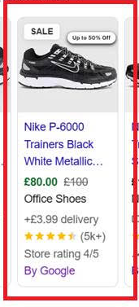


Google Feed Optimisation – PPC Image Overlay
Mock-up illustration for design reference only — not a live implementation

Slide 41
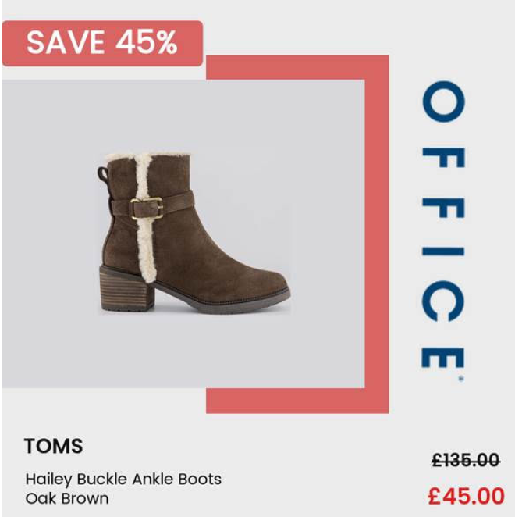


Social Feed Optimisation – Image Overlay
Mock-up illustration for design reference only — not a live implementation

Slide 42
RoAS Intelligence – Spend Optimisation
Pinpoint pockets of poor spend and move that budget into better-performing campaigns.
1
IDENTIFY
2
REALLOCATE
3
MODEL & MEASURE
Find the product groups where spend is delivering below-target RoAS — the money quietly leaking out of your campaigns.
Shift that spend into the campaigns and product groups already proven to convert, so every pound works harder.
See the projected revenue uplift before committing a penny, then track the actual gains month on month.
Optimise spend on any dimension of your product data
Category
Brand
Price range
Colour
Size
Delivery timeframe
…or any combination of them — if it’s in your product data, we can target spend on it.

Slide 43
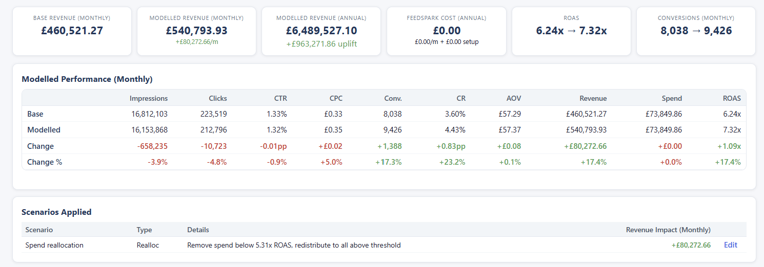
The RoAS Dashboard in Action
Finding the poor spend, modelling the reallocation and measuring the gain.
Modelled on live account data: reallocating spend from product groups below 5.31x RoAS lifts account RoAS from 6.24x to 7.32x — a modelled +£963k annual revenue uplift at exactly the same budget.

Slide 44
What comes next
Open priorities first, then the enrichment the two-year foundation has earned.
Phase | Focus | What we do
Now | Onboard & scope | Onboarding call and requirements; create platform and feeds; shipping-rate configuration; deepest-node category mapping.
P0 | Data fields — the real gaps | Pattern field 66.7% → ~100%; deepen custom product-type where 43% sit at one level; CL1 and CL3 back-fill; extend the same rules to DE, FR, IE and beyond.
Then | Titles & descriptions | MASK titles at 80–120 chars; description expansion past 500; next batch of Tachyon intent terms; read out the US short-vs-long test.
Build | Conversational attributes & Visual attr. extraction | item_group_title and variant_option; popularity_rank from labels; related_product for outfits and bundles; governed question_and_answer – using Tachyon AI to embellish AI terms.
Measure | Score & test | GB feed audited — 22,527 SKUs scored. Extend the audit to DE, FR, IE and other markets en-masse.
Lead with onboarding, platform build and data-field rules; the AI-readiness work follows the structural fixes it depends on.

Slide 45
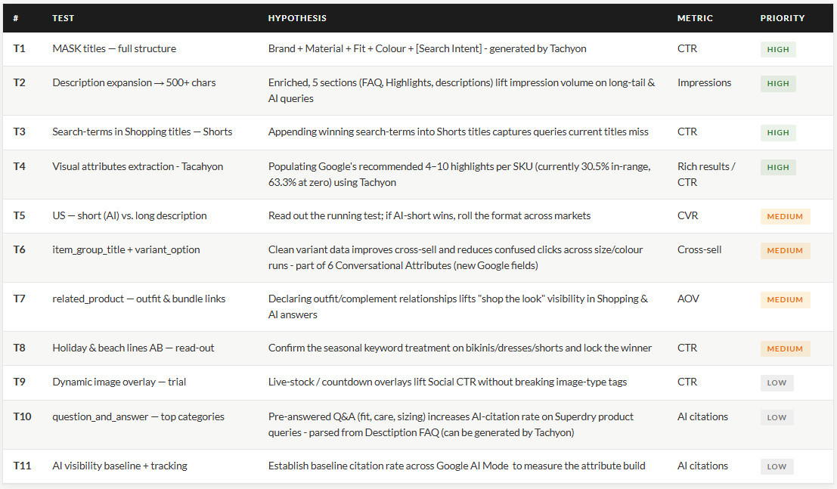
Actual Roadmap
Q3 & Q4
Tachyon Onboarding focus & FS recommend Dynamic Overlay to Social presence to catchup with competitors.

Slide 46
Questions?
Ray Vũ
Senior Account Manager
Account management
ray@feedspark.com
Steven Opuni — Account Manager
steven@feedspark.com
ASPL — Content Team

