Slide 1
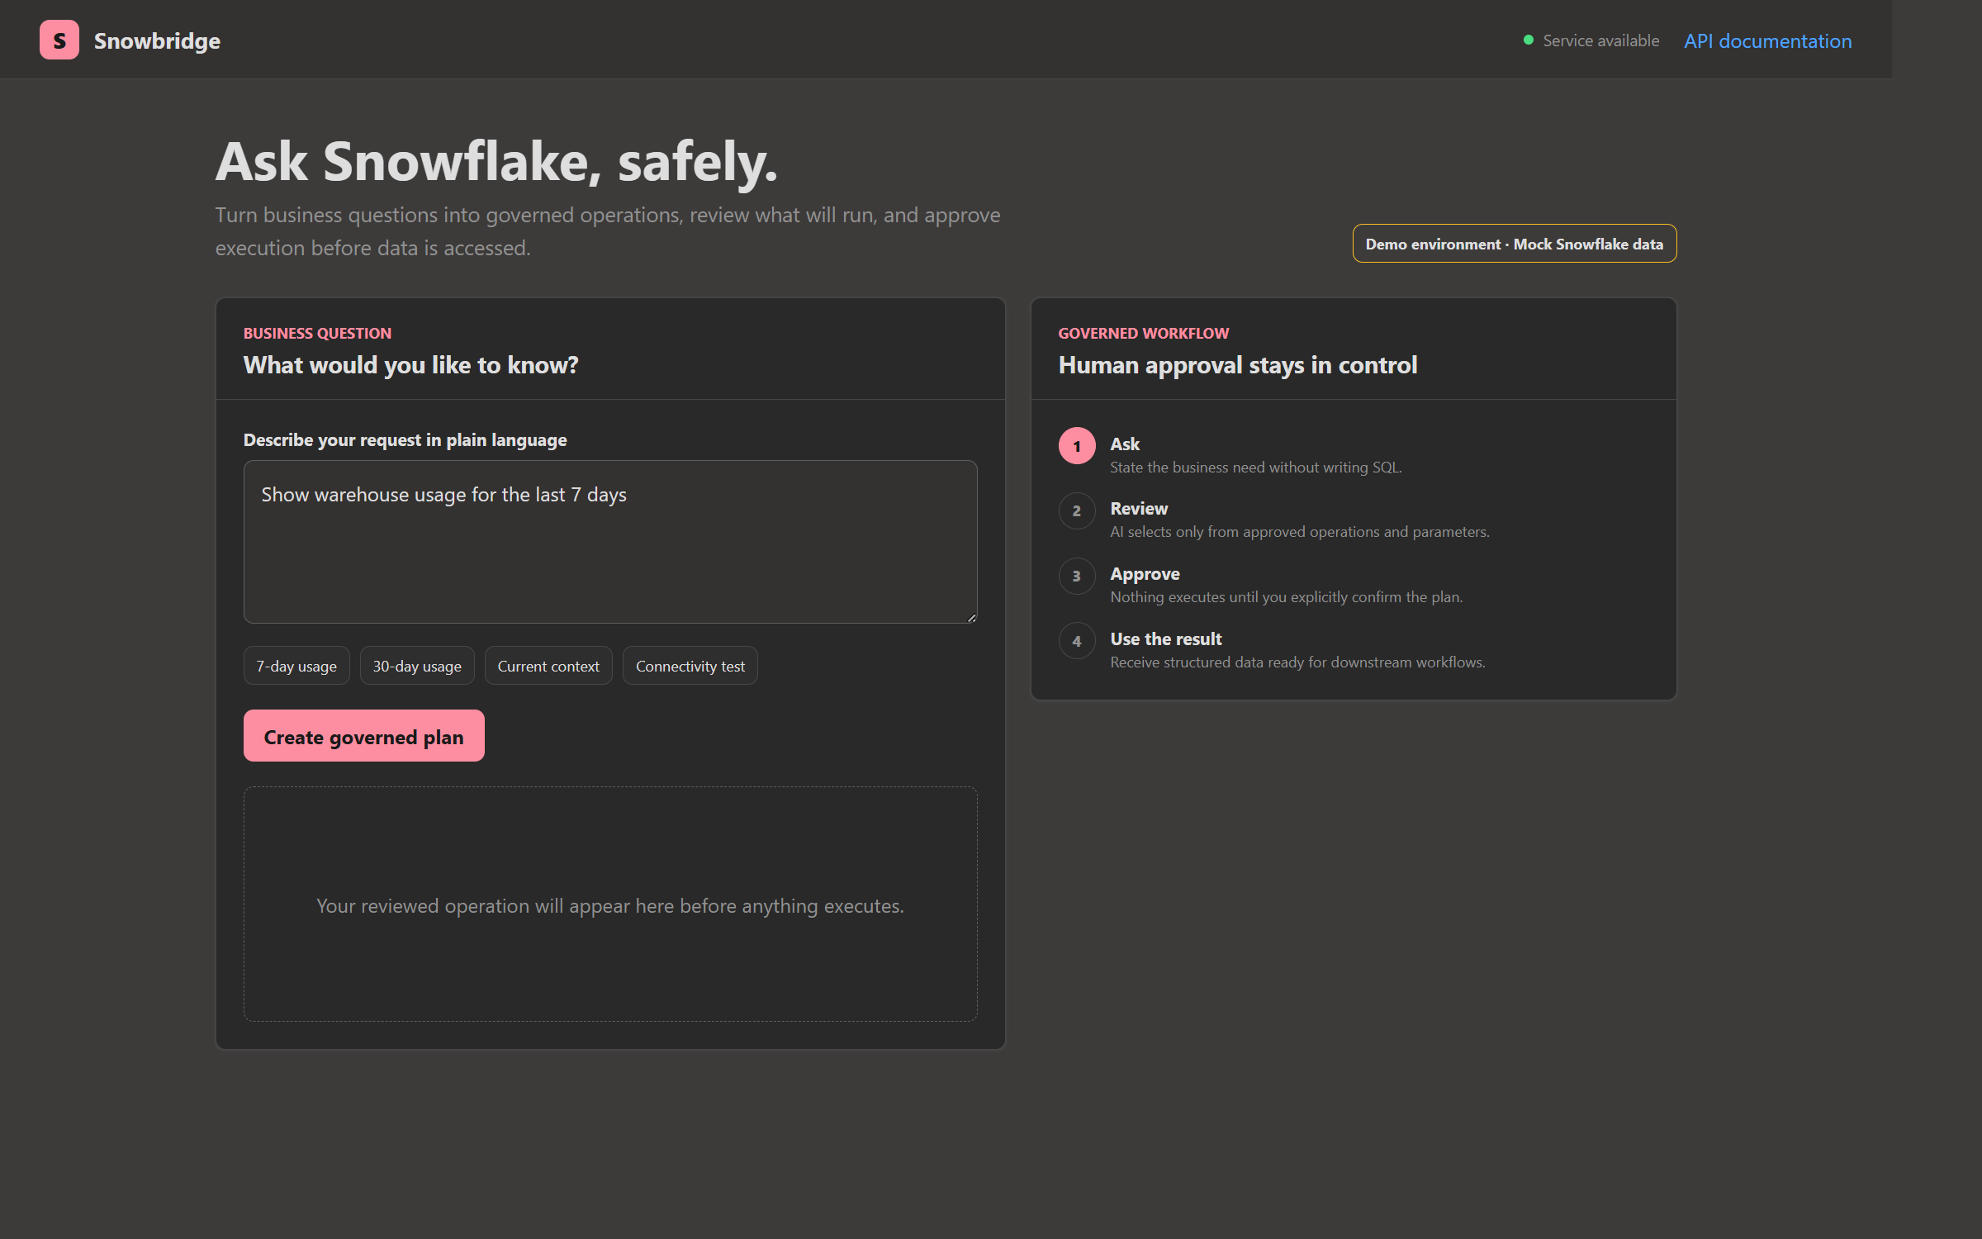
MICROSOFT AZURE + SNOWFLAKE
Snowbridge
Governed AI access to Snowflake operations
Ask in business language. Review the plan. Approve before execution.
BUSINESS OVERVIEW
Live on Azure Container Apps
Notes:
Snowbridge gives business users a controlled way to request approved Snowflake operations in natural language. The key message is not unrestricted AI access. AI interprets intent, while deterministic application code controls what may execute.

Slide 2
SNOWBRIDGE
WHY SNOWBRIDGE
The integration gap is a governance gap
Business demand
Enterprise control
Fast answers from operational data
SNOWBRIDGE
Predictable, reviewable execution
One governed interface
Users want simple questions answered without learning SQL, credentials, or connector details.
Allowlisted operations, explicit approval, parameter validation, managed identity, and stable API contracts.
Intent translated into approved operations and validated parameters.
NO MODEL-GENERATED SQL
02
Notes:
The business problem is not simply connectivity. Native connectors solve many copy scenarios. Snowbridge addresses the shared governance layer: consistent operations, validation, approval, and response contracts across multiple Azure orchestrators and users.

Slide 3
SNOWBRIDGE
VALUE
Business value, built into the interaction
1
0
3
1
stable interface
generated SQL
approved operations
human approval gate
A common contract for business UI and technical integrations.
The model never writes or submits arbitrary Snowflake queries.
Echo, current context, and warehouse usage summary today.
Execution requires explicit confirmation of the reviewed plan.
The result: speed for the user without surrendering control to the model.
03
Notes:
Use these four numbers as a memory device. One interface. Zero generated SQL. Three operations in the current MVP. One explicit approval gate. The operation catalog can grow without changing the governance model.

Slide 4
SNOWBRIDGE
GOVERNED WORKFLOW
AI interprets intent; application code controls execution
1
2
3
4
5
Ask
Interpret
Validate
Approve
Execute
Business question
Foundry structures intent
Catalog + parameter rules
Human confirmation
Owned connector logic
Nothing runs until the reviewed plan is explicitly confirmed.
04
Notes:
Walk left to right. Foundry produces a structured plan, not SQL. Deterministic validation checks the selected operation and parameters. The user approves. Only then does owned connector code execute a predefined operation.

Slide 5
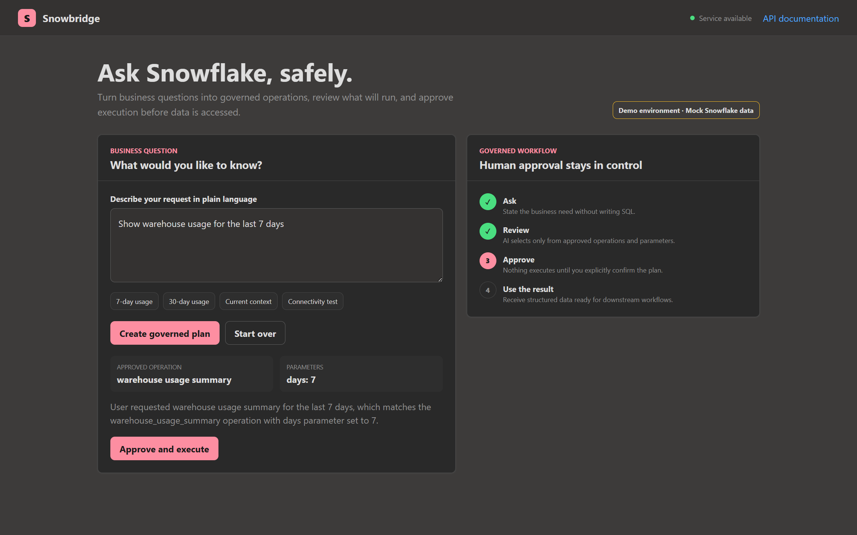
SNOWBRIDGE
PRODUCT EXPERIENCE
The approval boundary is visible to the user
1 PLAIN LANGUAGE
The user asks a business question without writing SQL.
2 REVIEW
The approved operation and parameters are shown before execution.
3 APPROVE
A deliberate action supplies the confirmation required by the API.
05
Notes:
This is the customer-facing experience. The interface removes the need to manually wrap JSON in Swagger, but it does not remove the approval control. Swagger remains available separately for technical reviewers.

Slide 6
SNOWBRIDGE
ARCHITECTURE
A compact Azure foundation with clear trust boundaries
Microsoft Foundry
Azure Container Registry
Intent → structured plan
Immutable application image
Azure Container Apps
Business UI
FastAPI + governed execution
Same-origin web experience
Snowflake adapter
Key Vault
Mock today; connector-ready
Secret boundary
Managed identity
Resource-scoped access to ACR, Key Vault, and Foundry. No API key is required in the deployed app.
06
Notes:
The application runs as one Container App for the MVP. Its system-assigned managed identity has resource-scoped ACR Pull, Key Vault Secrets User, and Cognitive Services OpenAI User roles. Application Insights and Log Analytics provide monitoring.

Slide 7
SNOWBRIDGE
TRUST AND CONTROLS
Defense in depth, not model confidence
1 Allowlisted operation catalog
2 Deterministic parameter validation
3 Explicit human confirmation
4 Parameterized connector-owned SQL
The model cannot bypass the catalog, invent parameters, or execute directly.
07
Notes:
Avoid saying the model is trusted because it is accurate. The safety story is architectural. Even an incorrect or malicious request must pass the catalog, deterministic validation, human confirmation, and owned connector logic.

Slide 8
SNOWBRIDGE
DEMO GUIDE
A three-minute customer demonstration
01
Ask
“Show warehouse usage for the last 7 days.”
02
Review
Point out the approved operation and days parameter.
03
Approve
Explain that execution requires explicit confirmation.
04
Result
Show the structured two-row mock result.
Open the live Snowbridge demo →
08
Notes:
Keep the demo short. Start with a familiar usage question. Pause at the review state and reinforce that the model selected an approved operation. Then approve and show the result. Mention that the data is intentionally mocked for the hackathon environment.

Slide 9
SNOWBRIDGE
Start governed. Expand deliberately.
The MVP proves the control model before expanding the operation catalog and connecting a production Snowflake account.
NOW
NEXT
Business outcome
Business UI
Foundry planner
Mock Snowflake adapter
Azure deployment
Production Snowflake identity
Expanded approved operations
Persistent job processing
Enterprise audit integration
Faster access to approved operations with a clear, reviewable control boundary.
GitHub repository
Live demo
Notes:
Close by separating what is proven from what is next. The MVP proves the governed interaction, Foundry integration, managed identity, deployment, and API contracts. Production Snowflake connectivity and broader operations are deliberate next steps.

