Slide 1

Gendering “The Great Resignation”: Labor, Care, and Survival in the “Post-Covid” World
ISA Northeast Annual Conference 2022, Baltimore
Aida A. Hozić and Xiao Sun
Nov. 5, 2022
Notes:
Mention:
ISA paper → a long blog post
Post- different meanings

Slide 2
Introduction
Background
“The Great Resignation”(GR)- Anthony Klotz
Why does it matter
GR is a backdrop story to “tight labor market” and “hidden text” of anti-inflationary measures
What we do
“make the invisible visible”, highlight the gender dimension of GR from feminist political economy perspectives
Method and scope
Comparative analysis with the US, selected OECD countries, and China
Descriptive analysis, U.S.BLS (JOLTS), OECD employment, (China) National Bureau Statistics employment, etc.
150 media articles about GR narratives
Notes:
Start with Question:
4 million workers left their jobs every month in 2021; reluctant to seek employment
Anthony Klotz, Professor of Management at the University College London, used the term, The Great Resignation, to describe the quitting trend.
record numbers of people leaving their jobs amid strong labor demand and low unemployment.
after the COVID-19 pandemic ends. spring and summer of 2021
Other words: “The Great Return”, “The Great Reshuffle”, and “The Quiet Quitting”
reluctant to seek employment (compared to the previous crises).
Over the period of 9 months in 2021, an average of 4 million workers left their jobs every month, and many more were reluctant to seek employment.
Nonetheless, the “Great Resignation” remains an important backdrop story to a series of the pandemic-related employment phenomena in the United States, but also elsewhere – pandemic burnout, “tight labor market,” alleged worker’s empowerment and demands for greater flexibility and higher wages, lackluster productivity, and even labor unrest
“The Great Resignation” also looms large as the hidden text behind Federal Reserve’s (and other central bankers’) responses to inflationary pressures, even though there is ample evidence that factors other than wages associated with the tight labor market (Global Supply Chain issues, Russian invasion of Ukraine, Western sanctions on Russia, increasing energy prices and food shortages but also profit-seeking and price gauging) are responsible for the high-rates of inflation worldwide.
Method:
have done simple regression analysis based on limited available public data, but no significant findings. Or because data problem. Unavailable data, different measurement of indicators, merging data problems
Limitations. Lack statistical causal evidence.

Slide 3
Arguments
Narratives of “The Great Resignation” overstate workers’ empowerment after the pandemic
Instead of resignations as “choice” – women and minorities are being forced out of the labor market
Gender-blind analysis obscured the degree to which erosion of women’s political and reproductive rights might have material foundations
Notes:
Media narratives – emphasis on professional employees; “The Great Resignation” - result of pandemic epiphany, life-work balance; neglect of gender/women
Data – resignations highly concentrated in low-wage high-contact sectors with predominantly female labor force; correlation with childcare and caregiving
Beyond US – no data but surveys highlight hybrid work, workers empowerment but data again showing job vacancies among frontline workers (predominantly women)
China – “lying flat” instead of resignations; correlations with childcare disruptions, pandemic burnout, “three children” policy

Slide 4
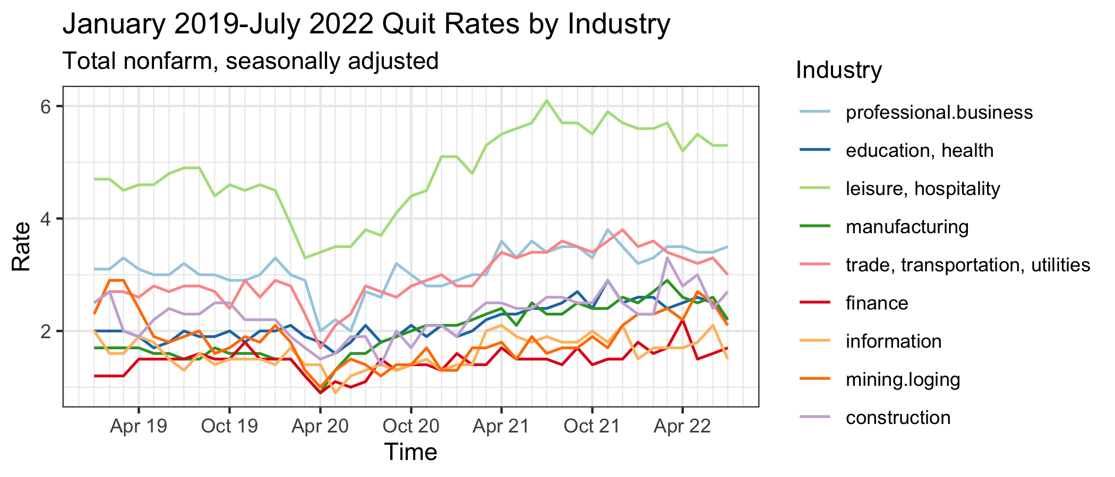
The US
What are the narratives?
Notes:
Graph source: US. BLS
Existing narratives: professional men and women; choosy: higher pay, career advancement; romanticized COVID-19 survival,
gender was rarely mentioned as a factor correlated with job quitting.
media coverage of “The Great Resignation” steered the focus towards professional classes and interpreted the phenomenon of job quitting as a matter of individual choice and personal advancement. The emphasis on pandemic-induced epiphany romanticized COVID-19 survival as a learning and life-improvement process, which has expanded individuals’ options and empowered them vis-à-vis their employers.
Leisure and hospitality sector has maintained the lead in “The Great Resignation,” peaking at 6.1% in July 2021.
These “frontline” and high-contact sectors, with predominantly female and immigrant labor force, offer fewer options for remote or hybrid work.
"the recent quit rates are too high to be explained solely by labor market tightening." Other factors might have affected individuals’ quit decisions, such as “the desire of workers to protect themselves and their families from COVID-19, as well as challenges in providing childcare as a result of pandemic-related closures of childcare centers and the widespread use of remote schooling."

Slide 5
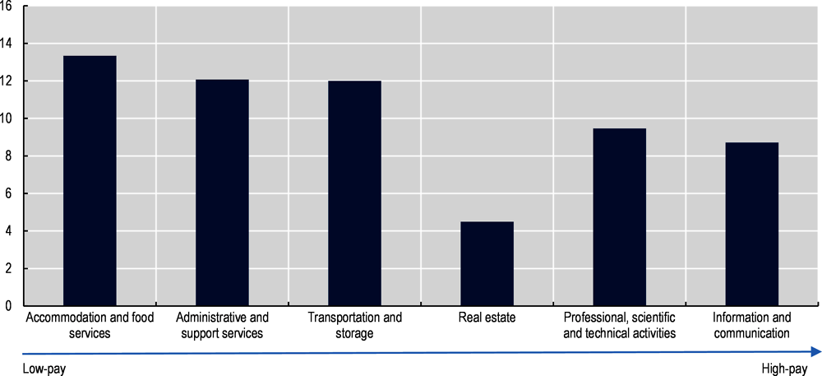
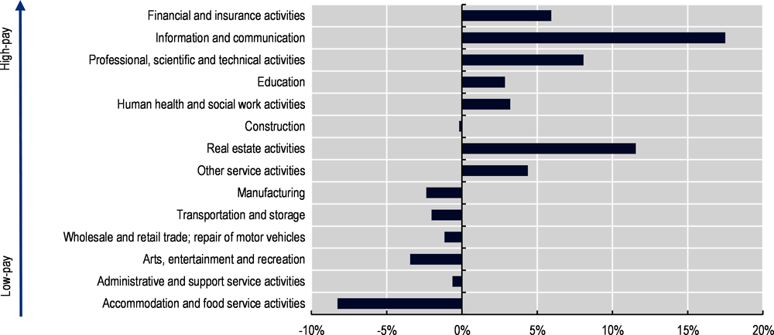
OECD
Percentage changes in the number of firms reporting recruiting challenges by service sector in the 27 EU member states from Q4 2019 to Q2 2022, seasonally adjusted
Average percentage change in employment by industry across selected OECD countries, Q1 2022 relative to Q1 2019
What are the narratives?
Notes:
widely cited surveys of the global workforce (Microsoft’s Work Trend Survey 2021, 2022)
Existing narratives: compensation, job satisfaction, empowerment, inclusive environment, remote work prospect
Low-paying and women-concentrated sectors lag behind in the recovery
over-represented professional and administrative workers in wealthy countries and the questions focused on factors associated with the prevalent interpretations of “The Great Resignation” – compensation, job satisfaction, empowerment, inclusive environment, prospects for working remotely. Not surprisingly, the surveys reaffirmed that flexibility and “hybrid workplaces” are the key to retaining employees, an option not available to most workers in high-contact jobs
Employment still lags behind in low-pay services, but has grown in high-pay services in the recovery

Slide 6
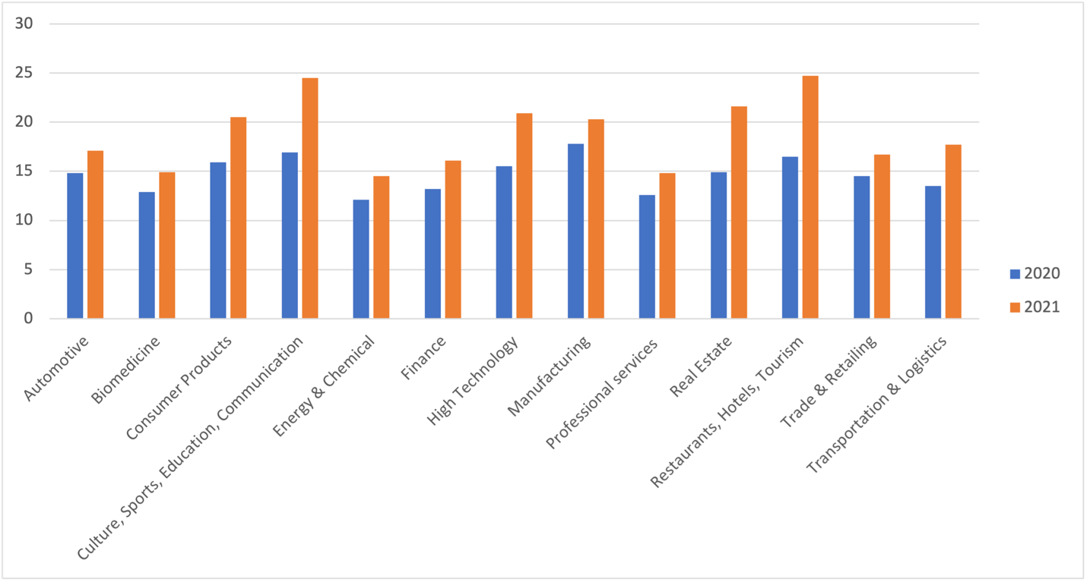
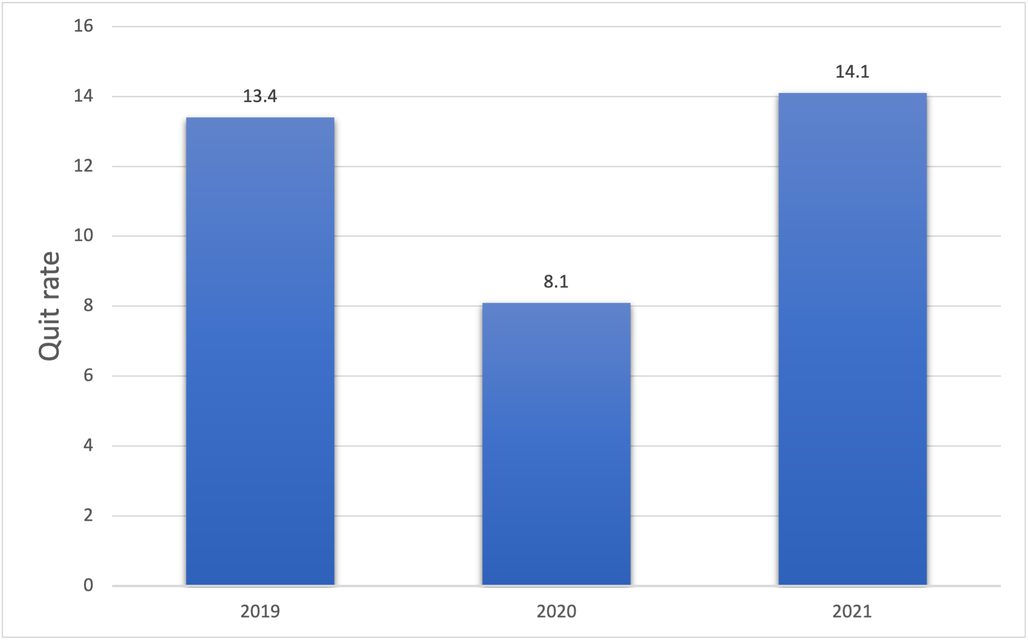
China: “lying flat” (quiet quitting )
2020 and 2021 Turnover Rates by Sector in China
What are the narratives?
Notes:
Chinese “zero-COVID” policy
“three-child” policy
Quit rates:
2019: 13.4
2020: 8.1
2021: 14.1
Much like the United States, China has also experienced a similar resignation trend in 2021. The quit rate increased from 8.1 percent in 2020 to 14.1 percent in 2021 (As 51 Job survey mentioned).
Recruitment Surveys conducted by 51 job (a human resource platform) research center about in 2020 and 2021 suggest that the top reason of quitting is the unattractive salary (53.1 percent and 51.6 percent), and the following is limited career progression. Gender considerations are lacking.
But unlike a large number of labor exits in the US, China's resignation patterns appear to be closer to “quiet quitting” in Western contexts. In Chinese, the trend is Known as “lying flat” (Tang ping: 躺平).

Slide 7
Recap
Media narratives – emphasis on professional employees; “The Great Resignation” is the result of pandemic epiphany, life-work balance; neglect of gender/women
Data – resignations are highly concentrated in low-wage, high-contact sectors with predominantly female labor force
Beyond the US – no data but surveys highlight hybrid work, workers empowerment but data again showing job vacancies among frontline workers, low pay sectors lag behind in recovery
China – “lying flat” instead of resignations; correlations with pandemic burnout, “Zero-Covid” policy induced childcare disruptions, three-child policy.
Notes:
Media narratives – emphasis on professional employees; “The Great Resignation” - result of pandemic epiphany, life-work balance; neglect of gender/women
Data – resignations highly concentrated in low-wage high-contact sectors with predominantly female labor force; correlation with childcare and caregiving
Beyond US – no data but surveys highlight hybrid work, workers empowerment but data again showing job vacancies among frontline workers (predominantly women)
China – “lying flat” instead of resignations; correlations with pandemic burnout, childcare disruptions, three-child policy.

Slide 8
Conclusion & Implications
gender-blind GR interpretations overstate workers’ empowerment after the pandemic
obscured the degree to which resignations (and job vacancies) have been concentrated in high-contact low-wage sectors, with predominantly female and often immigrant/minority labor force
erosion of women’s political and reproductive rights might have material foundations.
Notes:
COVID 19 threatened “decades of progress for women and girls, disproportionately impacting women’s incomes, employment, and education opportunities, while increasing pressures of unpaid care and fueling the “shadow pandemic” of gender-based violence.”
surveys and policies variations
surveys and policies across many countries are structurally gender-blind

