Slide 1

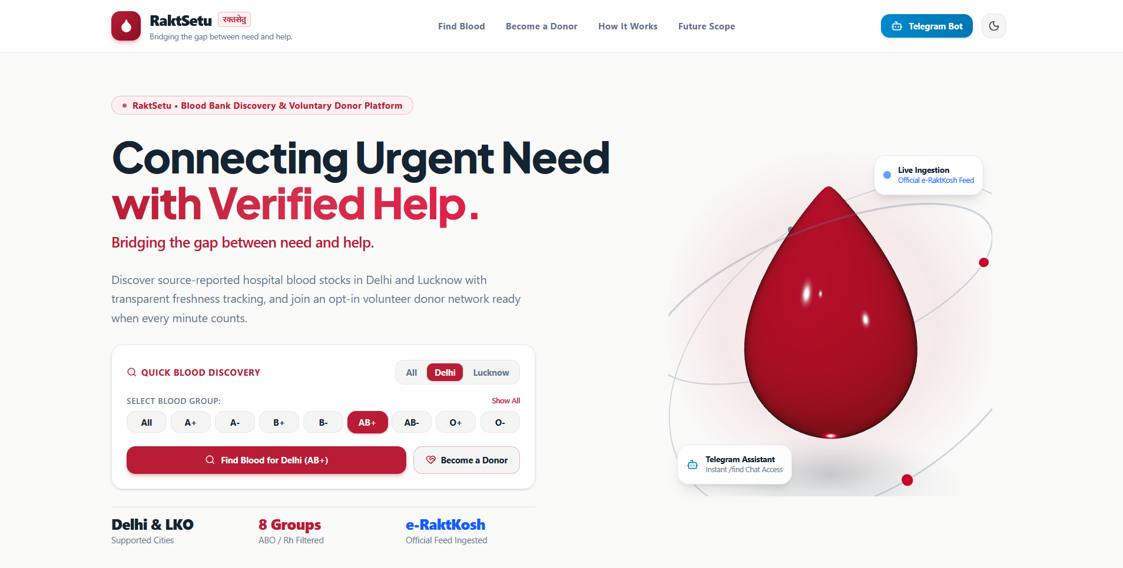
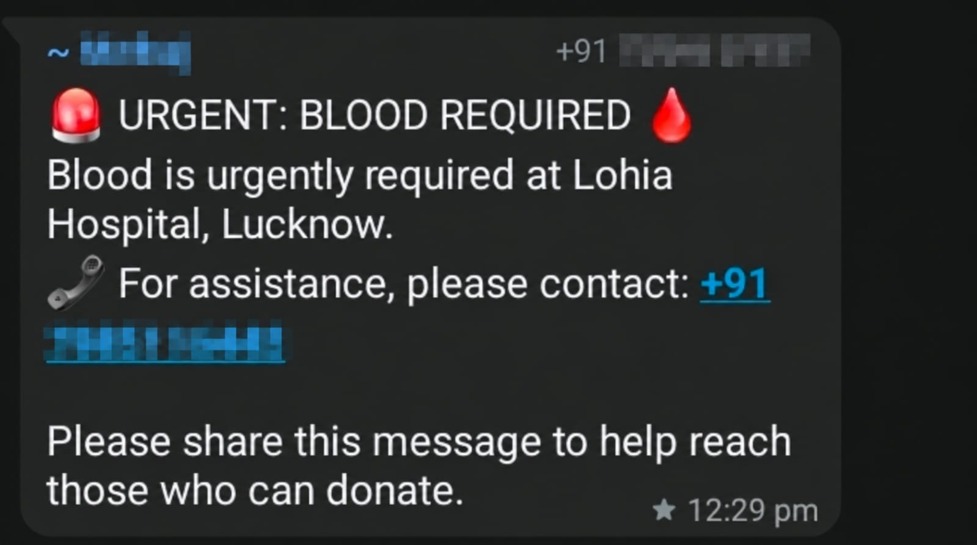
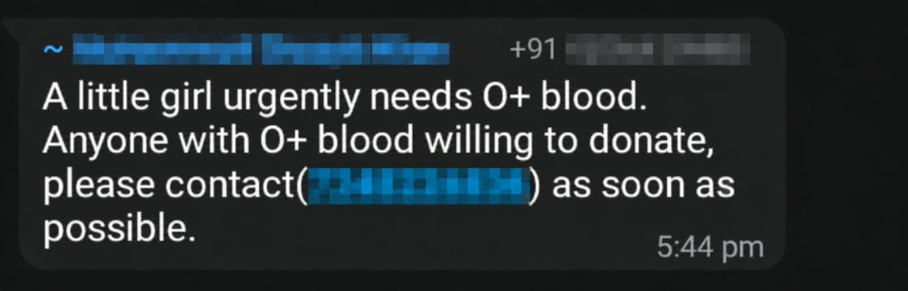


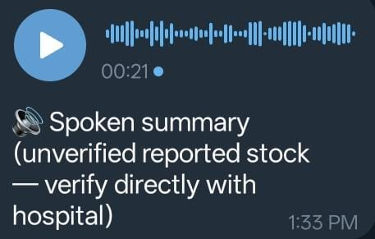

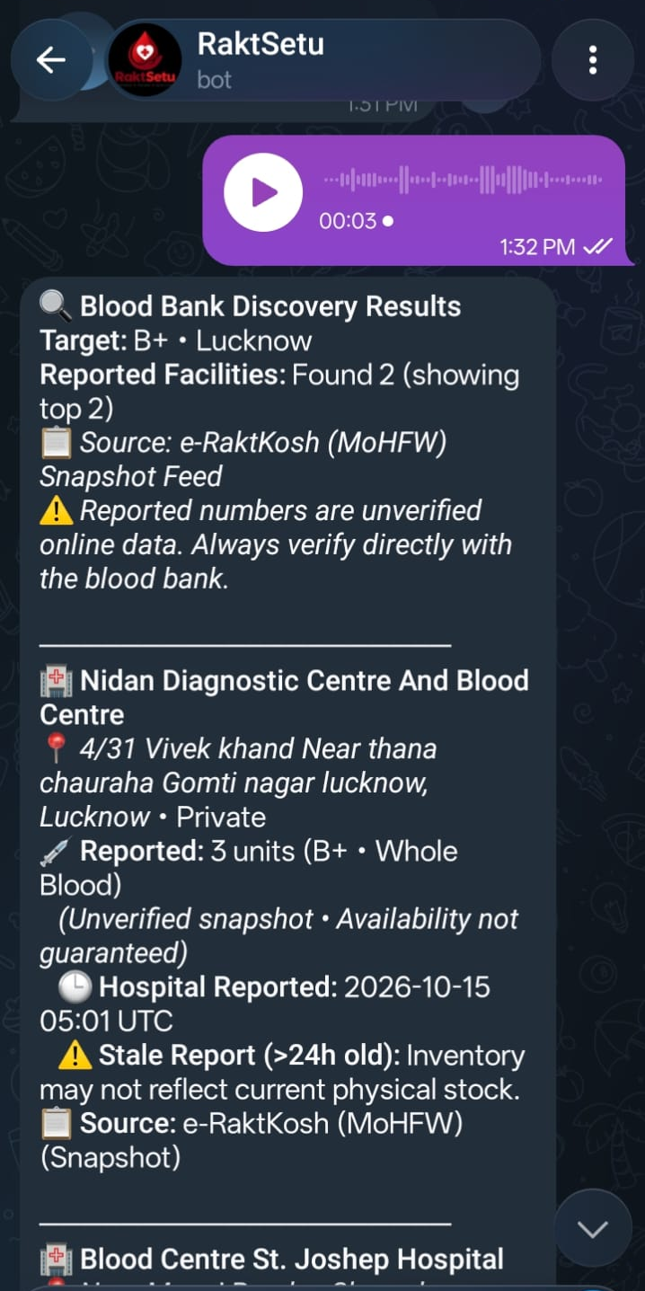
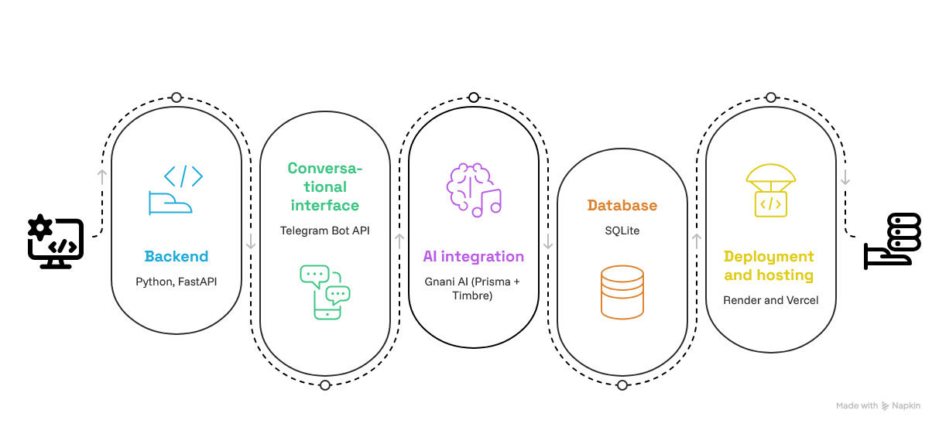










IMPACT ON SOCIETY
OUR SOLUTION
PROBLEM STATEMENT
Conversational AI is the primary interaction layer guiding people through blood-bank discovery, donor exploration and request coordination across the website and Telegram.
Finding information
≠
confirming availability
≠ coordinating a genuine donor request.
· More accessible discovery
· Encouraging voluntary donation
· Stronger community connectivity
· Responsible request handling
RaktSetu
Connecting Humanity, One Drop at a Time.
TECH STACK & ARCHITECTURE
Gnani AI Prisma converts the voice note into parameters needed by the backend server.
FEATURES
Blood Bank Discovery
Blood group filtering
Location based searching
Live blood stock information
Telegram bot interface
Voice based search
Ai-powered speech recognition
Ai voice responses
Text based searches
COMMERCIAL ASPECT
Target Customers
Institutional partnerships with hospitals and blood banks.
College Donation Network
Support donation drives.
Gnani Timbre generates a summary of the data reported as a voice response.
Revenue Model
B2B collaboration model
Go-to-Market
Network expansion with NGOs.

